Slide 1
3D Scanning
Sparks Lu
Last updated: 11-3-2020

Slide 2
Type
Contact
Non-contact active
laser
time of flight
triangulation
structured light
Non-contact passive
stereoscopic
photometric

Slide 3
Comparison

Slide 4
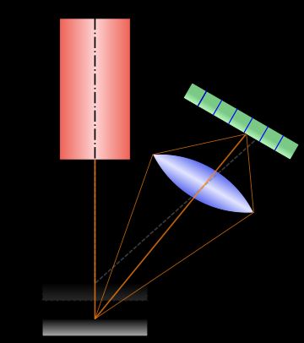
Range Scanner
Theory
Laser triangulation
Not good at
shiny
low surface albedo
significant subsurface scattering

Slide 5
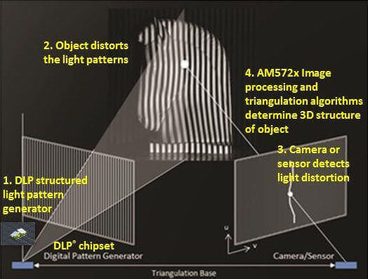
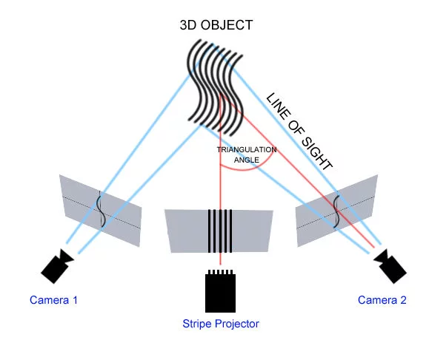
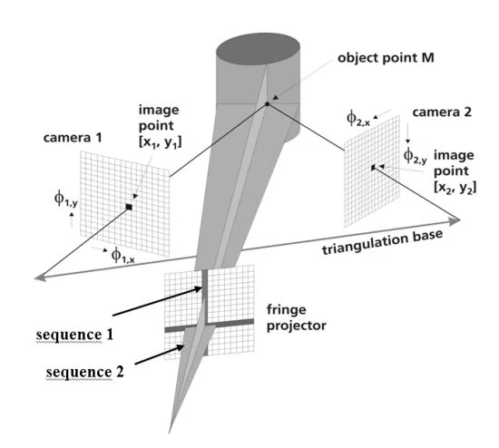
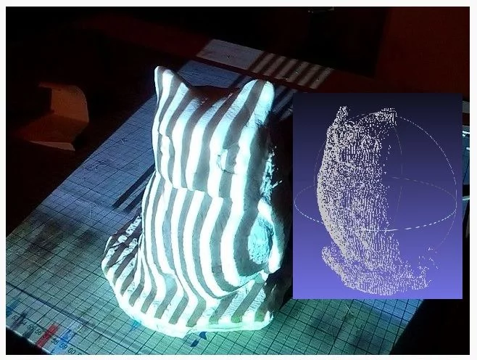
Structured-light 3D Scanner
Theory
consists of IR projector and IR sensor
Applications
PrimeSense
early version of Microsoft Kinect
Occipital Structure Sensor
Intel RealSense
Face ID: projecting more than 30K infrared dots
Not good at
reflective surface
transparent or semi-transparent surface
sub-surface scattering, such as skin, marble, wax, plants and human tissue
concave surface

Slide 6
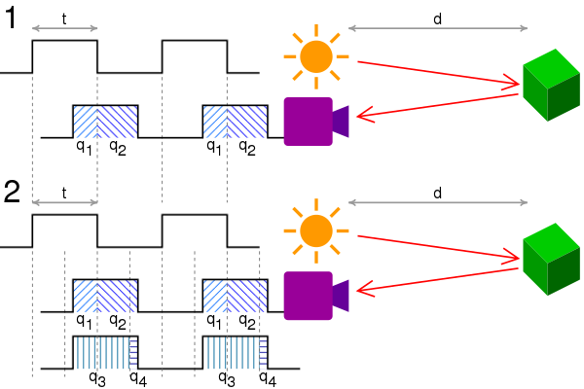
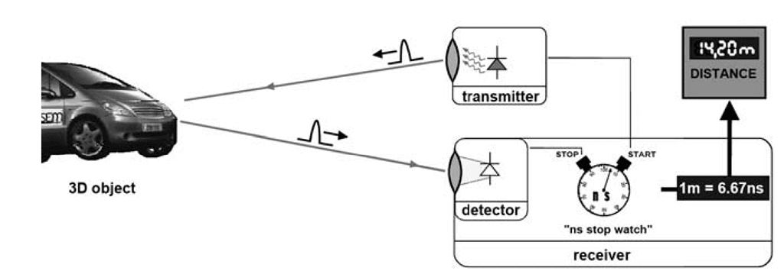
Time of Flight Camera
Disadvantages
background light
interference
multiple reflections
Application
Microsoft Kinect 2nd generation

Slide 7
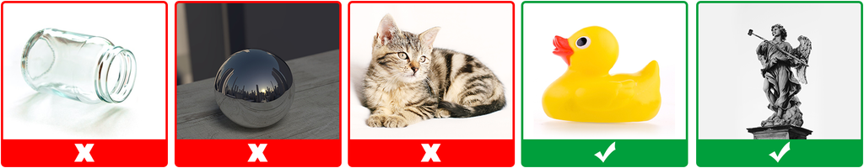
Photogrammetry
Reference
https://www.instructables.com/3D-Scan-Anything-Using-a-Camera-Photogrammetry-Wit/
Not suitable
Moving object
Having micro details, like leafy plants, hair and fur
Reflective
Transparent, translucent and untextured objects

Slide 8
Products

Slide 9
Reference
https://all3dp.com/1/best-3d-scanner-diy-handheld-app-software/

Slide 10
Structured Light
Shining3D EinScan SE / SP
IIIDScan PrimeSense 3D Scanner
Geometry camera: based on depth sensor 640x480
Texture camera
XYZPrinting Handheld
Based on Intel RealSense
Occipital Structure Sensor

Slide 11
Laser Triangulation
NextEngine 3D Scanner HD
max resolution: 0.1mm
FabScan Pi
Murobo Atlas
system: Raspberry Pi
BQ Ciclop
Arduino board
Logitech webcam

Slide 12
Photogrametry
3D Systems iSense

Slide 13
TOF
Microsoft Kinect （2nd version)
camera resolution: 1280x960

