Slide 1
Electron Notes
Sparks Lu
Last updated: 5/29/2021

Slide 2
Overview
Construct desktop UI application using web technology
Node.js runtime for backend
Chromium for frontend
Embeds Node
node_modules/.bin/electron --version
References
https://auth0.com/blog/electron-tutorial-building-modern-desktop-apps-with-vue-js/
https://nklayman.github.io/vue-cli-plugin-electron-builder/guide/commonIssues.html#blank-screen-on-builds-but-works-fine-on-serve
https://github.com/node-ffi/node-ffi/wiki/Node-FFI-Tutorial
https://www.cnblogs.com/silenzio/p/11580104.html

Slide 3
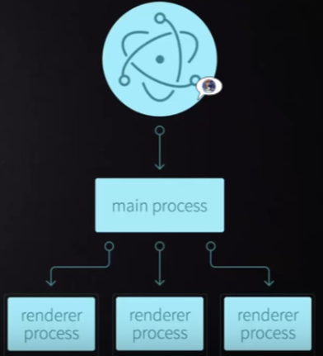
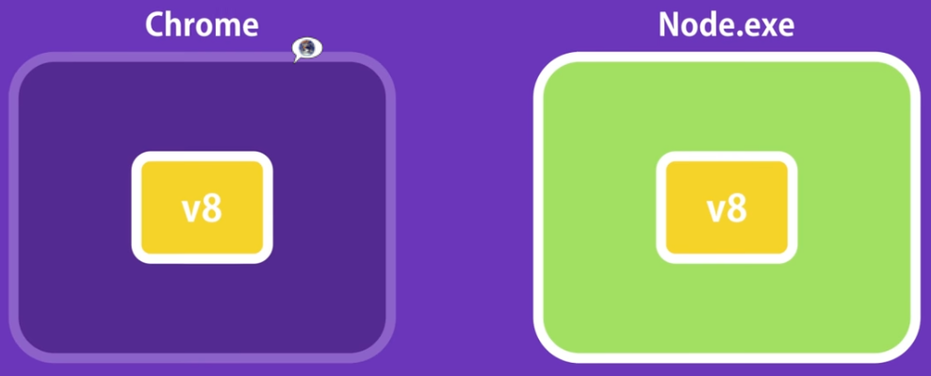
Theory
Processes
Main Process
package.json
Create BrowserWindow instances to run web pages
Renderer Process
Each web page runs its own isolated process

Slide 4
Install
Steps
Install Node.js
npm
npm install electron@6.0 -D // electron v6.0 for Node v12
cnpm i -g electron-builer
cnpm i -g windows-build-tools
yarn
npm install yarn -g
electron .
eslint
cnpm i -g eslint eslint-plugin-vue@latest
electron-builder
yarn add electron-builder --dev
electron-rebuild
This executable rebuilds native Node.js modules against the version of Node.js that your Electron project is using.
npm i -S electron-rebuild
.\node_modules\.bin\electron-rebuild
References
https://github.com/nodejs/node-gyp#on-windows

Slide 5
Create Application
Steps
npm init -y
Initialize npm
package.json was created as the result
npm install electron@latest --save-dev
Install electron locally
touch index.js
npx electron index.js
Launch application
npm start
your-app/
├── package.json
├── main.js
└── index.html
{
"name": "your-app",
"version": "0.1.0",
"main": "main.js"，
"scripts": {
"start": "electron ."
}
}

Slide 6
main.js
const { app, BrowserWindow } = require('electron')
function createWindow () {
// 创建浏览器窗口
const win = new BrowserWindow({
width: 800,
height: 600,
webPreferences: {
nodeIntegration: true
}
})
// 并且为你的应用加载index.html
win.loadFile('index.html')
// 打开开发者工具
win.webContents.openDevTools()
}
app.whenReady().then(createWindow)
// Quit when all windows are closed, except on macOS. There, it's common
// for applications and their menu bar to stay active until the user quits
// explicitly with Cmd + Q.
app.on('window-all-closed', () => {
if (process.platform !== 'darwin') {
app.quit()
}
})
app.on('activate', () => {
// On macOS it's common to re-create a window in the app when the
// dock icon is clicked and there are no other windows open.
if (BrowserWindow.getAllWindows().length === 0) {
createWindow()
}
})

Slide 7
Build On Windows
https://www.electronjs.org/docs/development/build-instructions-windows

Slide 8
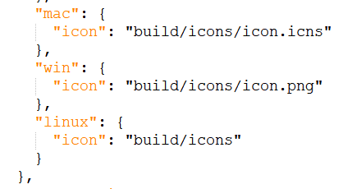
Deployment
icon
Modify package.json

Slide 9
Debug
Ctrl+Shift+i
toggle Chrome DevTools
Crl+r
reload window
https://www.npmjs.com/package/electron-log
npm i electron-log
log file
Windows: %USERPROFILE%\AppData\Roaming\{app name}\logs\{process type}.log
Linux: ~/.config/{app name}/logs/{process type}.log
Mac: ~/Library/Logs/{app name}/{process type}.log
log levels
error, warn, info, verbose, debug, silly
example
const log = require('electron-log')
log.info('Info')
log.warn('Warning')

Slide 10
FS
require('fs')
Usage
fs.writeFile(fn, buf, function (err) {
throw(err)
})
fs.readFileSync(fn)

Slide 11
asar
Reference
https://github.com/electron/asar
Install
npm install --engine-strict asar
Usage
asar l app.asar

Slide 12
Create Installer
References
https://newsn.net/say/electron-innosetup.html
Steps
Run Inno Setup Compiler with wizard mode

Slide 13
Electron-Vue

Slide 14
Intro
https://github.com/SimulatedGREG/electron-vue
my-project
├─ .electron-vue
│ └─ <build/development>.js files
├─ build
│ └─ icons/
├─ dist
│ ├─ electron/
│ └─ web/
├─ node_modules/
├─ src
│ ├─ main
│ │ ├─ index.dev.js
│ │ └─ index.js
│ ├─ renderer
│ │ ├─ components/
│ │ ├─ router/
│ │ ├─ store/
│ │ ├─ App.vue
│ │ └─ main.js
│ └─ index.ejs
├─ static/
├─ test
│ ├─ e2e
│ │ ├─ specs/
│ │ ├─ index.js
│ │ └─ utils.js
│ ├─ unit
│ │ ├─ specs/
│ │ ├─ index.js
│ │ └─ karma.config.js
│ └─ .eslintrc
├─ .babelrc
├─ .eslintignore
├─ .eslintrc.js
├─ .gitignore
├─ package.json
└─ README.md
# Install vue-cli and scaffold boilerplate
npm install -g vue-cli
vue init simulatedgreg/electron-vue my-project
# Install dependencies and run your app
cd my-project
cnpm i
npm run dev
# FAQ “process is not defined”
VUE

Slide 15
Set Up Project
References
https://stricker.digital/posts/electron-with-vue-and-webpack/
Vue CLI 3
vue --version
npm install -g @vue/cli
vue create {proj}
cd {proj}
vue add electron-builder
yarn electron:serve

Slide 16
Processes
Main process
Entry: src/main/index.js
Renderer process
IPC
ipcMain, ipcRenderer
ipcRenderer.invoke(msg, arguments) // send request to ipcMain
ipcMain.invoke(msg, arguments) // send request to ipcRenderer

Slide 17
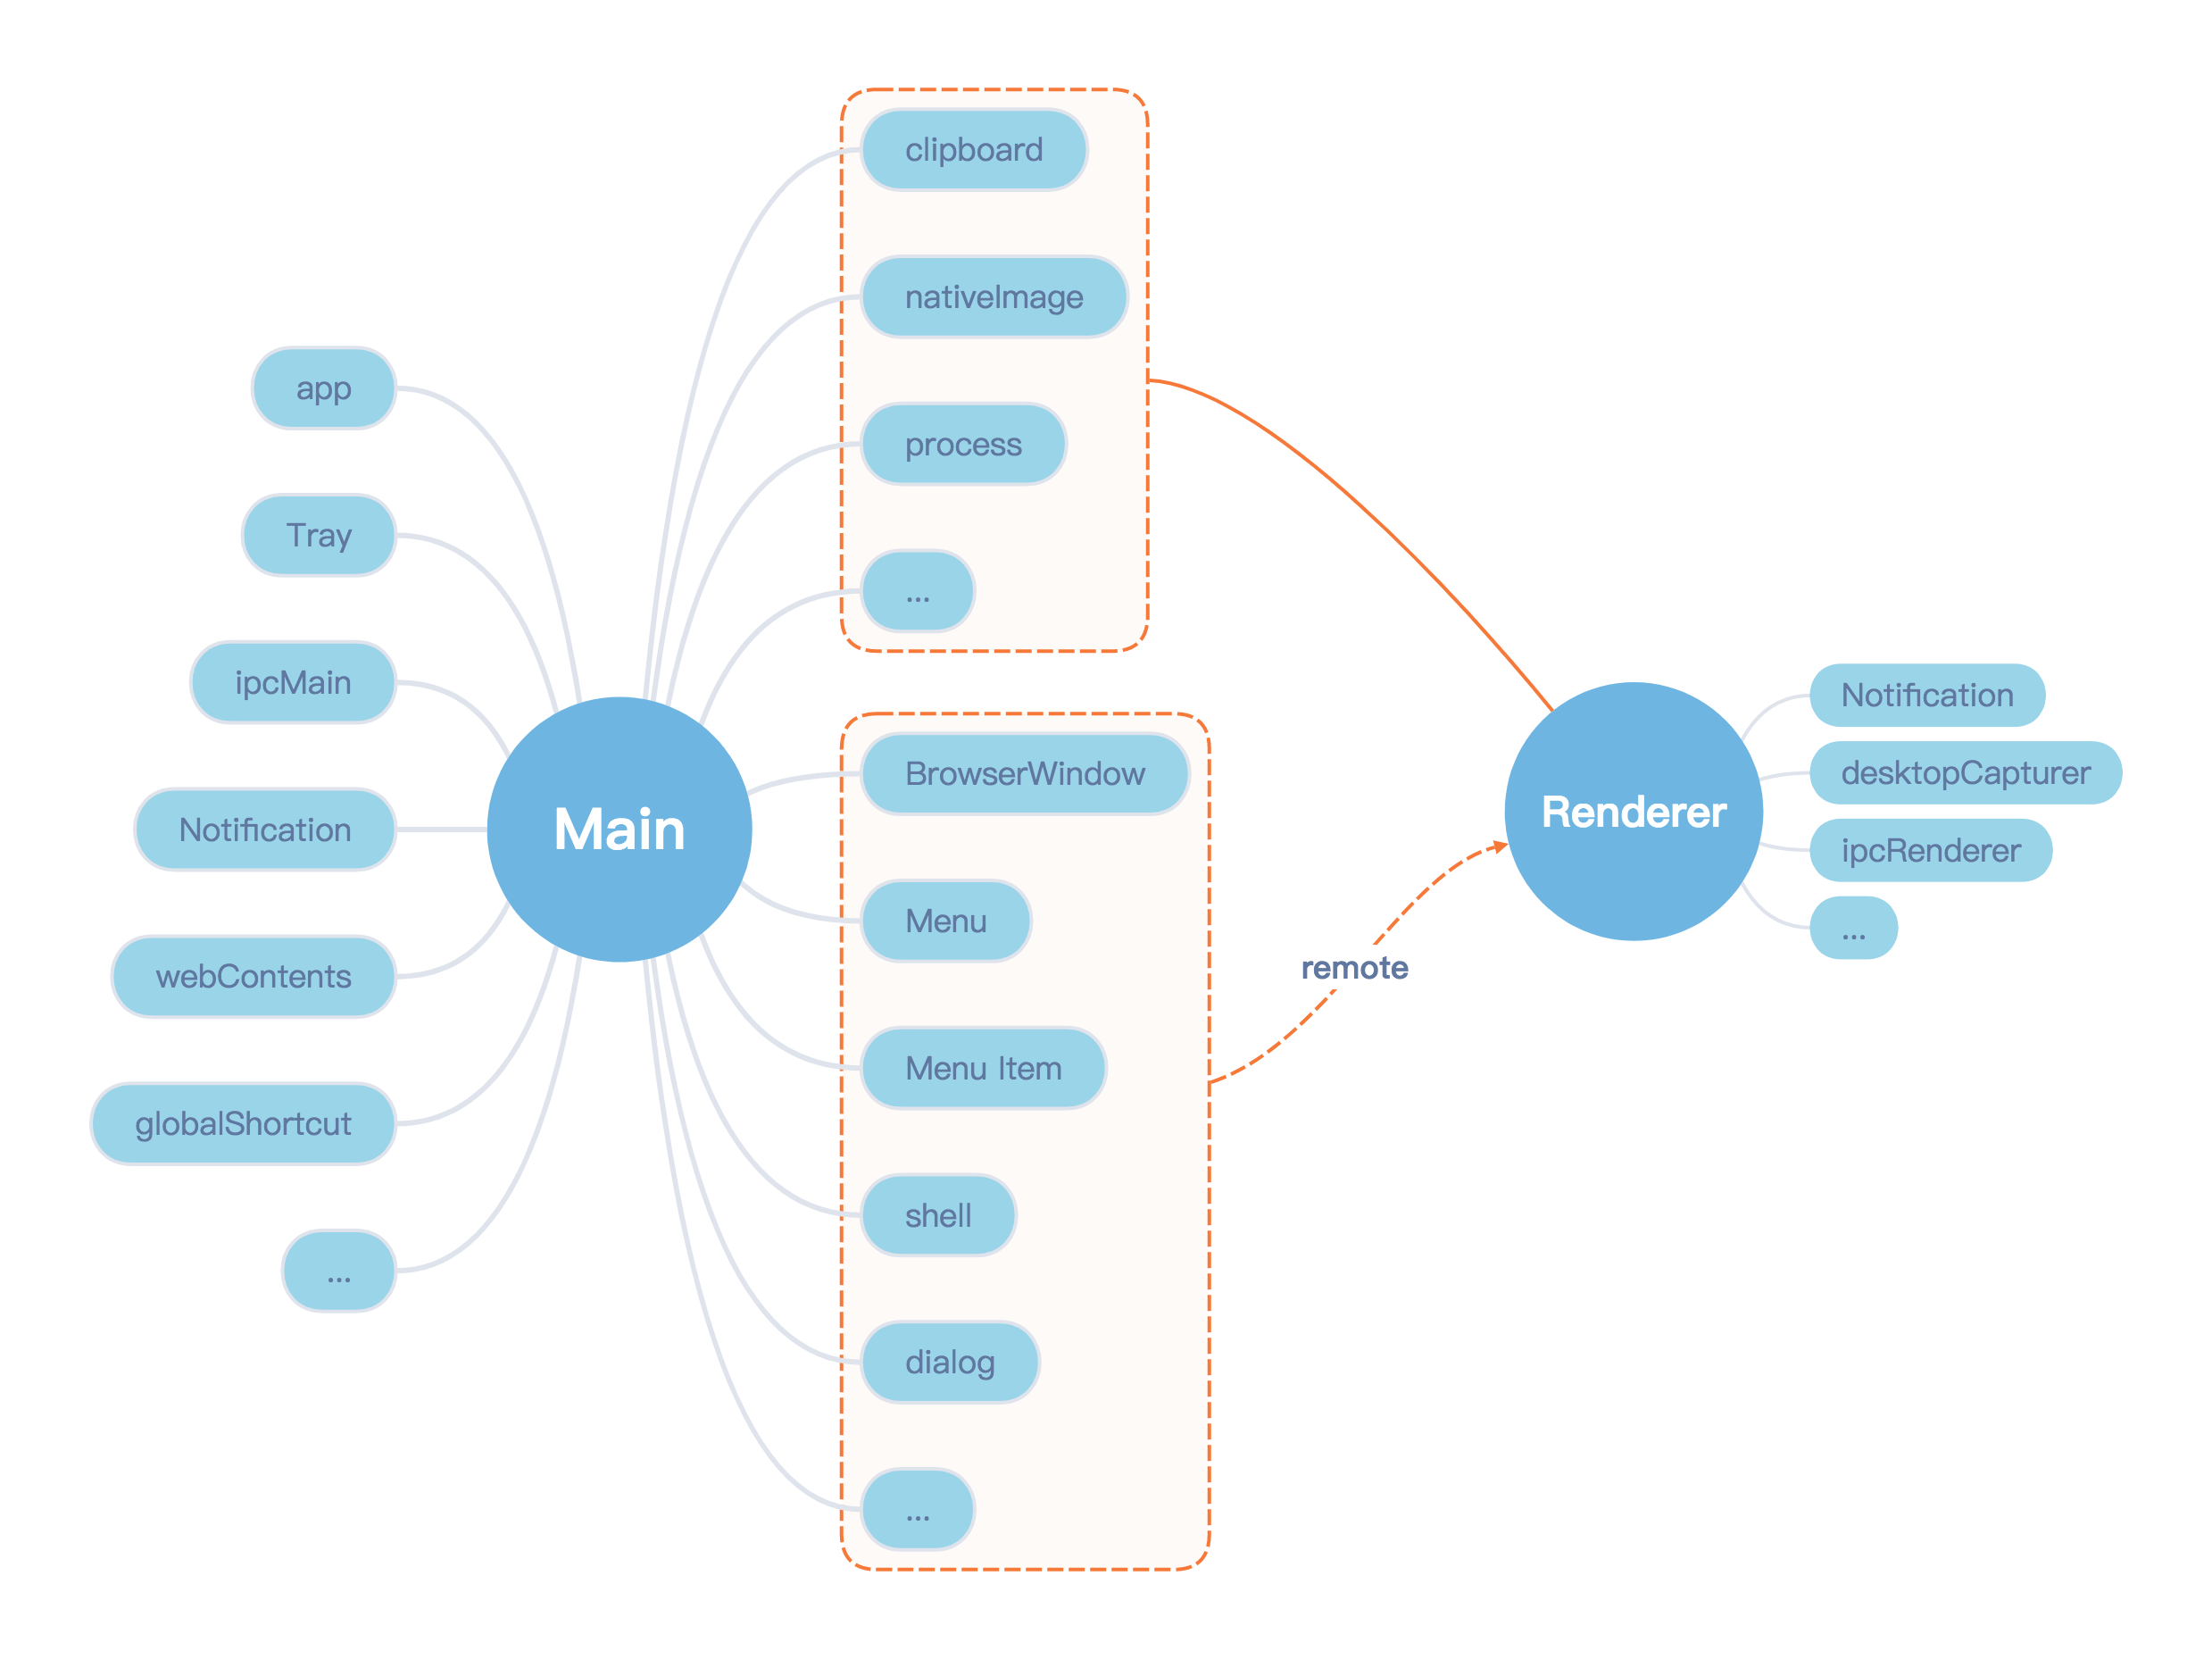
Modules

Slide 18
app
Hooks
will-finish-launching
ready
window-all-closed
before-quit
will-quit
quit
active
browser-window-created
browser-window-focus
Methods
quit()
getPath(name)
focus()

Slide 19
BrowserWindow
Hooks
closed
focus
show, hide
maximize, minimize
Methods
getFocusedWindow()
close()
focus()
show(), hide()
maximize(), minimize(), restore()

Slide 20
remote Module
shell
this.$electron.remote.shell.openExternal('url')
dialog
this.$electron.remote.dialog.showMessageBox({
title: 'title',
message: 'message',
detail: 'detail',
})

Slide 21
Call Function in C++ DLL
node-ffi-napi
https://github.com/node-ffi-napi/node-ffi-napi
Install
npm i ffi-napi ref-napi
Issue
dependent ref cannot be installed
If use @saleae/ref, runtime error because of version match
node-ffi
Node.js addon for loading and calling dynamic libraries using pure js
Install (support Node v12)
npm i -g node-gyp
https://github.com/lxe/node-ffi/tree/node-12
npm install @saleae/ffi
npm install -S lxe/node-ffi#node-12 lxe/ref#node-12 lxe/ref-struct#node-12
runtime error because of version match of ref
Native node addons
var ffi = require('ffi-napi');
var libm = ffi.Library('libm', {
'ceil': [ 'double', [ 'double' ] ]
});
libm.ceil(1.5); // 2
// You can also access just functions in the current process by passing a null
var current = ffi.Library(null, {
'atoi': [ 'int', [ 'string' ] ]
});
current.atoi('1234'); // 1234

Slide 22
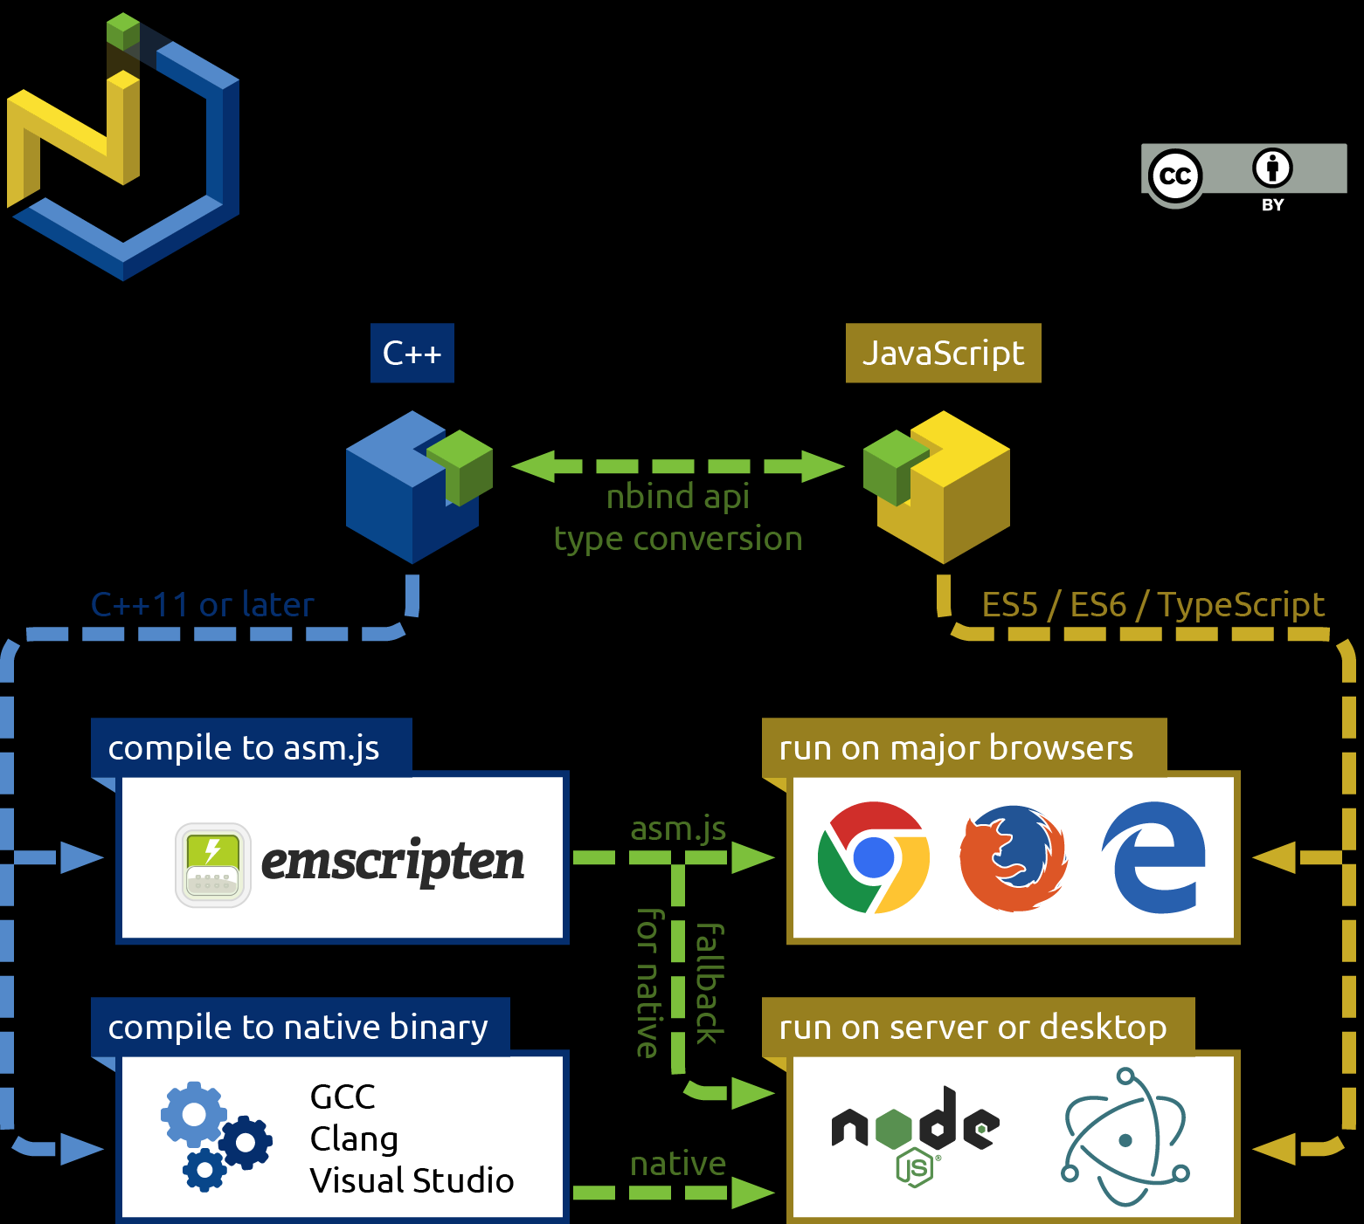
Call C++ interface - NBind
https://github.com/charto/nbind

Slide 23
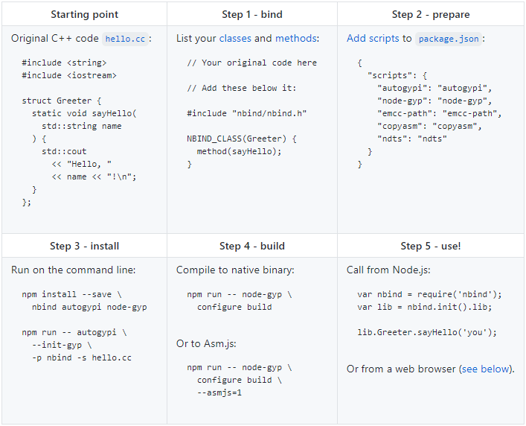
Call C++ interface - NBind

Slide 24
FAQ 1
sandbox (Electron 10.x, no solution yet)
Issue
The SUID sandbox helper binary was found
Solution
Make sure chromium-browser can work first
Make sure electron-quick-start-typescript can work by “npm start”
process is not defined
Issue
ERROR in Template execution failed: ReferenceError: process is not defined
Solution
Modify .electron-vue/webpack.web.config.js and .electron-vue/webpack.renderer.config.js, add templateParameters to HtmlWebpackPlugin
templateParameters(compilation, assets, options) {
return {
compilation: compilation,
webpack: compilation.getStats().toJson(),
webpackConfig: compilation.options,
htmlWebpackPlugin: {
files: assets,
options: options
},
process,
};
},

Slide 25
FAQ 2
Critical dependency: the request of a dependency is an expression
Modify .electron-vue/webpack.main.config.js
externals: [
...Object.keys(dependencies || {}),
{'electron-debug': 'electron-debug'}
],
Couldn't find preset "es2015"
npm i -S babel-preset-es2015
Error: Cannot find module 'chalk'
cnpm i -S chalk
libgconf
Issue
/mnt/c/Projects/FingerprintWinAPP/src/fingerprint-win-app/node_modules/_electron@2.0.18@electron/dist/electron: error while loading shared libraries: libgconf-2.so.4: cannot open shared object file: No such file or directory
Solution
sudo apt install libgconf-2-4

Slide 26
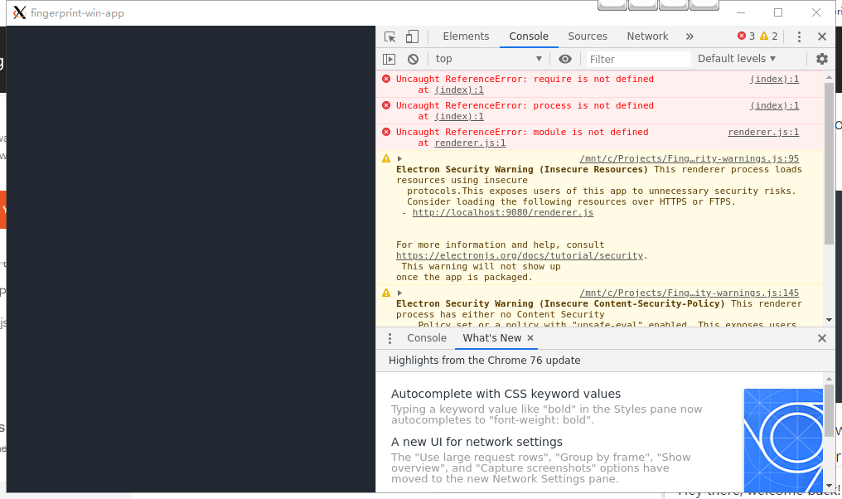
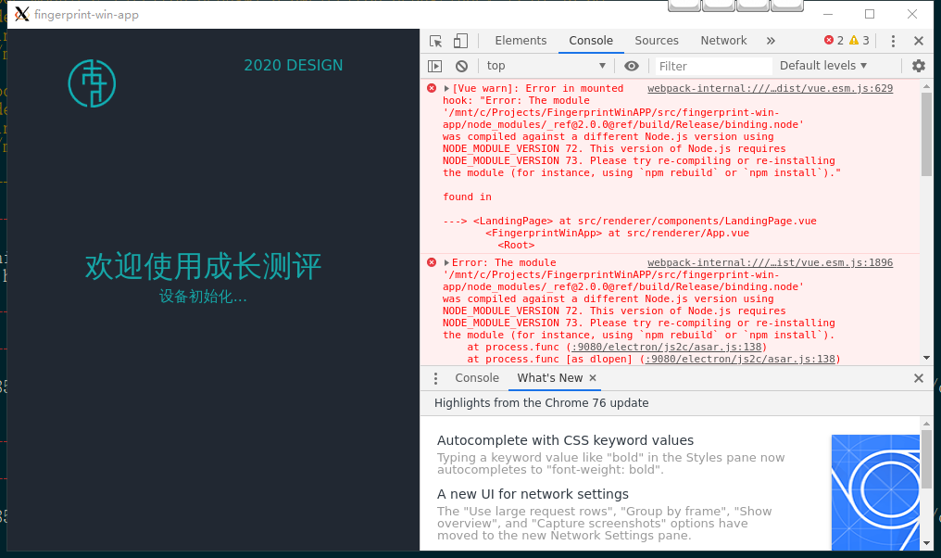
FAQ 3
require() is not defined
app.on('ready', () => {
mainWindow = new BrowserWindow({
webPreferences: {
nodeIntegration: true
}
});
});
Compiled against a different Node.js version
https://www.electronjs.org/docs/tutorial/using-native-node-modules
npm i -D electron-rebuild
./node_modules/.bin/electron-rebuild <module-name> # after “npm i”
Rebuild module
cd node_modules\ffi && HOME=~/.electron-gyp node-gyp rebuild --target=5.0.13 --arch=x64 --dist-url=https://electronjs.org/headers
5.0.13: Electron version
cnpm i -g node-gyp

Slide 27
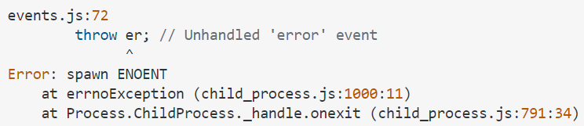

FAQ 4
Error: spawn ENOENT
Solution
rm -rf node_modules
npm i
Error: dynmic linking error 193
Cause
library is not 64bit (check by sigcheck)
Solution
install 32-bit node
node -p "process.arch" // output 32bit or 64bit node
reinstall node-gyp
cnpm install -g node-gyp
reinstall npm dependencies

Slide 28
THANKS
谢谢聆听

