Slide 1
Java Backend Notes
Sparks-Lu
Last updated: 5/29/2021

Slide 2
Install
Ref
https://blog.csdn.net/cpjiiiiiii/article/details/95317115
Steps
Install JDK
Configure environment variables
Install Eclipse

Slide 3
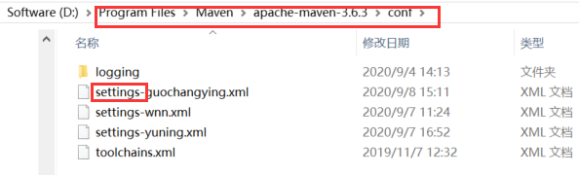
Maven
Install
Download zip from https://maven.apache.org/download.cgi
Add bin folder to system path
mvn -v
POM （Project Object Model）
pom.xml
更换国内镜像
全局配置: ${M2_HOME}/conf/settings.xml
用户配置: user.home/.m2/settings.xml
<mirror>
<id>alimaven</id>
<name>aliyun maven</name>
<url>http://maven.aliyun.com/nexus/content/repositories/central/</url>
<mirrorOf>central</mirrorOf>
</mirror>

Slide 4
Gradle
Intro
build tool
Install
https://gradle.org/install/

Slide 5
Vim
Reference
https://dev.to/mafflerbach/vim-as-java-ide-3b1a

Slide 6
Spring Cloud
参考
http://c.biancheng.net/spring_cloud/
介绍
开发分布式系统的“全家桶”，是一系列框架的有序集合。
环境搭建
JDK
java -version
Maven
mvn -version
Gradle
https://gradle.org/install/

Slide 7
Spring Boot

Slide 8
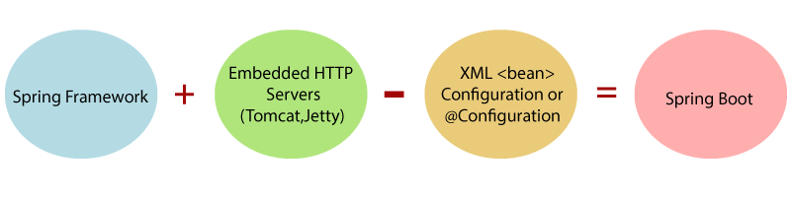
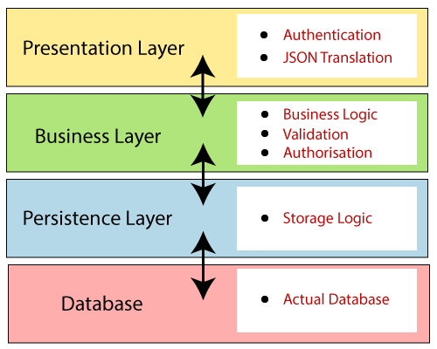
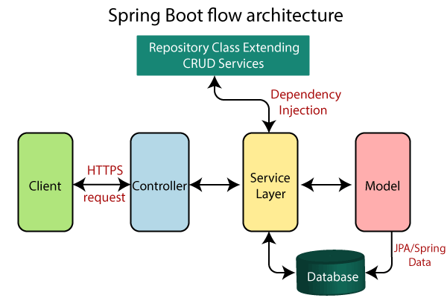
Introduction
简化新 Spring 应用的初始搭建以及开发过程

Slide 9
Install
Reference
https://docs.spring.io/spring-boot/docs/current-SNAPSHOT/reference/html/getting-started.html
Install
maven
gradle
Spring Boot CLI
spring --version

Slide 10
First App
Create pom.xml
Run “mvn package”
Add dependencies to pom.xml
mvn dependency:tree
Coding
@RestController
@RequestMapping
Run “mvn spring-boot:run”

