Slide 1
Web Server
Sparks Lu
Last updated: 3/1/2021

Slide 2
CentOS
Determine CentOS version
vim /etc/centos-release
Set up the system
sudo yum -y update
sudo yum groupinstall -y development
Install Python
wget http://www.python.org/ftp/python/2.7.15/Python-2.7.15.tar.xz
xz -d Python-2.7.15.tar.xz
tar xvf Python-2.7.15.tar
cd Python-2.7.15 && ./configure --prefix=/usr/local && make && make install
sudo yum install python-pip
sudo python -m pip install “django<2”

Slide 3
Ubuntu
Swap
Configure Swap
sudo fallocate -l 1G /swapfile
ls -lh /swapfile
sudo chmod 600 /swapfile
sudo mkswap /swapfile
sudo swapon /swapfile
sudo swapon --show
free -h
echo '/swapfile none swap sw 0 0' | sudo tee -a /etc/fstab
Swappiness
cat /proc/sys/vm/swappiness
sudo nano /etc/sysctl.conf
vm.swappiness=10
vm.vfs_cache_pressure=50

Slide 4
Windows Server
远程桌面连接
https://zhuanlan.zhihu.com/p/33490405
阿里云网页连接登录服务器
服务器管理-》本地服务器-》启用远程管理和远程桌面
Check port status
CurrPorts
http://www.nirsoft.net/utils/cports.html
Install Exchange Server
部署AD
https://blog.51cto.com/lumay0526/2046844
安装Exchange Server
https://blog.csdn.net/weixin_39585471/article/details/81081274
Post-installation
https://docs.microsoft.com/en-us/exchange/plan-and-deploy/post-installation-tasks/post-installation-tasks?view=exchserver-2019
Exchange Management Shell
Exchange admin center
https://<ServerFQDN>/ecp

Slide 5
Web Server Architecture
Django
Bootstrap
Nginx
Apache + mod_wsgi

Slide 6
Nginx
Install
sudo apt install nginx
Configuration Files
/etc/nginx/nginx.conf
/etc/nginx/conf.d/*.conf
/etc/nginx/sites-available
/etc/nginx/sites-enabled
/var/log/nginx/
Commands
nginx -v
nginx -h
service nginx start/stop/restart
nginx -s reload

Slide 7
Nginx Configuration
References
https://nginx.org/en/docs/http/ngx_http_core_module.html
Config options
max_ranges:
0 to disable byte-range support
max_ranges | Limits the maximum allowed number of ranges in byte-range requests | Default: not limited 0: disable byte-range support
proxy_connect_timeout
proxy_send_timeout
proxy_read_timeout
send_timeout

Slide 8
Apache
Install
Run as a service
httpd.exe -k install
conf/httpd.conf
WSGI (Web Service Gateway Interface)
mod_wsgi
module to host python applications
pip install mod_wsgi

Slide 9
Monitoring
 | 命令 | 说明
监控硬件 | ipmitool
CPU相关 | lscpu uptime top htop vmstat mpstat
内存 | free
磁盘 | df dd iotop
网络 | iftop nethogs sudo lsof -i -P -n | grep LISTEN | 列出正在监听的端口
监控出图 | mrtg nagios cacti zabbix

Slide 10
SAR
sudo apt install sysstat
Enable sysstat
/etc/default/sysstat false->true
Configure sysstat
/etc/cron.d/sysstat 5-55/10->*/2
/etc/sysstat/sysstat
HISTORY: 7->30
Start sysstat
sudo service sysstat restart
sudo service --status-all
log file: /var/log/sysstat/sa*
ksar
sudo apt install openjdk-8-jre
wget https://excellmedia.dl.sourceforge.net/project/ksar/ksar/5.0.6/kSar-5.0.6.zip
LC_ALL=C sar -A -f sa22 >sa22.parse
run.sh &
Select “load from text file...”
References
https://www.howtoforge.com/install-and-configure-sar-and-ksar-for-daily-monitoring-on-linux-and-generate-pdf-reports/
#!/bin/bash
idx=`date --date="1 days ago" +%Y%m%d`
work_dir="/home/lgm/SarReports/"
sar_file="$work_dir/sa$idx"
pdf_file="$work_dir/sa$idx.pdf'
ksar_dir=”/home/lgm/Programs/kSar-5.0.6/”
LC_ALL=C sar -A -f /var/log/sysstat/sa$idx > $sar_file
cd $ksar_dir
java -jar kSar.jar -input $sar_file -outputPDF $pdf_file
echo "Ksar graph successfully generated"

Slide 11
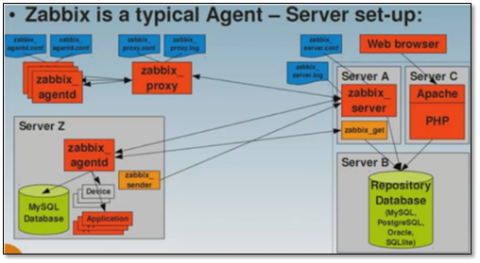
Zabbix
References
https://www.zabbix.com
Component
server
agent: deployed on the target machine to be monitored, responsible for reporting the gathered data from the target to the server
Suppor
MySQL/PostgreSQL support
Apache2/Nginx support
Install
apt-get install mysql-server mysql-client mlocate
sudo apt-get install zabbix-server-mysql zabbix-frontend-php zabbix-agent

Slide 12
阿里云域名+腾讯云服务器
References
https://blog.csdn.net/daotiao0199/article/details/81945865
Steps
阿里云->控制台->域名->域名列表->管理
修改域名的DNS服务器为s1g1ns1.dnspod.net和s1g1ns2.dnspod.net
腾讯云->控制台->域名服务->我的域名->添加解析
腾讯云域名诊断工具 https://domaintool.cloud.tencent.com

Slide 13
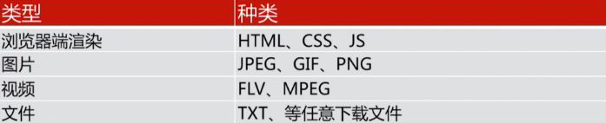
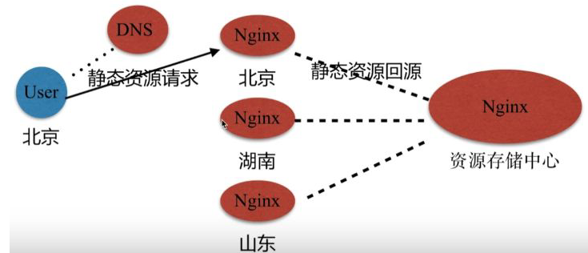
CDN
Content Delivery Network
动静分离
https://www.cnblogs.com/matengfei123/p/8005404.html

Slide 14
Set Up VPN
Rent server from vultr.com
Config server as VPN server
Refer
https://www.vultr.com/docs/setup-a-pptp-vpn-server-on-ubuntu
https://blog.warmcolor.net/2013/06/21/%E5%9F%BA%E4%BA%8Eubuntu%E6%90%AD%E5%BB%BAvpn%E6%9C%8D%E5%8A%A1%E5%99%A8%E5%B7%B2%E9%AA%8C%E8%AF%81/
Steps
apt-get install pptpd
Edit /etc/pptpd.conf
option /etc/ppp/pptpd-options
localip 192.168.0.1
remoteip 192.168.0.11-150
Edit /etc/ppp/pptpd-options
ms-dns: 8.8.8.8 8.8.4.4
/etc/ppp/chap-secrets
用户名 pptpd 密码 *
/etc/init.d/pptpd restart
iptables -I INPUT -p tcp --dport 1723 -j ACCEPT
/proc/sys/net/ipv4/ip_forward: 1
Edit /etc/sysctl.con
net.ipv4.ip_forward = 1
sysctl -p
/etc/init.d/procps restart
apt-get intall iptables
iptables --table nat --append POSTROUTING --out-interface {eth0} --jump MASQUERADE
Edit /etc/rc.local:
iptables --table nat --append POSTROUTING --out-interface eth0 --jump MASQUERADE
Set up client
Search vpn in start menu

Slide 15
HTTPS
References
https://www.cnblogs.com/tomingto/p/11327696.html
https://help.aliyun.com/document_detail/98576.htm?spm=a2c4g.11186623.2.19.181060e0zo8yDx#concept-omf-lxn-yfb
Steps
Generate keystore
在Tomcat安装目录下新建cert目录，将解压的证书和密码文件拷贝到cert目录下
Modify conf/server.xml

Slide 16
Q&A
Safari浏览器不支持将非ASCII字符存入Cookie

