Slide 1
Three.js Notes
Sparks Lu
Last updated: 4/25/2021

Slide 2
References
https://threejsfundamentals.org/threejs/lessons/threejs-textures.html
https://discoverthreejs.com/tips-and-tricks/

Slide 3
Coordinates
From screen space (normalized device coordinate) to world space
Vector3.unproject(camera)

Slide 4
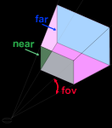
Camera
Perspective camera

Slide 5
Material
Material
Properties
transparent: true/false, default false
opacity: 0.0~1.0, default 1.0
Material
- opacity
-

Slide 6
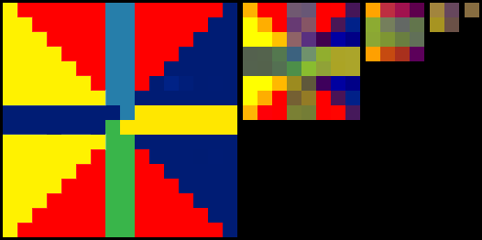
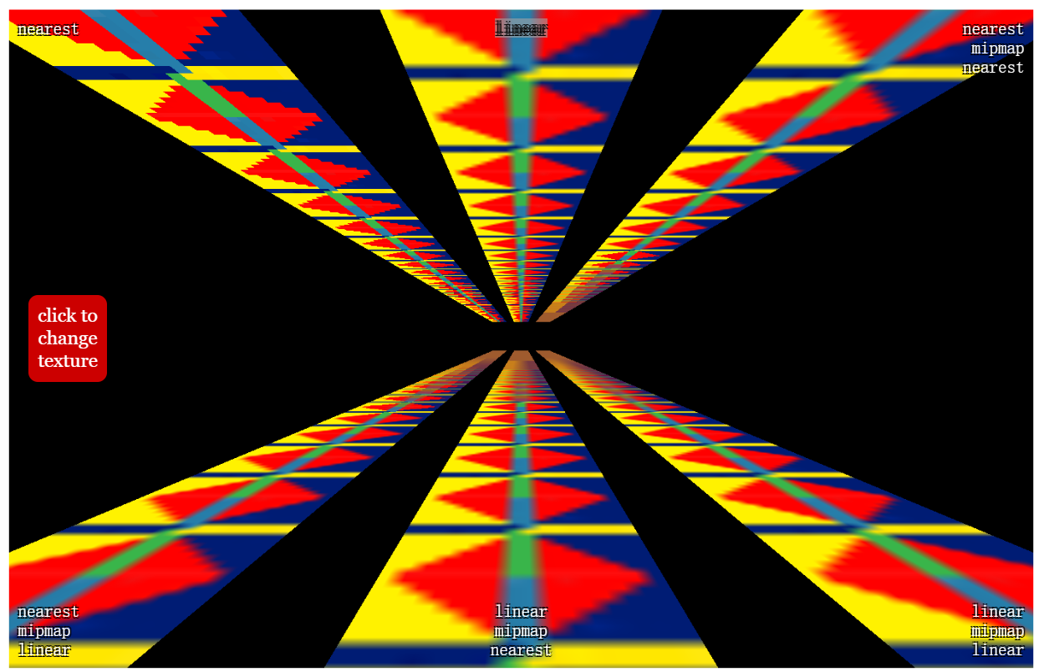
Texture - Mipmap
Mipmap
mip: copies of the texture, each one half as wide and half as tall as the previous mip
Options
Nearest: choose the closest pixel in the texture
Linear: choose 4 pixels from the texture and blend them
NearestMipmapNearestFilter: choose the nearest mip then choose one pixel
NearestMipmapLinearFilter: choose 2 mips, choose one pixel from each, blend the 2 pixels
LinearMipmapNearestFilter: chose the nearest mip then choose 4 pixels and blend them
LinearMipmapLinearFilter: choose 2 mips, choose 4 pixels from each and blend all 8 into 1 pixel
texture.magFilter = Three.LinearFilter / Three.NearestFilter
texture.minFilter = Three.NearestFilter / Three.LinearFilter / Three.NearestMipmapNearestFilter / Three.NearestMipmapLinearFilter / Three.LinearMipmapNearestFilter / Three.LinearMipmapLinearFilter

Slide 7
Texture Loader
TextureLoader
var loader = new THREE.TextureLoader()
loader.load(url, onLoadCallback, onProgressCallback, onErrorCallback)
Load cubemap
const loader = new THREE.CubeTextureLoader()
const texture = loader.load([
pos-x.jpg, neg-x.jpg, pos-y.jpg, neg-y.jpg, pos-z.jpg neg-z.jpg])
scene.background = texture
Load equirectangular
const loader = new THREE.TextureLoader()
const texture = loader.load('equi.jpg', () => {
const rt = new THREE.WebGLCubeRenderTarget(texture.image.height)
rt.fromEquirectangularTexture(render, texture)
scene.background = rt
})
TextureLoader
CubeTextureLoader

Slide 8
Sprite
SpriteMaterial
Properties
color: .map is multiplied by the color
map: texture
rotation
sizeAttenuation: whether or not size of sprite is attenuated by the camera depth, default true
SpriteMaterial
({map: texture,
color: color})
Sprite
(spriteMaterial)
- material

Slide 9
Texts
Refer
https://www.cnblogs.com/tengge/p/11979854.html
troika-three-text
https://protectwise.github.io/troika/troika-three-text/
npm i troika-three-text
SpriteText
https://github.com/vasturiano/three-spritetext
npm i three-spritetext
import SpriteText from 'three-spritetext'
var myText = new SpriteText('My text')
text is clear, not blurry
TextSprite
https://github.com/SeregPie/THREE.TextSprite
npm i @seregpie/three.text-sprite
import TextSprite from '@seregpie/three.text-sprite'
SpriteText2D
https://github.com/gamestdio/three-text2d
three-text2d
SpriteText2D
(msg, {props})

Slide 10
Raycaster
Code Snippets
var rc = new Three.Raycaster()
rc.setFromCamera(mousePos, camera)
rc.ray
direction

Slide 11
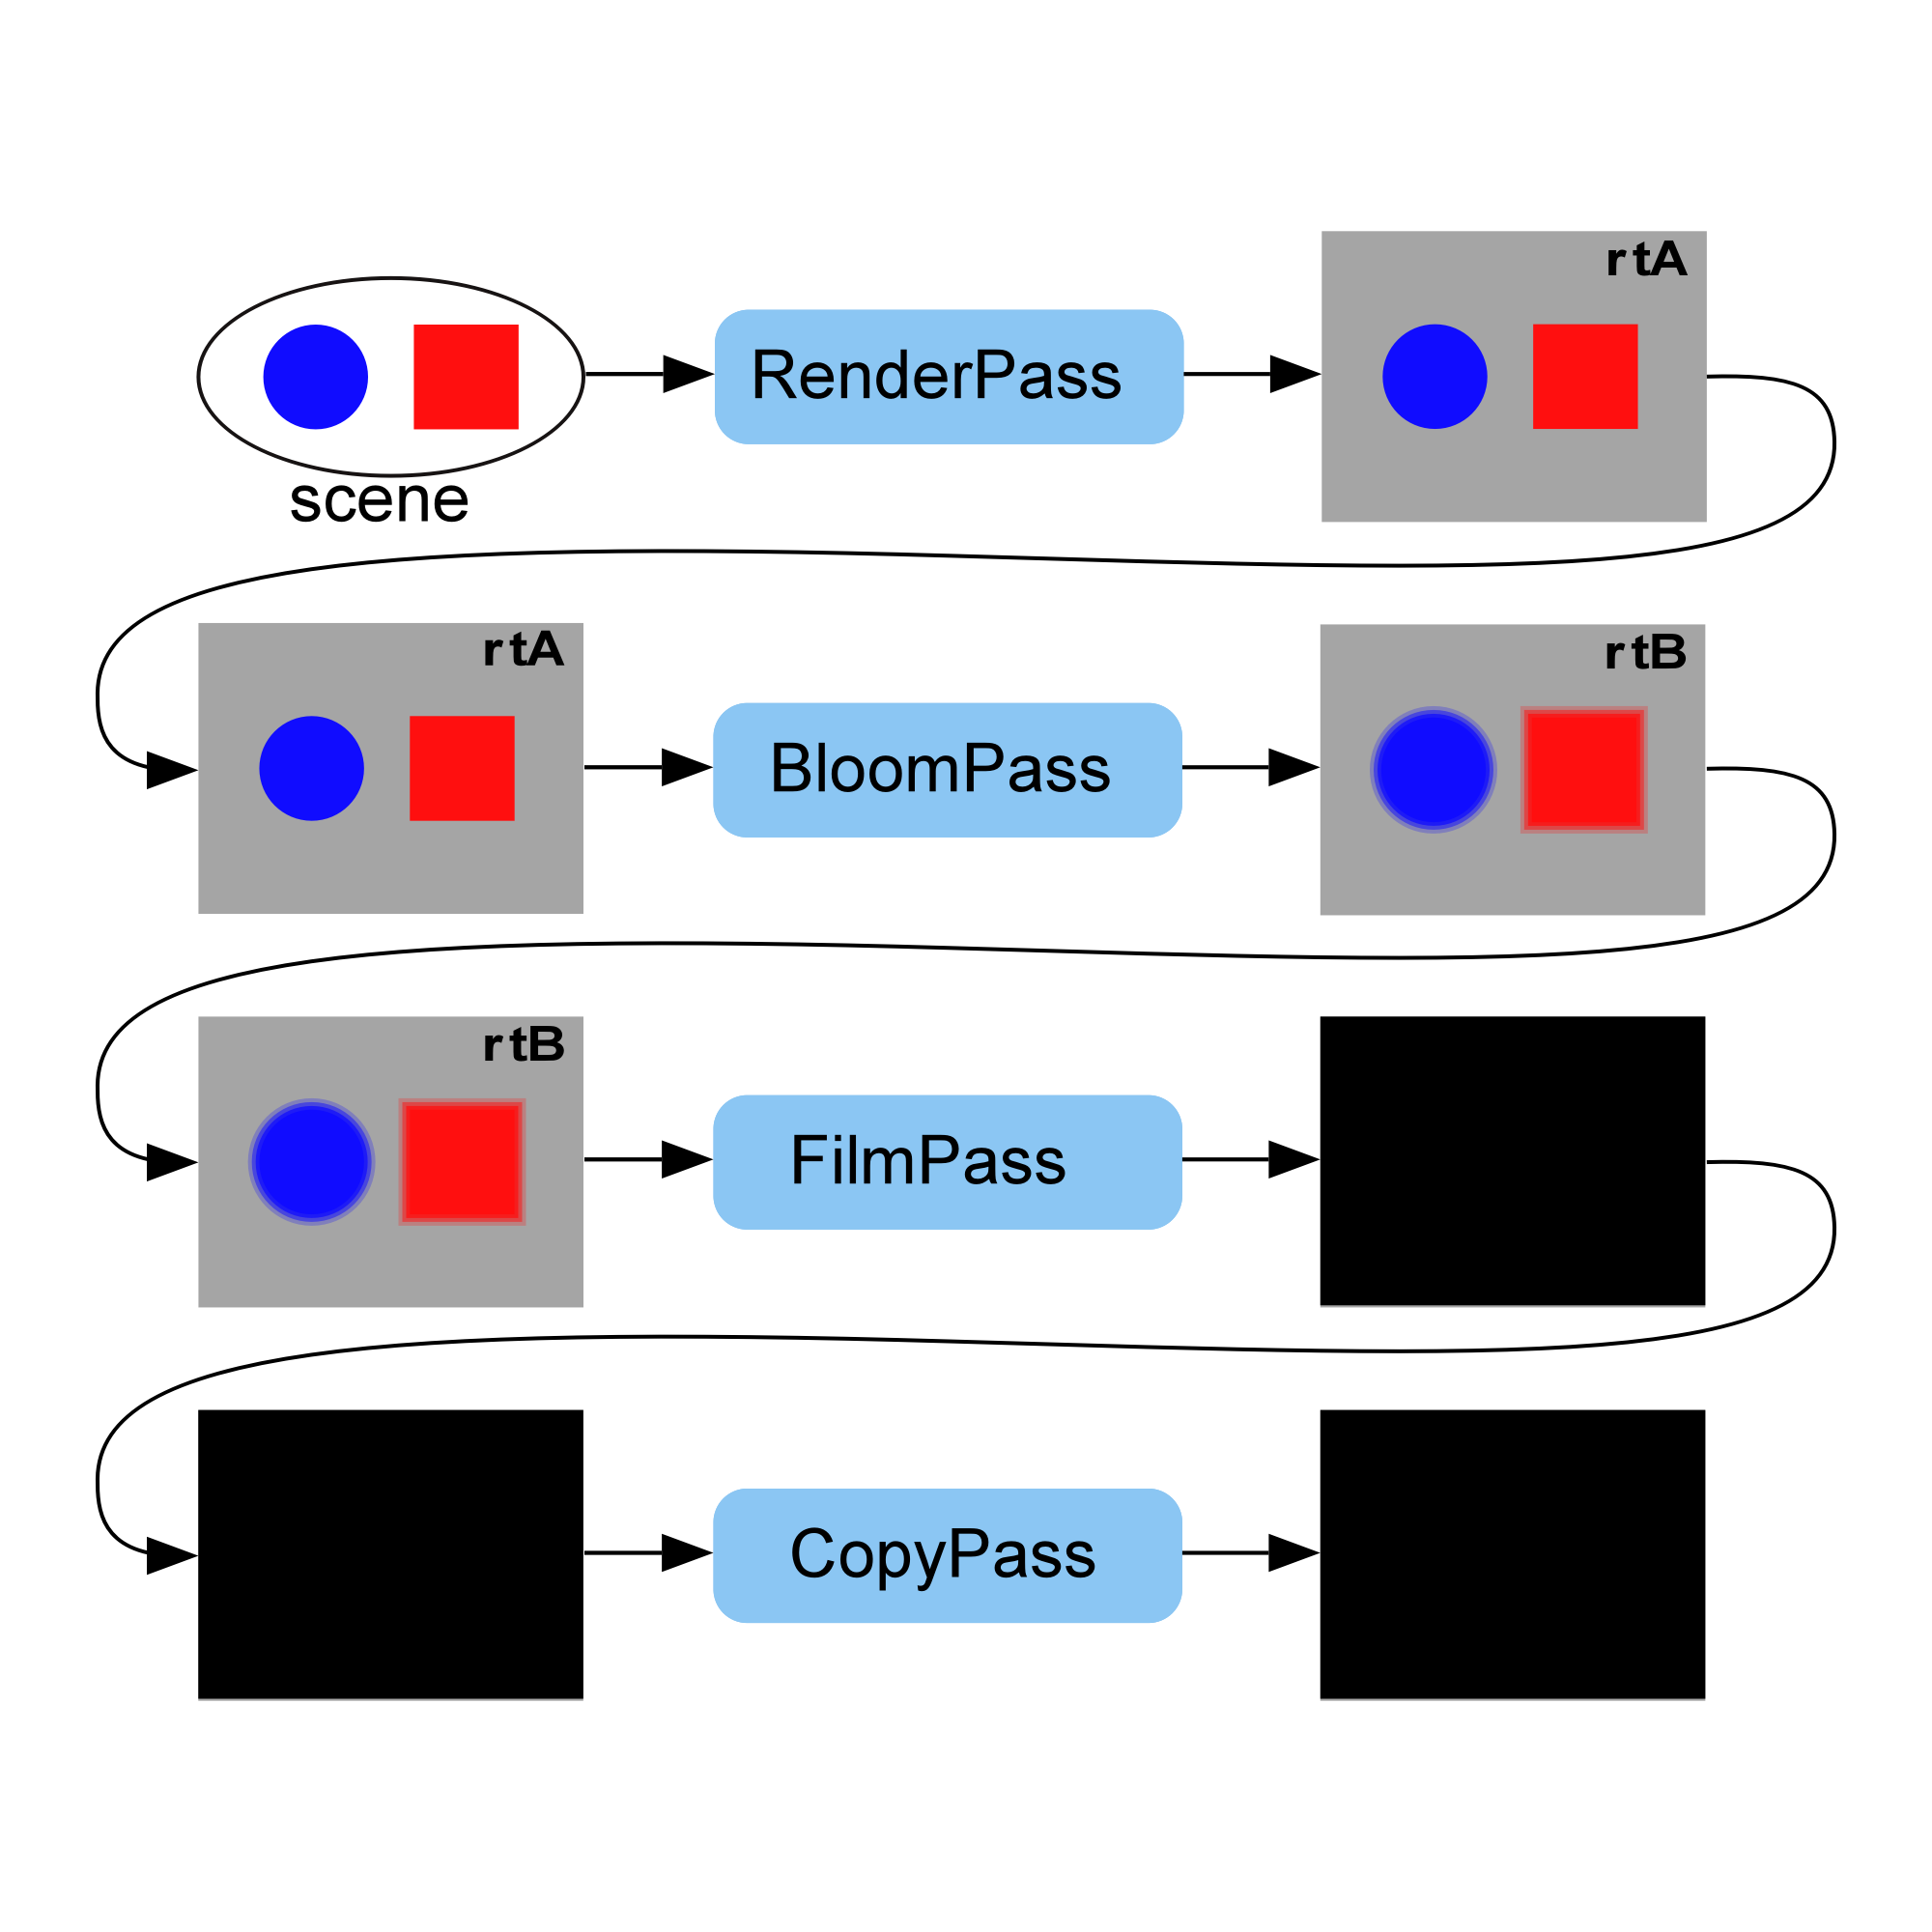
Post Processing
Refer
https://threejsfundamentals.org/threejs/lessons/threejs-post-processing.html

Slide 12
Particle System
https://redstapler.co/space-warp-background-effect-three-js/
Fog
https://dustinpfister.github.io/2018/04/16/threejs-fog/
scene.fog = THREE.fog(fogColor, nearDistance, farDistance)
Rain
https://redstapler.co/three-js-realistic-rain-tutorial/

