Slide 1
Blender Notes
Sparks Lu
Laste updated: 11/3/2020

Slide 2
Usage

Slide 3
Shortcuts
Key | Function | Note
Tab | switch between edit and object mode
Space | Search
Numpad 1~9 | Switch view among top/left/right/bottom Or rotate view point around an axis
Shift + A | Open “Add” menu
N | Open/close property window
T | Show/hide Tools panel
X | Delete menu

Slide 4
Shortcuts in Edit Mode
Key | Function | Note
A | select or deselect all
B | border (rectangle) select
C | circle select | Esc to exit this mode
S | Scale selected
G | Move selected
X | Delete selected
Ctrl+j | Join selected meshes
U | Show unwrap menu
Ctrl+e | Show edge menu
Shift+Alt+Right click | Select edge loop

Slide 5
Bake One Material From Multiple Materials
Create new UV map as “baked”
Open “UV/Image Editor”
Create new image as “baked”
Switch to edit mode and select all
Press 'u' to show “UV mapping” menu
Select “Smart UV Project”
In “Data Object” panel, select “baked” UV map.
In Render panel, “Bake” pane
Set “Bake Mode” to “Textures”
Press “Bake”
After baking, in “UV/Image Editor”
Save image as “baked-4096.png”
In “Material” panel, add new material as “baked” and select it
In “Texture” panel, add new texture, select “baked-4096.png”
Assign “baked” material to object

Slide 6
Combine Multiple Objects into One
Press 'B' for box selection
Select all objects to be combined
Press Ctrl+j to combine selected objects

Slide 7
Texture Paint Mode

Slide 8
UV Unwrap
Smart UV Project
'Tab': Switch to edit mode
'u': Show UV menu
Select 'Smart UV Project'
Manual UV Unwrap
'Tab': Switch to edit mode
'a': Select none
Switch to edge select
Select edges
'Ctrl-E': edge menu
Select 'Mark Seam'
'a': Select all
'u': Show UV menu
Select 'Unwrap'

Slide 9
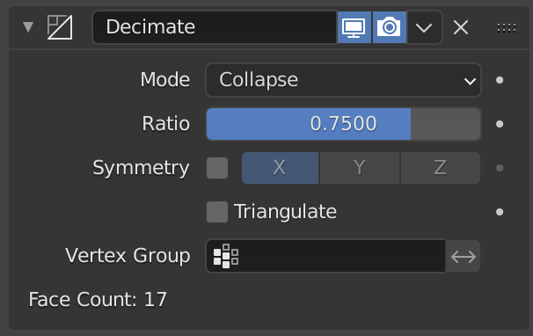
Decimate Model
Steps
Import model
Select model
Switch to “modifier” tab, select “Decimate” modifier
Change “Ratio” to decimate model
100K faces -> 10K faces
Export model
Scale down texture accordingly

Slide 10
Python Dev

Slide 11
Introduction
Reference
https://docs.blender.org/api/current/index.html
https://github.com/HusseinBakri/BlenderPythonDecimator

