Slide 1
Three.js Notes
Sparks Lu
Last updated: 2/6/2020

Slide 2
References
https://threejsfundamentals.org/threejs/lessons/threejs-textures.html

Slide 3
Coordinates
From screen space (normalized device coordinate) to world space
Vector3.unproject(camera)

Slide 4
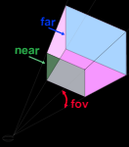
Camera
Perspective camera

Slide 5
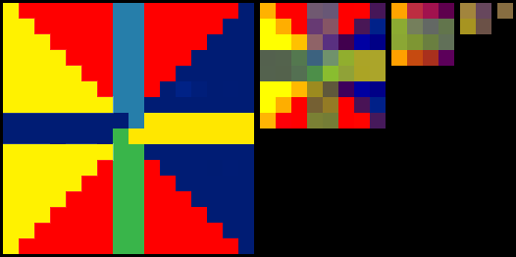
Texture
Cube texture
In order of px, nx, py, ny, pz, nz (right, left, top, bottom, front, back)
Mipmap
mip: copies of the texture, each one half as wide and half as tall as the previous mip
Texture
texture.magFilter = Three.LinearFilter / Three.NearestFilter
texture.minFilter = Three.NearestFilter / Three.LinearFilter / Three.NearestMipmapNearestFilter / Three.NearestMipmapLinearFilter / Three.LinearMipmapNearestFilter / Three.LinearMipmapLinearFilter

Slide 6
Texture Loader
TextureLoader
var loader = new THREE.TextureLoader()
loader.load(url, onLoadCallback, onProgressCallback, onErrorCallback)
TextureLoader
CubeTextureLoader

Slide 7
Raycaster
Code Snippets
var rc = new Three.Raycaster()
rc.setFromCamera(mousePos, camera)
rc.ray
direction

Slide 8
Particle System
https://redstapler.co/space-warp-background-effect-three-js/

