Slide 1
Docker Notes
Sparks Lu
Last updated: 1/30/2020

Slide 2
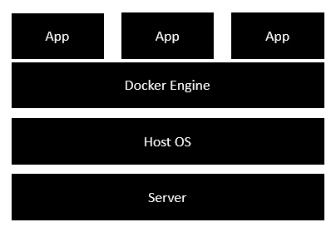
Intro
Concept
Docker: a platform to build, share, and run applications with containers
container: a running process
Docker image: everything needed to run an application
Dokerfile: describe how to assemble a private filesystem for a container
Install
Docker for Windows
https://github.com/docker/toolbox/releases
Start “Docker Quickstart Terminal”
Linux
sudo apt install apt-transport-https ca-certificates curl gnupg-agent software-properties-common
curl -fsSL https://download.docker.com/linux/ubuntu/gpg | sudo apt-key add -
Test install: docker run hello-world

Slide 3
Install on Ubuntu16.04
Install Docker Engine - Community (deb)
Download and install .deb for docker-ce docker-ce-cli, and containerd.io from https://download.docker.com/linux/ubuntu/dists/
sudo docker run hello-world # test installation
Install Docker Compose
sudo curl -L "https://github.com/docker/compose/releases/download/1.25.3/docker-compose-$(uname -s)-$(uname -m)" -o /usr/local/bin/docker-compose # slow
sudo curl -L https://get.daocloud.io/docker/compose/releases/download/1.25.3/docker-compose-`uname -s`-`uname -m` -o /usr/local/bin/docker-compose
sudo chmod +x /usr/local/bin/docker-compose
docker-compose --version # test installation

Slide 4
Install On Ubuntu 16.04
Install Docker Machine
Download docker-machine from https://github.com/docker/machine/releases/download/
docker-machine --version # test installation
wget -q https://www.virtualbox.org/download/oracle_vbox_2016.asc -O- | sudo apt-key add -
wget -q https://www.virtualbox.org/download/oracle_vbox.asc -O- | sudo apt-key add -
sudo sh -c 'echo "deb http://download.virtualbox.org/virtualbox/debian $(lsb_release -sc) contrib" >> /etc/apt/sources.list.d/virtualbox.list'
sudo apt update
sudo apt install virtualbox

Slide 5
Install On Aliyun Ubuntu 16.04
Docker Engine
sudo curl -fsSL https://get.docker.com | bash -s docker --mirror Aliyun
sudo -E sh -c 'apt-get install -y -qq --no-install-recommends docker-ce >/dev/null'
sudo -E sh -c 'docker version'
sudo docker run hello-world # test install

Slide 6
Components
Docker Compose
Bundle a multi-container application into a single app
docker-compose --version
Docker Machine
Create Docker hosts both locally and in the cloud
docker-machine --version
Kitematic
Docker CLI Client
Docker Compose
Docker Machine
Docker Engine

Slide 7
Working Logic
Docker Client
Docker Daemon
contact
pull from Docker Hub
create a new container
stream output

Slide 8
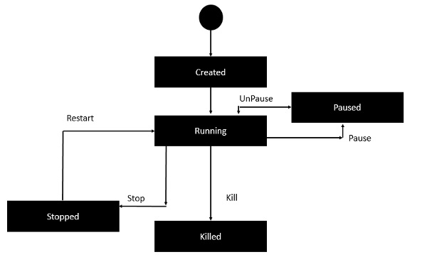
Container Lifecycle

Slide 9
Docker
docker commands
docker version/info
docker pull busybox // pull busy image from docker registry
docker run {image-name} // create a new container and run an image
-it // interactive
-p {port-number-host}:{port-number-container}
-d // daemon mode
--restart=always
docker images // list installed images
docker image build -t {image-name} .
docker container run --name {container-name} {image-name}
docker container rm --force {container-name}
docker rmi {image-id}
docker inspect {image-name}
docker ps // list containers
-a // list all
docker history {image-id}
docker top/stats/attach/pause/unpause/kill/stop/rm {container-id}
service docker start/stop // stop Docker daemon
docker network ls, docker network inspect {name}
docker exec -it <container_name> /bin/bash

Slide 10
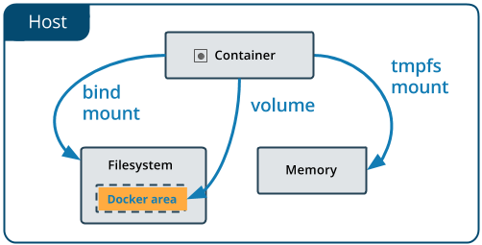
Docker Volume
Concept
Volumes in image are added when run container.
Commands
docker volume ls

Slide 11
Dockerfile
Intro
Tells docker how to build an image
Commands
FROM // what image to pull from the Docker Hub repository
WORKDIR
COPY
RUN
CMD
CMD [“echo”, “Image created”]
MAINTAINER // mail address
ENV {key1}={value1}
WORKDIR {dirname}
Build
docker build -t {image-name}:{tag-name} dir
-t: with tag
Public respositories
Docker Hub
#This is a sample Image
FROM ubuntu
MAINTAINER demousr@gmail.com
RUN apt-get update
RUN apt-get install –y nginx
CMD [“echo”,”Image created”]

Slide 12
Docker Compose
Intro
Used to run multiple containers as a single service
docker-compose commands
docker-compose build
docker-compose up -d // create and start containers
-d: in daemon mode
docker-compose down // Stop and remove containers, networks, images and volumes
docker-compose run web env // show env variables
docker-compose logs // show logs
docker-compose ps // list containers
docker-compose images // list images
docker-compose -h // show help
docker-compose.yml

Slide 13
Docker Machine
docker-machine commands
docker-machine create -d virtualbox {machine-name}
-d/--driver: which provider the machine should be created on (VirtualBox, DigitalOcean, AWS, etc.)
eval $(docker-machine env dev)
docker-machine ls
docker-machine ip default
docker-machine start {docker-machine-name}
eval "$(docker-machine env dev)" # make a machine active

Slide 14
References
https://www.tutorialspoint.com/docker/

