Slide 1
Flask Notes
Sparks Lu
Last updated: 8/31/2019

Slide 2
Intro
Micro-framework for developing web applications
written in python
based on the Werkzeug and Jinja2 template engine

Slide 3
Basic
pip install flask flask-cors python-dotenv
Run
export FLASK_APP=hello.py
After install python-dotenv, this can be written in .flaskenv of project top folder
flask run
flask run --host=0.0.0.0 // Visible by all IP, serve only one request at a time
URL
redirect(url_for('login'))
abort(401)
@app.route('/')
@app.route('/user/{user_id}')
@app.errorhandler(404)
from flask import Flask
app = Flask(__name__)
@app.route('/')
def hello_world():
return 'Hello, World!'

Slide 4
Request
from flask import Flask, request
app = Flask(__name__)
@app.route('/', methods=['GET', 'POST'])
def hello_world():
if request.method == 'GET':
func1()
elif request.method == 'POST':
func2()
Request
from flask import request
request.method
request.path
GET: request.args.get('username')
POST: request.form.get('username')
Upload
f = request.files['the_file']
f.save('uploaded.file')
Cookie
request.cookies.get('username')
resp = make_response(render_template(...))
resp.set_cookie('username', 'un1')

Slide 5
Response
Response format
response, status, headers
resp = make_response(response, status)
resp.headers['AAA'] = 'value'
Session
app.secret_key = 'AAA'
session['username'] = 'un1'

Slide 6
Render Template
Render template
from flask import render_template
render_template('hello.html', name=name)
templates/hello.html
Grammar in template
{{ var }}
{% if var %}, {% else %}, {% endif %}
{% for var in set %}, {% endfor %}
Template inheritance
{% block bname %}{% endblock %}
{% extends 'base.html' %}

Slide 7
Web Forms
pip install flask-wtf
Usage
from flask-wtf import FlaskForm
from wtforms import StringField, PasswordField, BooleanField, SubmitField
from wtforms.validators import DataRequired

Slide 8
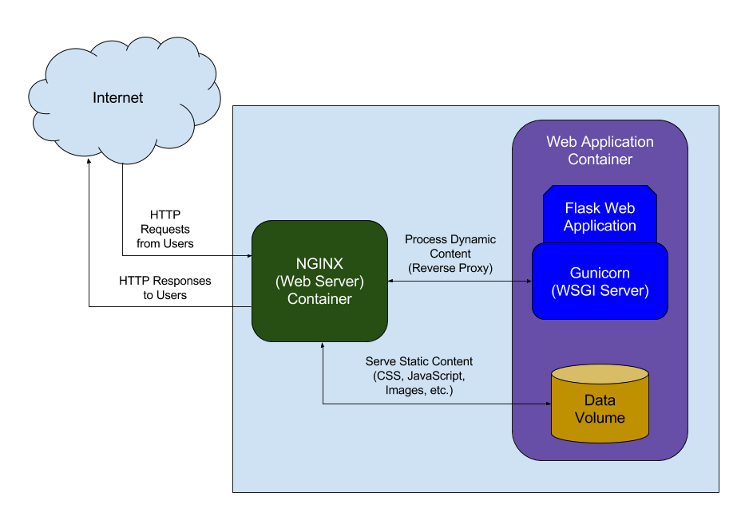
Deploy
Prepare Env
sudo apt-get update
sudo apt-get install python3-pip python3-dev nginx
sudo pip3 install virtualenv
virtualenv myprojectenv
source myprojectenv/bin/activate
pip install uwsgi flask
sudo ufw allow 5000
Gunicorn
Python WSGI HTTP server for Unix
Refer
http://www.patricksoftwareblog.com/how-to-configure-nginx-for-a-flask-web-application/

Slide 9
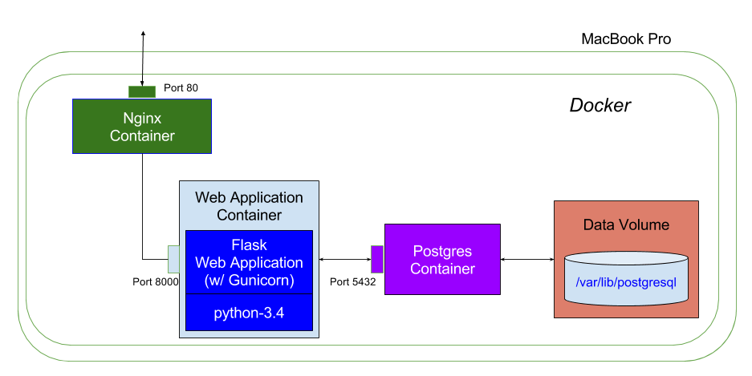
Deploy (Docker)
References
https://ianlondon.github.io/blog/deploy-flask-docker-nginx/
Dockerfile
FROM tiangolo/uwsgi-nginx-flask:python3.6
COPY ./app /app
Build and Run Docker image
go to flask project root folder
docker build -t flask_proj1 .
docker run -p 80:80 -t flask_proj1

Slide 10
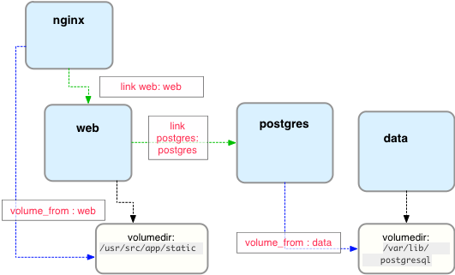
Deploy (Docker 2)
References
http://containertutorials.com/docker-compose/nginx-flask-postgresql.html
Config
docker-compose.yml
Dockerfile
Build container
sudo docker-compose build
Run container
sudo docker-compose up -d

Slide 11
Static Files
Basic
Url starts with '/static/'
Files should be in 'static/' folder in Flask APP's root

Slide 12
Media
References
https://www.iandevlin.com/blog/2012/09/html5/html5-media-and-data-uri/
https://blog.miguelgrinberg.com/post/video-streaming-with-flask/page/5?source=post_page---------------------------
https://blog.miguelgrinberg.com/post/flask-video-streaming-revisited

Slide 13
Session
Client-side
Server-side

