Slide 1
Android General
Sparks Lu
Last updated: 11/9/2021

Slide 2
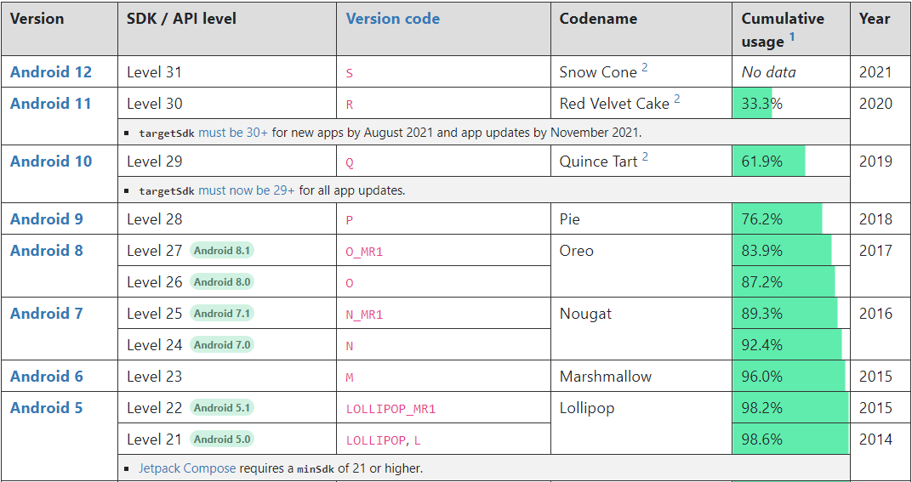
Android Versions

Slide 3
Set Up Dev Env on Windows
Steps
Download and install JDK
Download and install Android Studio from https://developer.android.google.cn/
Download and install gradio
download from https://gradle.org/releases/
unzip
add bin subfolder in unzipped folder to system path, e.g. D:\Programs\gradle-8.10\bin
run “gradle -v” to verify installation
Configure mirror
在$GRADLE_HOME/init.d/目录下新建文件：init.gradle
# ~/.gradle/init.gradle
allprojects {
repositories {
maven { url 'https://maven.aliyun.com/repository/public' }
}
}

Slide 4
Gradle
国内镜像
https://www.jianshu.com/p/8a1148d1162d
gradle wrapper
$HOME/.gradle/wrapper/dists/
gradle/wrapper/gradle-wrapper.properties
gradle config
$root/build.gradle
$root/app/build.gradle
AGP (Android Gradle Plugin)
https://gradle.org/releases/
4.2.2 （Android SDK 30.0.2 (R Android 11))
4.1.0 (Android SDK 29.0.2 (Q Android 10))
// Top-level build file where you can add configuration options common to all sub-projects/modules.
buildscript {
ext {
kotlin_version = '1.3.72'
}
repositories {
maven { url 'https://maven.aliyun.com/repository/public/' }
maven { url 'https://maven.aliyun.com/repository/gradle-plugin' }
maven { url 'https://maven.aliyun.com/repository/central' }
maven{url "https://jitpack.io"}
google()
// jcenter()
}
dependencies {
classpath "com.android.tools.build:gradle:4.0.1"
classpath "org.jetbrains.kotlin:kotlin-gradle-plugin:$kotlin_version"
// NOTE: Do not place your application dependencies here; they belong
// in the individual module build.gradle files
}
}
allprojects {
repositories {
maven { url 'https://maven.aliyun.com/repository/public/' }
maven { url 'https://maven.aliyun.com/repository/central' }
google()
// jcenter()
}
}
task clean(type: Delete) {
delete rootProject.buildDir
}

Slide 5
Issues & Solutions
unable to find gradle tasks to build
$HOME\.gradle\wrapper\dists\
控制台乱码
在help中找到Edit Custom VM Options... ，在文件中添加”-Dfile.encoding=UTF-8”

Slide 6
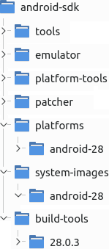
SDK Cmdline Tools
cmdline-tools
cmdline-tools\latest\bin\
sdkmanager
https://developer.android.com/studio/command-line/sdkmanager
sdkmanager --list List installed and avaiable packages
sdkmanager --list_installed List install packages
sdkmanager {package_name} Install package
sdkmanager.bat "system-images;android-30;default;arm64-v8a"
sdkmanager --uninstall {package-name}
avdmanager
avdmanager list List available targets, virtual devices, and device definitions
avdmanager list avd, list target, list device
avdmanager create avd --help
avdmanager create avd --force --name Pixel5 --package 'system-images;android-31;default;x86_64' --device ‘pixel_5’
Needs to install system-images first using sdkmanager
avd folder: {Android_sdk}/system-images/android-{apiLevel}/{variant}/{arch}/
avdmanager delete avd --name Pixel5
apkanalyzer
apkanalyzer apk summary myapk.apk
output package_name, version code, version name
apkanalyzer files list myapk.apk
apkanalyzer manifest print

Slide 7
Emulator
emulator
https://developer.android.google.cn/studio/run/emulator-commandline?hl=zh-cn
emulator --help
emulator -list-avds
avd needs to be created using “avdmanager create avd ...”
emulator -avd Pixel_5
snapshot
-no-snapshot-load code boot, save state when exit
-no-snapshot-save quick boot, do not save state when exit
-no-snapshot
-snapshot-list list snapshots
camera
-webcam-list list available camera name
-camera-back {cam_name}
storage
-sdcard {path} SD file path
misc
-shell launch shell

Slide 8
Platform Tools
adb (Android Debug Bridge)
references
https://developer.android.com/studio/command-line/adb
Included in platform-tools
adb devices -l
adb -s emulator-5554 install helloWorld.apk
must start emulator first
Phone
“Setting”->”About phone”->”Build number”, tap 7 times to make “Developer options” visible
turn on “Settings”->”Developer option”->”USB debugging”
adb install -t path_to_apk
adb pull remote local # pull from phone
adb push local remote # push to phone
adb shell
adb shell ls /system/bin
adb shell screencap /sdcard/1.jpg
adb shell screenrecord /sdcard/demo.mp4
adb logcat
-b {main/system/crash}
-d >C:\tmp\1.log # dump log to screen and exit
-v color
*:W # warning and above
*:E # error and above
-f /sdcard/logs
-c # clear logs

Slide 9
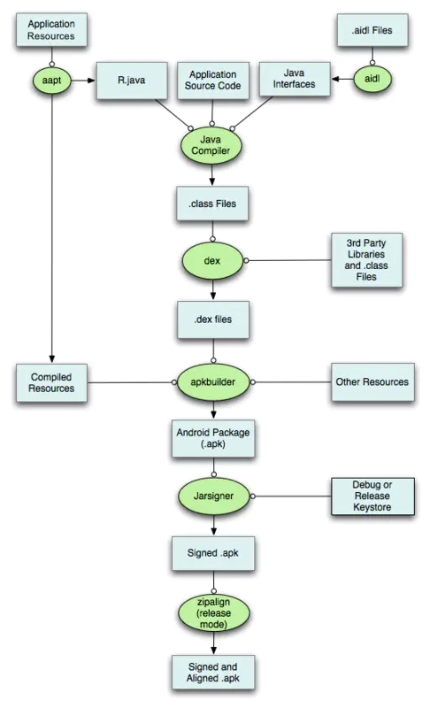
SDK Build Tools
aapt (Android Asset Packing Tool)
apksigner

Slide 10
SDK Build Tools
Check apk signature
keytool -printcert -jarfile {a.apk}
Check apk package name
aapt dump badging {a.apk} | grep package:\ name

Slide 11
Debug
UI methods
AlertDialog
Snackbar
Toast
short: about 2s, long: about 3.5s

Slide 12
Keystore
Generate
keytool -genkey -alias mydomain -keyalg RSA -keystore keystore.jks -keysize 2048
Verify
onkstore -file my_keystore -verify
keytool -list -v -keystore keystore.jks

Slide 13
Apps
Termux
terminal app
https://github.com/termux
JuiceSSH
https://juicessh.com/

Slide 14
Python Support
Steps
install termux
pkg install root-repo
pkg update
pkg install python

Slide 15
Printing
Mopia
https://mopria.org/
Mi Print

Slide 16
FAQ
cvc-complex-type.2.4.a: 发现了以元素 ‘base-extension’ 开头的无效内容。应以 ‘{layoutlib}’ 之一开头。
升级gradle
修改graddle-wrapper.properties中distributionUrl项
修改$root/build.gradle

