Slide 1
iOS General
Sparks Lu
Last update: 11/13/2021

Slide 2
iOS Development

Slide 3
Set Up - XCode
Steps
Apple Developer Program
Install Xcode
Launch Xcode
In Xcode Preferences->Accounts, add Apple ID

Slide 4
Set Up - Production Certificate
Creating a Production Certificate and p12 file
Development Provisioning Profile
contains a set of Development Certificates, Unique Device Identifiers(UDID), an App ID
Generate a CSR (Certificate Signing Request) file
On Mac, Finder->Application/Utilities, launch Keychain Access Program
Menu item: Keychain Access > Certificate Assistant > Request a Certificate From a Certificate Authority
Create certificate
Enter Apple Developer Program web page
Member Center > Certificates > Identifiers & Profiles > Certificates
Choose CSR generated in last step
Export a p12 file
Launch Keychain Access Program
In top-left “Keychain” pane, select “Login”
Select “File”->”Import” menu item, import .cer file created in last step. After this, the certificate is shwon in “My Certificate”
In bottom-left “Category” pane, select “My Certificates”, select the cGrtificate
Select “File”->”Export” menu item, selct “.p12” from file type dropdown menu. Then click “Save”.

Slide 5
Find Device UDID
Find device UDIDs
By Mac
connect iphone to Mac
“Apple logo” -> “About this Mac” -> “System Report” -> “Hardware” -> “USB” -> “iPhone” -> “Serial Number”
add “-” after the 8th digit
By XCode
connect iPhone to Mac
open XCode
“Window” -> “Devices and Simulators”
https://www.pgyer.com/udid
By ShowMyUDID.com in Safari on iPhone

Slide 6
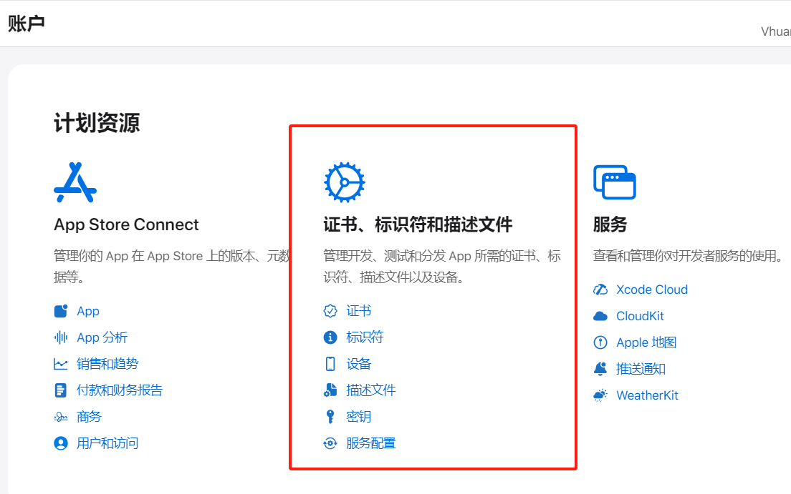
XCode - Signing & Capabilities
Create a provisioning profile
https://developer.apple.com/account
Add UDIDs
Open Apple developer portal “Certificates, Identifiers & Profiles” -> “Devices”
most 100 devices for an account
Create App ID
Open Apple developer portal “Certificates, Identifiers & Profiles” -> “Identifiers”
register a new App ID
Create a provisioning profile
Create certificate
Steps
in XCode, select project, in mid-pane, select “Signing & Capabilities”
Check “Automatically manage signing”
Click “Add Account”

Slide 7
.ipa
References
https://wiki.genexus.com/commwiki/servlet/wiki?34616,HowTo%3A+Create+an+.ipa+file+from+XCode
Build
Open xcode project
Select the deination scheme
Product -> Desitination -> Generic iOS Device
Archive the project
Product -> Archive
after finish archiving, select “Distribute”
after compilation, select “Export”
Install

Slide 8
CocoaPods
Intro
dependency manager for Swift and Objective-C Cocoa projects.
Commands
pod --version
pod repo # list repositories
~/.cocoapods/repos
change mirror
cd ~/.cocoapods/repos
git clone https://mirrors.tuna.tsinghua.edu.cn/git/CocoaPods/Specs.git master
In Podfile, change first line into “source 'https://mirrors.tuna.tsinghua.edu.cn/git/CocoaPods/Specs.git'”
pod init
create a Podfile with smart defaults
arch -x86_64 pod search Firebase
pod install --verbose --no-repo-update
...ruby classes.rb illegal instruction...
sudo arch -x86_64 gem install ffi
arch -x86_64 pod install
github access issue
Modify “Podfile”, change “source 'https://github.com/artsy/Specs.git'” into “source 'https://cdn.cocoapods.org/'”
Podfile
defines the pods to be used

Slide 9
Debug

Slide 10
Submit

Slide 11
Airprint
Remove header and footer
@media print {
header,footer {
display: none;
}
}

Slide 12
iOS Web Page Full Screen
Safari
In web page, add
<meta name="apple-mobile-web-app-capable" content="yes">
In Safari, add this page to home screen
Start this page from home screen

Slide 13
Interact with Python
References
https://juejin.cn/post/7229310327268032569
https://github.com/beeware/briefcase
https://github.com/pvieito/PythonKit

Slide 14
Install from non-AppStore
References
https://zhuanlan.zhihu.com/p/136358328
Methods
企业签名
超级签名
TestFlight签名

Slide 15
FAQ
Legacy build system error using Unity project
File -> Project Setting
Change “Build System” from “Legacy Build System (Deprecated)” to “New Build System (Default)”
mapfileparser.sh permission denied
Open terminal
chmod +x {}/MapFileParser.sh
UnityFramework.framework: errSecInternalComponent
When input password for login keychain, select “Always allow”

Slide 16
Mac Usage

Slide 17
Homebrew
Intro
package manager on Mac
Install
/usr/bin/ruby -e "$(curl -fsSL https://cdn.jsdelivr.net/gh/ineo6/homebrew-install/install)"
Usage
brew help
brew info {package-name}
brew install {package-name}
brew reinstall {package-name}

Slide 18
Ruby Gems
Change Mirror Sites
sudo gem update --system
gem sources --remove https://rubygems.org/
gem sources --add https://gems.ruby-china.com/
gem sources -l
sudo gem install -n /usr/local/bin cocoapods
sudo xcode-select -switch /Aplications/Xcode.app/Contents/Developer
Bundler
Ruby包管理工具
bundle install
read Gemfile, install listed gems

Slide 19
Access Github
Steps
http://ping.chinaz.com/ query github.com, to get fast-response ip
modify /etc/hosts, add ip/url pair

Slide 20
iOS Internal

Slide 21
Architecture
Cocoa Touch
UIKit
GameKit
MapKit
PushKit
iAd
Address Book UI
Twitter
EventKit UI
Message UI
Notification Center
Media
CoreAudioKit
AVKit
GLKit
SceneKit
Image I/O
SpriteKit
Quartz Core
OpenAL
GameController
Metal
Photos
Photos UI
Assets Library
Media Player
Core Audio
AV Foundation
OpenGL ES
Core Graphics
Core Image
Core Text
Core Video
Core Services
EventKit
Foundation
HealthKit
HomeKit
CloudKit
NewsstandKit
PassKit
StoreKit
Multi-peer Connectivity
Quick Look
Safari Services
Social
System Configuration
Account
Address Book
Ad Support
CFNetwork
JS Core
WebKit
Mobile Core
Core Data
Core Foundation
Core Location
Core Media
Core Motion
Core Telephony
Core OS
Generic Security Services
Local Authentication
Security
64bit Support
Accelerate
Core Bluetooth
External Accessory
Network Extension
System

Slide 22
Core Services Layer
High-Level Features
P2P
iCloud Storage
Block Objects
Data Protection
File-Sharing Support
Grand Central Dispatch
In-App Purchase
SQLite
XML Support

Slide 23
Media Layer
Graphics Technologies
UIKit Graphics
Photos Library
Image I/O
GLKit
Metal
TextKit
Core Graphics
Core Animation
Core Image
OpenGL ES
Core Text
Audio Technologies
AV Foundation
Media Player
Core Audio
OpenAL
Video Technologies
AV Foundation
AVKit
Core Media
UIImagePickerController

Slide 24
Cocoa Touch Layer
High-Level Features
App Extensions
Handoff
Document Picker
AirDrop
TextKit
UIKit Dynamics
Multitasking
Auto Layout
Storyboards
UI State Preservation
Push Notification
Local Notifications
Gesture Recognizers
Standard System View Controllers

