Slide 1
Flask Notes
Sparks Lu
Last updated: 2/12/2020

Slide 2
Intro
References
https://flask.palletsprojects.com/en/1.1.x/quickstart/
http://www.patricksoftwareblog.com/all-posts/
https://www.digitalocean.com/community/tutorials/how-to-structure-large-flask-applications
Micro-framework for developing web applications
written in python
based on the Werkzeug and Jinja2 template engine

Slide 3
Basic
pip install flask flask-cors python-dotenv
Run
export FLASK_APP=hello.py
After install python-dotenv, this can be written in .flaskenv of project top folder
flask run
flask run --host=0.0.0.0 // Visible by all IP, serve only one request at a time
URL
redirect(url_for('login'))
abort(401)
@app.route('/')
@app.route('/user/{user_id}')
@app.errorhandler(404)
app.url_map // List all routes
from flask import Flask
app = Flask(__name__)
@app.route('/')
def hello_world():
return 'Hello, World!'
Python Scripts
Templates

Slide 4
App Configuration
 | candidate values | default value | Note
ENV | 'production', 'development' | 'production'
DEBUG | True, False | False when ENV=='production' True when ENV=='development'
SECRET_KEY | Used for signing the session cookie | None
PERMANENT_SESSION_LIFETIME | datetime.timedelta or int | 31 days | Take effect if session.permanant is True （default false)

Slide 5
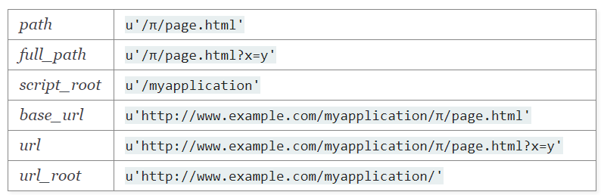
Request
Request
from flask import request
request.method
request.path
request.headers
request.headers.get('User-Agent')
GET: request.args.get('username')
POST:
request.form.get('username'), // multipart/form-data
request.files
jobj = request.get_json() // applicaiton/json
Upload
f = request.files['the_file']
f.save('/tmp' + f.filename)
Cookie
request.cookies.get('username')
resp = make_response(render_template(...))
resp.set_cookie('username', 'un1')
from flask import Flask, request
app = Flask(__name__)
@app.route('/', methods=['GET', 'POST'])
def hello_world():
if request.method == 'GET':
func1()
elif request.method == 'POST':
func2()

Slide 6
Response
Response format
response, status, headers
resp = make_response(response, status)
resp.headers['AAA'] = 'value'
URL encoding
import urllib.parse
urllib.parse.quote('query_str')
urllib.parse.urlencode({'p1': 'v1', 'p2': 'v2'})

Slide 7
Session
Session
implemented on top of cookie, signs the cookies cryptographically
app.secret_key = 'AAA'
session['username'] = 'aaa'
session.pop('username', None)

Slide 8
Render Template
Render template
from flask import render_template
render_template('hello.html', name=name)
templates/hello.html
Grammar in template
{{ var }}
{% if var %}, {% else %}, {% endif %}
{% for var in set %}, {% endfor %}
Template inheritance
{% block bname %}{% endblock %}
{% extends 'base.html' %}

Slide 9
Misc Functions
url_for(endpoint, **values)
url_for('login', next='/')
logging
app.logger.debug()/.info()/.error()
Configure logging before creating the application object
from logging.config import dictConfig
dictConfig({
'version': 1,
'formatters': {'default': {
'format': '[%(asctime)s] %(levelname)s in %(module)s: %(message)s',
}},
'handlers': {'wsgi': {
'class': 'logging.StreamHandler',
'stream': 'ext://flask.logging.wsgi_errors_stream',
'formatter': 'default'
}},
'root': {
'level': 'INFO',
'handlers': ['wsgi']
}
})
app = Flask(__name__)

Slide 10
Web Forms
pip install flask-wtf
Usage
from flask-wtf import FlaskForm
from wtforms import StringField, PasswordField, BooleanField, SubmitField
from wtforms.validators import DataRequired

Slide 11
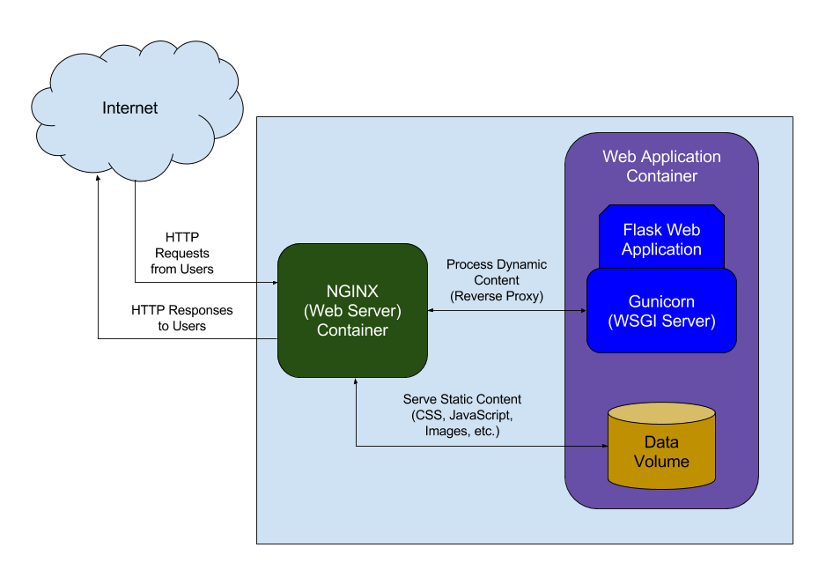
Deploy
Prepare Env
sudo apt-get update
sudo apt-get install python3-pip python3-dev nginx
sudo pip3 install virtualenv
virtualenv myprojectenv
source myprojectenv/bin/activate
pip install uwsgi flask
sudo ufw allow 5000
Gunicorn
Python WSGI HTTP server for Unix
gunicorn
-w {workers} # workers, 2*num_cores + 1
-b {server_socket} # bind
Refer
http://www.patricksoftwareblog.com/how-to-configure-nginx-for-a-flask-web-application/

Slide 12
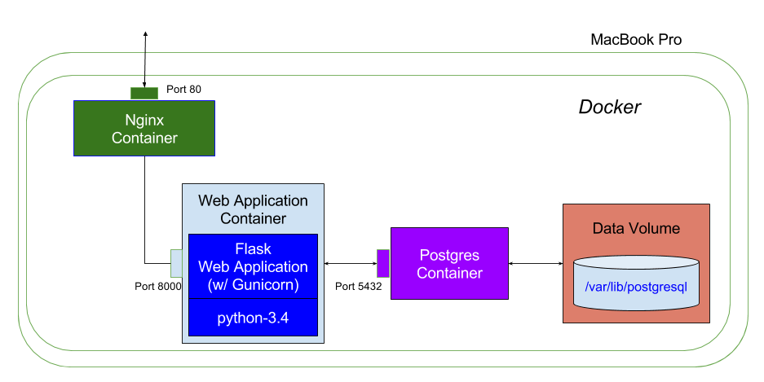
Deploy (Docker)
References
https://ianlondon.github.io/blog/deploy-flask-docker-nginx/
Dockerfile
FROM tiangolo/uwsgi-nginx-flask:python3.6
COPY ./app /app
Build and Run Docker image
go to flask project root folder
docker build -t flask_proj1 .
docker run -p 80:80 -t flask_proj1

Slide 13
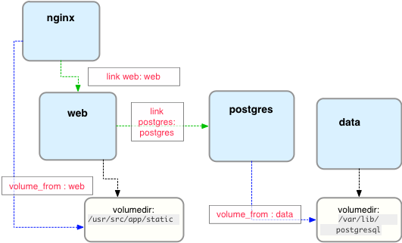
Deploy (Docker 2)
References
http://www.patricksoftwareblog.com/how-to-use-docker-and-docker-compose-to-create-a-flask-application/
Config
docker-compose.yml
Dockerfile
Build container
sudo docker-compose build
Run container
sudo docker-compose up -d

Slide 14
Static Files
Basic
Url starts with '/static/'
Files should be in 'static/' folder in Flask APP's root

Slide 15
Media
References
https://www.iandevlin.com/blog/2012/09/html5/html5-media-and-data-uri/
https://blog.miguelgrinberg.com/post/video-streaming-with-flask/page/5?source=post_page---------------------------
https://blog.miguelgrinberg.com/post/flask-video-streaming-revisited

Slide 16
Flask-SQLAlchemy - Overview
References
https://flask-sqlalchemy.palletsprojects.com/en/2.x/
Intro
DB toolkit and ORM(Object-Relational Mapper) implementation written in Python
Install
pip install flask-sqlalchemy
SQLAlchemy
SignallingSession
Model
SQLite3:
sudo apt install sqlite3
sqlite3
.help
.open {db_filename}
.tables
select * from {table_name};
.quit

Slide 17
Flask-SQLAlchemy (1)
Init
from flask_sqlalchemy import SQLAlchemy
app = Flask(__name__)
app.config['SQLALCHEMY_DATABASE_URI'] = 'sqlite:///users.sqlite3'
db = SQLAlchemy(app)
db.create_all() // create all tables
class MyModel(db.Model)
db.Column(...)
unique=True/False
default=value
nullable=True/False
primary_key=True/False
db.ForeignKey('table.field_name')
db.relationship(...)
type | explanation
Integer
String(size)
Text | Unicode text
DateTime | expressed as Python datetime object
Float
Boolean
PickleType | pickled Python object
LargeBinary | arbitrary binay data

Slide 18
Flask-SQLAlchemy (2)
Query
MyModel.query.all()
obj_list = MyModel.query.filter_by(field='value').all()
obj = MyModel.query.filter_by(filed='value').first()
obj_list = MyModel.query.filter(MyModel.field1=='value', MyModel.field2>value2, MyModel.field3.in_((value1, value2)))
obj_list = MyModel.query.filter(or_(MyMode.field1=='value', MyModel.field2>value2))
obj_list = MyModel.query.order_by(MyModel.field).all()
obj = MyModel.query.get(1) // query by primary key
Class mapping
__tablename__ = 'tn'
Add record
db.session.add(obj)
db.session.commit()
Delete record
db.session.delete(obj)
db.session.commit()
Update record
db.session.flush()
db.session.commit()

Slide 19
Redis
Intro
In-memory key-value pair DB
Commonly used for caching, transient data storage, and as holding area for data during analysis
Install
sudo apt install redis-server
nohup redis-server &
Usage
import redis
r = redis.StrictRedis(ip, port, db=1)
r.hset(name, key, value)
r.hget(name, key)
Redis-cli
redis-cli ping

Slide 20
Session
Client-side
Server-side

Slide 21
Blueprint
Aim
Support modules
How to use
Declare blueprint in module
from flask import Blueprint
module = Blueprint('module', __name__)
@module.route('...')
Register blueprint
from module import module
app.register_blueprint(module)

Slide 22
Celery
Intro
A powerful task queue
pip install celery
https://flask.palletsprojects.com/en/1.1.x/patterns/celery/
Depends a message queue broker service (redis)
A celery worker process needs to run to receive and execute the task
Usage
Celery(name, backend='url_backend' broker='url_broker')
result backend
create celery object along with app, before blueprint register
write celery.task function (must be json serializable)
Run celery
celery worker -A app.celery --loglevel=info -P threads
-P threads: allow to spawn child processes
celery status
Celery Worker Server
Broker Service
Celery Client

Slide 23
Login
Aliyun-SMS
Access-key

Slide 24
Wechat Pay
pip install Flask-WXPay

Slide 25
Upload Files
Upload multiple files
files = request.files.getlist("images")
<form method="POST" enctype="multipart/form-data" action="/upload">
<input type="file" name="file[]" multiple="">
<input type="submit" value="add">
</form>

Slide 26
Others
Access objects
from flask import current_app as app
with app.app_context():
// codes using app

