Slide 1
WSL Notes
Sparks Lu
Last updated: 1/27/2021

Slide 2
References
https://learn.microsoft.com/en-us/windows/wsl/
https://github.com/QMonkey/wsl-tutorial
https://medium.com/@japheth.yates/the-complete-wsl2-gui-setup-2582828f4577
https://github.com/lackovic/notes/tree/master/Windows/Windows%20Subsystem%20for%20Linux#use-chromedriver-in-wsl
https://research.wmz.ninja/articles/2017/11/setting-up-wsl-with-graphics-and-audio.html
https://learn.microsoft.com/en-us/windows/wsl/basic-commands

Slide 3
Install
Enable WSL in Windows
Settings -> Update and Security -> For developers, select “Developer” mode
Open PowerShell
Run Enable-WindowsOptionalFeature -Online -FeatureName Microsoft-Windows-Subsystem-Linux
Run “wsl -l -v” to determine version 1/2
Install Ubuntu 16.04
Install XServer on Windows
VcXsrv
In .bashrc
export DISPLAY=:0
export LIBGL_ALWAYS_INDIRECT=1
Upgrade to WSL2
https://aka.ms/wsl2-install
https://aka.ms/wsl2kernel
https://docs.microsoft.com/en-gb/windows/wsl/wsl2-kernel
wsl --set-version {Ubuntu-16.04} 2
wsl --set-default-version 2

Slide 4
Commands
Command | Meaning | Note
wsl --list --all | List all installed distributions
wsl --distribution {distributionName} --user {userName} | Start a distribution with specified user
wsl --unregister {distributionName}
wsl –mount \\.\PHYSICALDRIVE0 –partition1. |  | Windows command: wmic diskdrive list brief // list drives
wsl --system -d Ubuntu-20.04 df -h /mnt/wslg/distro | Disk usage for a distribution

Slide 5
Config
${user_home}/.wslconfig
global for all distributions
/etc/wsl.config
for each distribution
使用 systemd 作为初始化系统（init system），而不是传统的 SysV init
[boot]
systemd=true
# 可以使用 systemctl enable/start/stop/status 来控制服务
# 服务会在 WSL 启动时自动启动（如果已 enable)

Slide 6
Storage
C:\Users\{username}\AppData\Local\Packages
CanonicalGroupLimited.Ubuntu18.04onWindows_79rhkp1fndgsc
Disk in Linux
C:\Windows\WinSxS\amd64_microsoft-windows-lxss-vm-mode_31bf3856ad364e35_10.0.18362.1049_none_dc51d333d925c283\ext4.vhdx.gz
Shrink disk size in Linux
References: https://stephenreescarter.net/how-to-shrink-a-wsl2-virtual-disk/
wsl -l -v
wsl --terminate {Ubuntu-18.04}, wsl --shutdown
diskpart
select vdisk file="<PATH-TO-VHDX>"
attach vdisk readonly
compact vdisk
waiting...
detach vdisk

Slide 7
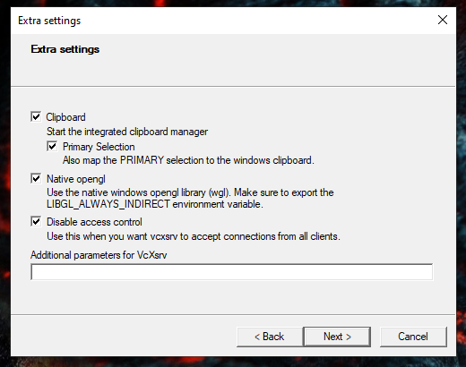
Run GUI Apps
Steps
Windows
Install VcXsrv
Change property of vcxsrv.exe
Compatibility -> Change high DPI settings, check “Override high DPI scaling behavior”, select App
Control Panel\System and Security\Windows Defender Firewall\Allowed apps
Select VcXsrv windows xserver, Check both Private and Public checkboxes
Launch VcXsrv with “disable access control”
Download config.xlaunch
from https://github.com/lackovic/notes/blob/master/Windows/Windows%20Subsystem%20for%20Linux/config.xlaunch to your file system (save it in %AppData%\Microsoft\Windows\Start Menu\Programs\Startup if you want to make XLaunch automatically run at startup) and double click on it to run XLaunch
WSL
Add to ~/.profile
export DISPLAY=${DISPLAY:-$(grep -Po '(?<=nameserver ).*' /etc/resolv.conf):0}
export LIBGL_ALWAYS_INDIRECT=1

Slide 8
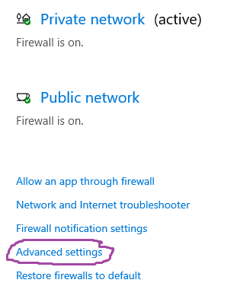
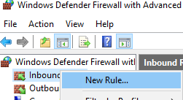
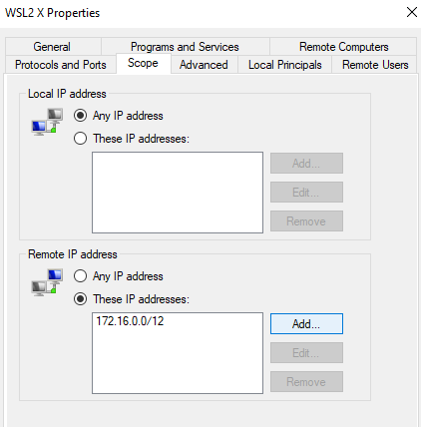
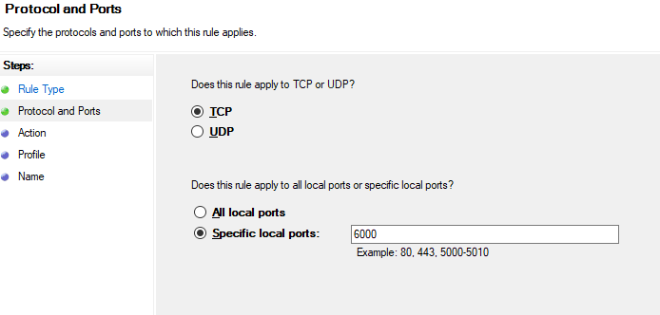
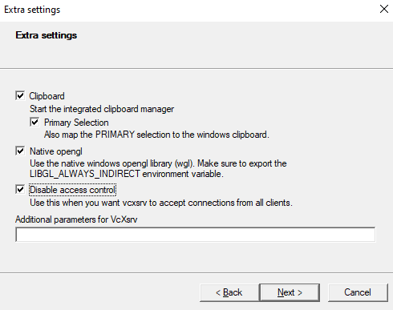
Run GUI Apps in WSL2
References
https://skeptric.com/wsl2-xserver/
Steps
Allow WSL access via Windows Firefall
Enable public access from an X11 server when starting VcXsrv
Configure .bashrc
export DISPLAY=$(awk '/nameserver / {print $2; exit}' /etc/resolv.conf 2>/dev/null):0
export LIBGL_ALWAYS_INDIRECT=1

Slide 9
Access WSL files in Windows
In Explorer, input “\\wsl$”
In WSL, input “explorer.exe .”

Slide 10
Network
Access Windows local host
cat /etc/resolve.conf
Make port in WLS2 accessable by LAN
get ip address in WSL2
hostname -I # e.g. 172.31.11.138
Forward Port from Windows to WSL2
run command in powershell (Administrator)
# Replace: - 8080 with your port - 172.31.11.138 with your WSL2 IP
netsh interface portproxy add v4tov4 listenport=8443 listenaddress=0.0.0.0 connectport=8443 connectaddress=172.31.11.138
allow port in Windows firewall
New-NetFirewallRule -DisplayName "WSL2 Docker Port 8443" -Direction Inbound -Action Allow -Protocol TCP -LocalPort 8443

Slide 11
GPU
sudo apt install nvidia-384
glxinfo | grep “OpenGL”
sudo apt install mesa-utils
glxgears -info

Slide 12
Audio

Slide 13
Change Swap Size
wsl --shutdown
Copy .wslconfig to Windows $HOME
C:/Users/{username}/
# Settings apply across all Linux distros running on WSL 2
# Can see memory in wsl2 with "free -m"
# Goes in windows home directory as .wslconfig
[wsl2]
# Limits VM memory to use no more than 48 GB, defaults to 50% of ram
memory=48GB
# Sets the VM to use 8 virtual processors
processors=8
# Sets the amount of swap storage space to 8GB, default is 25% of available RAM
swap=16GB

Slide 14
USB
Steps
wsl --shutdown
插入U盘
wsl --distribution {Ubuntu20}
Protocols
MTP (Media Transfer Protocol)
based on PTP
add more extensions
PTP (Picture Transfer Protocl)
挂载为数码相机

Slide 15
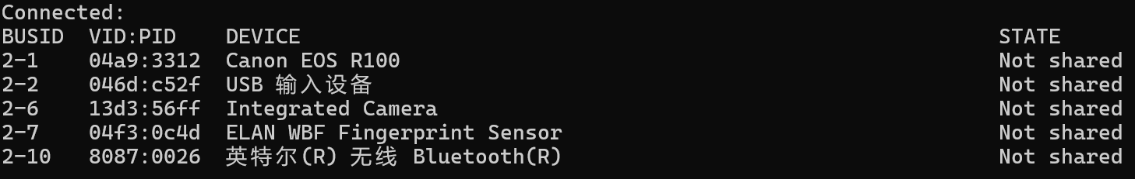
Support USB Devices
References
https://docs.microsoft.com/en-us/windows/wsl/connect-usb
https://github.com/dorssel/usbipd-win
https://zhuanlan.zhihu.com/p/529559033
Steps
Windows
winget install --interactive --exact dorssel.usbipd-win
re-launch Windows PowerShell
usbipd list
usbipd bind --busid=<BUSID>
usbipd attach --wsl --busid <busid>
usbipd detach --busid <busid>
WSL2
lsusb

Slide 16
Back and Move
Export
wsl --list --verbose // get linux distribution name
wsl --shutdown
mkdir D:\backup
wsl --export {Ubuntu-18.04} D:\backup\ubuntu-18.04.tar
wsl --unregister {Ubuntu-18.04}
Import
mkdir D:\WSL\
wsl --import {Ubuntu-18.04} D:\WSL\ D:\backup\ubuntu-18.04.tar
cd $env:USERPROFILE\AppData\Local\Microsoft\WindowsApps
.\ubuntu1804.exe config --default-user lgm
wsl --distribution {Ubuntu-18.04}
Change .vhdx position
wsl --export Ubuntu-20.04 D:\wsl-backup\ubuntu2004.tar
wsl --unregister Ubuntu-20.04
wsl --import Ubuntu-20.04 D:\wsl-distros\Ubuntu2004 D:\wsl-backup\ubuntu2004.tar --version 2
after import, default user is root, need to add user
export USER=yourusername
echo "[user]" > /etc/wsl.conf
echo "default=$USER" >> /etc/wsl.conf
restart wsl distribution
Launch .vhdx
wsl --import --vhd MyUbuntu C:\WSL\MyUbuntu\ C:\WSL\MyUbuntu\ext4.vhdx --version 2

Slide 17
Decrease WSL2 Disk Size
Disk file
C:\Users\{username}\AppData\Local\Packages\CanonicalGroupLimited.Ubuntu20.04LTS_79rhkp1fndgsc\LocalState
Decrease size
wsl --shutdown
diskpart
select vdisk file=”C:\Users\{username}\AppData\Local\Packages\CanonicalGroupLimited.Ubuntu20.04LTS_79rhkp1fndgsc\LocalState”
attach vdisk readonly
compack vdisk
detach vdisk
exit
result
153GB->144GB

Slide 18
FAQ
System has not been booted with systemd as init system (PID 1). Can't operate.
Use “sudo service redis-server start” instead
datetime is incorrect
sudo hwclock -s
sudo crontab -e
10 * * * * ntpdate time.windows.com

