Slide 1
File Format Notes
Sparks Lu
Last Updated: 10/8/2018

Slide 2
JSON

Slide 3
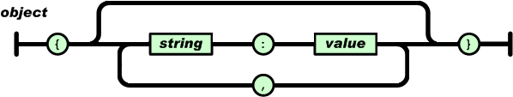
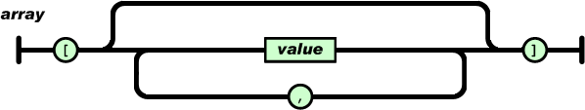
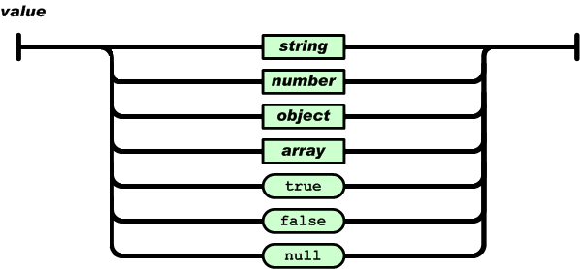
Concept
{
"pi": 3.141,
"happy": true,
"name": "Niels",
"nothing": null,
"answer": {
"everything": 42
},
"list": [1, 0, 2],
"object": {
"currency": "USD",
"value": 42.99
}
}

Slide 4
C++ Library
Ref
https://github.com/nlohmann/json
JSON for Modern C++
#include <nlohmann/json.hpp>
// for convenience
using json = nlohmann::json;
json j;
j["pi"] = 3.141;
j.push_back("foo");
auto j3 = json::parse("{ \"happy\": true, \"pi\": 3.141 }");
std::string s = j.dump();

Slide 5
YAML

Slide 6
Concept
References
https://www.freecodecamp.org/news/what-is-yaml-the-yml-file-format/
https://docs.fileformat.com/programming/yaml/
https://docs.ansible.com/ansible/latest/reference_appendices/YAMLSyntax.html
Employees:
- name: John Doe
department: Engineering
country: USA
- name: Kate Kateson
department: IT support
country: United Kingdom

Slide 7
MarkDown

Slide 8
Intro
Formatting
**Bold**
*Italic*
***Bold & Italic***
`inline code`
Headers
# H1
## H2
### H3
Unordered list
- Item
Ordered list
1. First
Task list
- [ ] Unchecked
- [x] Checked
Links
[Link text] (https://example.com)
Code Blocks
inline
`a line of code`
Fenced block
```python
```
Tables
|Column1|Column2|
|Cell |Cell |
Horizontal rules
---
***
___
Escape
\
Emoji
:smile :rocket :warning

Slide 9
Mermaid

Slide 10
Intro
References
https://github.com/mermaid-js/mermaid
https://zhuanlan.zhihu.com/p/627356428
Intro
开源的文本驱动图表生成工具
语言风格类似于 Markdown
优点：简单性和可移植性
支持图表类型
流程图（Flowchart）：展示过程、决策和操作流程。
序列图（Sequence Diagram）：展示对象之间的交互顺序。
甘特图（Gantt Chart）：展示项目计划和进度。
词云图（Class Diagram）：展示类的结构和关系。
饼图（Pie Chart）：展示数据占比。
捷径图（Shortcut）：简单展示快捷方式。
状态图（State Diagram）：展示对象状态的转换。
用户旅程图（Journey）：展示用户如何与应用程序交互。
Usage
Keyword: graph, subgraph, pie, -->, -|>, ---, --, =>, ==>, class, interface, participant, note, title, style, click, loop, alt, activate, deactivate, subroutine
# flowchart
graph LR
A-->B;
B-->C;
C-->D;
sequenceDiagram
A->>B: Message 1
B-->>A: Message 2
gantt
title Example Gantt Chart
dateFormat YYYY-MM-DD
section Section
task 1: 2019-01-01, 30d
task 2: 2019-02-01, 14d
task 3: 2019-03-01, 7d
pie
title Example Pie Chart
"First slice": 30
"Second slice": 20
"Third slice": 50

Slide 11
Tools
https://github.com/mermaid-js/mermaid-cli
npm install -g @mermaid-js/mermaid-cli
mmdc -i input.mmd -o output.svg

Slide 12
THANKS
谢谢聆听

