Slide 1
Resources Notes
Sparks-Lu
Last updated: 9/28/2023

Slide 2
Change History
11/10/2021
Added audio codec conversion

Slide 3
镜像站
https://mirrors.huaweicloud.com/home

Slide 4
Mix
https://mixkit.co/
Video templates
Premier Pro, After Effects, Final Cut Pro, DaVinci Resolve
Video
4K, nature, lifestyle, business, animals, zoom background, vertical, backgrounds
Music
ambient, cinematic, corporate, drum & base, experimental, funk, hip-hop, jazz
Audio effects
animals, game, human, instrument, lifestyle, nature, tech, transition, warfare
Icon
https://pixabay.com/zh/
photos
illustrations
vectors
videos
music
audio effects
gifs

Slide 5
Images
General Images
pexels.com
unsplash.com
API
pixabay.com
https://stocksnap.io/
https://www.si.edu/openaccess
can download, share, and reuse millions of the Smithsonian’s images—right now, without asking
5.1 million 2D and 3D digital items from across the Smithsonian’s 21 museums, nine research centers, libraries, archives, and the National Zoo.
Panorama
https://polyhaven.com/zh/hdris
https://www.vecteezy.com
attribution: <a href="https://www.vecteezy.com/free-photos/360">360 Stock photos by Vecteezy</a>
SVG
https://www.svgrepo.com

Slide 6
Icons
https://fonts.google.com/icons
license: apache
https://github.com/google/material-design-icons.git
https://www.iconfinder.com/
fast access
free, commercial use
https://www.flaticon.com/
slow access

Slide 7
Music
https://musopen.org/
all royalty free
search by composer, instrument, period
https://freesfx.co.uk/
Slow to download
sound effects, music

Slide 8









Fonts
References
https://zhuanlan.zhihu.com/p/126721357
https://www.fonts.net.cn/
http://wenq.org/wqy2/index.cgi?FontGuide
免费可商用
思源黑体
https://github.com/adobe-fonts/source-han-sans/tree/release/
思源宋体
https://github.com/adobe-fonts/source-han-serif/tree/release/
手书体
https://www.zcool.com.cn/work/ZMjI2MDk1MDg=.html
站酷系列字体
https://www.zcool.com.cn/special/zcoolfonts/
华为鸿蒙HarmonyOS Sans字体
斗鱼追光体
https://github.com/refinec/PingFangSC
苹方字体
MIT

Slide 9
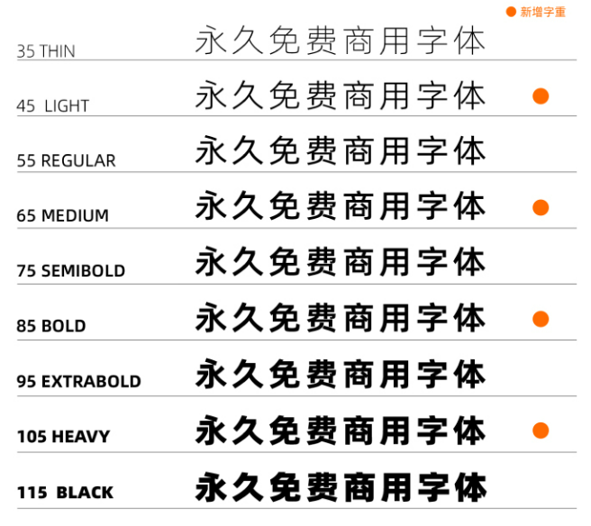
Fonts - 2
免费可商用
阿里巴巴普惠体2.0
https://www.alibabafonts.com/#/home
GB18030-2022
9个fontweight
阿里巴巴普惠体3.0
方正字库
https://www.foundertype.com/index.php/About/powerbus.html
免费字体：包括五种字体：方正黑体、方正书宋、方正仿宋、方正楷体、 方正甲骨文。针对“商业发布”这种使用方式免费。

Slide 10
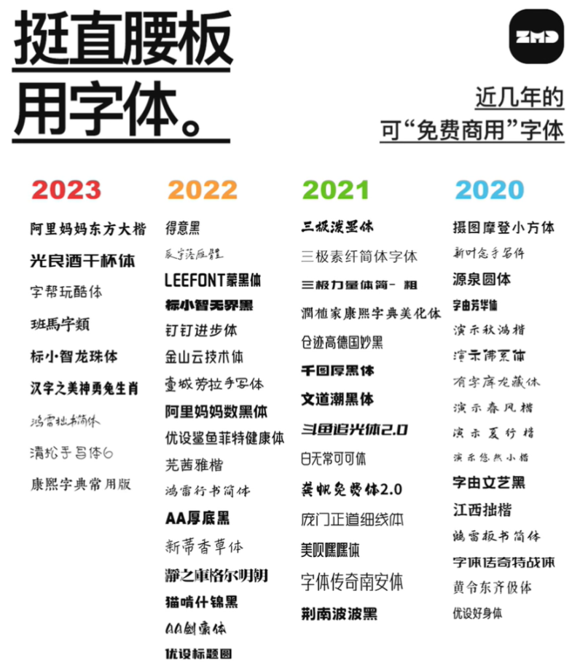
Fonts - 3
钉钉进步体
https://page.dingtalk.com/wow/dingtalk/default/dingtalk/y-W5aF3_ZJwzulU0nceIl
得意黑
https://github.com/atelier-anchor/smiley-sans
OFL-1.1
GPL
文泉驿
王汉宗自由字型

Slide 11
3D Models
Models
https://polyhaven.com/zh/models
total: 286
https://www.turbosquid.com/
https://www.si.edu/openaccess
can download, share, and reuse millions of the Smithsonian’s images—right now, without asking
including 3d models from museums
Models, materials
https://ambientcg.com/
CC0 license
Blender Resources
City Scapes
https://www.blenderx.cn/1445.html
Plant Library
https://www.blenderx.cn/4365.html
Interior
https://www.blenderx.cn/4243.html
Textures
https://polyhaven.com/zh/textures
total: 432
https://cc0-textures.com/
total: 3314
https://freepbr.com/

