Slide 1
Windows Notes
Last updated：3/16/2022
Sparks Lu
汇报人：WPS

Slide 2
Commands
xcopy some_source_dir new_destination_dir\ /E/H
Check .net version
dotnet --list-sdks
dotnet --list-runtimes
dotnet executable
wmic diskdrive list brief
list mounted disks

Slide 3
环境变量
TEMP
default: %SystemRoot%\TEMP
GRADLE_USER_HOME
default %HOME%\.gradle
store several GB data

Slide 4
性能优化
References
https://zhuanlan.zhihu.com/p/637086990
Steps
Win+i 打开系统设置，辅助功能-》视觉效果，关闭“透明效果”和“动画效果”
系统设置中，“系统”-》高级系统设置-》视觉效果tab页，选择”调整为最佳性能“
系统设置中，”应用”-》“启动”，禁用不必要的启动程序
系统设置中，“系统”-》“存储”-》“临时文件”，全部删除
系统设置中，“系统”-》“通知”，关闭通知

Slide 5
WinGet
Command | Explanation | Note
winget list | List installed windows programs
winget export {output_file} | Export list of install programs
winget search {program} | Search for a program
winget show {program} | Show info of installed program
winget install {package-name} | Install a program

Slide 6
Create Windows Installer
Inno Setup
www.innosetup.com
App.iss
setup compiler
Chinese install language support
references
https://blog.csdn.net/Pailugou/article/details/115174416
https://github.com/jrsoftware/issrc/blob/main/Files/Languages/Unofficial/ChineseSimplified.isl
steps
[Setup]
ShowLanguageDialog = yes
create ChineseSimplified.isl
UTF-8 with BOM
copy ChineseSimplified.isl to “Languages” subfolder in Inno Setup install folder
[Languages]
Name: "en"; MessagesFile: "compiler:Default.isl"; LicenseFile:英文协议文件路径; InfoBeforeFile:英文文件路径
Name: "cn"; MessagesFile: "compiler:Languages\ChineseSimplified.isl";LicenseFile:中文协议路径(UTF-8 BOM); InfoBeforeFile:中文文件路径

Slide 7
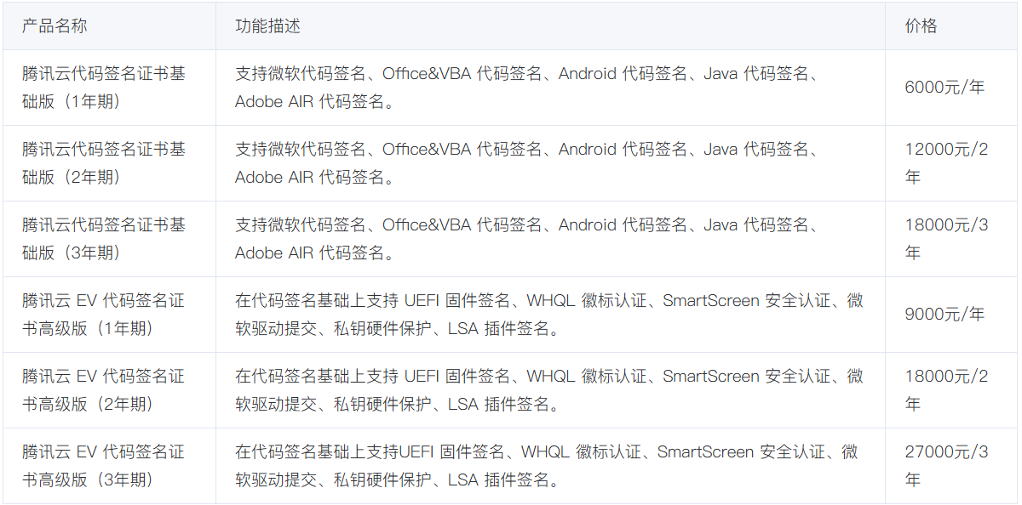
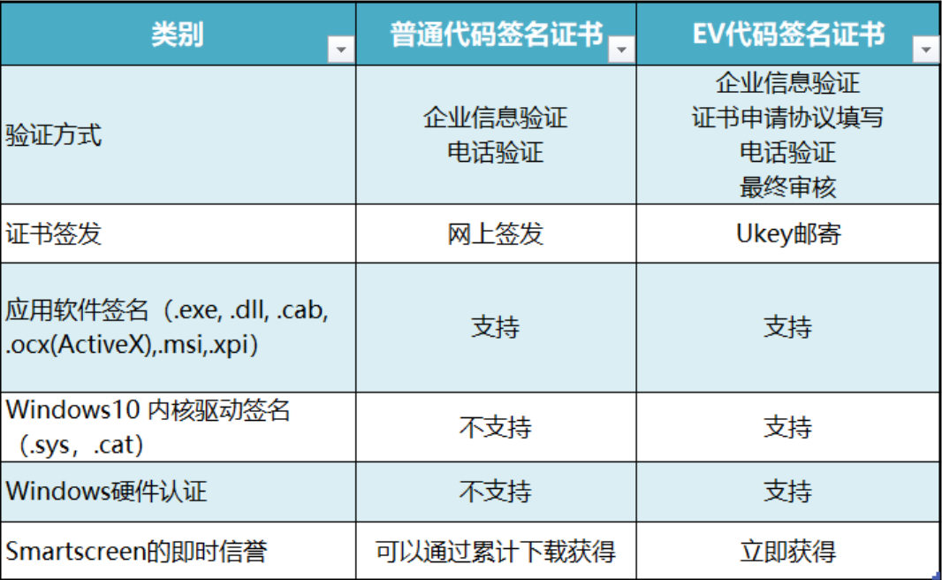
Sign Windows Installer
Steps
Download Windows SDK installer from https://developer.microsoft.com/en-us/windows/downloads/windows-sdk/
Install Windows SDK by checking “Windows SDK Signing Tools for Desktop Apps”
Locate signtool.exe
default location: C:\Program Files (x86)\Windows Kits\10\bin\10.0.26100.0\x64
add the path to system PATH
sign executable
signtool sign /a /t http://timestamp.digicert.com /fd SHA256 "YourFile.exe"
SignTool sign /f MyCert.pfx /p MyPassword /t http://timestamp.digicert.com MyControl.exe
OV/EV code signing certificate
verify sign
signtool verify /pa "YourInstaller.exe"
References
腾讯云代码签名证书
https://cloud.tencent.com/product/csc
https://learn.microsoft.com/en-us/windows/win32/seccrypto/using-signtool-to-sign-a-file
https://www.wosign.com/Products/WoSign_CodeSigning_Organizations.htm
一年2888元
https://marketplace.huaweicloud.com/contents/f82ca92a-e193-4dec-92f0-655434118fad#productid=OFFI1043352066753900544
最低990元一年
https://www.ihuandu.com/codesigning.html
普通最低880一年，EV最低2500一年

Slide 8
Command Alias
References
https://blog.csdn.net/yiranzhiliposui/article/details/83116819

Slide 9
Network
hosts
C:\Windows\System32\drivers\etc\hosts
After modify hosts
net stop dnscache
net start dnscache
ipconfig /flushdns
Firewall
netsh advfirewall set allprofiles state off # 关闭防火墙
netsh advfirewall set allprofiles state on # 打开防火墙

