Slide 1
Web Geneal Notes
Sparks Lu
Last updated: 10/16/2019

Slide 2
General

Slide 3
HTTP Status Code
1×× Informational
100 Continue
101 Switching Protocols
102 Processing
2×× Success
200 OK
201 Created
202 Accepted
203 Non-authoritative Information
204 No Content
205 Reset Content
206 Partial Content
207 Multi-Status
208 Already Reported
226 IM Used
3×× Redirection
300 Multiple Choices
301 Moved Permanently
302 Found
303 See Other
304 Not Modified
305 Use Proxy
307 Temporary Redirect
308 Permanent Redirect
4×× Client Error
400 Bad Request
401 Unauthorized
402 Payment Required
403 Forbidden
404 Not Found
405 Method Not Allowed
406 Not Acceptable
407 Proxy Authentication Required
408 Request Timeout
409 Conflict
410 Gone
411 Length Required
412 Precondition Failed
413 Payload Too Large
414 Request-URI Too Long
415 Unsupported Media Type
416 Requested Range Not Satisfiable
417 Expectation Failed
418 I'm a teapot
421 Misdirected Request
422 Unprocessable Entity
423 Locked
424 Failed Dependency
426 Upgrade Required
428 Precondition Required
429 Too Many Requests
431 Request Header Fields Too Large
444 Connection Closed Without Response
451 Unavailable For Legal Reasons
499 Client Closed Request
5×× Server Error
500 Internal Server Error
501 Not Implemented
502 Bad Gateway
503 Service Unavailable
504 Gateway Timeout
505 HTTP Version Not Supported
506 Variant Also Negotiates
507 Insufficient Storage
508 Loop Detected
510 Not Extended
511 Network Authentication Required
599 Network Connect Timeout Error

Slide 4
Common Errors
net::ERR_CONNECTION_RESET
Maybe setting of max upload file size
e.g. nginx/sites-enabled/flask-project

Slide 5
Website Check List
Ref
https://www.namecheap.com/resource-center/getting-started/website-check-up/
Check list
Response and load time
large image files, unclean codes, poor hosting
https://www.17ce.com/
Mobile friendly
mobiletest.me
Brand
Icongraphy, Colors, Logos, Font
Above the fold, below the fold
Compelling, readable content
Clear navigation
Search function
Analytics
Broken links
www.deadlinkchecker.com
Security
siteguarding
Acunetix
Contact info

Slide 6
Backend API Testing Using Curl
Option | Meaning | Notes
-v | verbose output
-i | Output response headers
-I | Fetch the HTTP header only
-H '...' | GET with provided header | -H “Content-Type: application/json”
-X POST | POST
-d '{'a': 'val', ...} | POST additional data
-F name=content | Post form data content: @filename to post file content
-r (--range) {start}-{end} | Download byte range | --range 0-99

Slide 7
Web Server for Development
http-server
npm install http-server -g
http-server {path} {options}
-p: port to use
-a: address to use
-d: show directory listings
-i: display autoIndex

Slide 8
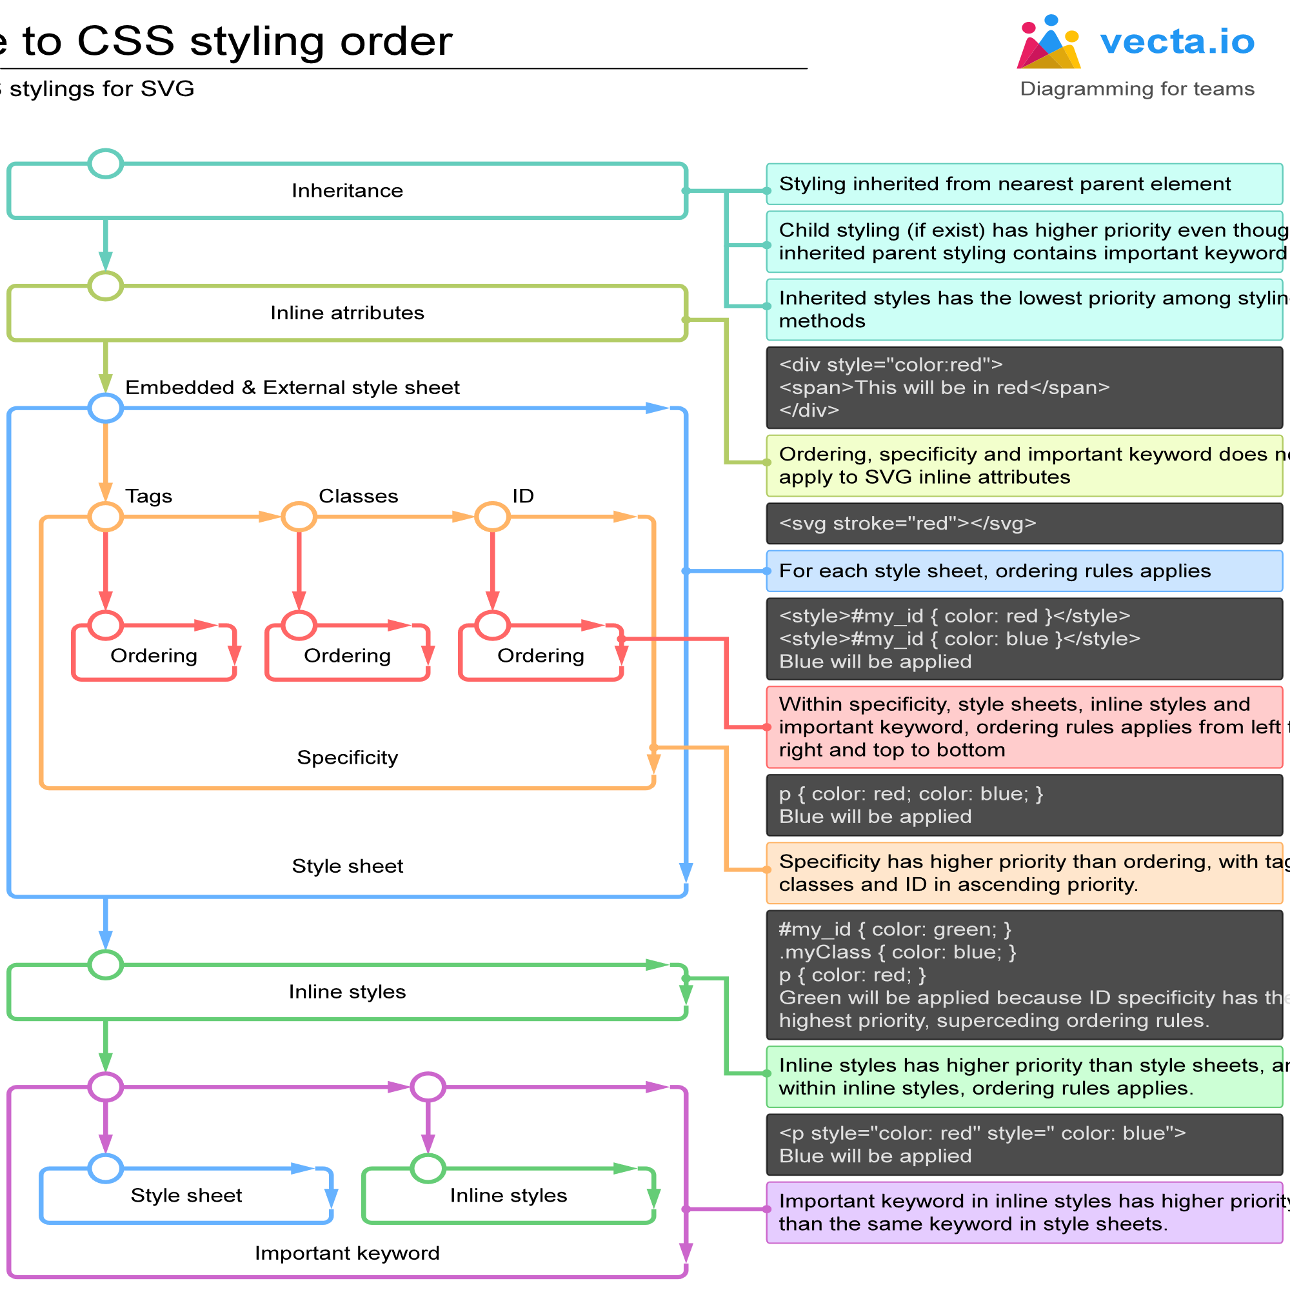
CSS - 1
限制宽高且等比缩放
img {
max-width:64px;
max-height:64px;
width:auto;
height:auto;
}

Slide 9
CSS - 2
Units
rem font size of root element (<html>)
vh 1/100 of the height of the viewport
vw 1/100 of the width of the viewport
vmin min(vh, vw)
vmax max(vh, vw)
em width of ‘M’ of the font size of current element

Slide 10
Resolution Adaptation Test
Website
http://whatismyscreenresolution.net/
http://www.responsinator.com/
http://testsize.com/
Tools

Slide 11
Browser Compatibility Test
Website
http://browsershots.org/
https://www.browserstack.com/ (paid)

Slide 12
Favicon
Generation
https://favicon.io/
How to use
Add to html
<link rel="apple-touch-icon" sizes="180x180" href="/apple-touch-icon.png">
<link rel="icon" type="image/png" sizes="32x32" href="/favicon-32x32.png">
<link rel="icon" type="image/png" sizes="16x16" href="/favicon-16x16.png">
<link rel="manifest" href="/site.webmanifest">

Slide 13
SSH
Avoid freeze
Modify /etc/ssh/ssh_config on client
Host *
ServerAliveInterval 100
Modify /etc/ssh/sshd_config on server
ClientAliveInterval 60
TCPKeepAlive yes
ClientAliveCountMax 10000
Run 'service sshd restart' on server

Slide 14
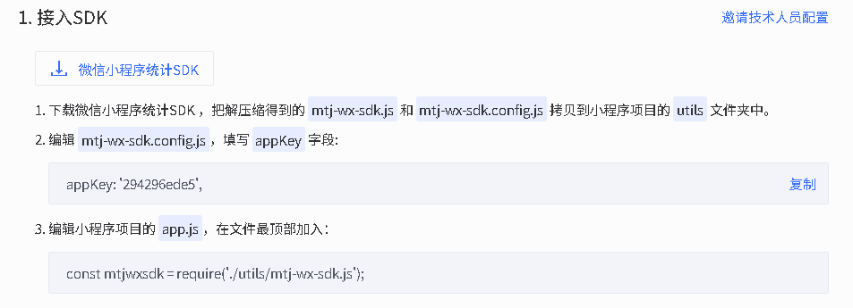
Statistics
Baidu
Mobile
https://mtj.baidu.com/web/dashboard
Web
https://tongji.baidu.com

Slide 15
SEO - General
References
https://zhuanlan.zhihu.com/p/335743455
Title
在标题增加搜索量较高的词
在标题减少搜索量较低的词
丰富页面内容
添加相关链接
Register to search engine
https://www.bing.com/webmasters

Slide 16
SEO - Sitemaps
References
https://www.sitemaps.org/index.html

Slide 17
SEO - Robots.txt
References
https://seosherpa.com/robots-txt/
User agents
Google: Googlebot
Google Images: Googlebot-Image
Google Video: Googlebot-Video
Google News: Googlebot-News
Bing: Bingbot
Bing Images & Videos: MSNBot-Media
Yahoo: Slurp
Yandex: YandexBot
Baidu: Baiduspider
DuckDuckGo: DuckDuckBot
Directives
Disallow
Allow
Sitemap
Sitemap: [URL location of sitemap]
User-agent: [bot identifier]
[directive 1]
[directive 2]
[directive ...]
User-agent: [another bot identifier]
[directive 1]
[directive 2]
[directive ...]

Slide 18
Crawl
Puppeteer
references
https://www.aymen-loukil.com/en/blog-en/google-puppeteer-tutorial-with-examples/#3Mobile_device_emulation_example
launch Chromium in headless mode
cnpm i -g puppeteer
website-screenshot
const puppeteer = require('puppeteer');
(async () => {
const browser = await puppeteer.launch();
const page = await browser.newPage();
await page.goto('https://example.com');
await page.screenshot({ path: 'example.png' });
await browser.close();
})();

Slide 19
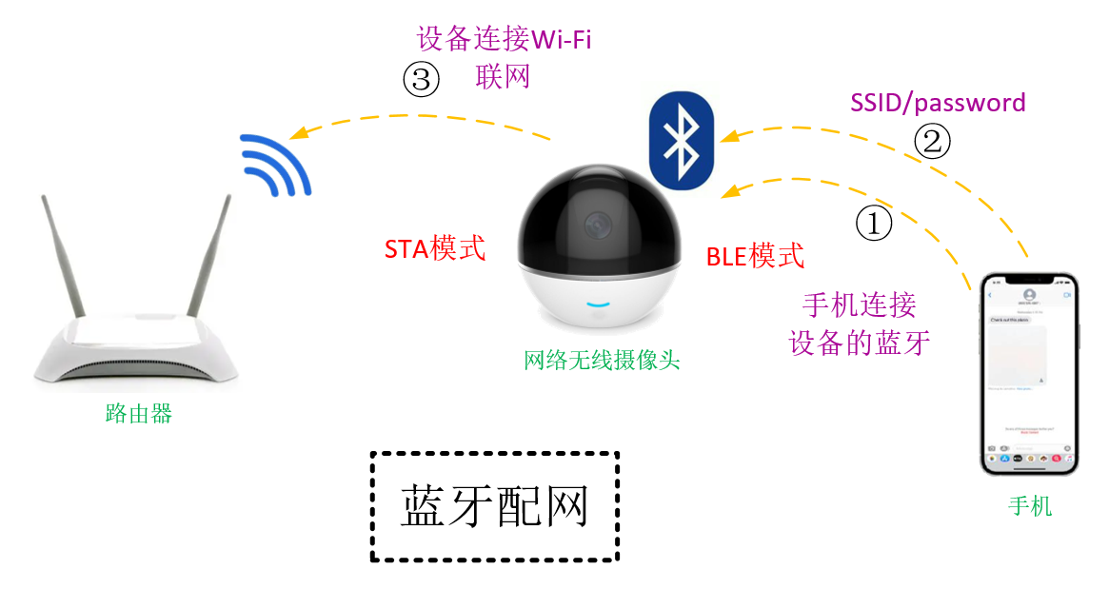
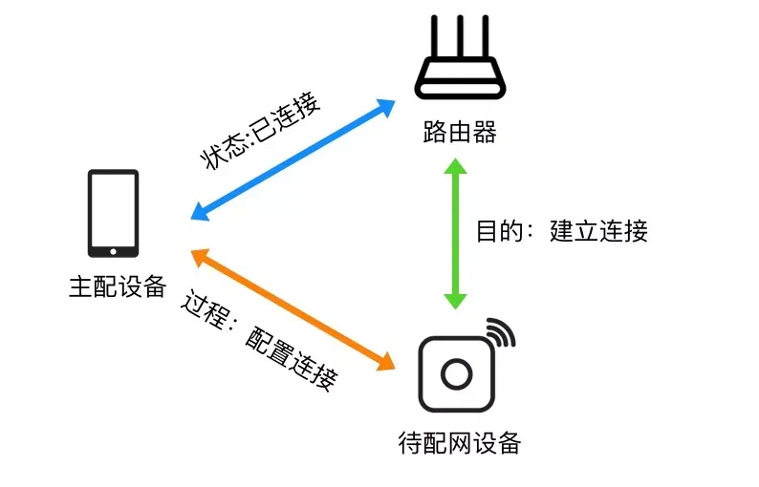
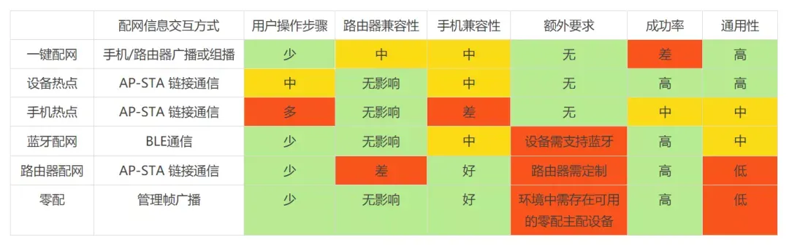
配网
References
https://zhuanlan.zhihu.com/p/222428623
https://zhuanlan.zhihu.com/p/410052540
https://blog.51cto.com/u_16213335/12126510 （Android App中蓝牙配网）
Methods
一键配网
广播包长方式、组播地址方式
整体兼容性差，配网成功率低
设备热点配网
手机热点配网
蓝牙配网
手机APP通过蓝牙连接到待配网的设备
手机通过BLE将Wi-Fi路由器的配网信息（SSID/password）发送给设备端
路由器配网
路由器在配网模式下开启一个特定的用于配网的SSID，设备发现了这个热点后连接这个热点以获取配网信息
零配
摄像头扫码配网

Slide 20
蓝牙配网
// 搜索设备
wx.startBluetoothDevicesDiscovery({
success: function (res) {
console.log('开始搜索设备', res);
}
});
// 监听搜索到的设备
wx.onBluetoothDeviceFound(function (res) {
const devices = res.devices;
if (devices.length > 0) {
const targetDevice = devices[0]; // 假设第一个设备是目标设备
wx.createBLEConnection({
deviceId: targetDevice.deviceId,
success: function (res) {
console.log('蓝牙连接成功', res);
// 发送Wi-Fi配置信息
const wifiInfo = { ssid: 'YourWiFiSSID', password: 'YourWiFiPassword' };
const buffer = new ArrayBuffer(64);
const dataView = new DataView(buffer);
// 按照设备协议封装数据
// 例如：前32字节为SSID，后32字节为密码
for (let i = 0; i < wifiInfo.ssid.length; i++) {
dataView.setUint8(i, wifiInfo.ssid.charCodeAt(i));
}
for (let i = 0; i < wifiInfo.password.length; i++) {
dataView.setUint8(32 + i, wifiInfo.password.charCodeAt(i));
}
wx.writeBLECharacteristicValue({
deviceId: targetDevice.deviceId,
serviceId: '服务UUID',
characteristicId: '特征值UUID',
value: buffer,
success: function (res) {
console.log('Wi-Fi配置信息发送成功', res);
},
fail: function (err) {
console.error('发送失败', err);
}
});
},
fail: function (err) {
console.error('蓝牙连接失败', err);
}
});
}
});
微信小程序蓝牙配网步骤
步骤1：设备进入配网模式
物联网设备需要支持蓝牙功能，并在配网模式下广播特定的蓝牙服务。
设备通常会有一个配网按钮，长按后进入配网模式。
步骤2：小程序搜索并连接设备
使用微信小程序的蓝牙API（如 wx.startBluetoothDevicesDiscovery）搜索附近的蓝牙设备。
找到目标设备后，通过 wx.createBLEConnection 建立蓝牙连接。
步骤3：发送Wi-Fi配置信息
小程序通过蓝牙API（如 wx.writeBLECharacteristicValue）将Wi-Fi的SSID和密码发送给设备。
数据通常需要按照设备厂商定义的协议进行封装。
步骤4：设备连接Wi-Fi
设备接收到Wi-Fi配置信息后，尝试连接指定的Wi-Fi网络。
设备通过蓝牙向小程序反馈连接状态（成功或失败）。
步骤5：小程序显示配网结果
小程序监听设备的反馈，并根据结果提示用户配网是否成功。
微信小程序API
wx.startBluetoothDevicesDiscovery：开始搜索附近的蓝牙设备。
wx.onBluetoothDeviceFound：监听搜索到的蓝牙设备。
wx.createBLEConnection：连接指定的蓝牙设备。
wx.writeBLECharacteristicValue：向设备写入数据（如Wi-Fi配置信息）。
wx.onBLECharacteristicValueChange：监听设备返回的数据（如连接状态）

Slide 21
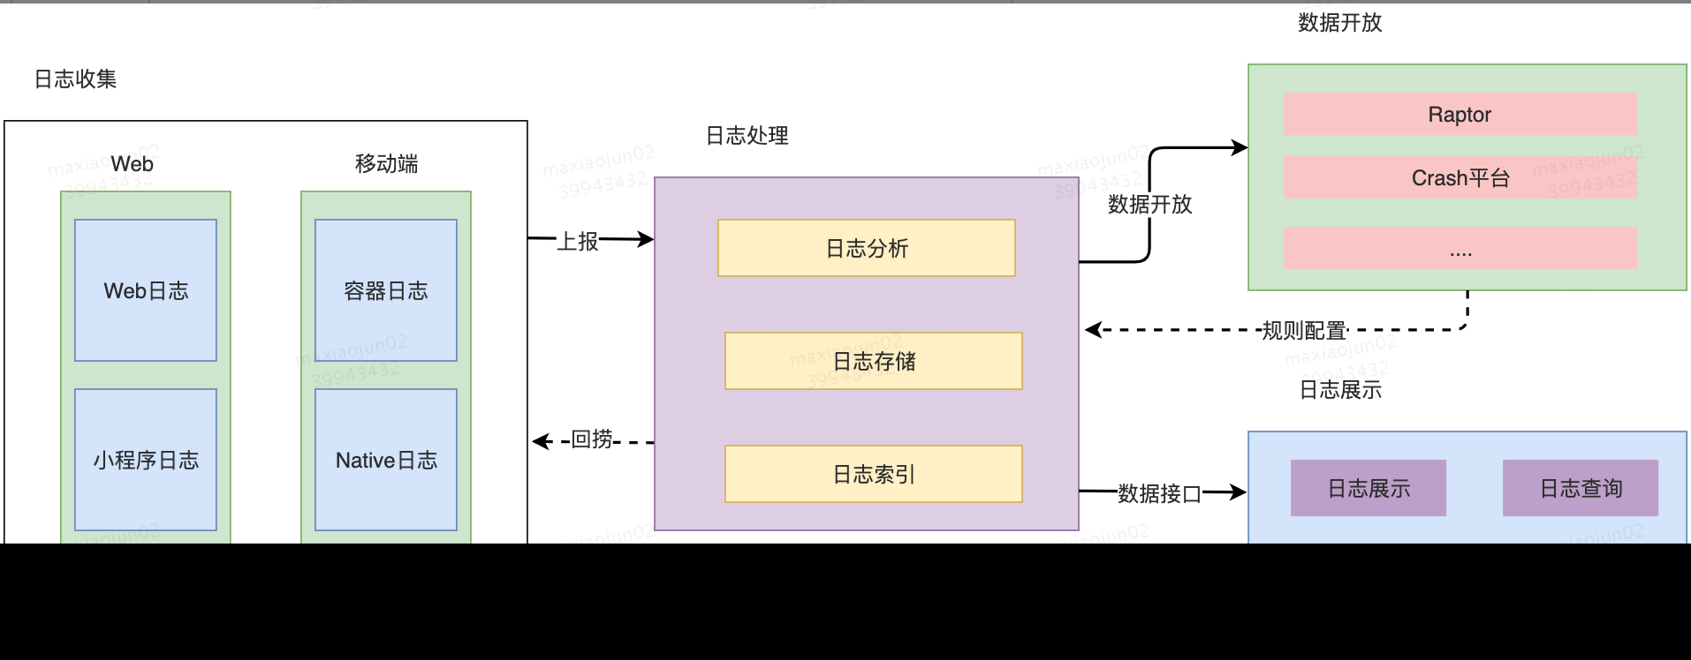
Log System
https://github.com/Meituan-Dianping/Logan
MIT license

Slide 22
Edge Browser
edge://net-internals/#dns
Check DNS lookup result
Clear host cache

Slide 23
Network Protocols

Slide 24
mDNS
References
https://blog.alexsun.top/vuepress-network-notes/application-layer-protocol/dns/mdns.html
https://baike.baidu.com/item/mdns/7544078
服务发现
设备B广播自己提供的服务（如 _http._tcp.local）。
设备A发送服务查询请求。
设备B响应，提供服务的详细信息（如IP地址、端口号等）。
嵌入式设备通常使用轻量级的 mDNS 实现库
Avahi：Linux 平台常用的 mDNS 实现。
Apple Bonjour：macOS 和 Windows 平台的支持。
ESP-IDF：ESP32 开发框架中集成了 mDNS 功能。

Slide 25
ClearPath

Slide 26
References
https://www.arubanetworks.com/assets/so/SO_ClearPass.pdf
https://www.arubanetworks.com/products/security/network-access-control/secure-access/

Slide 27
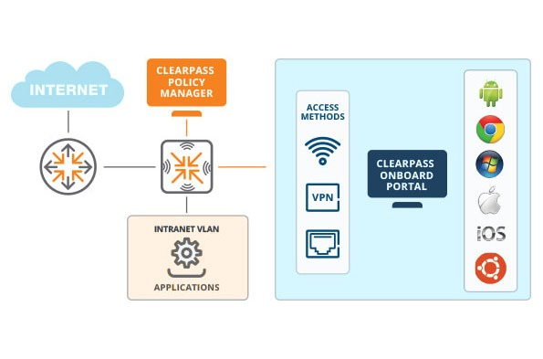
Intro
Intro
API
https://community.arubanetworks.com/browse/articles/blogviewer?blogkey=0744ffa6-e5aa-4957-9910-c3f52b9f3055
create a new guest account
user name, password, expire_time, role_id
update a guest account
delete a guest account
fetch a guest account details

Slide 28
Apps

Slide 29
Telegram
APIs
https://core.telegram.org/api
3 ways
Bot APIs
bots are small applications that run entirely within the Telegram app.
TDLib & Telegram APIs
a tool for third-party developers that makes it easy to build fast, secure and feature-rich Telegram apps

Slide 30
Performance

Slide 31
In General
References
https://www.webpagetest.org/
https://web.dev/fast/#optimize-webfonts
https://developer.mozilla.org/en-US/docs/Learn/Performance/CSS
https://developer.mozilla.org/en-US/docs/Web/Performance/Lazy_loading
https://phoenixnap.com/kb/reduce-server-response-time
https://phoenixnap.com/kb/best-website-speed-performance-test-tools#ftoc-4-varvy-pagespeed-optimmization
Lazy loading
JS
type=”module”
CSS
Images
<img loading=”lazy”>

Slide 32
FAQ

Slide 33
Avoid Auto Change Into HTTPS
References
https://www.cnblogs.com/colder/p/18072929
Step
Chrome
地址栏中输入chrome://net-internals/#hsts
在Delete domain security policies中输入项目的域名，并Delete（删除）
Edge
地址栏中输入edge://net-internals/#hsts
在Delete domain security policies中输入项目的域名，并Delete（删除）

