Slide 1
Notes of Raspberry Pi
Sparks Lu
Last updated: 9/6/2018

Slide 2
Build Kernel Image
Steps
git clone https://github.com/RPI-Distro/pi-gen.git
edit build.sh
stages
stage 0: bootstrap, stage 1: minimal, stage 2: lite, stage 3: desktop, stage 4: normal, stage 5: full
echo "IMG_NAME='raspios'" > config
touch ./stage3/SKIP ./stage4/SKIP ./stage5/SKIP
touch ./stage4/SKIP_IMAGES ./stage5/SKIP_IMAGES
sudo ./build.sh # or ./build-docker.sh

Slide 3
Setup
wpa_supplicant.conf
country=GB
ctrl_interface=DIR=/var/run/wpa_supplicant GROUP=netdev
update_config=1
network={
scan_ssid=1
ssid="Sparks"
psk="7001#mly"
proto=WPA
key_mgmt=WPA-PSK
}
Steps
Download Raspbian Stretch Lite
https://www.raspberrypi.org/downloads/raspbian/
Download Etcher and write image image on microSD card
Create empty "ssh" file in boot partition
Create wpa_supplicant.conf
Connect
USB
Ethernet
Power on
Check IP address of Pi
ssh pi@ip
password: raspberry
WIFI
disabled before WIFI country is set correctly

Slide 4
Config
raspi-config
“Advanced Options” -> “Expand Filesystem”
“Localisation Options” -> “Change Locale”
Check “en_US.UTF8 UTF8”, “zh_CN.GBK GBK”, “zh_CN.UTF8 UTF8”
“Localisation Options” -> “Change Wi-Fi Country”
CN
“Localisation Options” -> “Change Timezone”
“Asia” -> “Shanghai”
WIFI
sudo rfkill unblock wifi
ip link set wlan0 up (or sudo ifconfig wlan0)
Unplug ethernet
Reboot
Set fixed IP address
sudo nano /etc/dhcpcd.conf
Auto start after power on
In /etc/rc.local, add “exec ...” before “exit 0”
dhcpcd.conf
interface wlan0
inform 192.168.31.188
static routers=192.168.31.1
static domain_name_servers=192.168.31.1
static domain_search=192.168.31.1

Slide 5
Install Softwares
Apt Source
modify /etc/apt/sources.list
deb http://mirrors.tuna.tsinghua.edu.cn/raspbian/raspbian/ stretch main non-free contrib
deb-src http://mirrors.tuna.tsinghua.edu.cn/raspbian/raspbian/ stretch main non-free contrib
sudo apt update
sudo apt dist-upgrade
Install softwares
sudo apt install vim

Slide 6
Install Python
Install Python
sudo apt install python2.7-dev python3-dev
wget https://bootstrap.pypa.io/get-pip.py
sudo python get-pip.py
sudo python3 get-pip.py
sudo pip install virtualenv virtualenvwrapper
sudo rm -rf ~/.cache/pip
Edit ~/.profile as the one on the right
source ~/.profile
mkvirtualenv py3 -p python3
Install Python packages in virtualenv
Modify pip.conf as the one on the right
pip install numpy (slow)
~/.profile
export WORKON_HOME=$HOME/.virtualenvs
export VIRTUALENVWRAPPER_PYTHON=/usr/bin/python3
source /usr/local/bin/virtualenvwrapper.sh
/etc/pip.conf
[global]
index-url = https://pypi.tuna.tsinghua.edu.cn/simple

Slide 7
Install OpenCV3
Install packages
build-essential cmake pkg-config
libjpeg-dev libtiff5-dev libjasper-dev libpng12-dev
libavcodec-dev libavformat-dev libswscale-dev libv4l-dev libxvidcore-dev libx264-dev
libgtk2.0-dev libgtk-3-dev
libatlas-base-dev gfortran
scp opencv-3.4.1.zip and opencv_contrib-3.4.1.zip to Pi
Unzip opencv-3.4.1.zip and opencv_contrib-3.4.1.zip
Build opencv
cmake
-D CMAKE_BUILD_TYPE=RELEASE -D CMAKE_INSTALL_PREFIX=/usr/local -D INSTALL_PYTHON_EXAMPLES=ON -D OPENCV_EXTRA_MODULES_PATH=~/opencv_contrib-3.4.1/modules -D BUILD_EXAMPLES=ON ..
Modify /etc/dphys-swapfile CONF_SWAPSIZE to 1024
sudo /etc/init.d/dphys-swapfile restart
make -j4 && sudo make install && sudo ldconfig
ln -s /usr/local/lib/python3.5/site-packages/cv2xxx.so ~/.virtualenv/py3.5/lib/python3.5/site-packages/cv2.so
Revert /etc/dphys-swapfile CONF_SWAPSIZE to 1024
sudo /etc/init.d/dphys-swapfile restart

Slide 8
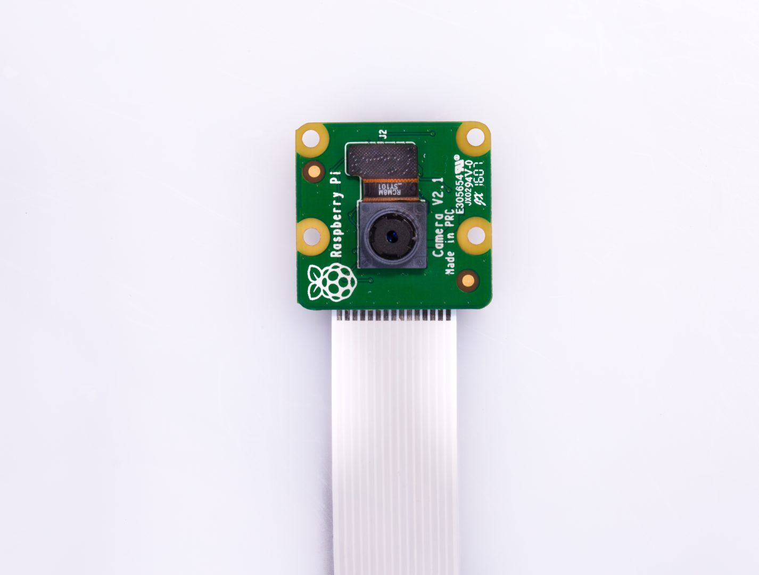
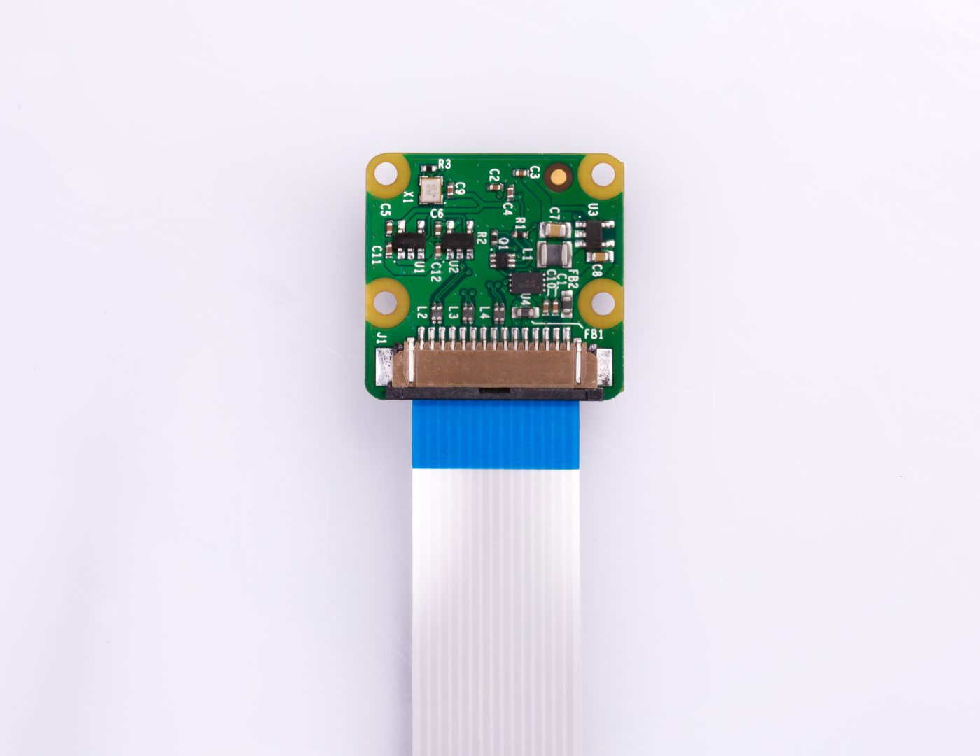
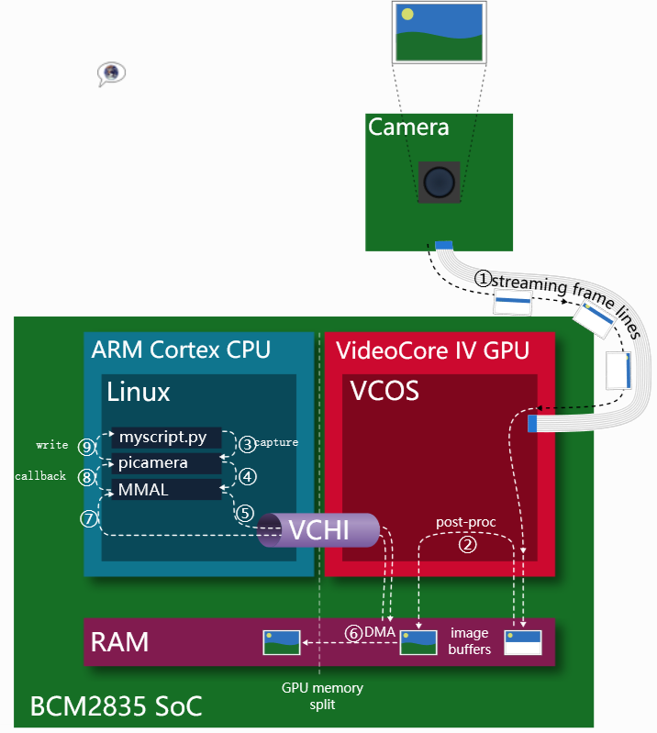
Setup Camera Module
Spec
Sony IMX219 8MP sensor
Max image resolution 2592*1944
Supports 1080p30, 720p60 video
CSI interface with Raspberry Pi
Picamera python library
pip install picamera
Connect Pi Camera with Raspberry Pi
Ensure the connection is correct
Enable
sudo raspi-config
“Interfacing Options” -> “P1 Camera” -> Enable
raspistill -o 1.jpg
raspivid -o 1.h264 -t 10000
Refer
https://picamera.readthedocs.io/
https://elinux.org/RPi_USB_Webcams

