Slide 1
WSL Notes
Sparks Lu
Last updated: 1/27/2021

Slide 2
References
https://github.com/QMonkey/wsl-tutorial
https://medium.com/@japheth.yates/the-complete-wsl2-gui-setup-2582828f4577
https://github.com/lackovic/notes/tree/master/Windows/Windows%20Subsystem%20for%20Linux#use-chromedriver-in-wsl
https://research.wmz.ninja/articles/2017/11/setting-up-wsl-with-graphics-and-audio.html
https://learn.microsoft.com/en-us/windows/wsl/basic-commands

Slide 3
Install
Enable WSL in Windows
Settings -> Update and Security -> For developers, select “Developer” mode
Open PowerShell
Run Enable-WindowsOptionalFeature -Online -FeatureName Microsoft-Windows-Subsystem-Linux
Run “wsl -l -v” to determine version 1/2
Install Ubuntu 16.04
Install XServer on Windows
VcXsrv
In .bashrc
export DISPLAY=:0
export LIBGL_ALWAYS_INDIRECT=1
Upgrade to WSL2
https://aka.ms/wsl2-install
https://aka.ms/wsl2kernel
https://docs.microsoft.com/en-gb/windows/wsl/wsl2-kernel
wsl --set-version {Ubuntu-16.04} 2
wsl --set-default-version 2

Slide 4
Commands
Command | Meaning | Note
wsl --list --all | List all installed distributions
wsl --distribution {distributionName} --user {userName} | Start a distribution with specified user
wsl --unregister {distributionName}
wsl –mount \\.\PHYSICALDRIVE0 –partition1. |  | Windows command: wmic diskdrive list brief // list drives

Slide 5
Config
${user_home}/.wslconfig
global for all distributions
/etc/wsl.config
for each distribution

Slide 6
Storage
C:\Users\{username}\AppData\Local\Packages
CanonicalGroupLimited.Ubuntu18.04onWindows_79rhkp1fndgsc
Disk in Linux
C:\Windows\WinSxS\amd64_microsoft-windows-lxss-vm-mode_31bf3856ad364e35_10.0.18362.1049_none_dc51d333d925c283\ext4.vhdx.gz
Shrink disk size in Linux
References: https://stephenreescarter.net/how-to-shrink-a-wsl2-virtual-disk/
wsl -l -v
wsl --terminate {Ubuntu-18.04}
diskpart
select vdisk file="<PATH-TO-VHDX>"
attach vdisk readonly
compact vdisk
waiting...
detach vdisk

Slide 7
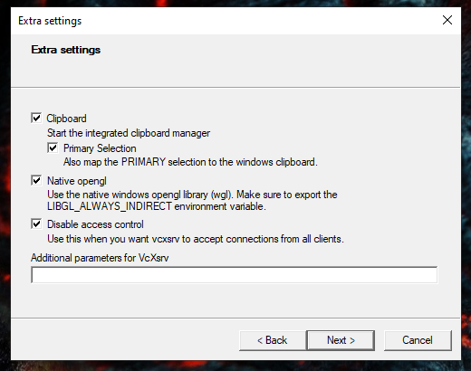
Run GUI Apps
Steps
Windows
Install VcXsrv
Change property of vcxsrv.exe
Compatibility -> Change high DPI settings, check “Override high DPI scaling behavior”, select App
Control Panel\System and Security\Windows Defender Firewall\Allowed apps
Select VcXsrv windows xserver, Check both Private and Public checkboxes
Launch VcXsrv with “disable access control”
Download config.xlaunch
from https://github.com/lackovic/notes/blob/master/Windows/Windows%20Subsystem%20for%20Linux/config.xlaunch to your file system (save it in %AppData%\Microsoft\Windows\Start Menu\Programs\Startup if you want to make XLaunch automatically run at startup) and double click on it to run XLaunch
WSL
Add to ~/.profile
export DISPLAY=${DISPLAY:-$(grep -Po '(?<=nameserver ).*' /etc/resolv.conf):0}
export LIBGL_ALWAYS_INDIRECT=1

Slide 8
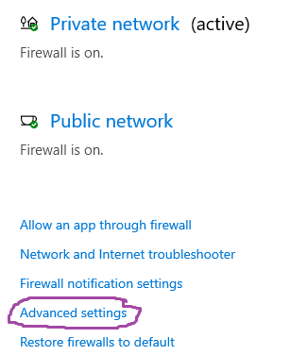
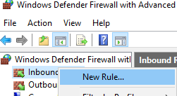
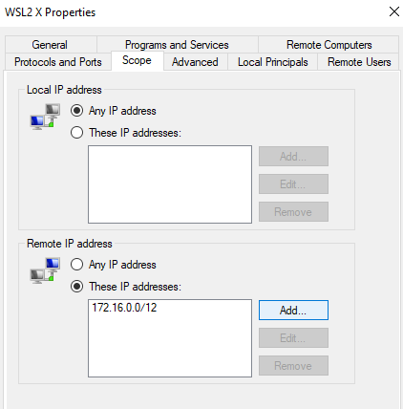
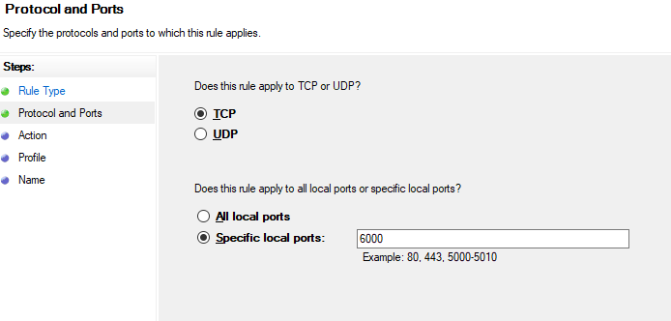
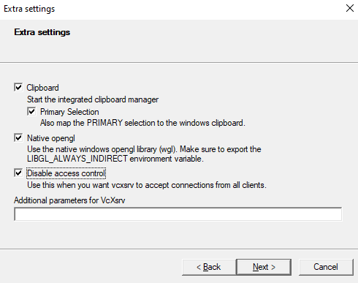
Run GUI Apps in WSL2
References
https://skeptric.com/wsl2-xserver/
Steps
Allow WSL access via Windows Firefall
Enable public access from an X11 server when starting VcXsrv
Configure .bashrc
export DISPLAY=$(awk '/nameserver / {print $2; exit}' /etc/resolv.conf 2>/dev/null):0
export LIBGL_ALWAYS_INDIRECT=1

Slide 9
Access WSL files in Windows
In Explorer, input “\\wsl$”
In WSL, input “explorer.exe .”

Slide 10
Network
Access Windows local host
cat /etc/resolve.conf

Slide 11
GPU
sudo apt install nvidia-384
glxinfo | grep “OpenGL”
sudo apt install mesa-utils
glxgears -info

Slide 12
Audio

Slide 13
USB
Steps
wsl --shutdown
插入U盘
wsl --distribution {Ubuntu20}

Slide 14
USB
References
https://docs.microsoft.com/en-us/windows/wsl/connect-usb
Steps
download and install windows support
https://github.com/dorssel/usbipd-win/releases
winget install --interactive --exact dorssel.usbipd-win
install tools in Linux
sudo apt install linux-tools-5.4.0-77-generic hwdata
sudo update-alternatives --install /usr/local/bin/usbip usbip /usr/lib/linux-tools/5.4.0-77-generic/usbip 20
Connect
Windows
usbipd wsl list
usbipd wsl attach --busid <busid>
Linux
lsusb

Slide 15
Change Swap Size
wsl --shutdown
Copy .wslconfig to Windows $HOME
C:/Users/{username}/
# Settings apply across all Linux distros running on WSL 2
# Can see memory in wsl2 with "free -m"
# Goes in windows home directory as .wslconfig
[wsl2]
# Limits VM memory to use no more than 48 GB, defaults to 50% of ram
memory=48GB
# Sets the VM to use 8 virtual processors
processors=8
# Sets the amount of swap storage space to 8GB, default is 25% of available RAM
swap=16GB

Slide 16
Support USB Disk
References
https://github.com/dorssel/usbipd-win
Steps
Windows
winget install usbipd
usbipd list
usbipd bind --busid=<BUSID>
WSL2
sudo apt install linux-tools-common
usbipd wsl list
usbipd wsl attach --busid=<BUSID>

Slide 17
Back and Move
Export
wsl --list --verbose // get linux distribution name
wsl --shutdown
mkdir D:\backup
wsl --export {Ubuntu-18.04} D:\backup\ubuntu-18.04.tar
wsl --unregister {Ubuntu-18.04}
Import
mkdir D:\WSL\
wsl --import {Ubuntu-18.04} D:\WSL\ D:\backup\ubuntu-18.04.tar
cd $env:USERPROFILE\AppData\Local\Microsoft\WindowsApps
.\ubuntu1804.exe config --default-user lgm
wsl --distribution {Ubuntu-18.04}

Slide 18
FAQ
System has not been booted with systemd as init system (PID 1). Can't operate.
Use “sudo service redis-server start” instead
datetime is incorrect
sudo hwclock -s
sudo crontab -e
10 * * * * ntpdate time.windows.com

