Slide 1
DB Notes
Sparks Lu
Last updated: 3/15/2022

Slide 2
SQL
Purpose | Command | Note
Select records | select distinct {column-name} from {table-name} order by id desc limit 10 | select id,phone,jd_amount from registered_user where phone like '%18657141696%';
Rename a table | alter table {old_table_name} rename to {new_table_name}
Deleta a table | drop table “{table_name}” | Delete table, data, and table structure
 | truncate table {table_name} | Delete all data, keep table structure
Add a column | alter table {table_name} add {column_name} varchar NULL alter table capture add time_called timestamp without time zone;
Remove a column | alter table {table_name} drop column {column_name}
Rename a column | alter table {table_name} rename column {A} to {B}
Modify a column | alter table {table_name} modify column {column_name} {data_type}
Modify a column (postgresql) | alter table {table_name} alter column {column_name} type {data_type}
Modify a column to remove unique constraint | ALTER TABLE tbl_name DROP CONSTRAINT {constraint_name}; | \d {table} to get constraint_name
Update record | update {table_name} set {col1}={value1} where {condition}; | update registered_user set jd_amount=11 where id=5298;
Create a DB | create database {db_name}
Remove a DB | drop database {db_name}
Add record | INSERT INTO {table_name} VALUES (value1, value2, value3...); INSERT INTO table_name(column1, column2...) VALUES (value1, value2...); | insert into product (name, full_name, unit_price) values ('tour_video_dewatermark', '漫游视频去 水印', '500');
Delete record | delete from {table_name} where id=1;

Slide 3
SQLite
References
https://sqlite.org/index.html
https://www.sqlite.org/lang_altertable.html
Command line tools
download sqlite3 from https://sqlite.org/download.html
.quit // exit
.open {db_name}
.tables
.schema {table_name}
Dump db to sql
.once db.sql
.dump
Dump table data to csv
.headers on
.mode csv
.once ‘user.csv’
select * from user;
Run a sql script
.read init.sql
Create table from csv
.mode csv
.import product.csv product

Slide 4
PostgreSql

Slide 5
Intro
References
https://www.postgresql.org/docs/current/admin.html
FAQ
BLOB -> LargeBinary
This result object does not return rows. It has been closed automatically.
docker-compose.yml
gunicorn remove “--preload” option
psql
Docker
sudo docker exec -it fishpano_db_1 /bin/bash
run psql -U {username} {dbname}
Commands
dropdb -U fishpano fishpano_db
createdb -U fishpano fishpano_db
sudo service postgresql restart
sudo -u postgres psql
psql -U {username} {dbname}
postgresql Commands:
# \q // quit interactive terminal
# create database {dbname};
# \l // list databases
# \c {dbname} // connect db
# \dt // display tables
# \ds // display sequences
# \d {tablename} // display columes in table
# table {tablename}
# select * from “{tablename}”;
# drop database {dbname}

Slide 6
Back up and Recover
Backup
Dump
apt install postgresql
pg_dump dbname > dbname-backup.sql
pg_dump -U fishpano fishpano_db >/tmp/20211221.pgdump
sudo docker compose exec db pg_dump -U fishpano fishpano_db | gzip >/tmp/20211221.pgdump.gz
Reload
psql -d newdb -f db.sql
sudo docker compose exec db psql --username=fishai --dbname=fishai_db
psql -U fishpano fishpano_db < {dumpfile}
sudo docker compose up -d db
cat pgdump | sudo docker compose exec -T db psql -U fishpano fishpano_db
Create table from CSV
COPY table_name FROM 'path/to/data.csv' DELIMITER ',' CSV HEADER;
Purpose | Command | Note
Remove not null for column | alter table model3d alter column time_uploaded drop not null;
Add not null for column | alter table model3d alter column time_uploaded set not null;

Slide 7
Misc
Execute a sql file
psql -h hostname -d database_name -U user_name -p 5432 -a -q -f filepath
Dump a table as sql inserts
pg_dump -h localhost -p 5432 -U user -W --table="table-name" --data-only --column-inserts database-name > table.sql

Slide 8
Postgresql - pgAdmin
References
https://www.pgadmin.org/
https://www.pgadmin.org/download/
Usage

Slide 9
Postgresql - Internal
Basic
All data is located in base/
Every relation has a relfilenode
base/<db oid>/<relfilenode>
Commands
explain analyze select * from model3d;

Slide 10
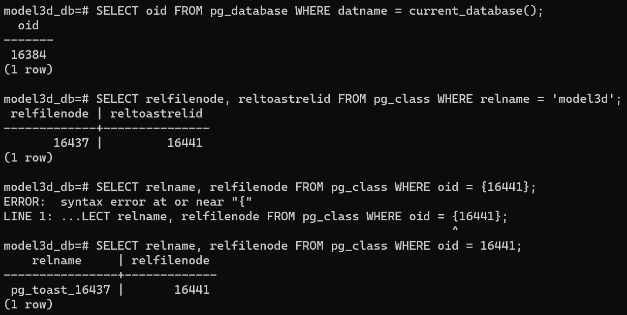
Postgresql - Recover Data
Refer
https://www.postgresql.org/message-id/20050117195609.GA93502@winnie.fuhr.org
WAL (Write-Ahead-Logging)
_data/pg_wal/
PITR (Point In Time Recovery)
Steps
Back up all the files related in db
pg_basebackup
sudo docker exec -u root -it model3d_db_1 pg_basebackup -h 127.0.0.1 -U model3d -p 5432 -Ft -Pv -Xf -z -Z5 -D ../backup/
SELECT oid FROM pg_database WHERE datname = current_database();
oid
SELECT relfilenode, reltoastrelid FROM pg_class WHERE relname = 'table_name';
relfilenode | reltoastrelid
The table's main file is $PGDATA/base/26492/36008 (also 36008.1, 36008.2, etc. if they exist).
SELECT relname, relfilenode FROM pg_class WHERE oid = {reltoastrelid};
relname | relfilenode
The table's TOAST data is in $PGDATA/base/26492/36011*.

Slide 11
Sqlite->Postgresql - Sequel Gem
Install
apt install ruby ruby2.5-dev libsqlite3-dev
gem install sequel sqlite3 pg
Use
sequel -C sqlite:/www/input.sqlite3 postgres://user@localhost/db
# /www/input.sqlite3 is full path

Slide 12
Sqlite->Postgresql - Dump/Load
references
https://stackoverflow.com/questions/4581727/convert-sqlite-sql-dump-file-to-postgresql
Steps
dump
.dump > ./sqlite-dumpfile.sql
Modify
id: change type from “int” to “serial”, remove “autoincrement”
change “datetime” column to “timestamp”
boolean “1”->”1::boolean”, “0”->”0::boolean”
“blob” type -> “bytea”
foreign key: “set constraints all deferred” in begin/commit pair
Load
psql -d dbname -U username -W < ./sqlite-dumpfile.sql
Issues
Too many manual steps

Slide 13
Sqlite->Postgresql - PGLoader
pgloader
reference: https://pgloader.readthedocs.io/en/latest/ref/sqlite.html
sudo apt install pgloader
create a file migrate.pgloader
pgloader --debug migrate.pgloader
Issues:
id cannot be created automatically
migrate.pgloader
load database
from 'latest-sqlite-file.db'
into postgresql:///new_db_name
with include drop, quote identifiers, create tables, create indexes, reset sequences
set work_mem to '16MB', maintenance_work_mem to '512 MB';

Slide 14
SQLite -> Postgresql - Issues
Issues
table name (“user”, “order”, ...) is reserved keyword
rename table first before migration (change in DBeaver because of foreign key handling)
alter table “user” rename to “registered_user”
alter table “order” rename to “customer_order”
user_id=-1
It’s not allowed as it’s used as foreign key
Update sqlite db first
(psycopg2.OperationalError) lost synchronization with server: got message type "
caused by “gunicorn --preload”
solution: remove “--preload”

Slide 15
SQL Server

Slide 16
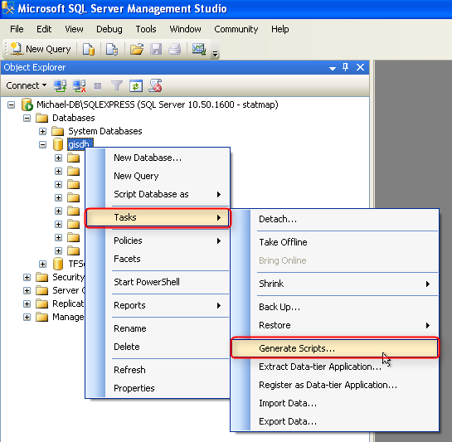
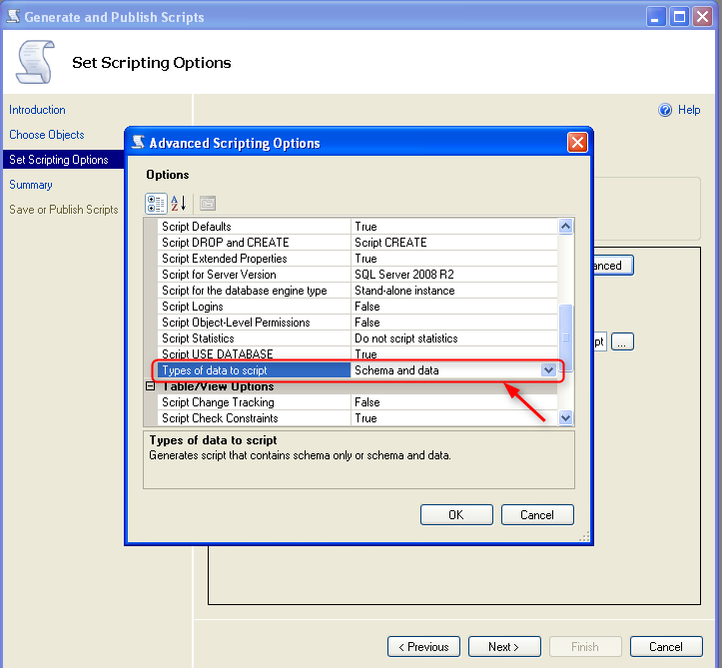
SQL Server
References
http://statmap.co.uk/?page_id=9207
Export

Slide 17
SSMS (SQL Server Management Studio)
References
https://learn.microsoft.com/zh-cn/sql/ssms/download-sql-server-management-studio-ssms?view=sql-server-ver16&redirectedfrom=MSDN

Slide 18
Connect from Ubuntu 20
References
https://learn.microsoft.com/en-us/sql/linux/sql-server-linux-setup-tools?tabs=ubuntu-install&view=sql-server-ver16#ubuntu
Commands
curl https://packages.microsoft.com/keys/microsoft.asc | sudo tee /etc/apt/trusted.gpg.d/microsoft.asc // Import the public repository GPG keys
curl https://packages.microsoft.com/config/ubuntu/20.04/prod.list | sudo tee /etc/apt/sources.list.d/mssql-release.list // Register repository
sudo apt-get update
sudo apt-get install mssql-tools18 unixodbc-dev
echo 'export PATH="$PATH:/opt/mssql-tools18/bin"' >> ~/.bashrc
source ~/.bashrc
sqlcmd -?

Slide 19
sqlcmd
Commands
sqlcmd -S tcp:<computer name>,<port number>

Slide 20
MySQL

Slide 21
Client
mycli
https://thevaluable.dev/mysql-command-line-tool-mycli/
pip install mycli
mycli -h localhost -u root -P 3306
Commands
show databases
\l # list databases
\dt # dump tables

Slide 22
Misc

Slide 23
Visualization
Grafana
https://medium.com/analytics-vidhya/grafana-with-postgresql-data-visualization-with-open-source-tool-36f5150fa290

Slide 24
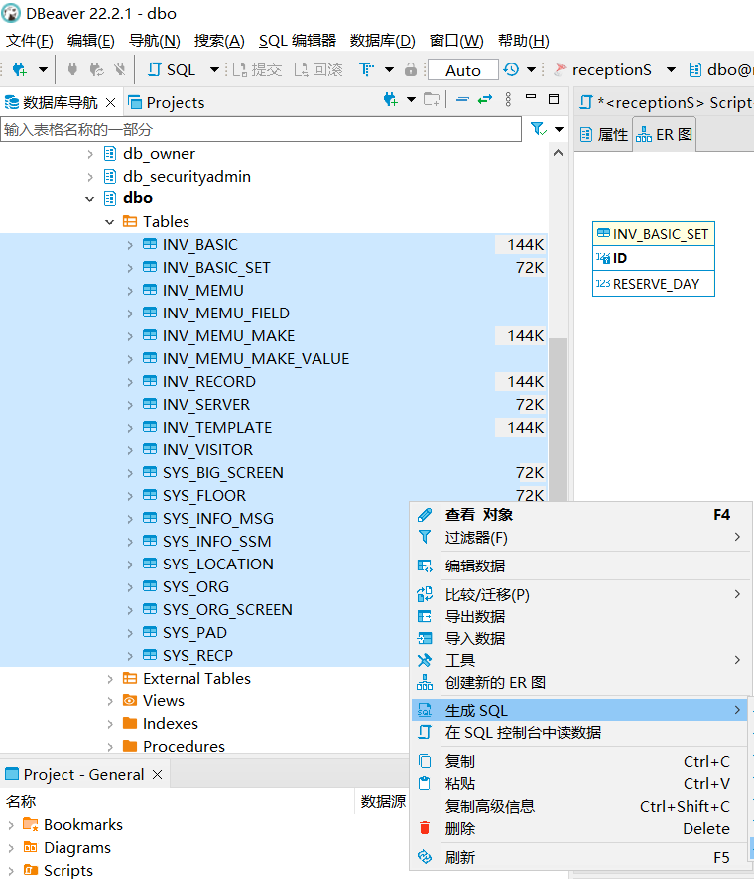
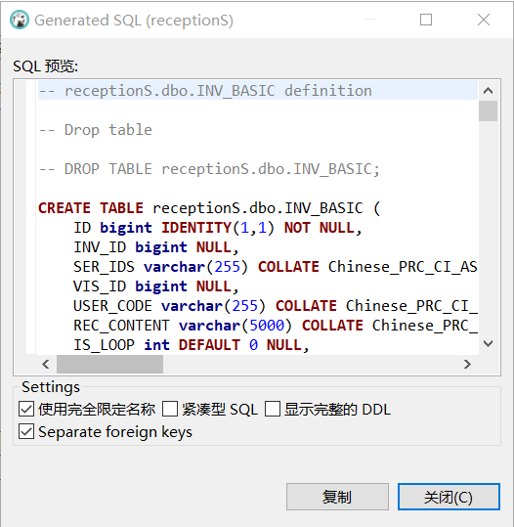
DBeaver
Export table structures
select tables
right click, “Generate SQL” ->”DDL”
copy in the popup

