Slide 1
Docker Notes
Sparks Lu
Last updated: 12/21/2021

Slide 2
References
Install
https://ostechnix.com/install-docker-ubuntu/
Dockerfile
https://docs.docker.com/develop/develop-images/dockerfile_best-practices/
https://www.tutorialspoint.com/docker/
https://runnable.com/blog/9-common-dockerfile-mistakes
https://www.digitalocean.com/community/tutorials/how-to-debug-and-fix-common-docker-issues
https://docs.docker.com/build/cache/
Issues and Solutions
https://www.digitalocean.com/community/tutorials/how-to-debug-and-fix-common-docker-issues

Slide 3
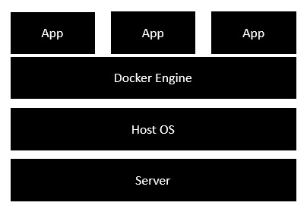
Intro
Concept
Docker: a platform to build, share, and run applications with containers
container: a running process
Docker image: everything needed to run an application
Dokerfile: describe how to assemble a private filesystem for a container
Install
Docker for Windows
https://github.com/docker/toolbox/releases
Start “Docker Quickstart Terminal”
Ubuntu Linux
sudo apt install apt-transport-https ca-certificates curl gnupg-agent software-properties-common
curl -fsSL https://download.docker.com/linux/ubuntu/gpg | sudo apt-key add -
CentOS
Test install: docker run hello-world

Slide 4
Install on Ubuntu 20.04
Install Docker
sudo apt install -y apt-transport-https ca-certificates curl software-properties-common gnupg lsb-release
curl -fsSL https://download.docker.com/linux/ubuntu/gpg | sudo gpg --dearmor -o /usr/share/keyrings/docker-archive-keyring.gpg
echo "deb [arch=$(dpkg --print-architecture) signed-by=/usr/share/keyrings/docker-archive-keyring.gpg] https://download.docker.com/linux/ubuntu $(lsb_release -cs) stable" | sudo tee /etc/apt/sources.list.d/docker.list > /dev/null
sudo apt update
sudo apt install -y docker-ce docker-ce-cli containerd.io docker-compose-plugin
sudo apt install -y docker-ce=5:20.10.22~3-0~ubuntu-focal docker-ce-cli=5:20.10.22~3-0~ubuntu-focal containerd.io docker-compose-plugin=2.14.1~ubuntu-focal
sudo systemctl status/start/enable docker
sudo docker version
sudo docker compose version

Slide 5
Install on Ubuntu 18.04
Install Docker
sudo apt install apt-transport-https ca-certificates curl software-properties-common gnupg lsb-release
curl -fsSL http://mirrors.aliyun.com/docker-ce/linux/ubuntu/gpg | sudo apt-key add -
sudo add-apt-repository "deb [arch=amd64] http://mirrors.aliyun.com/docker-ce/linux/ubuntu $(lsb_release -cs) stable"
sudo apt update
sudo apt install docker-ce=5:20.10.22~3-0~ubuntu-bionic docker-ce-cli=5:20.10.22~3-0~ubuntu-bionic containerd.io docker-compose-plugin=2.14.1~ubuntu-bionic
sudo systemctl status/start/enable docker
sudo service docker start // If error occurs
sudo docker version
sudo docker compose version

Slide 6
Install On Ubuntu 16.04 (2)
Install Docker Machine
Download docker-machine from https://github.com/docker/machine/releases/download/
docker-machine --version # test installation
wget -q https://www.virtualbox.org/download/oracle_vbox_2016.asc -O- | sudo apt-key add -
wget -q https://www.virtualbox.org/download/oracle_vbox.asc -O- | sudo apt-key add -
sudo sh -c 'echo "deb http://download.virtualbox.org/virtualbox/debian $(lsb_release -sc) contrib" >> /etc/apt/sources.list.d/virtualbox.list'
sudo apt update
sudo apt install virtualbox

Slide 7
Install On Aliyun Ubuntu 16.04 (3)
Docker Engine
sudo curl -fsSL https://get.docker.com | bash -s docker --mirror Aliyun
sudo -E sh -c 'apt-get install -y -qq --no-install-recommends docker-ce >/dev/null'
sudo -E sh -c 'docker version'
sudo docker run hello-world # test install

Slide 8
Install on CentOS
References
https://www.digitalocean.com/community/tutorials/how-to-install-and-use-docker-compose-on-centos-7
Install docker
sudo yum check-update
sudo yum install -y yum-utils device-mapper-persistent-data lvm2
sudo vim /usr/bin/yum-config-manager
modify first line from #/usr/bin/python to /usr/bin/python?
sudo yum-config-manager --add-repo https://download.docker.com/linux/centos/docker-ce.repo
sudo yum install docker
Install docker-compose
sudo curl -L "https://github.com/docker/compose/releases/download/1.23.2/docker-compose-$(uname -s)-$(uname -m)" -o /usr/local/bin/docker-compose
Or download directly from https://github.com/docker/compose/releases
sudo curl -L https://get.daocloud.io/docker/compose/releases/download/1.25.3/docker-compose-`uname -s`-`uname -m` -o /usr/local/bin/docker-compose
sudo chmod +x /usr/local/bin/docker-compose
docker-compose --version
Start
systemctl start docker.service

Slide 9
Components
Docker Compose
Bundle a multi-container application into a single app
docker-compose --version
Docker Machine
Create Docker hosts both locally and in the cloud
docker-machine --version
Kitematic
Docker CLI Client
Docker Compose
Docker Machine
Docker Engine

Slide 10
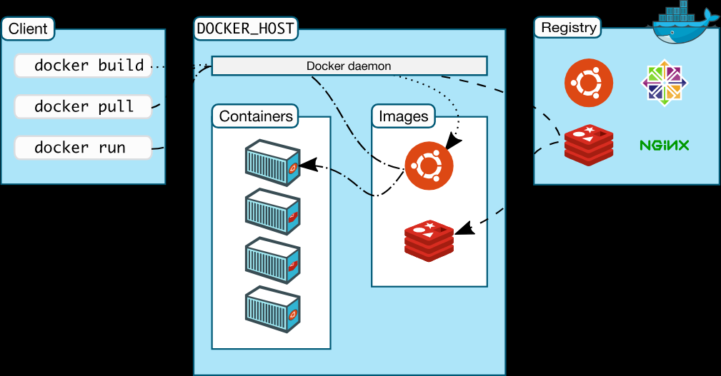
Components 2

Slide 11
Working Logic
Docker Client
Docker Daemon
contact
pull from Docker Hub
create a new container
stream output

Slide 12
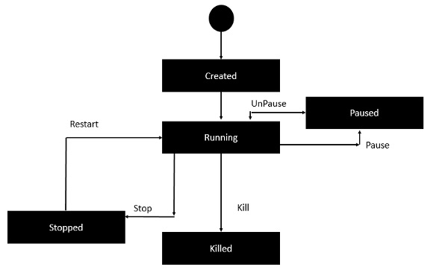
Container Lifecycle

Slide 13
Docker Commands - Basic
Command | Description | Note
docker version
docker info
docker pull {image-name} | Pull docker image from registry | docker pull busybox
docker build . -t {image-name} | Build docker
docker run -p 8081:8080 -d {image-name} | Run docker image
docker stop {container-id}
docker stop $(docker ps -q) | stop all containers
docker ps docker ps -aq | List docker images and container ids List container ids
docker logs -f {container-id} | Show logs in docker image, -f follow
docker network ls | List network names for containers
docker network inspect {network_name}
docker exec -it <container_name> /bin/bash | Run bash in container in interactive mode
docker cp {local_file} {image_name}:{dir_in_image} docker cp {image_name}:{dir_in_image} {local_dir}

Slide 14
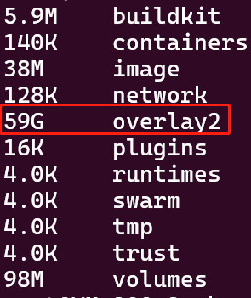
Docker Commands - System
Command | Description | Note
docker system df -v | Show docker disk usage
docker system info | Display system-wide info
docker system prune docker system prune -a | Remove unused data Remove all unused data | Files in /var/lib/docker are huge.
sudo docker builder prune -a
docker system events | Get real-time events from the server

Slide 15
Docker Commands - Container
Command | Description | Note
docker container ls -a | list containers
docker container ps | list containers
docker container stop {container-name} | stop container
docker container stop $(docker container ls -aq) | stop all containers
docker container rm --force {container-name} | remove a container
docker container run --name {container-name} {image-name}
docker top/stats/attach/pause/unpause/kill/stop/rm {container-id}

Slide 16
Docker Commnads - Image
Command | Description | Note
docker images | list installed images
docker image prune | clean up dangling images, free huge space
docker rmi {image-id} | remove docker image
docker image build -t {image-name}
docker inspect {image-name} docker inspect {container-id}
docker history {image-id}

Slide 17
Docker Commands - Volume
Command | Description | Note
docker volume ls
docker volume inspect {volume-name} | Get mount point of the volume
docker volume rm {volume-name}
docker volume prune

Slide 18
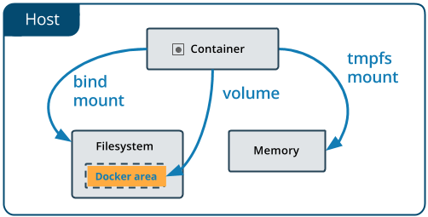
Docker Volume
References
https://docs.docker.com/storage/volumes/
Concept
Volumes in image are added when run container.
Volume data is preserved across runs.
stored in /var/lib/docker/volumes/{volume-name}/
Commands
docker volume ls
docker volume inspect {volume_name}
docker system prune --volumes

Slide 19
Dockerfile
#This is a sample Image
FROM ubuntu
MAINTAINER demousr@gmail.com
RUN apt-get update
RUN apt-get install –y nginx
CMD [“echo”,”Image created”]
Intro
Tells docker how to build an image
Build
docker build -t {image-name}:{tag-name} dir
-t: with tag
Inner
Each instruction in this Dockerfile translates (roughly) to a layer in your final image
Whenever a layer changes, that layer will need to be re-built. Docker will invalidate the cache for this layer.
If a layer changes, all other layers that come after it are also affected.
Best practice
Put more stable instructions into head of the Dockerfile

Slide 20
Instructions in Dockerfile
References
https://www.fosstechnix.com/dockerfile-instructions/
Instruction | Meaning | Note
FROM | docker image name to pull from | FROM ubuntu:latest
CMD | execute when image is deployed | CMD ["/usr/sbin/apache2", "-D", "FOREGROUND"]
RUN | execute when image is deployed | RUN apt-get update
ENV | set environment variables with key and value | ENV workdirectory /usr/node
ADD | copies a file and directory from your host to Docker image, can from URL | ADD java/jdk-8u231-linux-x64.tar /opt/jdk/
COPY | copies a file and directory from your host to Docker image, can from URL | COPY package*.json ./
ENTRYPOINT | specifies a commands that will executes when the Docker container starts | ENTRYPOINT ["ls"]
VOLUME | create or mount volume to docker container | VOLUME /node
USER | set the user name and UID when running container | USER admin
WORKDIR | set the working directory | WORKDIR /nodejsapp
ARG | set Environment variables with key and value during the image build | ARG JAVA_PATH=/opt/jdk/jdk1.8.0_251

Slide 21
Docker Compose V2
References
https://docs.docker.com/compose/compose-v2/
https://docs.docker.com/engine/reference/commandline/compose/
Intro
The new Compose V2, which supports the compose command as part of the Docker CLI

Slide 22
Docker Compose - Intro
Intro
Used to run multiple containers as a single service
https://docs.docker.com/compose/compose-file/
docker-compose.yml
ports
{host}:{container}, ports {container}
shared among different services
if only a container port is provided, a random host port will be chosen
expose
ports are not exposed to host machine, only exposed to linked services
volumes:
path-based volume
- /host/path:/container/path
named volume
named_volume_name: /container/path
the volume will get saved to /var/lib/docker/volumes/named_volume_name/_data
create a volume only
- /container/path
command
override default command in Dockerfile

Slide 23
Docker Compose - Commands
Command | Description | Note
docker compose version | Show docker compose version
docker compose config | Show docker compose config
docker compose build | Build containers
docker compose up -d | Create and start containers | -d: in daemon mode
docker compose up --no-start | Create a container, but not start
docker compose up/start {service_name} | Start a defined service | service_name like flask
docker compose run {service_name} env | Show env variables
docker compose down | Stop and remove containers, networks, images and volumes | -v: remove named volumes
docker compose logs --tail=10 | Show container logs
docker compose ps | List running containers
docker compose images | List images
docker compose {command} --help | Show help about a command
docker compose exec {service-name} {cmd} | Execute a command in a running container

Slide 24
Docker Compose - Advanced
Logic for docker compose up
A network called myapp_default is created, myapp is the name of the folder where this docker-compose.yml file is located
this name can be overriden with -p {projectname} when run docker-compose up
A container is created using web’s configuration. It joins the network myapp_default under the name web
A container is created using db’s configuration. It joins the network myapp_default under the name db
Set project name
Define in .env
COMPOSE_PROJECT_NAME=SOMEPROJECTNAME
docker-compose.yml
docker-compose.override.yml
override config in docker-compose.yml
set time zone
volumes:
- "/etc/timezone:/etc/timezone:ro"
- "/etc/localtime:/etc/localtime:ro”

Slide 25
Docker Machine
docker-machine commands
docker-machine create -d virtualbox {machine-name}
-d/--driver: which provider the machine should be created on (VirtualBox, DigitalOcean, AWS, etc.)
eval $(docker-machine env dev)
docker-machine ls
docker-machine ip default
docker-machine start {docker-machine-name}
eval "$(docker-machine env dev)" # make a machine active

Slide 26
Alpine
Intro
a minimal docker image based on Alpine Linux with a complete package index and only 5MB in size

Slide 27
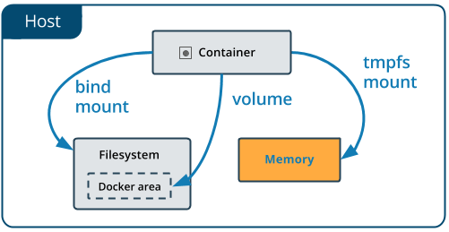
tmpfs
Features
Do not persist in either the host or the container writable layer
Limitations
Cannot share between containers
Only available when host is Linux
Configure
In docker-compose.yml
version 3.6或以上
tmpfs: /tmp

Slide 28
Clean
References
https://depot.dev/blog/docker-clear-cache
sudo docker system prune -a -f
dangerous
Clear build cache
docker buildx prune -f
/var/lib/docker
Huge size

Slide 29
Docker Images
Ubuntu images
ubuntu:22.04
ubuntu:20.04
Python docker images
https://hub.docker.com/_/python/
Nginx docker images
https://hub.docker.com/_/nginx/

Slide 30
GPU Support
References
https://docs.docker.com/engine/reference/commandline/run/
docker-compose
https://docs.docker.com/compose/gpu-support/
docker
install driver in host OS
https://docs.nvidia.com/datacenter/tesla/tesla-installation-notes/index.html#ubuntu-lts
sudo apt-get install linux-headers-$(uname -r)
distribution=$(. /etc/os-release;echo $ID$VERSION_ID | sed -e 's/\.//g')
wget https://developer.download.nvidia.com/compute/cuda/repos/$distribution/x86_64/cuda-keyring_1.0-1_all.deb
sudo dpkg -i cuda-keyring_1.0-1_all.deb
sudo apt-get update
sudo apt-get -y install cuda-drivers
export PATH=/usr/local/cuda-11.7/bin${PATH:+:${PATH}}
export LD_LIBRARY_PATH=/usr/local/cuda-11.7/lib64\ ${LD_LIBRARY_PATH:+:${LD_LIBRARY_PATH}}
cat /proc/driver/nvidia/version
services:
test:
image: tensorflow/tensorflow:latest-gpu
command: python -c "import tensorflow as tf;tf.test.gpu_device_name()"
deploy:
resources:
reservations:
devices:
- driver: nvidia
device_ids: ['0', '3']
capabilities: [gpu]

Slide 31
GPU Support 2
Docker
install Nvidia container toolkit
distribution=$(. /etc/os-release;echo $ID$VERSION_ID)
curl -s -L https://nvidia.github.io/nvidia-docker/gpgkey | sudo apt-key add -
curl -s -L https://nvidia.github.io/nvidia-docker/$distribution/nvidia-docker.list | sudo tee /etc/apt/sources.list.d/nvidia-docker.list
sudo apt-get update
sudo apt-get install -y nvidia-container-toolkit
sudo systemctl restart docker
test
docker run --gpus all nvidia/cuda:10.0-base nvidia-smi

Slide 32

tmpfs
References
https://docs.docker.com/storage/tmpfs/
Info
only persisted in the host memory
Limitations
can’t share tmpfs mounts between containers
only available if you’re running Docker on Linux

Slide 33
Timezone
Set timezone
# Set up time zone.
ENV TZ=Asia/Shanghai
RUN sudo apt-get update && \
sudo DEBIAN_FRONTEND=noninteractive apt-get install -yq tzdata

Slide 34
Docker Mirrors
/etc/docker/daemon.json
tencentyun
{
"registry-mirrors": [
"https://mirror.ccs.tencentyun.com",
]
}
aliyun
https://cr.console.aliyun.com/cn-hangzhou/instances/mirrors
https://nume0cg0.mirror.aliyuncs.com
sudo systemctl restart docker

Slide 35
Change Docker Cache Location
References
https://www.guguweb.com/2019/02/07/how-to-move-docker-data-directory-to-another-location-on-ubuntu
Steps
sudo systemctl stop docker
Create /etc/docker/daemon.json
{
"data-root": "/data/system/docker"
}
sudo rsync -aP /var/lib/docker/ /path/to/your/docker
sudo mv /var/lib/docker /var/lib/docker.old
sudo systemctl start docker
sudo rm -rf /var/lib/docker.old

Slide 36
FAQ
docker run hello-world
Issue:
docker: Cannot connect to the Docker daemon at unix:///var/run/docker.sock. Is the docker daemon running?.
Solution
sudo dockerd
docker-compose up
Issue
Traceback (most recent call last):
File "urllib3/connectionpool.py", line 677, in urlopen
File "urllib3/connectionpool.py", line 392, in _make_request
File "http/client.py", line 1252, in request
File "http/client.py", line 1298, in _send_request
File "http/client.py", line 1247, in endheaders
File "http/client.py", line 1026, in _send_output
File "http/client.py", line 966, in send
File "docker/transport/unixconn.py", line 43, in connect
FileNotFoundError: [Errno 2] No such file or directory
Solution
sudo dockerd
Postgresql
psycopg2.OperationalError: FATAL: password authentication failed
It may be caused by old volume in docker. Remove the old volume with “sudo docker-compose down -v”

