Slide 1
Resources Notes
Sparks-Lu
Last updated: 9/28/2023

Slide 2
Change History
11/10/2021
Added audio codec conversion

Slide 3
镜像站
https://mirrors.huaweicloud.com/home

Slide 4
Mix
https://mixkit.co/
Video templates
Premier Pro, After Effects, Final Cut Pro, DaVinci Resolve
Video
4K, nature, lifestyle, business, animals, zoom background, vertical, backgrounds
Music
ambient, cinematic, corporate, drum & base, experimental, funk, hip-hop, jazz
Audio effects
animals, game, human, instrument, lifestyle, nature, tech, transition, warfare
Icon
https://pixabay.com/zh/
photos
illustrations
vectors
videos
music
audio effects
gifs

Slide 5
Images
General Images
pexels.com
unsplash.com
API
pixabay.com
Panorama
https://polyhaven.com/zh/hdris

Slide 6
Music
https://musopen.org/
all royalty free
search by composer, instrument, period
https://freesfx.co.uk/
Slow to download
sound effects, music

Slide 7








Fonts
References
https://zhuanlan.zhihu.com/p/126721357
https://www.fonts.net.cn/
http://wenq.org/wqy2/index.cgi?FontGuide
免费可商用
思源黑体
https://github.com/adobe-fonts/source-han-sans/tree/release/
思源宋体
https://github.com/adobe-fonts/source-han-serif/tree/release/
手书体
https://www.zcool.com.cn/work/ZMjI2MDk1MDg=.html
站酷系列字体
https://www.zcool.com.cn/special/zcoolfonts/
方正字库
https://www.foundertype.com/index.php/About/powerbus.html
免费字体：包括五种字体：方正黑体、方正书宋、方正仿宋、方正楷体、 方正甲骨文。针对“商业发布”这种使用方式免费。
GPL
文泉驿

Slide 8
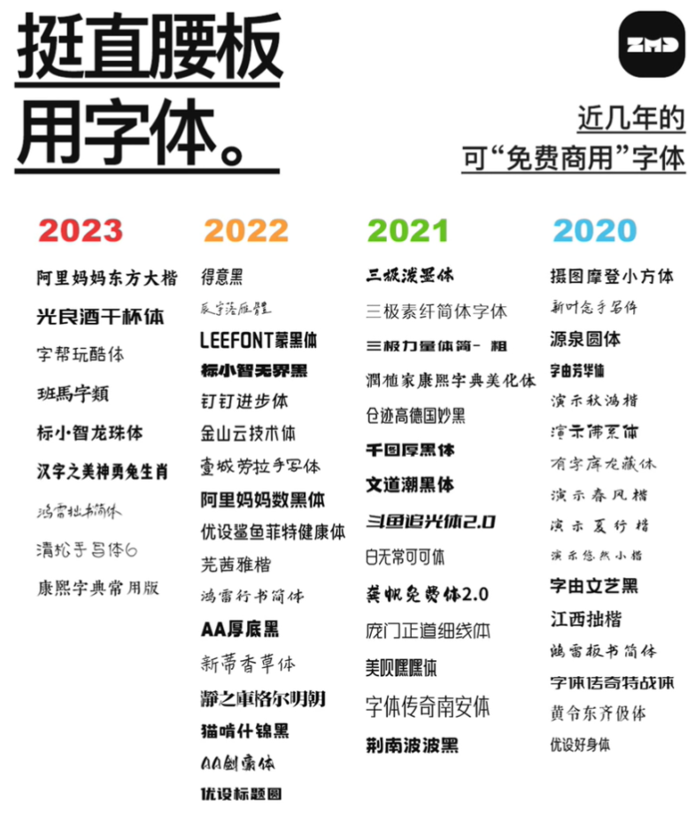
Fonts - 2
钉钉进步体
https://page.dingtalk.com/wow/dingtalk/default/dingtalk/y-W5aF3_ZJwzulU0nceIl
得意黑
https://github.com/atelier-anchor/smiley-sans
OFL-1.1

Slide 9
3D Models
Models
https://polyhaven.com/zh/models
total: 286
Textures
https://polyhaven.com/zh/textures
total: 432
https://cc0-textures.com/
total: 3314

