Slide 1
Electron Notes
Sparks Lu
Last updated: 5/29/2021

Slide 2
Overview
Construct desktop UI application using web technology
Node.js runtime for backend
Chromium for frontend
Embeds Node
node_modules/.bin/electron --version
References
https://blog.logrocket.com/building-app-electron-vue/
https://auth0.com/blog/electron-tutorial-building-modern-desktop-apps-with-vue-js/
https://github.com/node-ffi/node-ffi/wiki/Node-FFI-Tutorial
https://www.cnblogs.com/silenzio/p/11580104.html
https://nklayman.github.io/vue-cli-plugin-electron-builder/guide/

Slide 3
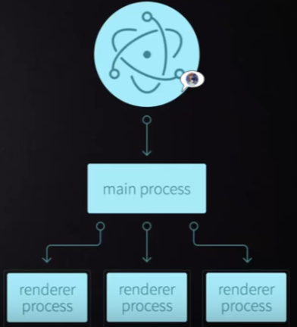
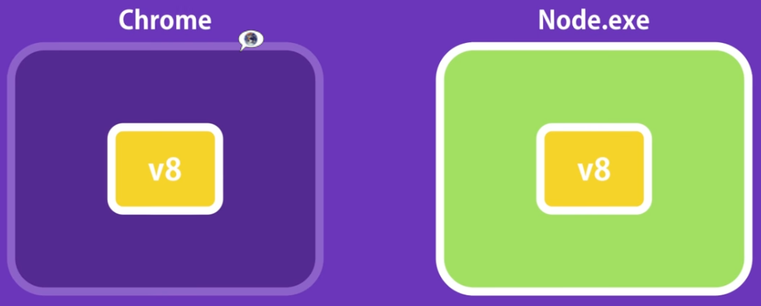
Theory
Processes
References
https://www.electronjs.org/docs/latest/tutorial/process-model
Main Process
package.json
window management
The main process' primary purpose is to create and manage application windows with the BrowserWindow module.
application lifecycle
The main process also controls your application's lifecycle through Electron's app module.
Renderer Process
Each web page runs its own isolated process
Each Electron app spawns a separate renderer process for each open BrowserWindow (and each web embed).
the renderer has no direct access to require or other Node.js APIs
Utility Process
Each Electron app can spawn multiple child processes from the main process using the UtilityProcess API
runs in a Node.js environment, meaning it has the ability to require modules and use all of Node.js APIs
utility process can establish a communication channel with a renderer process using MessagePorts.

Slide 4
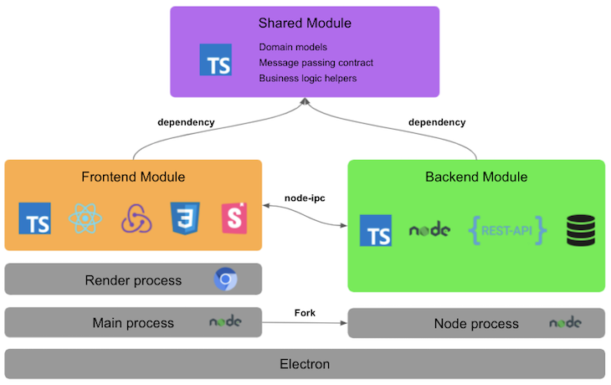
Advanced Architecture

Slide 5
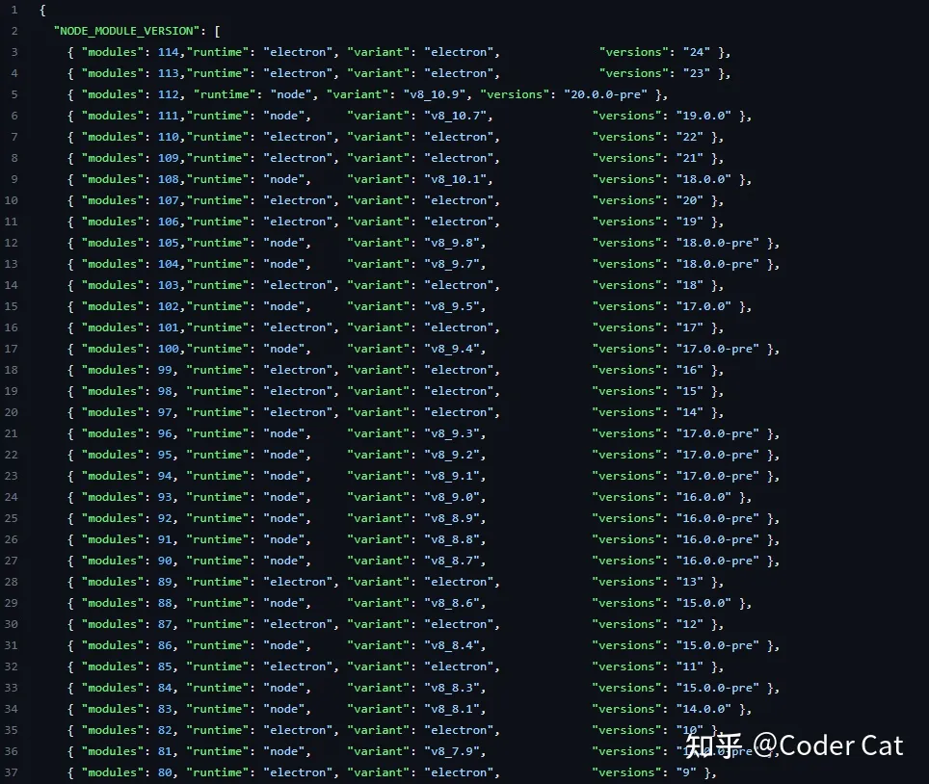
Install
Steps
Install Node.js
npm
npm install electron@6.0 -D // electron v6.0 for Node v12
npm i -g electron-builder
npm i -g windows-build-tools
electron .
eslint
npm i -g eslint eslint-plugin-vue@latest
electron-rebuild
This executable rebuilds native Node.js modules against the version of Node.js that your Electron project is using.
npm i -S electron-rebuild
.\node_modules\.bin\electron-rebuild
References
https://github.com/nodejs/node-gyp#on-windows

Slide 6
Install Using Electron Forge
References
https://www.electronforge.io/#getting-started
Steps
yarn create electron-app my-app --template=webpack
Steps 2
yarn global add @vue/cli
vue create {myproject}
cd myproject
vue add electron-builder
yarn electron:serve

Slide 7
Install 2
References
https://blog.logrocket.com/building-app-electron-vue/
Steps
npm install -g @vue/cli
vue create vue-desktop
vue add electron-builder
npm run electron:serve

Slide 8
Electron Forge
References
https://github.com/electron-userland/electron-forge
Steps
npm install -g electron-forge
yarn create electron-app my-new-app
cd my-new-app
npm start

Slide 9
Create Application
Electron + Vue3 + Vite
https://github.com/Deluze/electron-vue-template
npm i
npm run dev
npm run build:linux
Electron
npm init -y
Initialize npm
package.json was created as the result
npm install electron@latest --save-dev
Install electron locally
touch index.js
npx electron index.js
Launch application
npm start
your-app/
├── package.json
├── main.js
└── index.html
{
"name": "your-app",
"version": "0.1.0",
"main": "main.js"，
"scripts": {
"start": "electron ."
}
}

Slide 10
main.js
const { app, BrowserWindow } = require('electron')
function createWindow () {
// 创建浏览器窗口
const win = new BrowserWindow({
width: 800,
height: 600,
webPreferences: {
nodeIntegration: true
}
})
// 并且为你的应用加载index.html
win.loadFile('index.html')
// 打开开发者工具
win.webContents.openDevTools()
}
app.whenReady().then(createWindow)
// Quit when all windows are closed, except on macOS. There, it's common
// for applications and their menu bar to stay active until the user quits
// explicitly with Cmd + Q.
app.on('window-all-closed', () => {
if (process.platform !== 'darwin') {
app.quit()
}
})
app.on('activate', () => {
// On macOS it's common to re-create a window in the app when the
// dock icon is clicked and there are no other windows open.
if (BrowserWindow.getAllWindows().length === 0) {
createWindow()
}
})

Slide 11
Build On Windows
https://www.electronjs.org/docs/development/build-instructions-windows
Steps
yarn install
Install sharp
download sharp prebuilds
wget https://github.com/lovell/sharp/releases/download/v0.32.0/sharp-v0.32.0-napi-v7-win32-ia32.tar.gz
cp sharp-v0.32.0-napi-v7-win32-ia32.tar.gz C:\Users\losti\AppData\Roaming\npm-cache\_prebuilds\550e99-sharp-v0.32.0-napi-v7-win32-ia32.tar.gz
yarn add --platform=win32 --arch=ia32 sharp
yarn electron:serve // dev
yarn add es5-ext
yarn electron:build // build

Slide 12
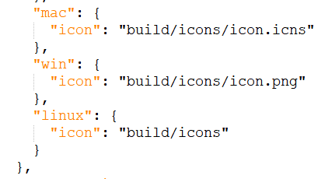
Package & Deployment
References
https://zhuanlan.zhihu.com/p/616596556
icon
Modify package.json

Slide 13
Debug
Ctrl+Shift+i
toggle Chrome DevTools
Crl+r
reload window
https://www.npmjs.com/package/electron-log
npm i electron-log
log file
Windows: %USERPROFILE%\AppData\Roaming\{app name}\logs\{process type}.log
Linux: ~/.config/{app name}/logs/{process type}.log
Mac: ~/Library/Logs/{app name}/{process type}.log
log levels
error, warn, info, verbose, debug, silly
example
const log = require('electron-log')
log.info('Info')
log.warn('Warning')

Slide 14
FS
require('fs')
Usage
fs.writeFile(fn, buf, function (err) {
throw(err)
})
fs.readFileSync(fn)

Slide 15
asar
Reference
https://github.com/electron/asar
Install
npm install --engine-strict asar
Usage
asar l app.asar

Slide 16
Create Installer
References
https://newsn.net/say/electron-innosetup.html
Steps
Run Inno Setup Compiler with wizard mode

Slide 17
Electron-Vue

Slide 18
Intro
https://github.com/SimulatedGREG/electron-vue
my-project
├─ .electron-vue
│ └─ <build/development>.js files
├─ build
│ └─ icons/
├─ dist
│ ├─ electron/
│ └─ web/
├─ node_modules/
├─ src
│ ├─ main
│ │ ├─ index.dev.js
│ │ └─ index.js
│ ├─ renderer
│ │ ├─ components/
│ │ ├─ router/
│ │ ├─ store/
│ │ ├─ App.vue
│ │ └─ main.js
│ └─ index.ejs
├─ static/
├─ test
│ ├─ e2e
│ │ ├─ specs/
│ │ ├─ index.js
│ │ └─ utils.js
│ ├─ unit
│ │ ├─ specs/
│ │ ├─ index.js
│ │ └─ karma.config.js
│ └─ .eslintrc
├─ .babelrc
├─ .eslintignore
├─ .eslintrc.js
├─ .gitignore
├─ package.json
└─ README.md
# Install vue-cli and scaffold boilerplate
npm install -g vue-cli
SET npm_config_strict_ssl=false
vue init simulatedgreg/electron-vue my-project
# Install dependencies and run your app
cd my-project
npm i
npm run dev
# FAQ “process is not defined”
VUE

Slide 19
Set Up Project
References
https://stricker.digital/posts/electron-with-vue-and-webpack/
https://blog.csdn.net/ReDreamme/article/details/113865100
Vue CLI 3
install node v14.21.3 32bit
https://nodejs.org/en/download/releases/
npm --version // 6.14.18
npm install -g @vue/cli // as admin
vue --version
vue create {proj}
cd {proj}
set ELECTRON_MIRROR=http://npm.taobao.org/mirrors/electron/
vue add electron-builder
choose electron verson: 11.0.0
npn i -g --production windows-build-tools // as admin
npm i -g node-gyp // as admin
npm i -g @vue/devtools // as admin
npm i -S ref-napi ref-array-napi ref-struct-napi ffi-napi
npm i -S vue-devtools
npm i -S node-sass sass-loader
npm i -S element-ui
modify background.js
webPreferences: {
nodeIntegration: true
}
modify vue.config.js
module.exports = {
pluginOptions: {
electronBuilder: {
nodeIntegration: true,
externals: [‘ffi-napi’, ‘ref-napi’]
}
}
change src/background.js
// await installExtension(VUEJS_DEVTOOLS)
require('vue-devtools').install()
npm run electron:serve

Slide 20
Processes
Main process
Entry: src/main/index.js
Renderer process
IPC
ipcMain, ipcRenderer
ipcRenderer.invoke(msg, arguments) // send request to ipcMain
ipcRenderer.invoke('some-name', someArgument).then((result) => {
// ...
})
ipcMain.invoke(msg, arguments) // send request to ipcRenderer
ipcMain.handle('some-name', async (event, someArgument) => {
const result = await doSomeWork(someArgument)
return result
})

Slide 21
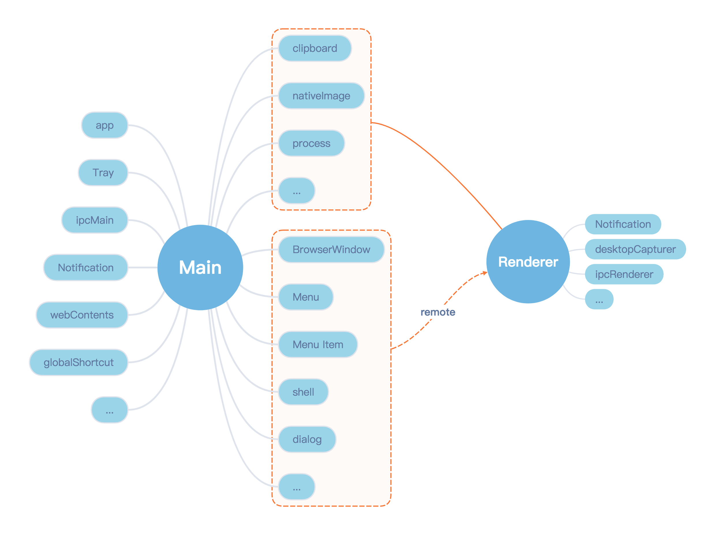
Modules

Slide 22
app
Hooks
will-finish-launching
ready
window-all-closed
before-quit
will-quit
quit
active
browser-window-created
browser-window-focus
Methods
quit()
getPath(name)
focus()

Slide 23
BrowserWindow
Hooks
closed
focus
show, hide
maximize, minimize
Methods
getFocusedWindow()
close()
focus()
show(), hide()
maximize(), minimize(), restore()

Slide 24
remote Module
shell
this.$electron.remote.shell.openExternal('url')
dialog
this.$electron.remote.dialog.showMessageBox({
title: 'title',
message: 'message',
detail: 'detail',
})

Slide 25
Call Function in C++ DLL
node-ffi-napi
https://github.com/node-ffi-napi/node-ffi-napi
Install
npm i ffi-napi ref-napi
Issue
dependent ref cannot be installed
If use @saleae/ref, runtime error because of version match
node-ffi
Node.js addon for loading and calling dynamic libraries using pure js
Install (support Node v12)
npm i -g node-gyp
https://github.com/lxe/node-ffi/tree/node-12
npm install @saleae/ffi
npm install -S lxe/node-ffi#node-12 lxe/ref#node-12 lxe/ref-struct#node-12
runtime error because of version match of ref
Native node addons
var ffi = require('ffi-napi');
var lib = ffi.Library('user32', {
'GetSysColor': [ 'int', [ 'int' ] ]
});
console.log('Loaded user32')
let ret = lib.GetSysColor(0);
console.log('sys color 0:', ret)

Slide 26
FFI
References
https://github.com/node-ffi/node-ffi/wiki/Node-FFI-Tutorial
https://www.sobyte.net/post/2022-02/communicate-with-cpp-code-in-node/
https://tootallnate.github.io/ref/
https://www.mo4tech.com/node-ffi-usage-guide.html
https://zhuanlan.zhihu.com/p/40526242
https://www.sobyte.net/post/2022-02/communicate-with-cpp-code-in-node
Usage
const ffi = require('ffi')
const ref = require('ref')
const ref_struct = require('ref-struct')
basic types
ref.types.int ref.types.char ref.types.void
pointer type
int * -> ref.refType(‘int’)
pointer dereference
*p -> ref.deref()
get address of variable
var.ref()
allocate mem
ref.alloc('int')
array
ref-array
structure
ref-struct
Buffer
The principle of node-ffi pointer implementation is to use the Buffer class to realize memory sharing between C code and JS code with the help of REF, making Buffer become a pointer in C language. Note that once ref is referenced, the prototype of Buffer is modified, and some methods are replaced and injected.

Slide 27
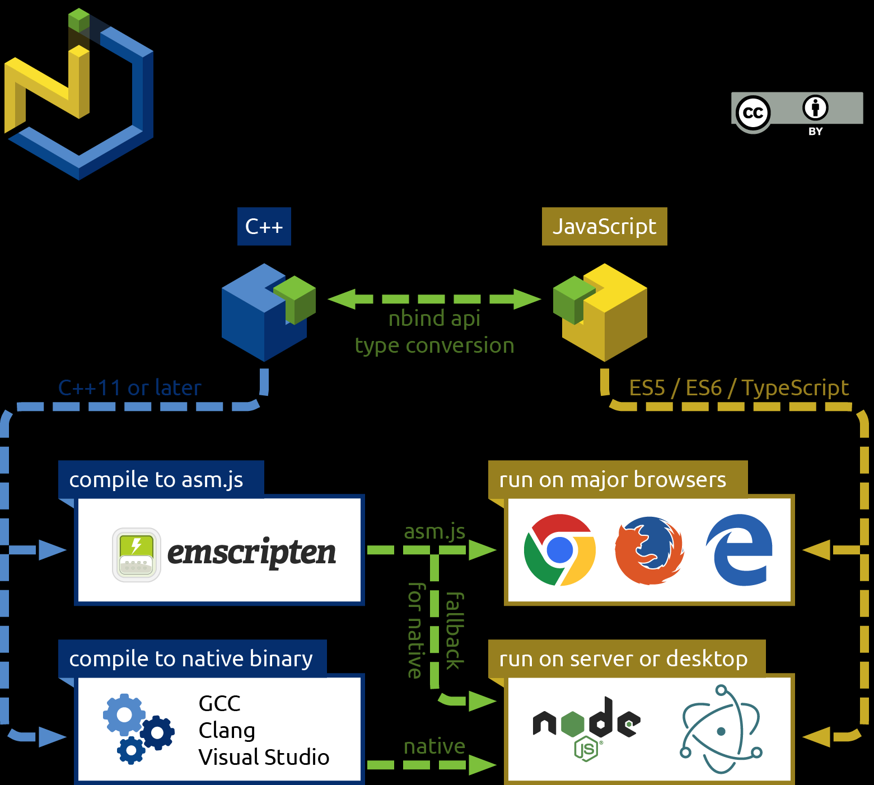
Call C++ interface - NBind
https://github.com/charto/nbind

Slide 28
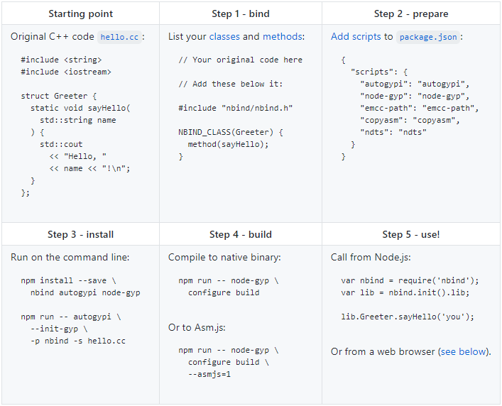
Call C++ interface - NBind

Slide 29
Issues and Solutions

Slide 30
Crash Analysis
References
https://www.sobyte.net/post/2021-09/electron-crash-sentry/
Command line switches
https://www.electronjs.org/docs/latest/api/command-line-switches
--log-level
INFO = 0, WARNING = 1, LOG_ERROR = 2, LOG_FATAL = 3

Slide 31
Issue 1
sandbox (Electron 10.x, no solution yet)
Issue
The SUID sandbox helper binary was found
Solution
Make sure chromium-browser can work first
Make sure electron-quick-start-typescript can work by “npm start”
process is not defined
Issue
ERROR in Template execution failed: ReferenceError: process is not defined
Solution
Modify .electron-vue/webpack.web.config.js and .electron-vue/webpack.renderer.config.js, add templateParameters to HtmlWebpackPlugin
templateParameters(compilation, assets, options) {
return {
compilation: compilation,
webpack: compilation.getStats().toJson(),
webpackConfig: compilation.options,
htmlWebpackPlugin: {
files: assets,
options: options
},
process,
};
},

Slide 32
Issue 2
Critical dependency: the request of a dependency is an expression
Modify .electron-vue/webpack.main.config.js
externals: [
...Object.keys(dependencies || {}),
{'electron-debug': 'electron-debug'}
],
Couldn't find preset "es2015"
npm i -S babel-preset-es2015
Error: Cannot find module 'chalk'
cnpm i -S chalk
libgconf
Issue
/mnt/c/Projects/FingerprintWinAPP/src/fingerprint-win-app/node_modules/_electron@2.0.18@electron/dist/electron: error while loading shared libraries: libgconf-2.so.4: cannot open shared object file: No such file or directory
Solution
sudo apt install libgconf-2-4

Slide 33
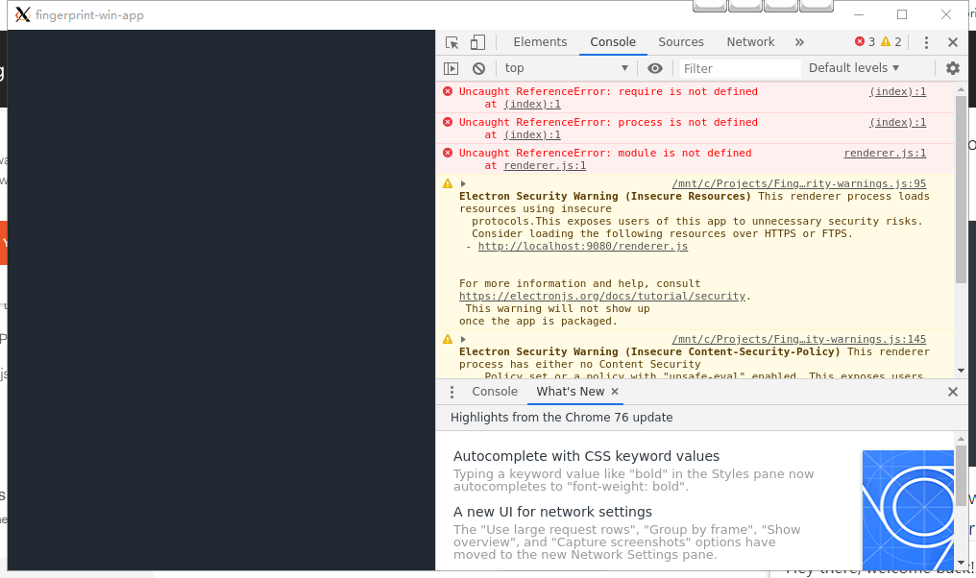
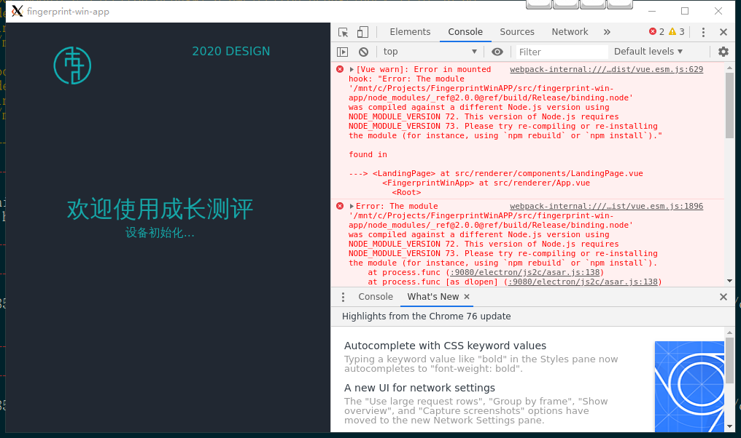
Issue 3
require() is not defined
app.on('ready', () => {
mainWindow = new BrowserWindow({
webPreferences: {
nodeIntegration: true
}
});
});
Compiled against a different Node.js version
https://www.electronjs.org/docs/tutorial/using-native-node-modules
npm i -D electron-rebuild
./node_modules/.bin/electron-rebuild <module-name> # after “npm i”
Rebuild module
cd node_modules\ffi && HOME=~/.electron-gyp node-gyp rebuild --target=5.0.13 --arch=x64 --dist-url=https://electronjs.org/headers
5.0.13: Electron version
cnpm i -g node-gyp

Slide 34
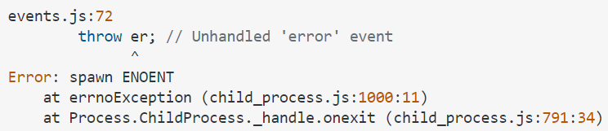

Issue 4
Error: spawn ENOENT
Solution
rm -rf node_modules
npm i
Error: dynmic linking error 193
Cause
library is not 64bit (check by sigcheck)
Solution
install 32-bit node
node -p "process.arch" // output 32bit or 64bit node
reinstall node-gyp
cnpm install -g node-gyp
reinstall npm dependencies

Slide 35
Issue 5
RequestError: unable to verify the first certificate
set ELECTRON_MIRROR=http://npm.taobao.org/mirrors/electron/
Error: PostCSS received undefined instead of CSS string
npm uninstall node-sass
npm uninstall sass-loader
npm install -S node-sass@4.14.1
npm install -S sass-loader@8.0.0
App crash when callback is invoked
https://community.particle.io/t/timer-callback-method-calling-httpclient-crashes-on-electron/22373
timer -> change to thread
https://github.com/electron/electron/issues/25397
v11.0.0 or newer
code: 'ERR_ICON_TOO_SMALL'
build/icon.ico needs to be at least 256x256

Slide 36
Issue 6
应用白屏
references
https://juejin.cn/post/7136124646079856671
https://www.zhihu.com/question/54091307

Slide 37
Issues in yarn install
ValueError: invalid mode: 'rU' while trying to load binding.gyp
this issue happens when python version is 3.11
solution: change 3.11 back to 3.10

Slide 38
THANKS
谢谢聆听

