Slide 1
Java Backend Notes
Sparks-Lu
Last updated: 5/29/2021

Slide 2
Install
Ref
https://blog.csdn.net/cpjiiiiiii/article/details/95317115
Steps
Install JDK
v1.8.0_162
Install OpenJDK in Ubuntu
sudo add-apt-repository ppa:webupd8team/ppa:web-upd8team
sudo apt update
sudo apt install openjdk-8-jdk
java -version
Configure environment variables
JAVA_HOME C:\Program Files\Java\jdk1.8.0_162

Slide 3
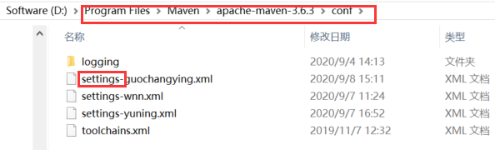
Maven
Install
Download zip from https://maven.apache.org/download.cgi
Add bin folder to system path
mvn -v
POM （Project Object Model）
pom.xml
更换国内镜像
全局配置: ${M2_HOME}/conf/settings.xml
用户配置: user.home/.m2/settings.xml
Build
mvn compile
mvn package
mvn clean
mvn clean package
<mirror>
<id>alimaven</id>
<name>aliyun maven</name>
<url>http://maven.aliyun.com/nexus/content/repositories/central/</url>
<mirrorOf>central</mirrorOf>
</mirror>

Slide 4
Gradle
Intro
build tool
Prerequisite
java -version
Install
https://gradle.org/install/
download from https://mirrors.cloud.tencent.com/gradle/

Slide 5
Vim
Reference
https://dev.to/mafflerbach/vim-as-java-ide-3b1a

Slide 6
Spring Cloud
参考
http://c.biancheng.net/spring_cloud/
介绍
开发分布式系统的“全家桶”，是一系列框架的有序集合。
环境搭建
JDK
java -version
Maven
mvn -version
Gradle
https://gradle.org/install/

Slide 7
Install Tomcat as Windows Service
Reference
https://tomcat.apache.org/tomcat-8.5-doc/windows-service-howto.html
Steps
bin/service.bat install {ServiceName}

Slide 8
Keytool
Verify keystore
keytool -list -v -keystore <yr keystore file>

Slide 9
Spring Boot

Slide 10
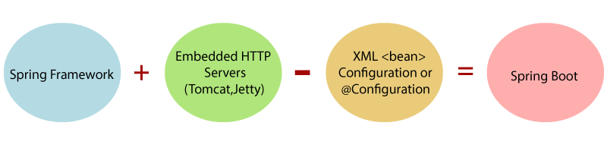
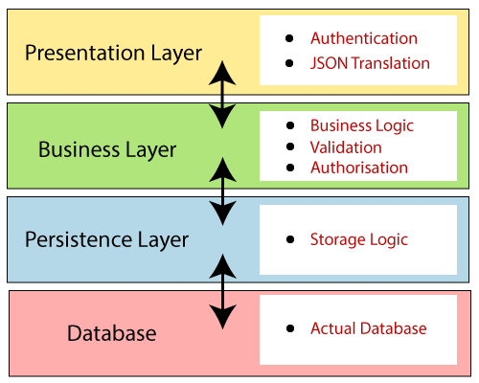
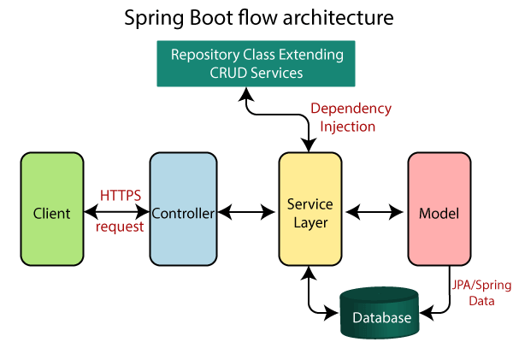
Introduction
简化新 Spring 应用的初始搭建以及开发过程

Slide 11
Install
Reference
https://docs.spring.io/spring-boot/docs/current-SNAPSHOT/reference/html/getting-started.html
Install
maven
gradle
Spring Boot CLI
spring --version

Slide 12
First App
Create pom.xml
Run “mvn package”
Add dependencies to pom.xml
mvn dependency:tree
Coding
@RestController
@RequestMapping
Run “mvn spring-boot:run”

Slide 13
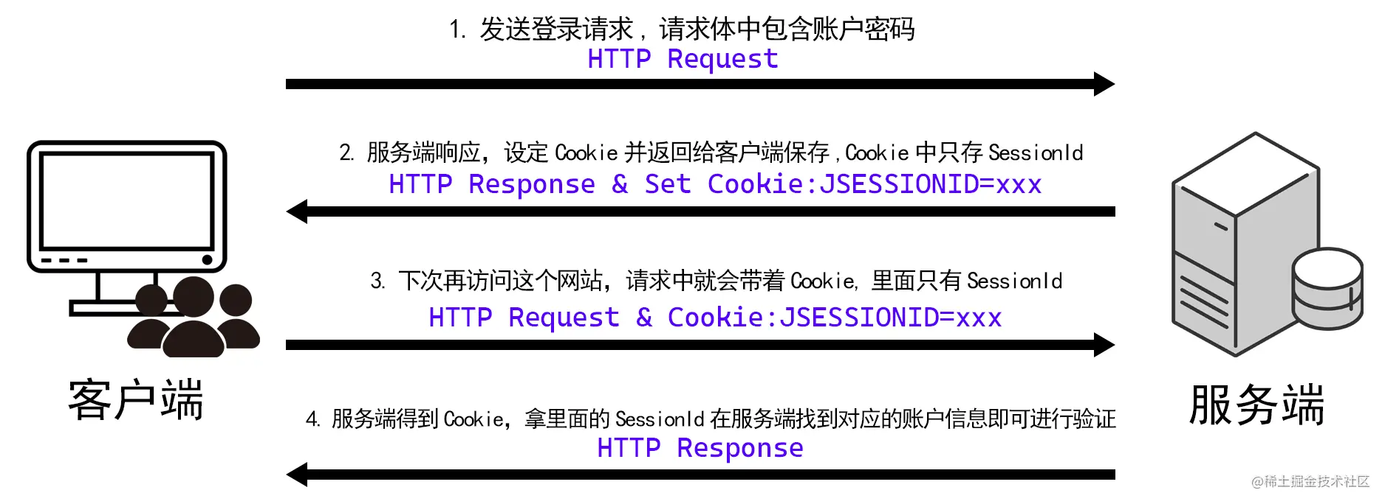
Session
References
https://www.techgeeknext.com/spring-boot/spring-boot-session-management
https://www.baeldung.com/spring-security-session
https://juejin.cn/post/6992562025318760461
Steps
Add dependency to pom.xml
<dependencies>
<!-- ... -->
<dependency>
<groupId>org.springframework.session</groupId>
<artifactId>spring-session-core</artifactId>
</dependency>
<dependency>
<groupId>org.springframework.session</groupId>
<artifactId>spring-session-jdbc</artifactId>
</dependency>
</dependencies>
application.properties
spring.session.store-type=jdbc # Session store type.

Slide 14
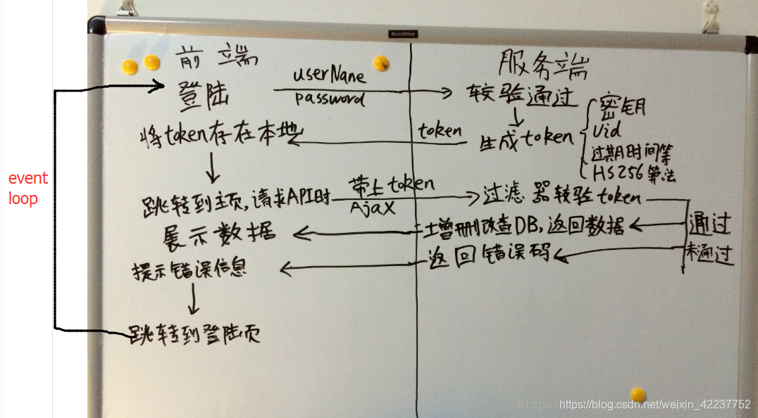
Token
References
https://blog.csdn.net/weixin_42237752/article/details/88655511
https://juejin.cn/post/7035280102636126244
https://www.jianshu.com/p/0e77beb3c1e5

Slide 15
DB

Slide 16
Structure
dao
define mapper functions
mapping
define mapping between pojo and SQL statements
pojo
define java object

Slide 17
Pojo (Plain Old Java Object)
A Pojo class
contains variables and their getters and setters
References
https://www.javatpoint.com/pojo-in-java
https://www.baeldung.com/java-pojo-class

Slide 18
MyBatis
References
https://www.baeldung.com/mybatis
Intro
an open source, lightweight, persistence framework
automates the mapping among SQL databases and objects in Java, .NET, and Ruby on Rails.
an alternative to JDBC and Hibernate
set up all the queries using annotations
Mapper class
an interface with method definitions that match up against the SqlSession methods
@Results, @Result, @Select, @Update, @Delete, @Insert
Mapper XML
contains a set of statements to configure various SQL statements such as select, insert, update, and delete
in accordance with pojo
Result maps
Add a new DB column
update mapper xml
update pojo

Slide 19
MyBatis Plus
References
https://www.bmabk.com/index.php/post/84156.html
Features
启动即会自动注入基本 CURD，性能基本无损耗，直接面向对象操作
强大的 CRUD 操作：内置通用 Mapper、通用 Service，仅仅通过少量配置即可实现单表大部分 CRUD 操作，更有强大的条件构造器，满足各类使用需求
内置代码生成器
内置分页插件
IService
boolean save(T entity)
boolean saveBatch(Collection<T> entityList)
boolean saveOrUpdateBatch(Collection<T> entityList)
boolean removeById(Serializable id)
boolean removeById(T entity)
boolean removeByMap(Map<String, Object> columnMap)
boolean remove(Wrapper<T> queryWrapper)
boolean removeByIds(Collection<?> list)
boolean removeBatchByIds(Collection<?> list)
boolean updateById(T entity)
boolean update(T entity, Wrapper<T> updateWrapper)
boolean updateBatchById(Collection<T> entityList)
boolean saveOrUpdate(T entity);
T getById(Serializable id)
listByIds(Collection<? extends Serializable> idList)
List<T> listByMap(Map<String, Object> columnMap)
T getOne(Wrapper<T> queryWrapper)
long count()
List<T> list()
<E extends IPage<T>> E page(E page, Wrapper<T> queryWrapper)
List<Object> listObjs()

Slide 20
Misc

Slide 21
Base64
java.util.Base64
encoding
String originalInput = "test input";
String encodedString = Base64.getEncoder().encodeToString(originalInput.getBytes());
decoding
byte[] decodedBytes = Base64.getDecoder().decode(encodedString);
String decodedString = new String(decodedBytes);

Slide 22
Properties
References
https://javapointers.com/how-to/how-to-load-properties-using-apache-commons-configuration-2/

Slide 23
Configure Tomcat as Windows Service
Run “bin/service.bat install”

Slide 24
Send Email
References
https://www.tutorialspoint.com/javamail_api/javamail_api_send_email_with_attachment.htm

