Slide 1
Node.js Notes
Sparks Lu
Last updated: 6/3/2021

Slide 2
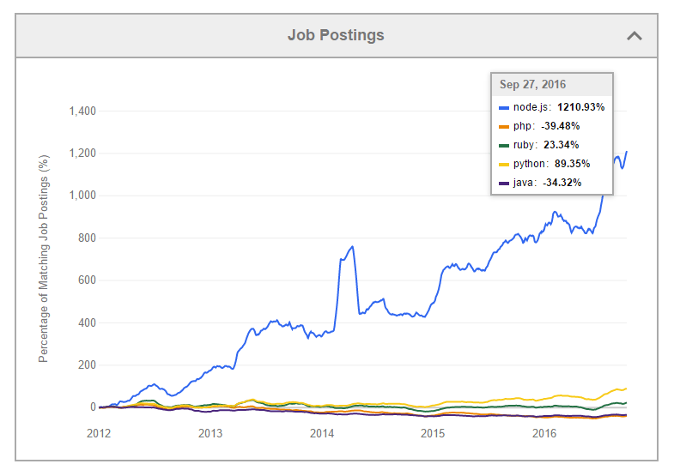
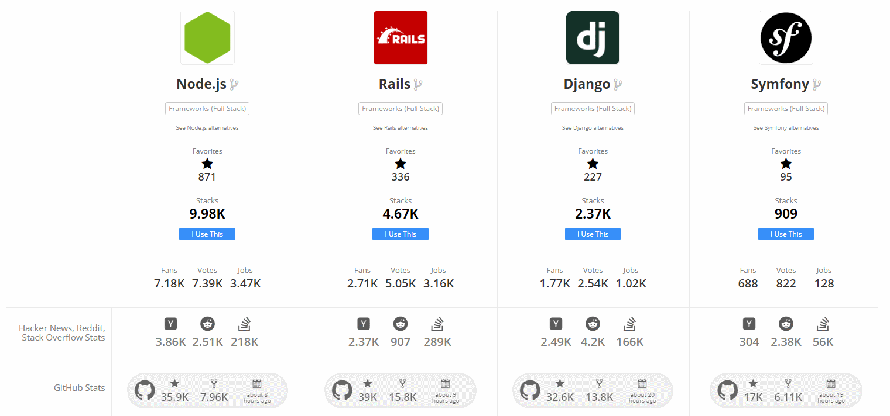
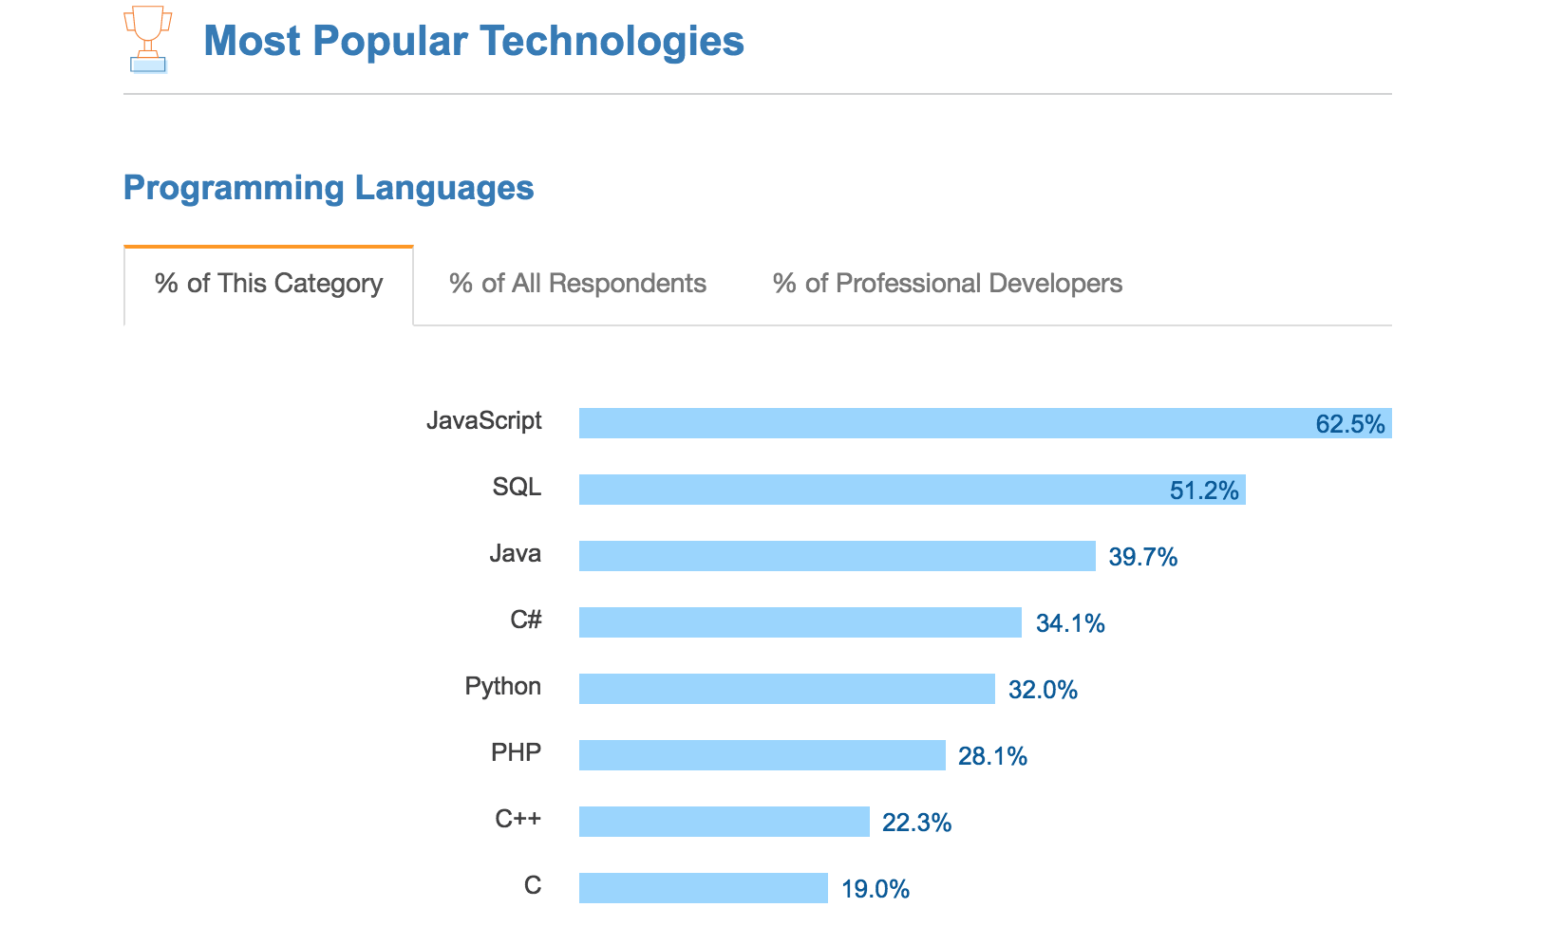
Overview
Overview
Runtime environment for executing JS code
Features
Asynchronous
node --version
node -p "process.arch" // 32bit or 64bit
Global object
global, window, module, __filename, __dirname
require: load module

Slide 3
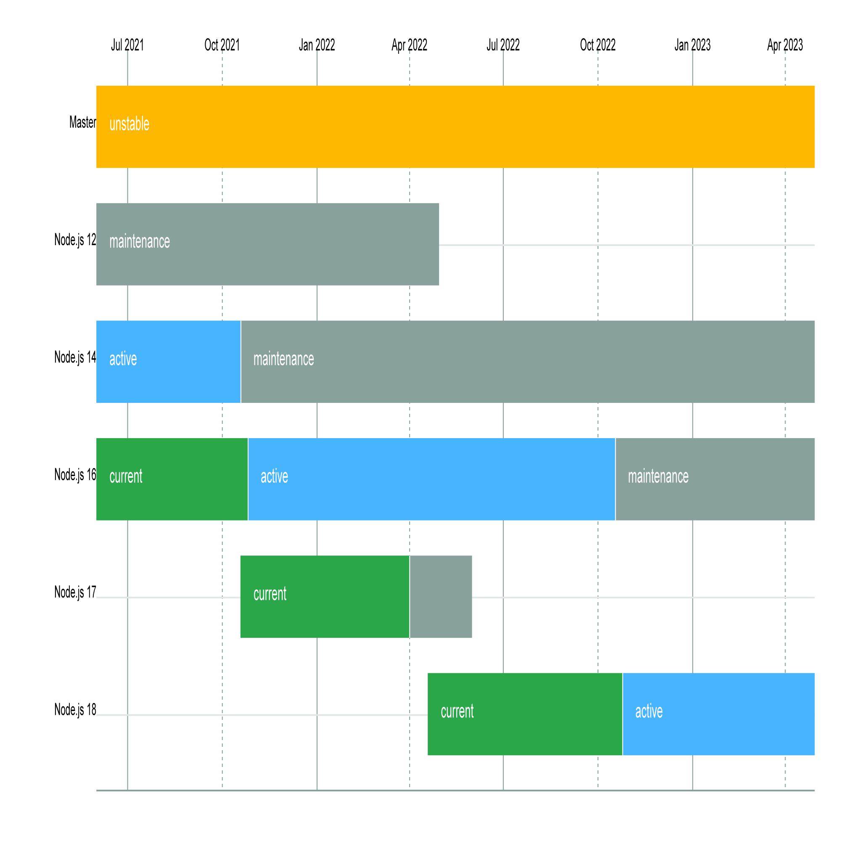
Install
Linux install
curl -sL https://deb.nodesource.com/setup_16.x | sudo -E bash -
sudo apt-get install -y nodejs
npm install --global windows-build-tools
Windows install
download installer from https://nodejs.org/en/download
Python and VS tools need to be installed along with it
Install check
node -v

Slide 4
NVM (Node.js Version Manager)
References
https://github.com/nvm-sh/nvm (Linux)
https://github.com/coreybutler/nvm-windows (Widnows)
Windows install
Download installers
https://github.com/coreybutler/nvm-windows/releases
backup %UserProfile%\.npmrc
delete %AppData%\npm
Linux install
curl -o- https://raw.githubusercontent.com/nvm-sh/nvm/v0.39.5/install.sh | bash
log out and log in again
Usage
nvm list
nvm list available // list available node versions
nvm install {version} {arch}
arch: 32 or 64
nvm install 16.20.2 64
nvm use {version}
nvm uninstall {version}
nvm alias default [ version_here]

Slide 5
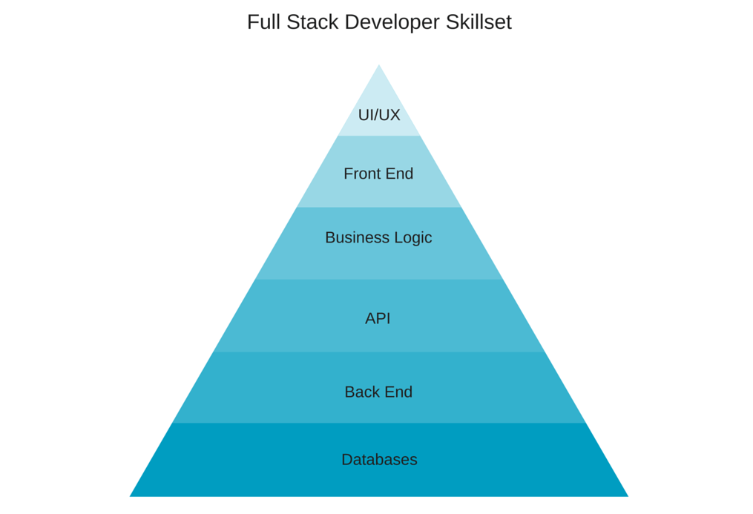
Full Stack Development
LAMP
MEAN
MEAN
PHP
MySQL
Express
MongoDB
Django
MySQL
Apache
AngularJS
Linux
Node.js
Python

Slide 6
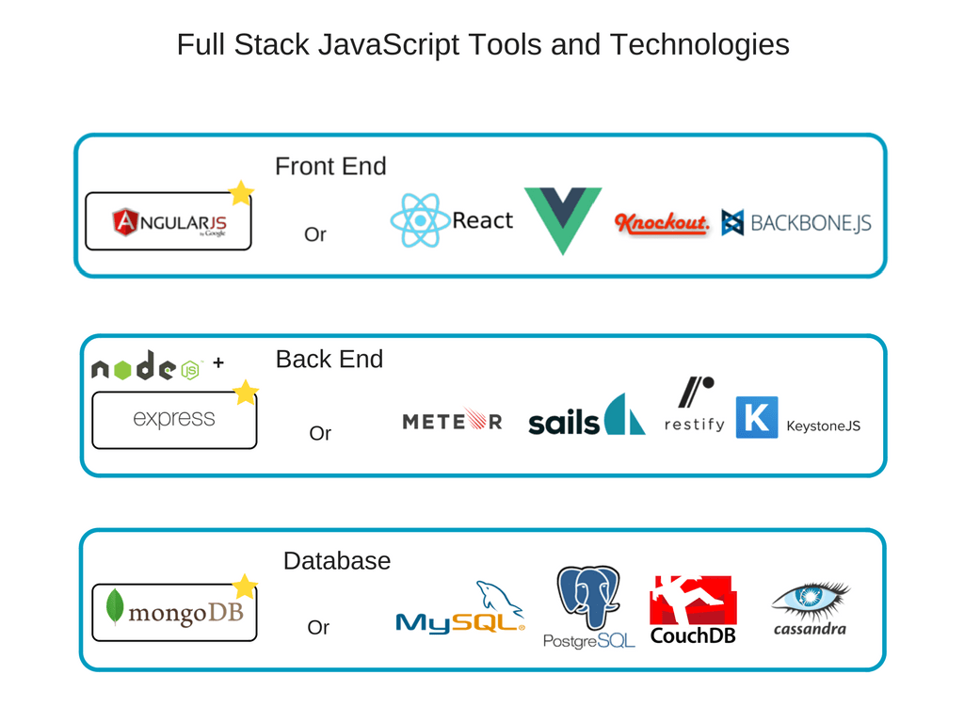
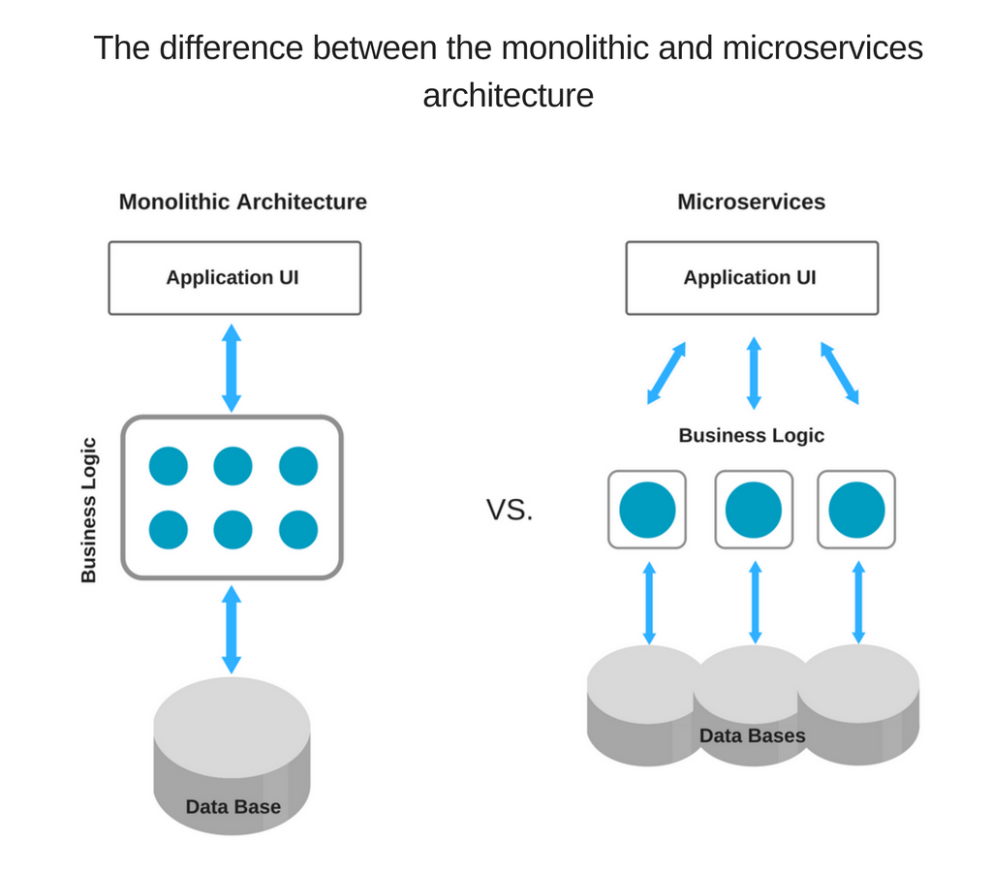
Web
Server
Express.js
Fontend
Angular.js
DB
MongoDB

Slide 7
Pros and Cons of Full-Stack JS Approach
Pros
Common language, better team efficiency with less resources
Extensive code reuse
High performance and speed
Huge talent pool
Extensive knowledge base
Free, open-source toolset
Cons
Insufficiency with computation-heavy backend
Relatively young technologies
Jack of all trade, master of none
Drawbacks of every separate tool in the stack combined

Slide 8
Package Management - npm
References
https://docs.npmjs.com/common-errors
Clean up packages
cnpm install depcheck -g
depcheck
Commnad | Explanation
npm config list | ~/.npmrc, ~/.npm/_logs/
npm config set registry http://registry.npm.taobao.org/ | Set npm registry mirror
npm config get registry | Get npm registry
npm list | List local installed packages
npm list -g | List global installed packages
npm install <package-name>@version-number | Install a package -g // global -S // install and save to package.json --verbose // verbose output
npm uninstall <package-name> | Uninstall a package
npm view <package-name> versions | List available versions of a package
npm search <keyword> | Search npm package
npm update <package-name>
npm update | Update all packages with newer minor version listed in package.json
npm cache clean | Clean npm cache
npm outdated | List outdated packages

Slide 9
Package Management - yarn
yarn
cnpm i -g yarn
yarn config set registry http://registry.npm.taobao.org
yarn config set registry http://registry.yarnpkg.com
yarn config list
yarn install --verbose
yarn add <package>
yarn remove <package>
yarn cache clean
yarn list
list installed packages in tree style
yarn list --pattern jszip

Slide 10
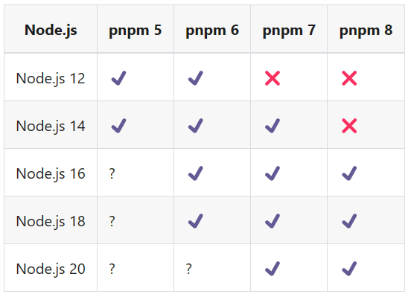
Package Management - pnpm
https://github.com/pnpm/pnpm
Install
Windows
Using PowerShell, iwr https://get.pnpm.io/install.ps1 -useb | iex
POSIX
curl -fsSL https://get.pnpm.io/install.sh | sh -
npm install -g pnpm
Usage
pnpm install
pnpm add {package}

Slide 11
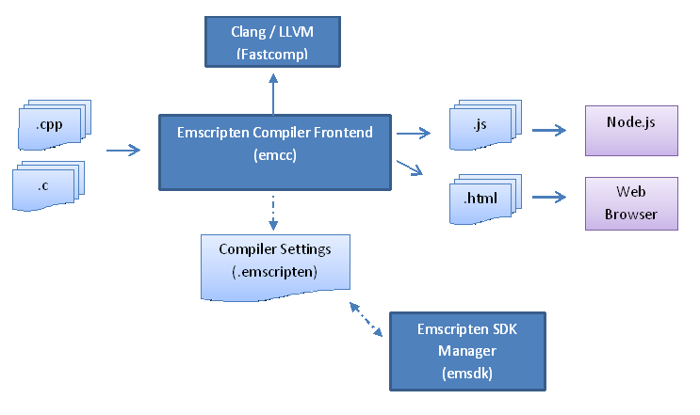
Interface with C++
FFI (Foreign Function Interface)
node-ffi
Node.js add-on for loading and calling dynamic libraries using pure JS
https://github.com/node-ffi/node-ffi/wiki/Node-FFI-Tutorial
SWIG
Interface compiler that connects programs written in C/C++ with scripting languages such as JS, Python, etc.
http://www.swig.org/tutorial.html
Emscripten
Compile LLVM into JS
http://kripken.github.io/emscripten-site/docs/getting_started/index.html
nbind
https://github.com/charto/nbind

Slide 12
node-opencv
Ref
https://github.com/peterbraden/node-opencv
https://community.risingstack.com/opencv-tutorial-computer-vision-with-node-js/

Slide 13
Set Up Web Server
server.js
const express = require("express");
const bodyParser = require("body-parser")
// New app using express module
const app = express();
app.use(bodyParser.urlencoded({
extended:true
}));
app.get("/", function(req, res) {
console.log('Received get request')
res.send('Received get request')
});
app.post("/qrcode", function(req, res) {
res.send("Received post request, body=", req.body);
});
app.listen(8080, function(){
console.log("server is running on port 8080");
})
References
https://nodejs.org/en/docs/guides/nodejs-docker-webapp/
Steps
mkdir proj & cd proj
cnpm init
create app.js
create package.json
run “node app.js”
package.json
{
"name": "docker_web_app",
"version": "1.0.0",
"description": "Node.js on Docker",
"author": "First Last <first.last@example.com>",
"main": "server.js",
"scripts": {
"start": "node server.js"
},
"dependencies": {
"express": "^4.16.1",
"body-parser": "^1.19.1"
}
}

Slide 14
Web Server using Docker
Docker
create Dockerfile
create server.js
run “docker build . -t node-web-app”
run “docker run -p 8080:8080 -d node-web-app”
Dockerfile
FROM node:16
# Create app directory
WORKDIR /usr/src/app
# Install app dependencies
# A wildcard is used to ensure both package.json AND package-lock.json are copied
# where available (npm@5+)
COPY package*.json ./
RUN npm install
# If you are building your code for production
# RUN npm ci --only=production
# Bundle app source
COPY . .
EXPOSE 8080
CMD [ "node", "server.js" ]
.dockerignore
node_modules
npm-debug.log

Slide 15
Express
Steps
/* express的服务器 */
//1. 导入express
var express = require('express')
//2. 创建express服务器
var server = express()
//3. 访问服务器(get或者post)
//参数一: 请求根路径
//3.1 get请求
server.get('/', function (request, response) {
// console.log(request)
response.send('get请求成功')
})
//3.2 post请求
server.post('/', function (request, response) {
response.send('post请求成功')
})
//4. 绑定端口
server.listen(4040)
console.log('启动4040')

Slide 16
Module Import and Export
References
https://www.freecodecamp.org/news/requiring-modules-in-node-js-everything-you-need-to-know-e7fbd119be8
require(‘module’)
steps: resolving, loading, wrapping, evaluating, caching
resolving
module.paths
index.js is used by default if require a folder
main property in package.json is used if require a folder
require.resolve
Only resolving, no other steps

Slide 17
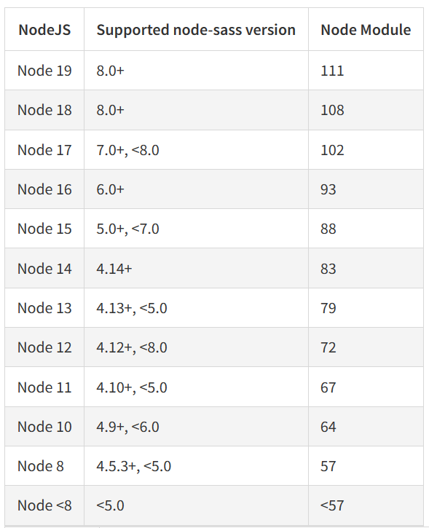
Node-sass
FAQ

Slide 18
Debug
set DEBUG=*,-not_this
set DEBUG= to turn off debug output

Slide 19
Printer - printer module
Install
npm install printer --legacy-peer-deps
sudo npm i -g node-gyp
sudo apt install -y libcups2-dev
npm i -D electron-rebuild
cd node_modules/printer && node-gyp rebuild --arch=arm64 && cd ../..
node_modules/.bin/electron-rebuild
Usage
const printer = require('printer')
printer.getPrinters()
printer.printDirect(options)
printer.printFile(options)
printer.getSupportedPrintFormats()
printer.printFile({filename:filename,
printer: process.env[3], // printer name, if missing then will print to default printer
success:function(jobID){
console.log("sent to printer with ID: "+jobID);
},
error:function(err){
console.log(err);
}
});

Slide 20
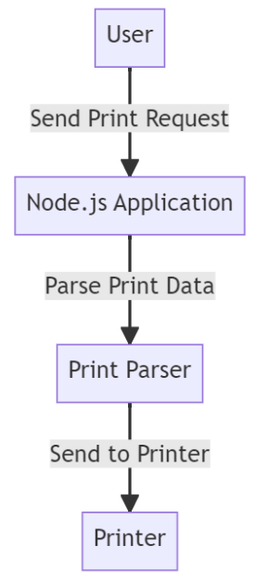
Printing
const PDFDocument = require('pdfkit');
let doc = new PDFDocument();
doc.text('Hello from Node.js!');
doc.pipe(fs.createWriteStream('output.pdf'));
doc.end();
References
https://github.com/tojocky/node-printer
https://marketsplash.com/tutorials/all/node-js-printing/
https://github.com/watson/ipp-printer
https://github.com/southlondonmakerspace/photo-printer
pdfkit
yarn add pdfkit
node-printer
yarn add node-printer
const printer = require('node-printer');
const printers = printer.list()
printer.setDefault(‘Printer_Name’)
const job=printer.print(‘filename’, options)
const jobInfo = printer.getJob('Printer_Name', job.id);
ipp-printer
yarn add ipp-printer
const printer = require('node-printer');
const options = {
media: 'A4',
n: 1
};
printer.print('path-to-file.txt', options);

Slide 21
FAQ
Error
issue: node/v8-internal.h:492:38: error: ‘remove_cv_t’ is not a member of ‘std’
CXXFLAGS="-std=c++17" npm i
issue: unable to verify the first certificate
change registry = "https://registry.npm.taobao.org/" into “http://registry.npm.taobao.org/”
issue: After upgrade nodejs, npm run build may fail with message like “Node Sass does not yet support your current environment:”
run “npm rebuild node-sass”
npm common errors
https://docs.npmjs.com/common-errors/

Slide 22
THANKS
谢谢聆听

