Slide 1
Web Server
Sparks Lu
Last updated: 3/7/2022

Slide 2
Change History
11/24/2021
Added “Lets’ Encrypt for Docker” slide
3/7/2022
Added ssh slide

Slide 3
General

Slide 4
CentOS
Determine CentOS version
vim /etc/centos-release
Set up the system
sudo yum -y update
sudo yum groupinstall -y development
Install Python
wget http://www.python.org/ftp/python/2.7.15/Python-2.7.15.tar.xz
xz -d Python-2.7.15.tar.xz
tar xvf Python-2.7.15.tar
cd Python-2.7.15 && ./configure --prefix=/usr/local && make && make install
sudo yum install python-pip
sudo python -m pip install “django<2”

Slide 5
Ubuntu
Swap
Configure Swap
sudo fallocate -l 1G /swapfile
ls -lh /swapfile
sudo chmod 600 /swapfile
sudo mkswap /swapfile
sudo swapon /swapfile
sudo swapon --show
free -h
echo '/swapfile none swap sw 0 0' | sudo tee -a /etc/fstab
Swappiness
cat /proc/sys/vm/swappiness
sudo nano /etc/sysctl.conf
vm.swappiness=10
vm.vfs_cache_pressure=50
Tools
check port status
sudo lsof -i -P -n | grep LISTEN

Slide 6
Windows Server
远程桌面连接
https://zhuanlan.zhihu.com/p/33490405
阿里云网页连接登录服务器
服务器管理-》本地服务器-》启用远程管理和远程桌面
Check port status
CurrPorts
http://www.nirsoft.net/utils/cports.html
Install Exchange Server
部署AD
https://blog.51cto.com/lumay0526/2046844
安装Exchange Server
https://blog.csdn.net/weixin_39585471/article/details/81081274
Post-installation
https://docs.microsoft.com/en-us/exchange/plan-and-deploy/post-installation-tasks/post-installation-tasks?view=exchserver-2019
Exchange Management Shell
Exchange admin center
https://<ServerFQDN>/ecp
SSH
References
https://www.hostwinds.com/tutorials/how-to-install-and-configure-openssh-windows-server-2016
Download and install OpenSSH server
download from https://github.com/PowerShell/Win32-OpenSSH/releases
extract to “C:\Program Files\OpenSSH-Win64”
setx PATH "$env:path;C:\Program Files\OpenSSH-Win64" -m
cd “C:\Program Files\OpenSSH-Win64”
.\install-sshd.ps1
Set-Service sshd -StartupType Automatic; Set-Service ssh-agent -StartupType Automatic; Start-Service sshd; Start-Service ssh-agent
Control Panel->Windows Firewall->Advanced Settings->Inbound Rules->New Rules
port 22

Slide 7
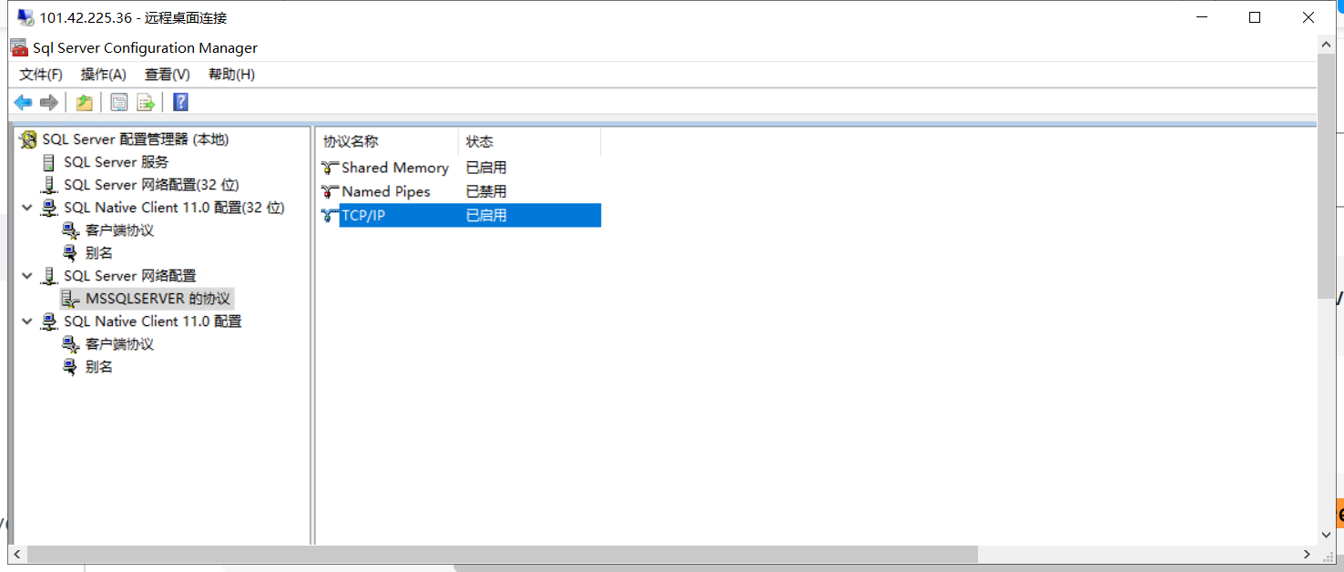
SQL Server
Setup
Install
Enable TCP/IP
Open “SQL Server Configuration Manager”
Expand “SQL Server Network Configuration”
Turn “TCP/IP” on

Slide 8
SSH
/etc/ssh/sshd_config
PasswordAuthentication
no -> yes
Avoid ssh connection freeze
TCPKeepAlive yes
ClientAliveInterval 100
ClientAliveCountMax 3000
sudo service sshd restart
ssh client
avoid freeze
~/.ssh/config
ServerAliveInterval // seconds that the client will wait before sending a null packet to the server (to keep the connection alive)
ClientAliveInterval // number of seconds that the server will wait before sending a null packet to the client (to keep the connection alive).

Slide 9
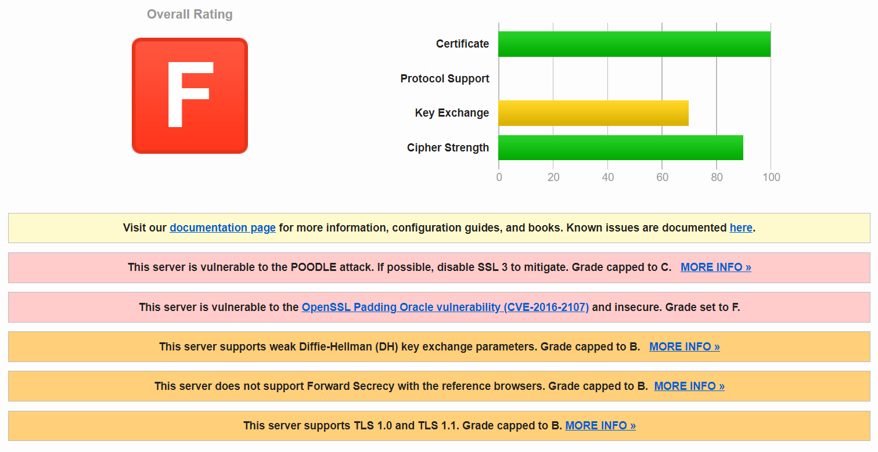
Windows Server - HTTPS
Cert
keytool -import -alias example -keystore "C:\Program Files (x86)\Java\jre1.6.0_22\lib\security\cacerts" -file example.cer
password: changeit
Server SSL test
https://www.ssllabs.com/ssltest/analyze.html

Slide 10
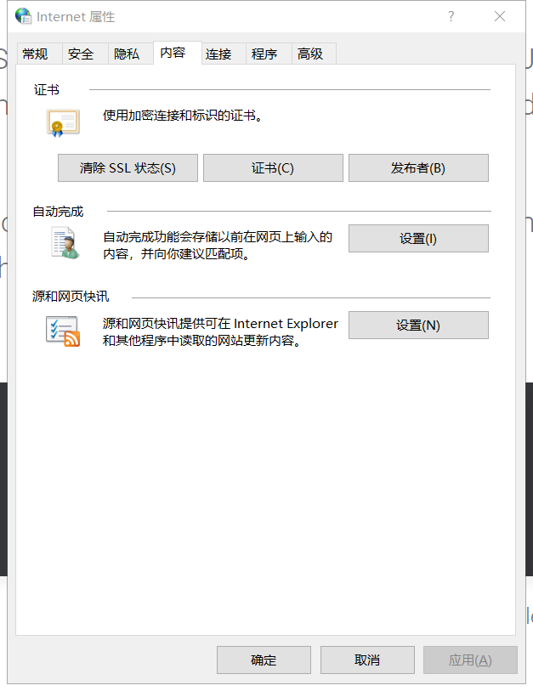
Let’s Encrypt on Windows
conf/server.xml
<Connector port="8443" protocol="org.apache.coyote.http11.Http11NioProtocol"
maxThreads="150" SSLEnabled="true">
<SSLHostConfig>
<Certificate certificateFile="conf/cert.pem"
certificateKeyFile="conf/privkey.pem"
certificateChainFile="conf/chain.pem" />
</SSLHostConfig>
</Connector>
References
https://certbot.eff.org/
Steps
Download certbot installer from https://certbot.eff.org/instructions?ws=apache&os=windows
certbot certonly --standalone
After success
Successfully received certificate.
Certificate is saved at: C:\Certbot\live\weifantasy.com\fullchain.pem
Key is saved at: C:\Certbot\live\weifantasy.com\privkey.pem
This certificate expires on 2022-03-20.
These files will be updated when the certificate renews.
Certbot has set up a scheduled task to automatically renew this certificate in the background.
cd C:\Certbot\live\weifantasy.com
cp cert.pem/chain.pem/privkey.pem $tomcat\conf
Modify conf/server.xlm
restart server
Control Panel -> Internet Options -> Content -> Clear SSL States

Slide 11
Web Server Architecture
Django
Bootstrap
Nginx
Apache + mod_wsgi

Slide 12
Nginx
Install
sudo apt install nginx
Configuration Files
/etc/nginx/nginx.conf
/etc/nginx/conf.d/*.conf
/etc/nginx/sites-available
/etc/nginx/sites-enabled
/var/log/nginx/
Commands
nginx -v
nginx -h
service nginx start/stop/restart
nginx -s reload
Content type
/etc/nginx/mime.types
gzip

Slide 13
Nginx Configuration
References
https://nginx.org/en/docs/http/ngx_http_core_module.html
Config options
max_ranges:
0 to disable byte-range support
max_ranges | Limits the maximum allowed number of ranges in byte-range requests | Default: not limited 0: disable byte-range support
proxy_connect_timeout
proxy_send_timeout
proxy_read_timeout
send_timeout
limit_rate | limit_rate 512k; // limit bandwidth to 512K | 该指令用于限制向客户端传输数据的速度，单位是Byte/s每秒传输的字节数，设置0禁用限制功能。

Slide 14
Apache
Install
Run as a service
httpd.exe -k install
conf/httpd.conf
WSGI (Web Service Gateway Interface)
mod_wsgi
module to host python applications
pip install mod_wsgi

Slide 15
Monitoring
 | 命令 | 说明
监控硬件 | ipmitool
CPU相关 | lscpu uptime top htop vmstat mpstat
内存 | free
磁盘 | df dd iotop
网络 | iftop nethogs sudo lsof -i -P -n | grep LISTEN netstat -nltp | 列出正在监听的端口
监控出图 | mrtg nagios cacti zabbix

Slide 16
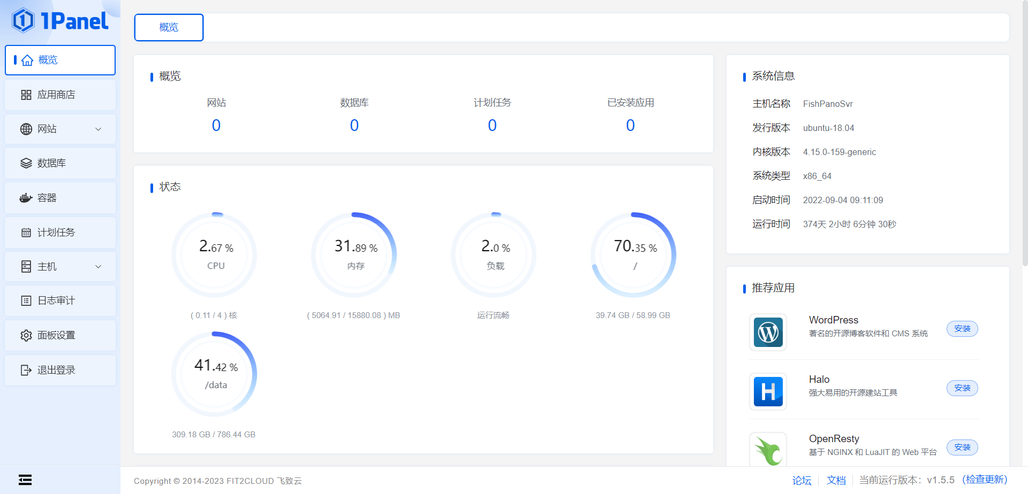
Operation & Maintenance Tools
1Panel
https://github.com/1Panel-dev/1Panel
Install
curl -sSL https://resource.fit2cloud.com/1panel/package/quick_start.sh -o quick_start.sh && sudo bash quick_start.sh

Slide 17
SAR
sudo apt install sysstat
Enable sysstat
/etc/default/sysstat false->true
Configure sysstat
/etc/cron.d/sysstat 5-55/10->*/2
/etc/sysstat/sysstat
HISTORY: 7->30
Start sysstat
sudo service sysstat restart
sudo service --status-all
log file: /var/log/sysstat/sa*
ksar
sudo apt install openjdk-8-jre
wget https://excellmedia.dl.sourceforge.net/project/ksar/ksar/5.0.6/kSar-5.0.6.zip
LC_ALL=C sar -A -f sa22 >sa22.parse
run.sh &
Select “load from text file...”
References
https://www.howtoforge.com/install-and-configure-sar-and-ksar-for-daily-monitoring-on-linux-and-generate-pdf-reports/
#!/bin/bash
idx=`date --date="1 days ago" +%Y%m%d`
work_dir="/home/lgm/SarReports/"
sar_file="$work_dir/sa$idx"
pdf_file="$work_dir/sa$idx.pdf'
ksar_dir=”/home/lgm/Programs/kSar-5.0.6/”
LC_ALL=C sar -A -f /var/log/sysstat/sa$idx > $sar_file
cd $ksar_dir
java -jar kSar.jar -input $sar_file -outputPDF $pdf_file
echo "Ksar graph successfully generated"

Slide 18
阿里云域名+腾讯云服务器
References
https://blog.csdn.net/daotiao0199/article/details/81945865
Steps
阿里云->控制台->域名->域名列表->管理
修改域名的DNS服务器为s1g1ns1.dnspod.net和s1g1ns2.dnspod.net
腾讯云->控制台->域名服务->我的域名->添加解析
腾讯云域名诊断工具 https://domaintool.cloud.tencent.com

Slide 19
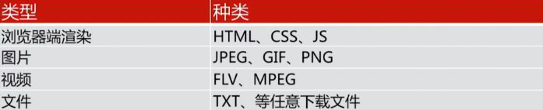
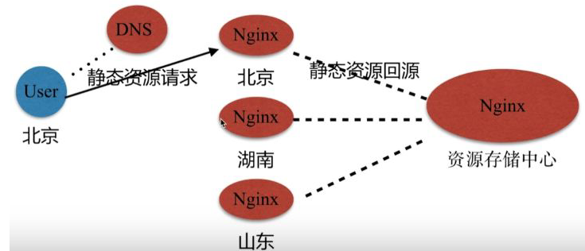
CDN
Content Delivery Network
动静分离
https://www.cnblogs.com/matengfei123/p/8005404.html

Slide 20
Set Up VPN
Rent server from vultr.com
Config server as VPN server
Refer
https://www.vultr.com/docs/setup-a-pptp-vpn-server-on-ubuntu
https://blog.warmcolor.net/2013/06/21/%E5%9F%BA%E4%BA%8Eubuntu%E6%90%AD%E5%BB%BAvpn%E6%9C%8D%E5%8A%A1%E5%99%A8%E5%B7%B2%E9%AA%8C%E8%AF%81/
Steps
apt-get install pptpd
Edit /etc/pptpd.conf
option /etc/ppp/pptpd-options
localip {server-ip}
remoteip 192.168.0.11-150
Edit /etc/ppp/pptpd-options
ms-dns 8.8.8.8
ms-dns 8.8.4.4
/etc/ppp/chap-secrets
用户名 pptpd 密码 *
/etc/init.d/pptpd restart
iptables -I INPUT -p tcp --dport 1723 -j ACCEPT
Edit /etc/sysctl.conf
net.ipv4.ip_forward = 1
sysctl -p
cat /proc/sys/net/ipv4/ip_forward: 1
/etc/init.d/procps restart
apt-get install iptables
sudo ifconfig
get eth0 name: e.g. enp1s0
iptables --table nat --append POSTROUTING --out-interface {eth0} --jump MASQUERADE
Edit /etc/rc.local:
iptables --table nat --append POSTROUTING --out-interface eth0 --jump MASQUERADE
sudo iptables-save
sudo systemctl enable pptpd
sudo apt-get install -y iptables-persistent
Set up client
Search vpn in start menu

Slide 21
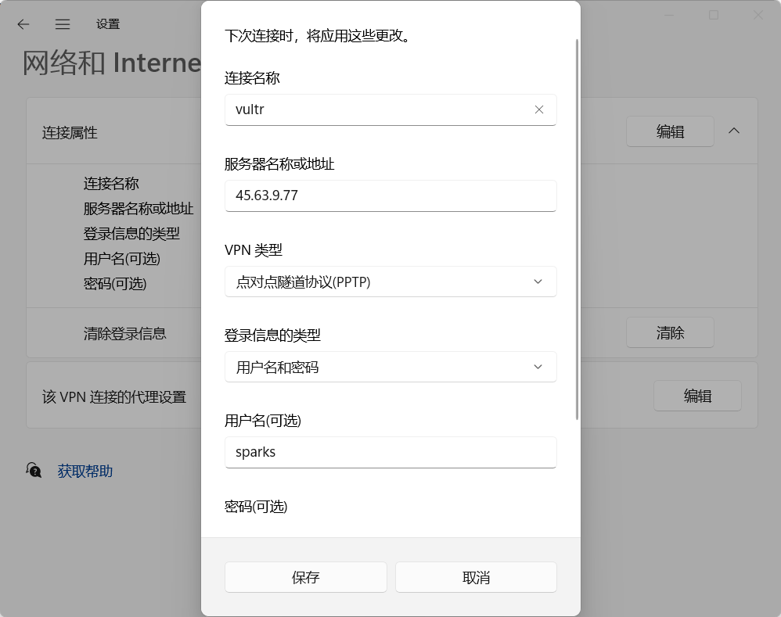
Set Up VPN 2
Client

Slide 22
Firewall
Ubuntu
sudo ufw status verbose
sudo ufw allow 80
sudo ufw delete allow 80
CentOS
firewall-cmd --zone=public --list-ports
firewall-cmd --zone=public --add-port=80/tcp --permanent
firewall-cmd --zone=public --add-port=443/tcp --permanent
firewall-cmd --zone=public --remove-port=80/tcp --permanent
firewall-cmd --reload
firewall-cmd --zone=public --query-port=80/tcp

Slide 23
OpenSSL
Command | Usage | Note
openssl genrsa -out privateKey.key 2048 | Generate private key
openssl req -new -key privateKey.key -out CSR.csr | Generate CSR (Certificate Signing Requests) | input fields
openssl req -out CSR.csr -new -newkey rsa:2048 -nodes -keyout privateKey.key -subj "/C=US/ST=Florida/L=Saint Petersburg/O=Your Company, Inc./OU=IT/CN=yourdomain.com" | Generate private key and CSR
openssl req -x509 -sha256 -nodes -days 365 -newkey rsa:2048 -keyout privateKey.key -out certificate.crt | Generate a self-signed certificate
openssl rsa -text -in privateKey.key -noout | Check private key info
openssl req -text -in CSR.csr -noout | Check CSR info
openssl x509 -text -in certificate.crt -noout | View certificate info
openssl s_client -showcerts -connect <hostname>:<port> -prexit | Check certificate of website
echo -n | openssl s_client -connect fr.cib-biz.com:8097 | openssl x509 > /tmp/cis.cert | Download certificate from a website | PKS (Public Key Cryptography Standards)
generate a key pair
generate a CSR (Certificatae Signing Request) that contains public key and domain name
upload request to a CA (Certificate Authority)
download the certificate
Ref:
https://www.digitalocean.com/community/tutorials/openssl-essentials-working-with-ssl-certificates-private-keys-and-csrs

Slide 24
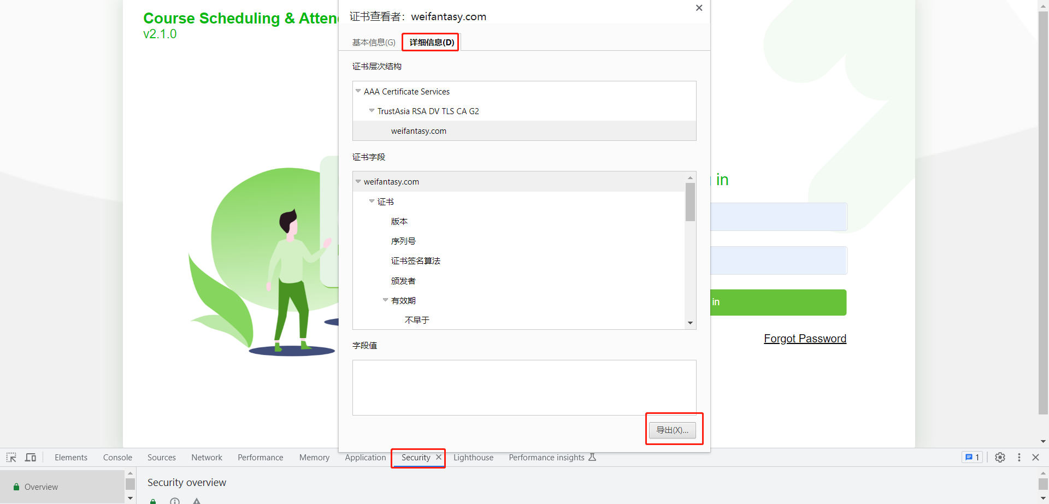
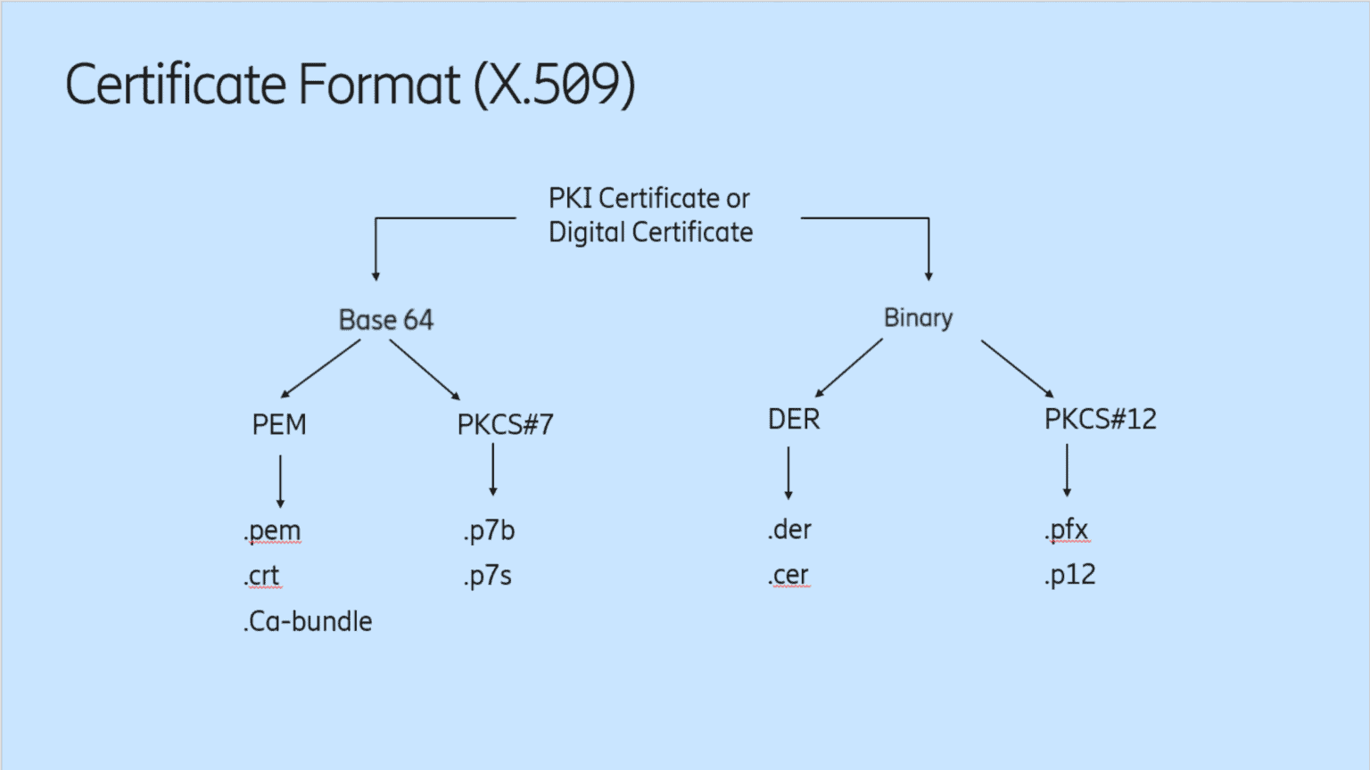
Certificate
References
https://thesecmaster.com/what-are-the-different-types-of-certificate-formats/
Format
Tomcat:.pfx
Nginx: .crt .pem
conversion
references
https://www.howtouselinux.com/post/converting-cer-crt-der-pem-pfx-certificate
https://www.sslshopper.com/ssl-converter.html
https://thesecmaster.com/what-are-the-different-types-of-certificate-formats/
convert .crt to .pfx
openssl pkcs12 -export -out domain.name.pfx -inkey domain.name.key -in domain.name.crt
convert .p7b to .pfx
openssl pkcs7 -print_certs -in certificate.p7b -out certificate.cer
openssl pkcs12 -export -in certificate.cer -inkey privateKey.key -out certificate.pfx -certfile CACert.cer
covnert .pfx to PEM
openssl pkcs12 -in certificate.pfx -out certificate.cer -nodes
convert PEM to .p7b
openssl crl2pkcs7 -nocrl -certfile certificate.cer -out certificate.p7b -certfile CACert.cer
Keytool
default password: “changeit”

Slide 25
Certificate 2
References
https://www.baeldung.com/jvm-certificate-store-errors
List certificates
keytool -list -keystore $JAVA_HOME\jre\lib\security\cacerts
// get a list of all the certificates registered in the JVM’s certificate store
Add certificate to JVM’s certificate store
$JAVA_HOME/bin/keytool -import -trustcacerts -file booking.crt -keystore $JAVA_HOME/jre/lib/security/cacerts
Verify .p7b certificate
openssl pkcs7 -print_certs -inform der -in file.p7b
Use .p7b certificate in Tomcat
refereces
https://ssle.cn/help/tomcat-an-zhuang-ssl-zheng-shu/
create keystore
keytool -genkey -alias server -keyalg RSA -keysize 2048 -keystore your_site_name.jks
import p7b into keystore
keytool -import -trustcacerts -alias server -file domain.p7b -keystore ssle.jks
check keystore
Modify conf/server.xml
set jks to “keystoreFile”
set “keystorePass”
Java Certificate
jks (Java KeyStore): repository of security certificates
create keystore
keytool -list -keystore ssle.jks -v

Slide 26
Certificate FAQ
SunCertPathBuilderException: unable to find valid certification path to requested target
Cause
the certificate offered by the endpoint is not considered valid to your JDK's default trust store
Solution
get InstallCert.java from https://github.com/escline/InstallCert
run “javac InstallCert.java”
run “java InstallCert localhost:8443”
add your localhost as a trusted keystore, and generates a file “jssecacerts”
copy the generated jssecacerts file to your $JAVA_HOME\jre\lib\security folder.
restart web service
References
https://mkyong.com/webservices/jax-ws/suncertpathbuilderexception-unable-to-find-valid-certification-path-to-requested-target/

Slide 27
SSL Certificate - Self-Signed
# /etc/nginx/snippets/aja-ssl-params.conf
# from https://cipherli.st/
# and https://raymii.org/s/tutorials/Strong_SSL_Security_On_nginx.html
ssl_protocols TLSv1 TLSv1.1 TLSv1.2;
ssl_prefer_server_ciphers on;
ssl_ciphers "EECDH+AESGCM:EDH+AESGCM:AES256+EECDH:AES256+EDH";
ssl_ecdh_curve secp384r1;
ssl_session_cache shared:SSL:10m;
ssl_session_tickets off;
ssl_stapling on;
ssl_stapling_verify on;
resolver 8.8.8.8 8.8.4.4 valid=300s;
resolver_timeout 5s;
# Disable preloading HSTS for now. You can use the commented out header line that includes
# the "preload" directive if you understand the implications.
#add_header Strict-Transport-Security "max-age=63072000; includeSubdomains; preload";
add_header Strict-Transport-Security "max-age=63072000; includeSubdomains";
add_header X-Frame-Options DENY;
add_header X-Content-Type-Options nosniff;
ssl_dhparam /etc/ssl/certs/aja-dhparam.pem;
Reference
https://alvinalexander.com/linux-unix/my-notes-how-configure-https-nginx-ubuntu-16/
https://www.digitalocean.com/community/tutorials/how-to-create-a-self-signed-ssl-certificate-for-nginx-in-ubuntu-16-04
Concept
SSL key (private key)
kept on server， used to encrypt content sent to client
SSL certificate (public certificate)
publicly shared with anyone requesting the content， used to decrypt content signed by the associated SSL key
Self-signed using openssl
openssl dhparam -out /etc/ssl/certs/aja-dhparam.pem 2048
/etc/nginx/snippets/aja-self-signed.conf
ssl_certificate /etc/ssl/certs/aja-nginx-selfsigned.crt；
ssl_certificate_key /etc/ssl/private/aja-nginx-selfsigned.key;
/etc/nginx/snippets/aja-ssl-params.conf
server {
#listen 80 default_server;
#listen [::]:80 default_server;
#listen 443 ssl http2 default_server;
#listen [::]:443 ssl http2 default_server;
# these work without "default_server"
listen 80;
listen [::]:80;
listen 443 ssl http2;
listen [::]:443 ssl http2;
server_name server_domain_or_IP;
include snippets/aja-self-signed.conf;
include snippets/aja-ssl-params.conf;

Slide 28
SSL Certificate - Self-Signed
Create
Nginx
openssl req -x509 -nodes -days 3650 -newkey rsa:2048 -keyout /etc/ssl/private/aja-nginx-selfsigned.key -out /etc/ssl/certs/aja-nginx-selfsigned.crt
output .key and .crt files for nginx server
Tomcat
Generate certificate
keytool -genkey -keyalg RSA -alias tomcat -keystore selfsigned.jks -validity 365 -keysize 2048
selfsigned.jks is the key store file
input domain name as common name
Verify certificate
keytool -list -v -keystore selfsigned.jks

Slide 29
信任自签名证书
References
https://www.jianshu.com/p/07233168346e

Slide 30
SSL Certificate - Letsencrypt
Reference
https://letsencrypt.org/
https://certbot.eff.org/instructions
https://www.digitalocean.com/community/tutorials/how-to-secure-nginx-with-let-s-encrypt-on-ubuntu-16-04
https://techsparx.com/software-development/docker/damp/nginx-cron-ssl.html
https://900913.ru/2017/06/09/kak-dobavit-ssl-na-ubuntu-server-16-04-i-vyshe/
Intro
offering free SSL/HTTPS certificates
The main issue with Letsencrypt is that certificates expire after 90 days.
Certbot: leading client program for Letsencrypt
Steps
Install Certbot
sudo apt install gpg software-properties-common
# sudo add-apt-repository ppa:certbot/certbot
# sudo apt update
sudo apt-get install python-certbot-nginx
Generate certificate
Make sure http://example.com can be accessed correctly
certbot certonly --nginx
output dir: /etc/letsencrypt/live/{url}/
output files: fullchain.pem, privkey.pem
Docker
Copy generated fullchain.pem and privkey.pem to nginx folder
Configure Dockerfile for nginx to copy the two files to /etc/letsencrypt/live/{url}/ folder
Modify ngix config file to support https

Slide 31
Let’s Encrypt for Docker
/letsencrypt/docker-compose.yml
version: '3.1'
services:
demo-site:
container_name: 'demo-site'
image: nginx:alpine
ports:
- "80:80"
volumes:
- ./nginx.conf:/etc/nginx/conf.d/default.conf
- ./site:/usr/share/nginx/html
networks:
- docker-network
networks:
docker-network:
driver: bridge
References
https://www.jianshu.com/p/ea090833f766
Apply
mkdir -p /letsencrypt/site
create “/letsencrypt/docker-compose.yml”
create “/letsencrypt/nginx.conf”
cd /letsencrypt && docker-compose up -d
run “apply.sh”
cd /letsencrypt && docker-compose down
copy certificate files from /letsencrypt/certbot/etc/letsencrypt/live/
Renew
create “/letsencrypt/renew.sh”
crontab -e
Add new line: “0 1 * * 0 /letsencrypt/renew.sh”
/letsencrypt/nginx.conf
server {
listen 80;
server_name example.com www.example.com;
location ~ /.well-known/acme-challenge {
allow all;
root /usr/share/nginx/html;
}
root /usr/share/nginx/html;
index index.html;
}
renew.sh
#!/bin/bash
docker run -it --rm \
-v /letsencrypt/certbot/etc/letsencrypt:/etc/letsencrypt \
-v /letsencrypt/certbot/var/lib/letsencrypt:/var/lib/letsencrypt \
-v /letsencrypt/certbot/var/log/letsencrypt:/var/log/letsencrypt \
-v /letsencrypt/site:/data/letsencrypt \
certbot/certbot \
renew --webroot -w /data/letsencrypt --quiet && docker kill --signal=HUP demo-site
apply.sh
docker run --rm -it \
-v /letsencrypt/certbot/etc/letsencrypt:/etc/letsencrypt \
-v /letsencrypt/certbot/var/log/letsencrypt:/var/log/letsencrypt \
-v /letsencrypt/site:/data/letsencrypt \
certbot/certbot \
certonly --webroot \
--email youremail@domain.com --agree-tos --no-eff-email \
--webroot-path=/data/letsencrypt \
-d example.com -d www.example.com

Slide 32
SSL Certificate - Letencypt for Docker
References
https://www.theparsedweb.com/production-ready-setup-with-nginx-flask-and-postgres/
https://stackoverflow.com/questions/66638368/how-to-do-auto-renewal-of-tls-certificates-with-certbot
https://delattreconsulting.com/2020/02/lets-encrypt-ssl-certificate-through-certbot-for-nginx-in-a-docker-environment/
Install
Offline
sudo apt-get install -y certbot
stop 80 port service
sudo certbot certonly --standalone --preferred-challenges http -d fishpano.com
generate certificate and chain: /etc/letsencrypt/live/fishpano.com/fullchain.pem
generate private key file: /etc/letsencrypt/live/fishpano.com/privkey.pem
modify docker-compose.yml to map “/etc/letsencrypt” folder and support 443 port
modify nginx configure file to forward http to https and configure ssl_certificate and ssl_certificate_key
Renew
sudo certbot renew
sudo certbot certonly --standalone --preferred-challenges http --force-renew -d fishpano.com
nginx-fishpano:
ports:
- "443:443"
- "80:80"
volumes:
- /etc/letsencrypt:/etc/letsencrypt
server {
listen 80;
listen [::]:80;
server_name _;
charset utf-8;
client_max_body_size 100M;
return 301 https://$host$request_uri;
}
server {
listen 443 ssl default_server;
ssl_certificate /etc/letsencrypt/live/fishpano.com/fullchain.pem;
ssl_certificate_key /etc/letsencrypt/live/fishpano.com/privkey.pem;
...
}

Slide 33
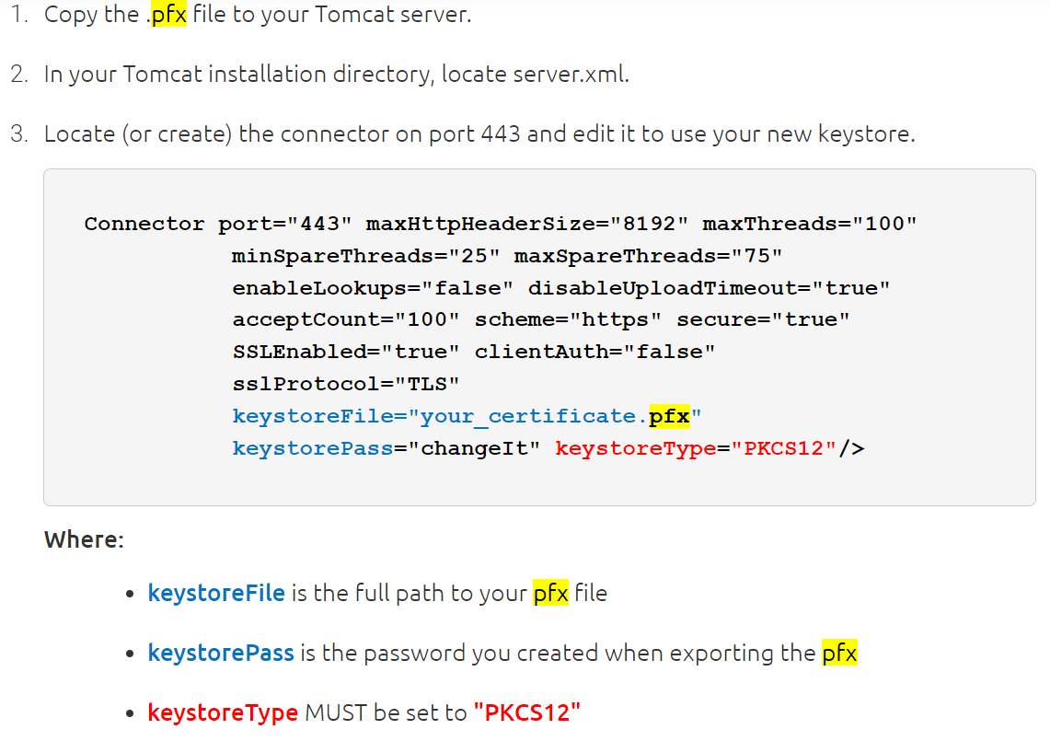
HTTPS
References
https://www.cnblogs.com/tomingto/p/11327696.html
https://help.aliyun.com/document_detail/98576.htm?spm=a2c4g.11186623.2.19.181060e0zo8yDx#concept-omf-lxn-yfb
https://www.linuxscrew.com/set-up-nginx-https-reverse-proxy-ubuntu
https://www.digicert.com/kb/util/csr-creation-ssl-installation-tomcat.htm
Concept
To enable HTTPS, a certificate from a CA (Certificate Authority) is needed.
ACME: Automatic Certificate Management Environment
Tomcat
pfx
import certificate
export certificate in a .pfx format
configure a SSLconnector
Generate keystore
在Tomcat安装目录下新建cert目录，将解压的证书和密码文件拷贝到cert目录下
Modify conf/server.xml
Check certificate
openssl s_client -showcerts -connect <hostname>:<port> -prexit
Linux + Nginx
sudo apt-get install software-properties-common
sudo add-apt-repository ppa:certbot/certbot
sudo apt-get update
sudo apt-get install python-certbot-nginx
sudo certbot --nginx

Slide 34
Gunicorn
References
https://medium.com/building-the-system/gunicorn-3-means-of-concurrency-efbb547674b7
Notes
sync workers execute one request after another
Worker Thread
request
Worker Process
Master Process
request
Worker Thread
Worker Process
Worker Thread
request

Slide 35
Redis
Server
sudo apt install redis-server
sudo service redis-server start
port 6379
sudo service redis-server status
Client
redis-cli
sudo apt install redis-tools
https://redis.com.cn/commands.html
redis-cli --rdb /tmp/dump.rdb // dump keys/values
Command | Explanation | Note
info | show info
auth {pwd} | verify password
ping | verify whether or not work
select {idx} | select a db
keys * | list all keys
scan 0 | list keys starting from 0
client list | list all clients
flushall | delete all keys in all dbs
flushdb | delete all keys in current db
monitor | monitor changes
role

Slide 36
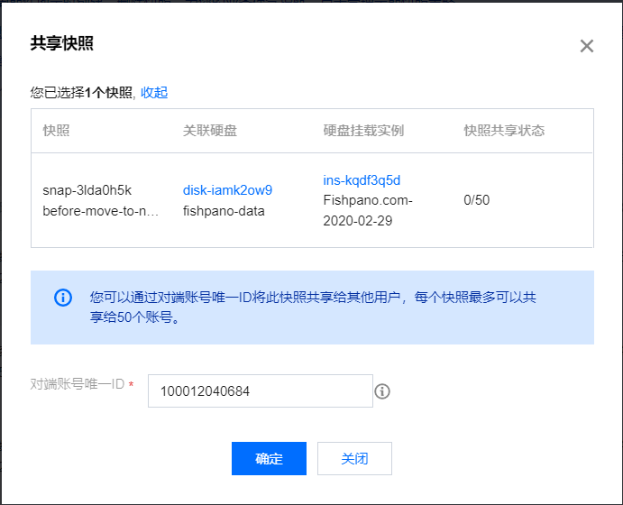
Replace Server
Steps
old server
create snapshot
share snapshot by account id
dump postgresql db
sudo docker-compose -f docker-compose.yml start db
sudo docker exec -t fishpano_db_1 pg_dump -U fishpano fishpano_db >/tmp/202112261900.pgdump
new server
open necessary ports
set swap
mount new disk
mkfs.ext4 /dev/vdb
sudo mount /dev/vdb /data
create disk from shared snapshot
mount created disk
mv files from created disk to new disk
restore DB
sudo docker compose up db &
sudo docker exec -it expovr-db-1 /bin/bash
dropdb -U fishpano fishpano_db
createdb -U fishpano fishpano_db
psql -U fishpano fishpano_db </tmp/202112261900.pgdump
copy bashrc, cron scripts
install docker environment
change DNS

Slide 37
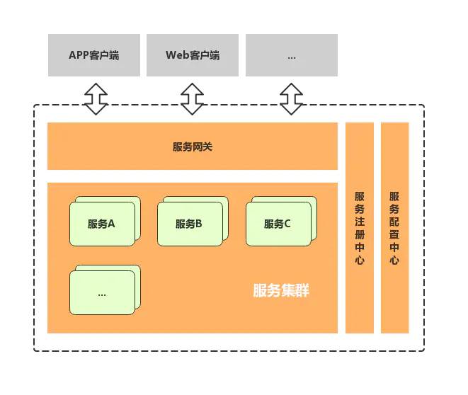
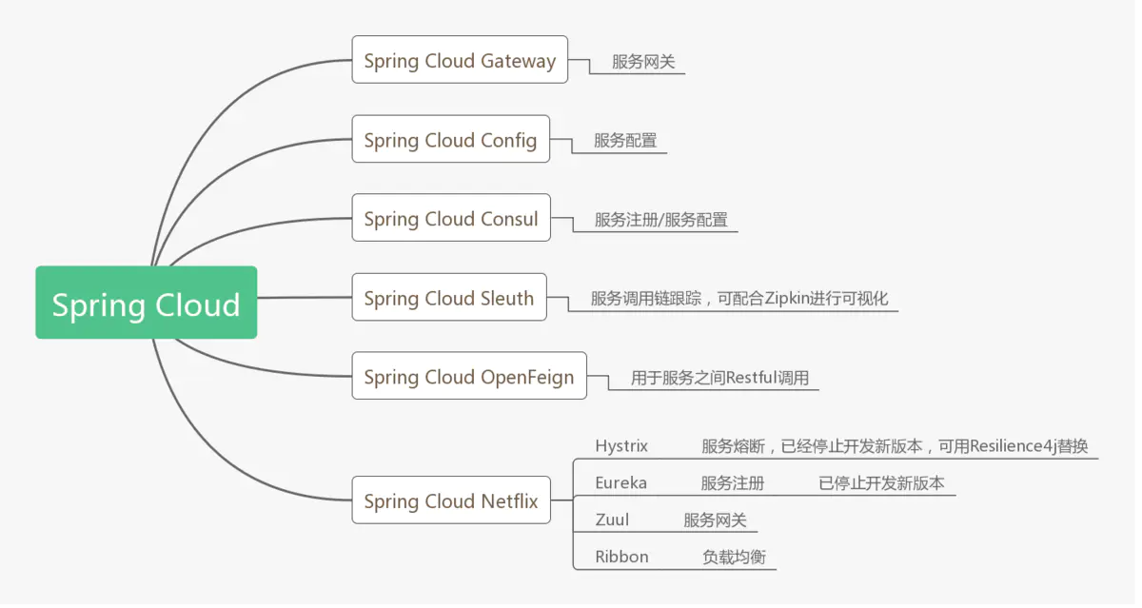
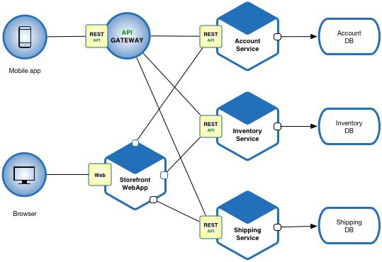
微服务
Intro
Framework: SpringCloud
优点：逻辑清晰、简化部署、可扩展、灵活组合、技术异构、高可靠
缺点：复杂度高、运维复杂、影响性能

Slide 38
FTP Concept
Mode
Active
PORT（主动）方式的连接过程是：客户端向服务器的FTP端口（默认是21）发送连接请求，服务器接受连接，建立一条命令链路。当需要传送数据时，客户端在命令链路上用PORT命令告诉服务器：“我打开了XXXX端口，你过来连接我”。于是服务器从20端口向客户端的XXXX端口发送连接请求，建立一条数据链路来传送数据。
Passive
PASV（被动）方式的连接过程是：客户端向服务器的FTP端口（默认是21）发送连接请求，服务器接受连接，建立一条命令链路。当需要传送数据时，服务器在命令链路上用PASV命令告诉客户端：“我打开了XXXX端口，你过来连接我”。于是客户端向服务器的XXXX端口发送连接请求，建立一条数据链路来传送数据。

Slide 39
FTP Server
References
https://www.linuxidc.com/Linux/2018-08/153491.htm
Linux
Install server
sudo apt install vsftpd
sudo systemctl status vsftpd
sudo systemctl enable --now vsftpd
Configure firewall
Configure users
sudo adduser ftpuser
sudo vim /etc/ssh/sshd_config
DenyUsers ftpuser
sudo systemctl restart sshd
Create the FTP folder and set permissions
Configure and secure vsftpd
vim /etc/vsftpd.conf
anonymous_enable=NO
local_enable=YES
write_enable=YES
pasv_min_port=30000 // passive mode min port
pasv_max_port=31000 // passive mode max port
chroot_local_user=YES
local_umask=022

Slide 40
FTP Server 2
Securing vsftpd with SSL/TLS
sudo openssl req -x509 -nodes -days 365 -newkey rsa:2048 -keyout /etc/ssl/private/vsftpd.pem -out /etc/ssl/private/vsftpd.pem
sudo nano /etc/vsftpd.conf
Remove lines
rsa_cert_file=/etc/ssl/certs/ssl-cert-snakeoil.pem
rsa_private_key_file=/etc/ssl/private/ssl-cert-snakeoil.key
ssl_enable=NO
Add lines
rsa_cert_file=/etc/ssl/private/vsftpd.pem
rsa_private_key_file=/etc/ssl/private/vsftpd.pem
ssl_enable=YES
allow_anon_ssl=NO
force_local_data_ssl=YES
force_local_logins_ssl=YES
ssl_tlsv1=YES
ssl_sslv2=NO
ssl_sslv3=NO
require_ssl_reuse=NO
ssl_ciphers=HIGH
sudo systemctl restart --now vsftpd
Disable shell access
echo -e '#!/bin/sh\necho "This account is limited to FTP access only."' | sudo tee -a /bin/ftponly
sudo chmod a+x /bin/ftponly
echo "/bin/ftponly" | sudo tee -a /etc/shells
sudo usermod ftpuser -s /bin/ftponly

Slide 41
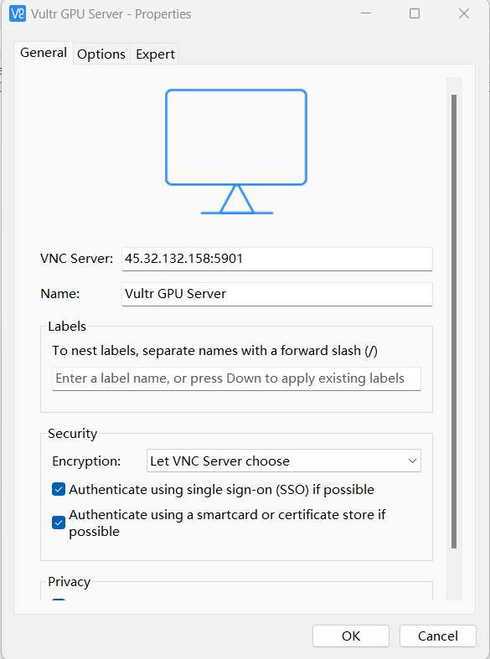
VNC
References
https://www.digitalocean.com/community/tutorials/how-to-install-and-configure-vnc-on-ubuntu-20-04
Steps
sudo apt update
sudo apt install xfce4 xfce4-goodies
sudo apt install tightvncserver
vncserver
it launches a default server instance on port 5901
vncserver -kill :1 // kill the vnc server
vim ~/.vnc/xstartup
#!/bin/bash
xrdb $HOME/.Xresources
startxfce4 &
chmod +x ~/.vnc/xstartup
vncserver -kill :1
vncserver
sudo ufw allow 5901/tcp

Slide 42
Add New Disk
Steps (e.g. /dev/vdb)
Create new empty partitions:
# parted -s /dev/vdb mklabel gpt
# parted -s /dev/vdb unit mib mkpart primary 0% 100%
Create new empty filesystem:
# mkfs.ext4 /dev/vdb1
Mount block storage:
# mkdir /mnt/blockstorage
# echo >> /etc/fstab
# echo /dev/vdb1 /mnt/blockstorage ext4 defaults,noatime,nofail 0 0 >> /etc/fstab
# mount /mnt/blockstorage

Slide 43
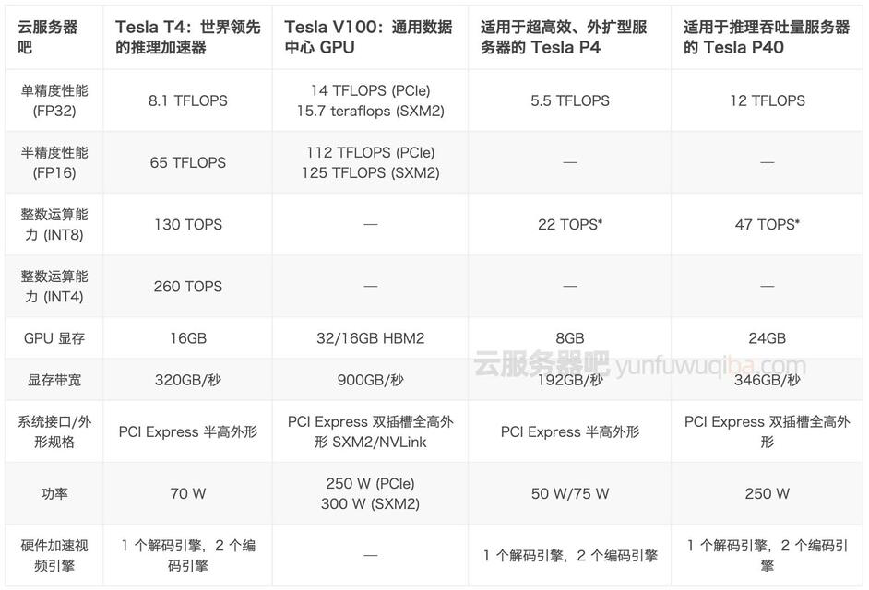
GPU Server

Slide 44
Q&A
Safari浏览器不支持将非ASCII字符存入Cookie
SameSite cookie issue
https://trinitytuts.com/fix-samesite-cookie-issue-in-chrome-browser/
It happens when debug frontend using “npm run dev”
solution: modify nginx configuration
云盘扩容
sudo apt-get install -y cloud-guest-utils
sudo growpart /dev/vda 1
sudo resize2fs /dev/vda1
server {
# Your other server directives...
location / {
proxy_cookie_path / "/; secure; HttpOnly; SameSite=None";
}
}

Slide 45
Zabbix

Slide 46
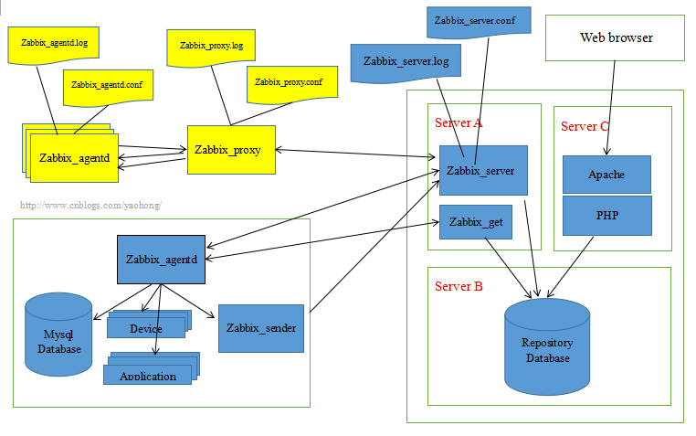
Intro
References
https://www.zabbix.com
Intro
Functions
主机的性能监控、网络设备性能监控、数据库性能监控、FTP 等通用协议监控、多种告警方式、详细的报表图表绘制
collect data through C/S mode
configure and display through B/S mode
Component
server
agent: deployed on the target machine to be monitored, responsible for reporting the gathered data from the target to the server
Support
MySQL/PostgreSQL support
Apache2/Nginx support
Install
apt-get install mysql-server mysql-client mlocate
sudo apt-get install zabbix-server-mysql zabbix-frontend-php zabbix-agent

Slide 47
Install (docker-compose)
References
https://programming.vip/docs/zabbix-installation-and-deployment-in-docker.html
https://fabianlee.org/2019/10/06/zabbix-using-docker-compose-to-install-and-upgrade-zabbix/

Slide 48
AWS

Slide 49
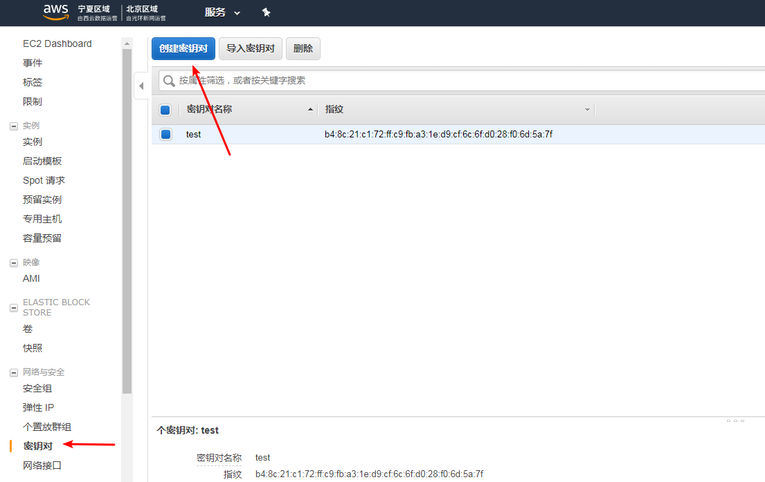
Set Up
References
https://blog.csdn.net/m0_37263637/article/details/91045566
Steps
download .pem file
create private key pair for a user (sparks) and download .pem
ssh-keygen -y -f sparks.pem // generate public key and save
ssh -i fishpano-jp.pem ubuntu@ec2-35-88-91-217.us-west-2.compute.amazonaws.com
sudo add user sparks
sudo vim /etc/sudoers // add sparks as sudoer
sudo su sparks
mkdir ~/.ssh
vim ~/.ssh/authorized_keys // paste public key for sparks into and save
ssh -i sparks.pem sparks@35.88.91.217 // ssh with new user
rsync -ahvz -e "ssh -i ../sparks.pem" --progress ../src/*.py $user_name@$host_name:$www_root

Slide 50
BaaS
Backend As A Service

Slide 51
Introduction
References
Firebase

Slide 52
Firebase
References
https://www.jianshu.com/p/b71f5d3b7c8c
Functions
Analytics
FCM (Firebase Cloud Messaging) 跨平台消息服务
https://www.jianshu.com/p/b50f5aee4403
Authentication
支持email, Facebook, Twitter, Github, Google sign-in
Realtime DB
NoSQL, json, offline usage
Storage
Hosting
Remote Config
Test Lab
Crash Reporting
Notifications
App Indexing
Dynamic Links
Invites
AdWords, AdMob

Slide 53
API Testing

Slide 54
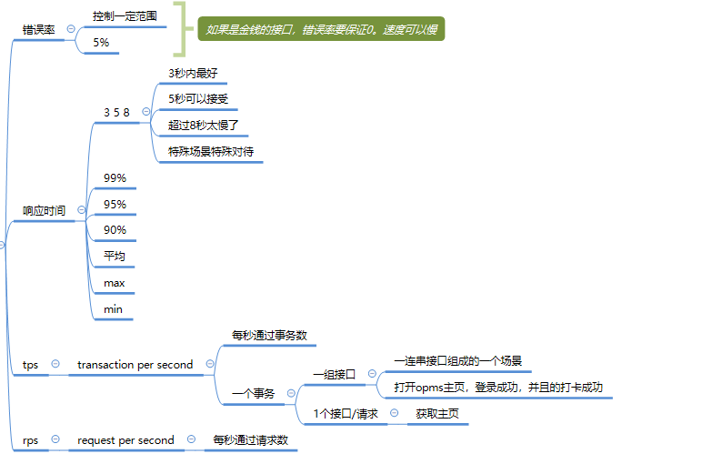
Intro

Slide 55
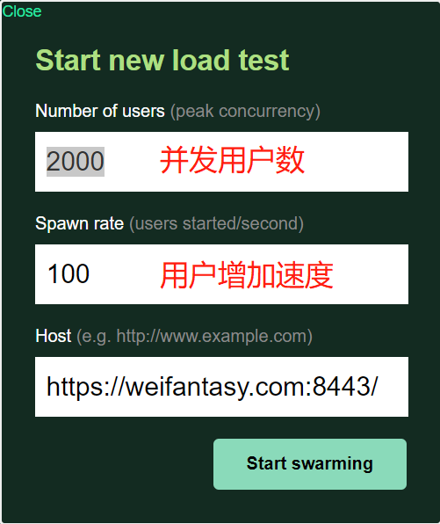
Locust
References
https://docs.locust.io/en/stable/index.html
https://locust.io/
Usage
pip install gevent==20.9.0
pip install locust==2.8.6
locust -V
locust --headless --users 10 --spawn-rate 1 -H http://your-server.com
-c: 并发用户数
-r: 启动虚拟用户的速率
Result
rps // requests per second
fails // percentage of failed requests
locustfile
locust -f locustfile
HttpUser class
client
from locust import HttpUser, between, task
class WebsiteUser(HttpUser):
wait_time = between(5, 15)
def on_start(self):
self.client.post("/login", {
"username": "test_user",
"password": ""
})
@task
def index(self):
self.client.get("/")
self.client.get("/static/assets.js")
@task
def about(self):
self.client.get("/about/")

Slide 56
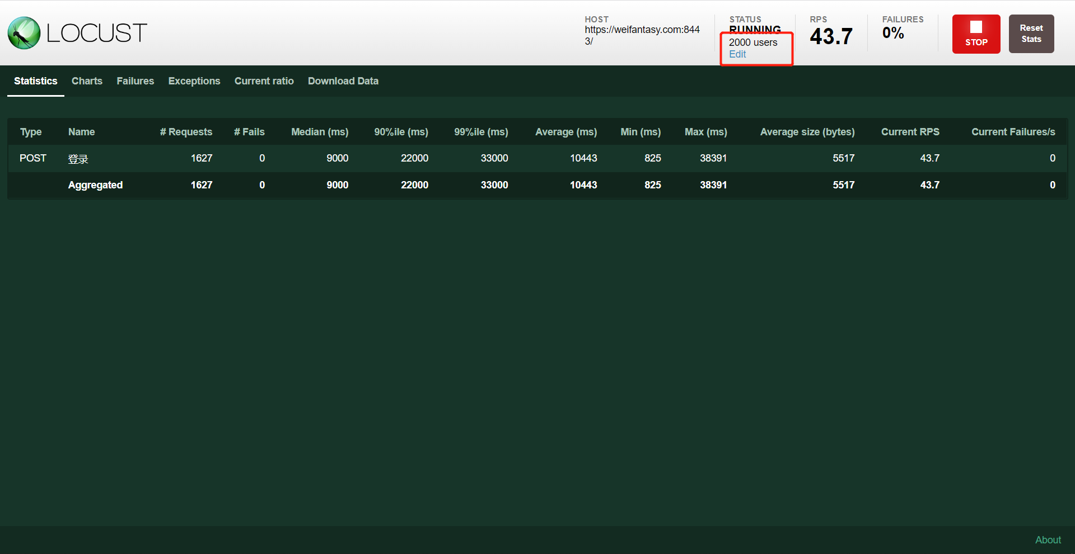
Locust - 2

Slide 57
CMS

Slide 58
Lin CMS
https://github.com/TaleLin/lin-cms-flask
MIT
前后端分离
功能
内置了 CMS 中最为常见的需求：用户管理、权限管理、日志系统等
实现
后端：flask
前端：vue3，element plus
后端
git clone https://github.com/TaleLin/lin-cms-flask.git starter
pip install -r requirements-dev.txt

Slide 59
Docker

Slide 60
Tomcat
References
https://blog.lukaspradel.com/dockerizing-a-tomcat-postgresql-java-web-application/
https://javatodev.com/docker-compose-spring-boot-postgresql/
https://github.com/bezkoder/docker-compose-spring-boot-postgres
https://juejin.cn/post/7176899356585361466
Dockerfile
FROM tomcat
COPY ROOT.war /usr/local/tomcat/webapps/
Docker compose
web, db

