Slide 1
Vue Notes
Sparks Lu
Last updated: 8/6/2021

Slide 2
General

Slide 3
Introdution
Progressive JS framework that focuses on building UI
React
AngularJS

Slide 4
Install
Methods
Include the <script> tag in the html file (cdnjs)
Install using NPM
curl -sL https://deb.nodesource.com/setup_14.x | sudo -E bash -
sudo apt install nodejs npm
nodejs -v
sudo npm install -g cnpm --registry=https://registry.npm.taobao.org
Use the vue-cli tool along with Webpack
sudo cnpm install -g @vue/cli // Install vue-cli globally
vue --version
vue init webpack myapp
npm run dev
npm run build // Build application to production
Install using the client-side package manager
Vim Support
https://github.com/posva/vim-vue
Vundle: Plugin 'posva/vim-vue'

Slide 5
Config
vue ui
Drop console when release:
build/webpack.prod.conf.js
new UglifyJsPlugin({
uglifyOptions: {
compress: {
warnings: false,
drop_debugger: true,
drop_console: true // 打包之后关闭console.log
}
},

Slide 6

Debug
npm run dev
webpack.prod.conf.js
drop_debugger
drop_console
Vue-devtools
Install
git clone https://github.com/vuejs/vue-devtools
cd vue-devtools
cnpm install
npm run build
open chrome://extensions/ in Chrome
打开“开发者模式”
Select vue-devtools/shells/chrome folder
Use
Open vue debug page (localhost:8080)
F12, Vue tab

Slide 7
Binding
Description | Data | Computed | Watcher
Store variables | Store local variables | Can be static, derived from other variables, or can be static functions | Does not store variables - only watches them.
React to variable value changes | Y | Y | Y
Cached? | Y | Y | N/A
Scope | Local to component | Local to component, but can derive/make calculations with variables from props, store, etc. | Can watch local or store variables and react to changes
Can be referred by <template> | Y e.g. {{ myName }} | Y {{ myCalcName }} | N/A
Can be referred by <script> methods | Y this.myName | Y this.myCalcName | N/A
Perform action when value changes | N | N | Y
Consequence of a value change | Change UI to react to change | Change UI | Perform action - local/vuex
Can change other variable values | N | Y | Y
Vue
el
Bind to HTML element
data
Bind data
computed
Bind computed data
cached
methods
Bind method

Slide 8
Directives
Bind with HTML
v-text
v-html
explain data as HTML
v-model
HTMl element value <-> Vue model
<input v-model=”message” placeholder=”edit me”>
Conditional or loop rendering
v-show
v-if/v-else/v-else-if
v-for
Event binding
v-on
<button v-on:click=”...”></button>, <input v-on:keyup.enter=”...”></input>
v-resize
v-resize:throttle, v-resize:debounce
class or style binding
v-bind:class=”...”, v-bind:style=”...”, v-bind:src=”...”,v-bind:href=”...”
v-pre
v-clock
v-once

Slide 9
Component
Global registration
Vue.component('component-name', {data: ..., props: ..., template: ...})
HTML component
Encapsulate and reuse
data: must be function

Slide 10
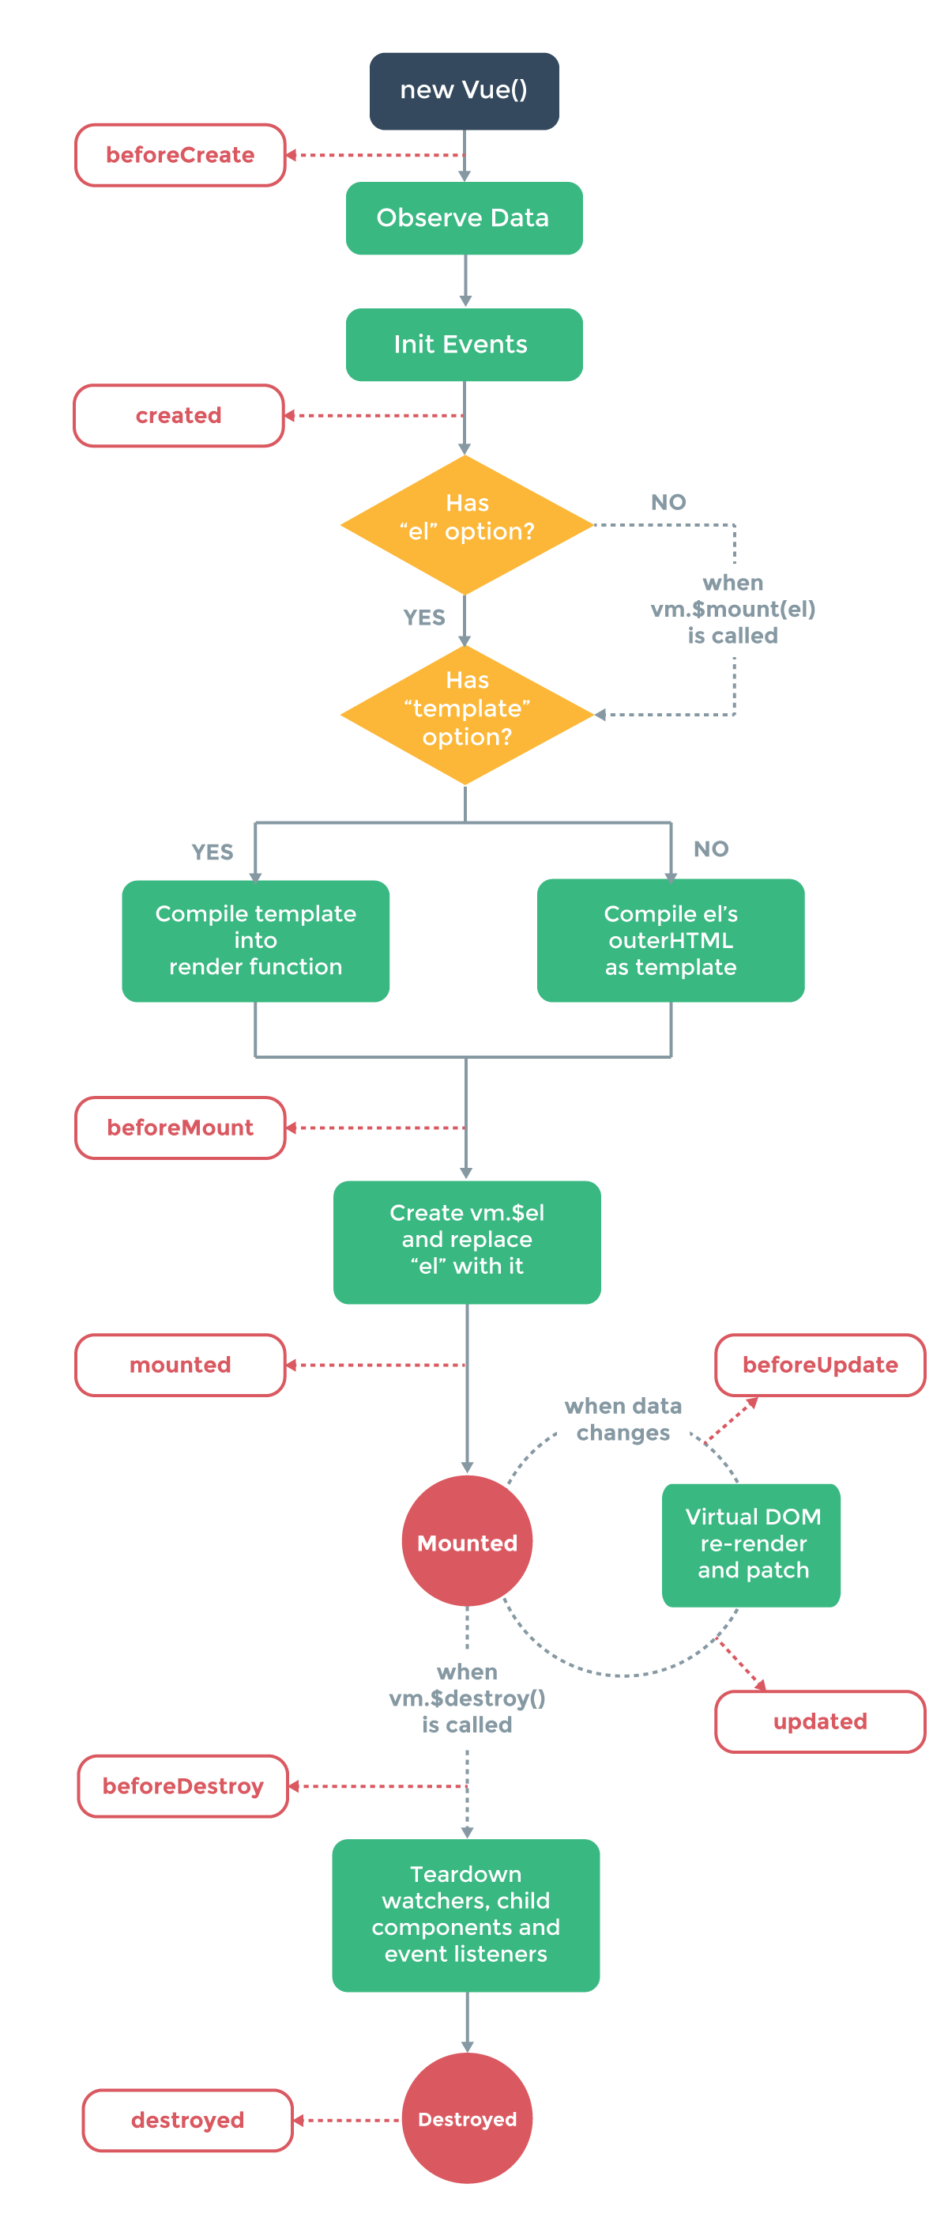
Lifecycle Hooks
Hooks
created
mounted
destroyed
activated/deactivated
for keep-alive components

Slide 11
Props
Concept
one-way-down binding
When the parent property update, it will flow down to the child.
But not the other way around

Slide 12
Additional Tools & Plugins
vue-router
vue-resource
vuex
Store
vue-async-data
vue-validator
vue-devtools
Chrome extension, Firefox addon
vue-touch

Slide 13
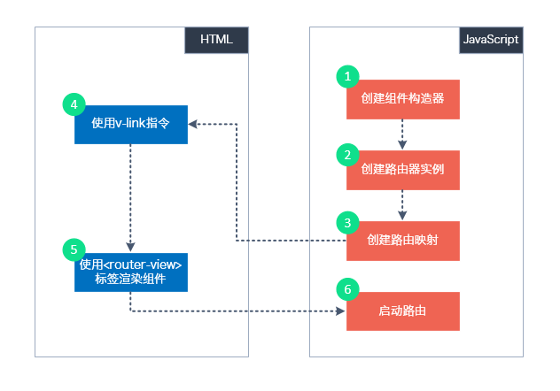
Single Page Application
Command
vue init webpack {appname}
Structure
index.html
src
App.vue
main.js
components/

Slide 14
Vue Router
import Vue from 'vue'
import VueRouter from 'vue-router'
Vue.use(VueRouter)
Install
npm install vue-router --save
Vue.use(VueRouter)
this.$router
router object
navigate to a new route
this.$router.push('route-name')
this.$router.replace({ path: 'name'})
this.$router.go(-1/1)
this.$route
<router-link>
<router-link to=”home”>Home</router-link>
<router-view>
Vue router puts the content which match current url
router.js
routes: [{path: 'url1', name: 'name1', component: 'component1'}]

Slide 15
Vue-i18n
const messages = {
en: {
message: {
hello: '{msg} world'
}
}
}
https://github.com/kazupon/vue-i18n
vue add i18n
Formatting
Named formatting
List formatting
HTML formatting
Custom formatting
Pluralization
$tc()
Datetime localization
$d()
Number formatting
<i18n-n :value=”...”></i18n>
v-t
better performance than $t
npm i --save-dev @kazupon/vue-i18n-loader
vue-cli-plugin-i18n
BabelEdit: translation editor
<p>{{ $t('message.hello', { msg: 'hello' }) }}</p>
<p>{{ $t('message.hello', ['hello']) }}</p>
<p v-html="$t('message.hello')"></p>
const i18n = new VueI18n({
locale: 'ja',
fallbackLocale: 'en',
messages
})

Slide 16
Axios
axios.post('/user', {
firstName: 'Fred', // 参数 firstName
lastName: 'Flintstone' // 参数 lastName
})
.then(function (response) {
console.log(response);
})
.catch(function (error) {
console.log(error);
});
npm install axios vue-axios
request
get, post
response
axios.interceptors.request.use(...)
axios.interceptors.response.use(...)
Serialize
default: json
axios.get('/user?ID=12345')
.then(function (response) {
console.log(response);
})
.catch(function (error) {
console.log(error);
});
response:
- data: {}
- status
- statusText
- headers: {}
- config: {}

Slide 17
Share Data Between Components
Parent -> child
props
Events
this.$emit(“msg”)
@msg='method'

Slide 18
Window
window.addEventListener('resize', funcName)
window.removeEventListener('resize', funcName)
window.innerWidth, window.innerHeight

Slide 19
Storage
Session storage
sessionStorage.setItem(key, value)
sessionStorage.getItem(key)
Local storage
localStorage.setItem(key, value)
localStorage.getItem(key)

Slide 20
Load External JS
https://www.npmjs.com/package/vue-plugin-load-script
Usage
In main.js
import LoadScript from 'vue-plugin-load-script'
Vue.use(LoadScript);
this.$loadScript("/js/jquery-2.2.4.min.js").then( () => {
})
.catch( () => {
})
this.$loadScript("https://maps.googleapis.com/maps/api/js")

Slide 21
Plugin
Vuetify
Install
vue add vuetify
npm install vuetify --save
Ref
https://vuetifyjs.com
Vue-element-admin
vue-resize-directive
npm install vue-resize-directive --save
import resize from 'vue-resize-directive'

Slide 22
Module System
Webpack
Speed up npm run build
https://www.hangge.com/blog/cache/detail_2105.html
266041ms
Install node latest version
from 8.x to 14.x:

Slide 23
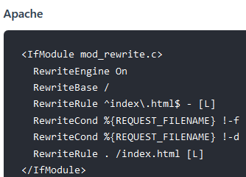
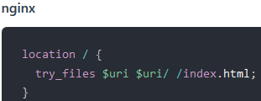

Issues and Solutions
Array value change
this.$set(array, index, newValue)
array[index] = newValue, change will not be detected
<select> in IE
If use customized bg image, default image is also shown
.select::-ms-expand {
display: none;
}
History mode

Slide 24
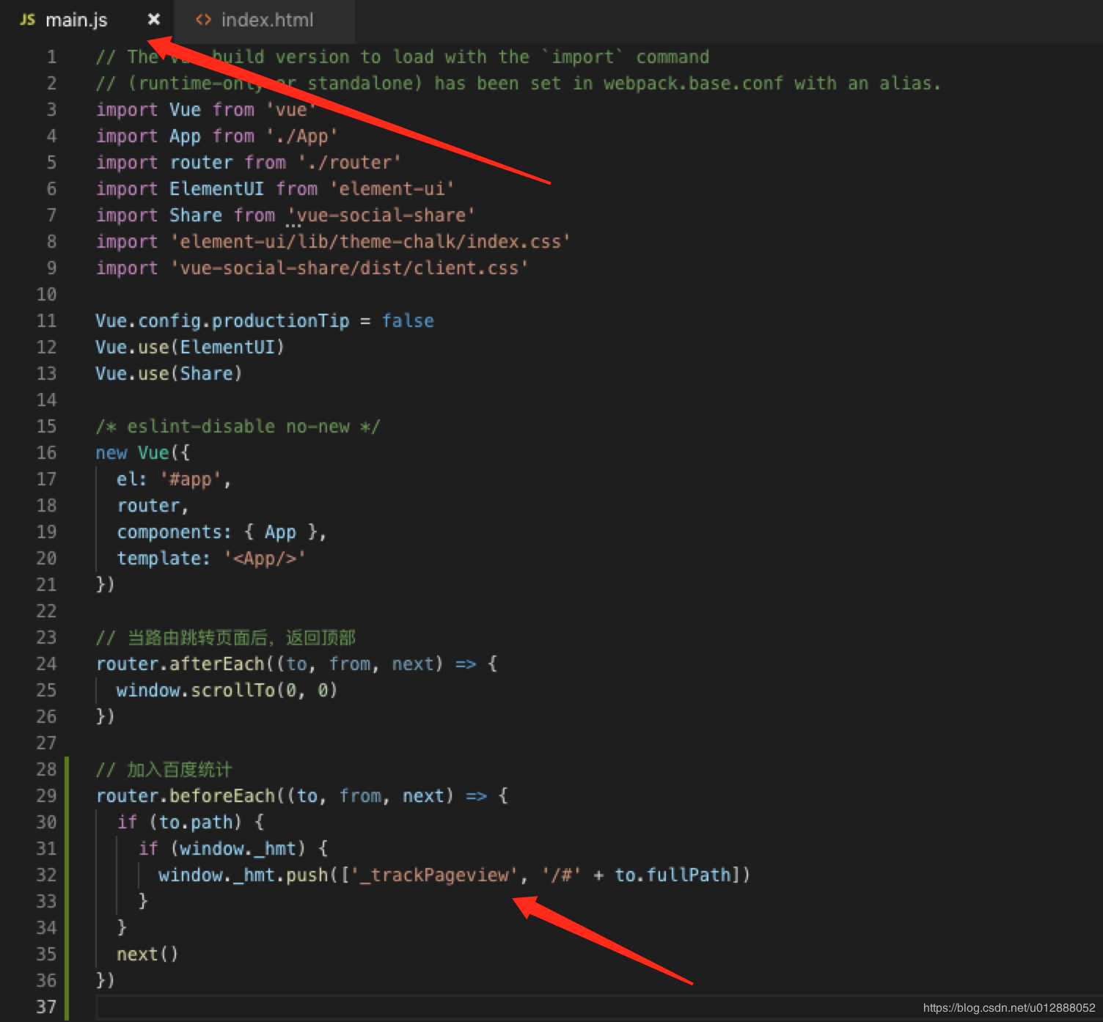
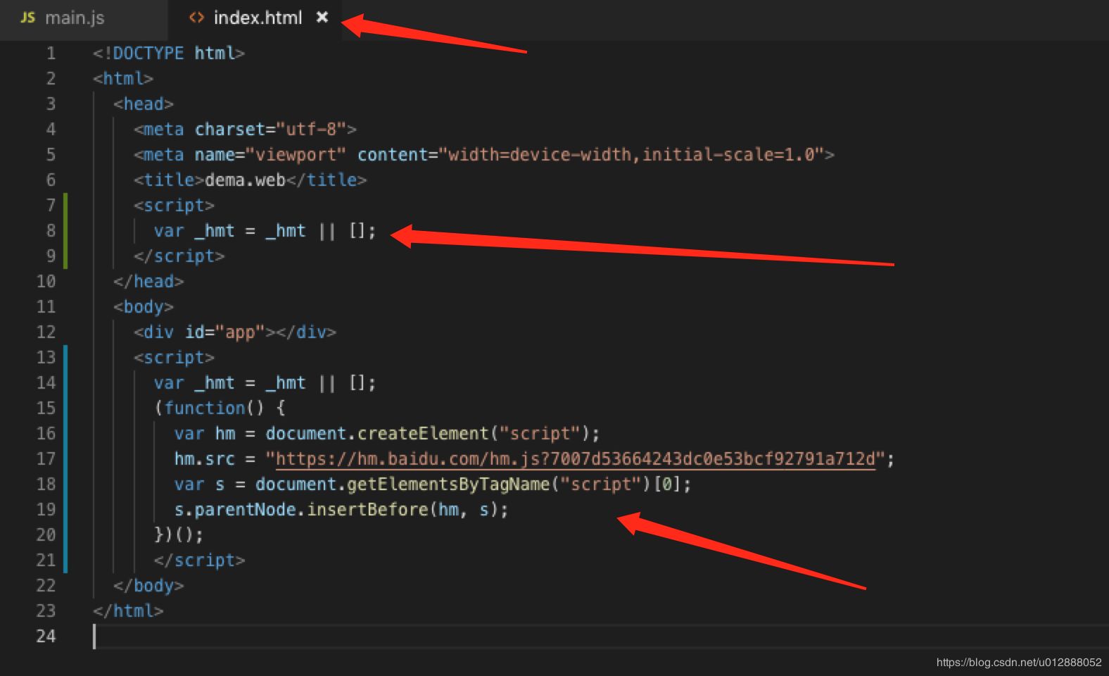
Add Baidu Tongji
References
https://blog.csdn.net/u012888052/article/details/93195909
Steps:
modify index.html
modify src/main.js

Slide 25
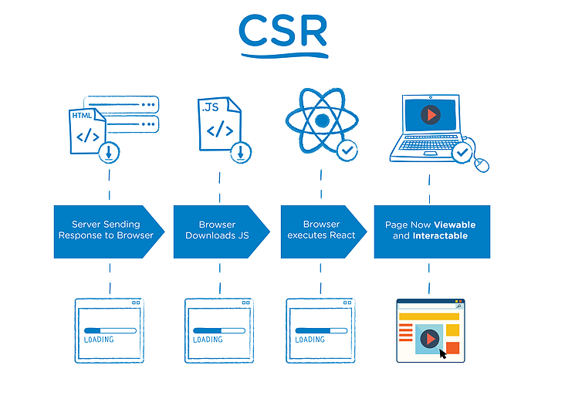
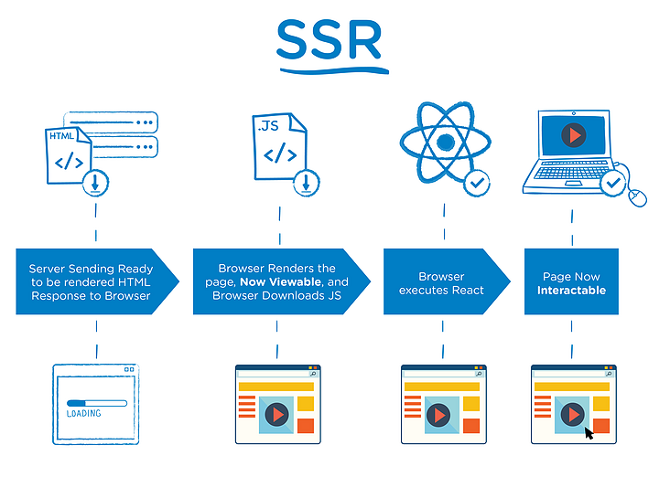
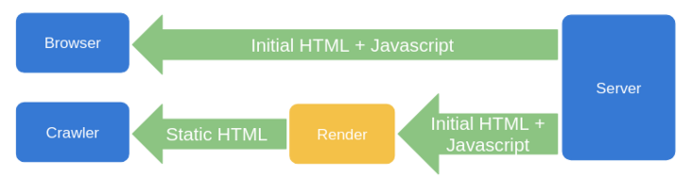
SEO - General
References
https://segmentfault.com/a/1190000023481810?utm_source=sf-similar-article
CSR (Client-Side Rendering)
缺点
SEO不友好（爬虫如果没有执行js的能力，如百度，获取到的页面是空的，不利于网站推广）
首屏加载慢（到达浏览器端后再加载数据，增加用户等待时间）
SSR (Server-Side Rendering)
Vue: Nuxt.js
React: Nextjs
缺点
代码改动大
Node容易成为性能瓶颈
构建时预渲染
prerender-spa-plugin, puppeteer, phantomjs
缺点
无法用于大量动态路径页面场景
后台请求数据变动时前端应该同步更新版本
服务端动态渲染（利用user-agent）
puppeteer, rendertron, prerender.io

Slide 26
SEO - Phantomjs
References
https://blog.csdn.net/dengzy926/article/details/105397730
https://www.jianshu.com/p/3b72c08cafb2
使用Phantomjs针对爬虫做处理
对已用SPA开发完成的项目，这是不二之选
无界面的webkit内核浏览器
通过Nginx配置，判断访问的来源UA是否是爬虫访问，如果是则将搜索引擎的爬虫请求转发到一个node server，再通过PhantomJS来解析完整的HTML，返回给爬虫。
Steps
install method 1
npm i phantomjs
install method 2
wget https://bitbucket.org/ariya/phantomjs/downloads/phantomjs-2.1.1-linux-x86_64.tar.bz2
tar xvjf phantomjs-2.1.1-linux-x86_64.tar.bz2 -C /usr/local/share/
git clone https://github.com/lengziyu/vue-seo-phantomjs.git
cd vue-seo-phantomjs && phantomjs spider.js 'https://www.baidu.com'
Promise issue
phantonjs ReferenceError: Can't find variable: Promise
cnpm i -S es6-promise
main.js:
import Promise from ‘es6-promise’
Promise.polyfill()
upstream spider_server {
server localhost:3000;
}
server {
listen 80;
server_name example.com;
location / {
proxy_set_header Host $host:$proxy_port;
proxy_set_header X-Real-IP $remote_addr;
proxy_set_header X-Forwarded-For $proxy_add_x_forwarded_for;
if ($http_user_agent ~* "Baiduspider|twitterbot|facebookexternalhit|rogerbot|linkedinbot|embedly|quora link preview|showyoubot|outbrain|pinterest|slackbot|vkShare|W3C_Validator|bingbot|Sosospider|Sogou Pic Spider|Googlebot|360Spider") {
proxy_pass http://spider_server;
}
}
}

Slide 27
SEO - Puppeteer
References
https://developers.google.com/web/tools/puppeteer/articles/ssr
https://zhuanlan.zhihu.com/p/70006823

Slide 28
Components

Slide 29
Vue UI Framework
Element UI
Vuetify
https://vuetifyjs.com/en/
BootstrapVue
https://bootstrap-vue.org/
https://github.com/bootstrap-vue/bootstrap-vue
Buefy
Quasar

Slide 30
Element UI
https://element.eleme.cn/#/zh-CN
Install
npm i element-ui -S
Usage
Import all
Import on demand
npm i babel-plugin-component -D
npm install babel-cli babel-preset-es2015
$msgbox(options)
$alert(message, title, options)
$confirm(message, title, options)
$prompt(message, title, options) // prompt input

Slide 31
Font Awesome
References
https://fontawesome.com/icons?d=gallery&m=free
https://github.com/FortAwesome/vue-fontawesome
https://blog.logrocket.com/full-guide-to-using-font-awesome-icons-in-vue-js-apps-5574c74d9b2d/
Icon library
solid (fas), regular (far), light (fal), brands (fab)
Usage
<link href="https://cdnjs.cloudflare.com/ajax/libs/font-awesome/5.11.2/css/all.min.css" rel="stylesheet" type="text/css">
Vue-fontawesome
npm install --save @fortawesome/fontawesome-svg-core @fortawesome/free-solid-svg-icons @fortawesome/free-regular-svg-icons @fortawesome/vue-fontawesome
In main.js
import { library } from '@fortawesome/fontawesome-svg-core'
import { faCoffee } from '@fortawesome/free-solid-svg-icons'
import { FontAwesomeIcon } from '@fortawesome/vue-fontawesome'
library.add(faCoffee)
Vue.component('font-awesome-icon', FontAwesomeIcon)

Slide 32
Progress UI
vue-ellipse-progress
https://github.com/setaman/vue-ellipse-progress
npm i -S vue-ellipse-progress
vue-progressbar
https://github.com/hilongjw/vue-progressbar
npm i vue-progressbar

Slide 33
Vue-Konva
References
https://github.com/konvajs/vue-konva
Install
npm i -S konva vue-konva
vue.js v2.4+
Shapes
v-rect, v-circle, v-ellipse, v-line, v-image, v-svg, v-text, v-text-path, v-star, v-label, v-path, v-regular-polygon

Slide 34
FAQ
Fixed CORS issue during debug
Modify config/index.js
proxyTable: {
'/': {
target: 'http://47.105.68.219:8090/',
changeOrigin: true,
pathRewrite: {
'^/': '/'
}
}
},

Slide 35
Advanced

Slide 36
Handle Large JS Files
Reference
https://github.com/vuejs-templates/webpack/issues/1297
https://www.jianshu.com/p/1c60ed2064b5
https://blog.csdn.net/qq_19694913/article/details/82628637
npm run build --report
Reduce size
element ui
remove whole library import
import only used component
remove language pack in moment.js
const webpack = require('webpack')
module.exports = {
plugins: [
new webpack.IgnorePlugin(/^\.\/locale$/, /moment$/)
]
}
import 'moment/locale/zh-cn';

Slide 37
THANKS
谢谢聆听

