Slide 1
Node.js Notes
Sparks Lu
Last updated: 6/3/2021

Slide 2
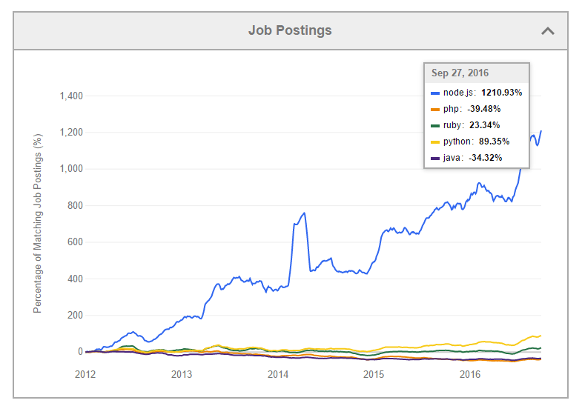
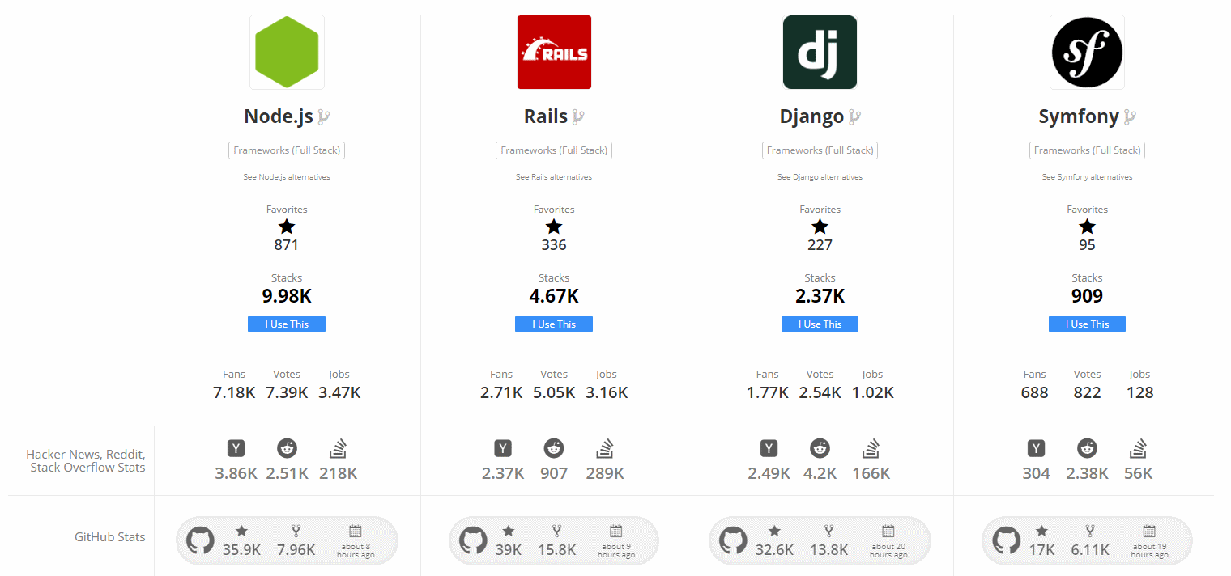
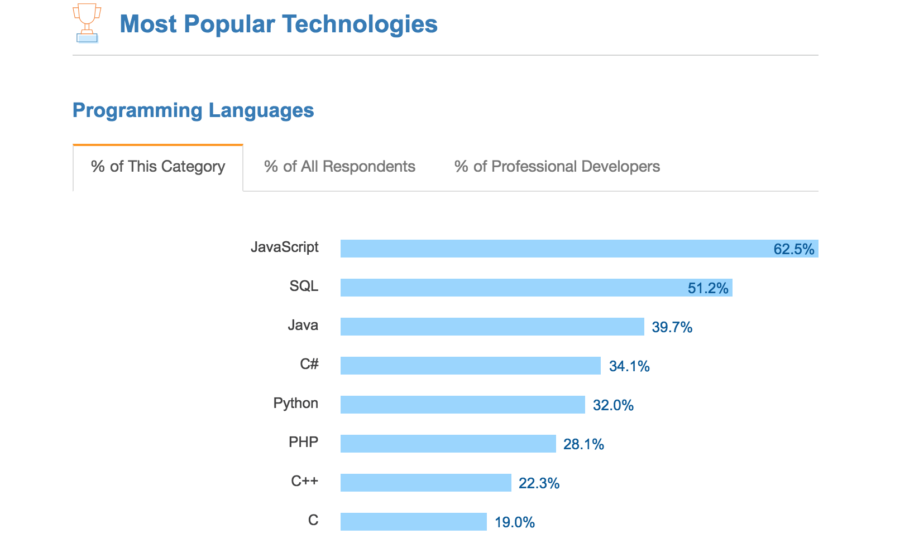
Overview
Overview
Runtime environment for executing JS code
Features
Asynchronous
node --version
node -p "process.arch" // 32bit or 64bit
Global object
global, window, module, __filename, __dirname
require: load module

Slide 3
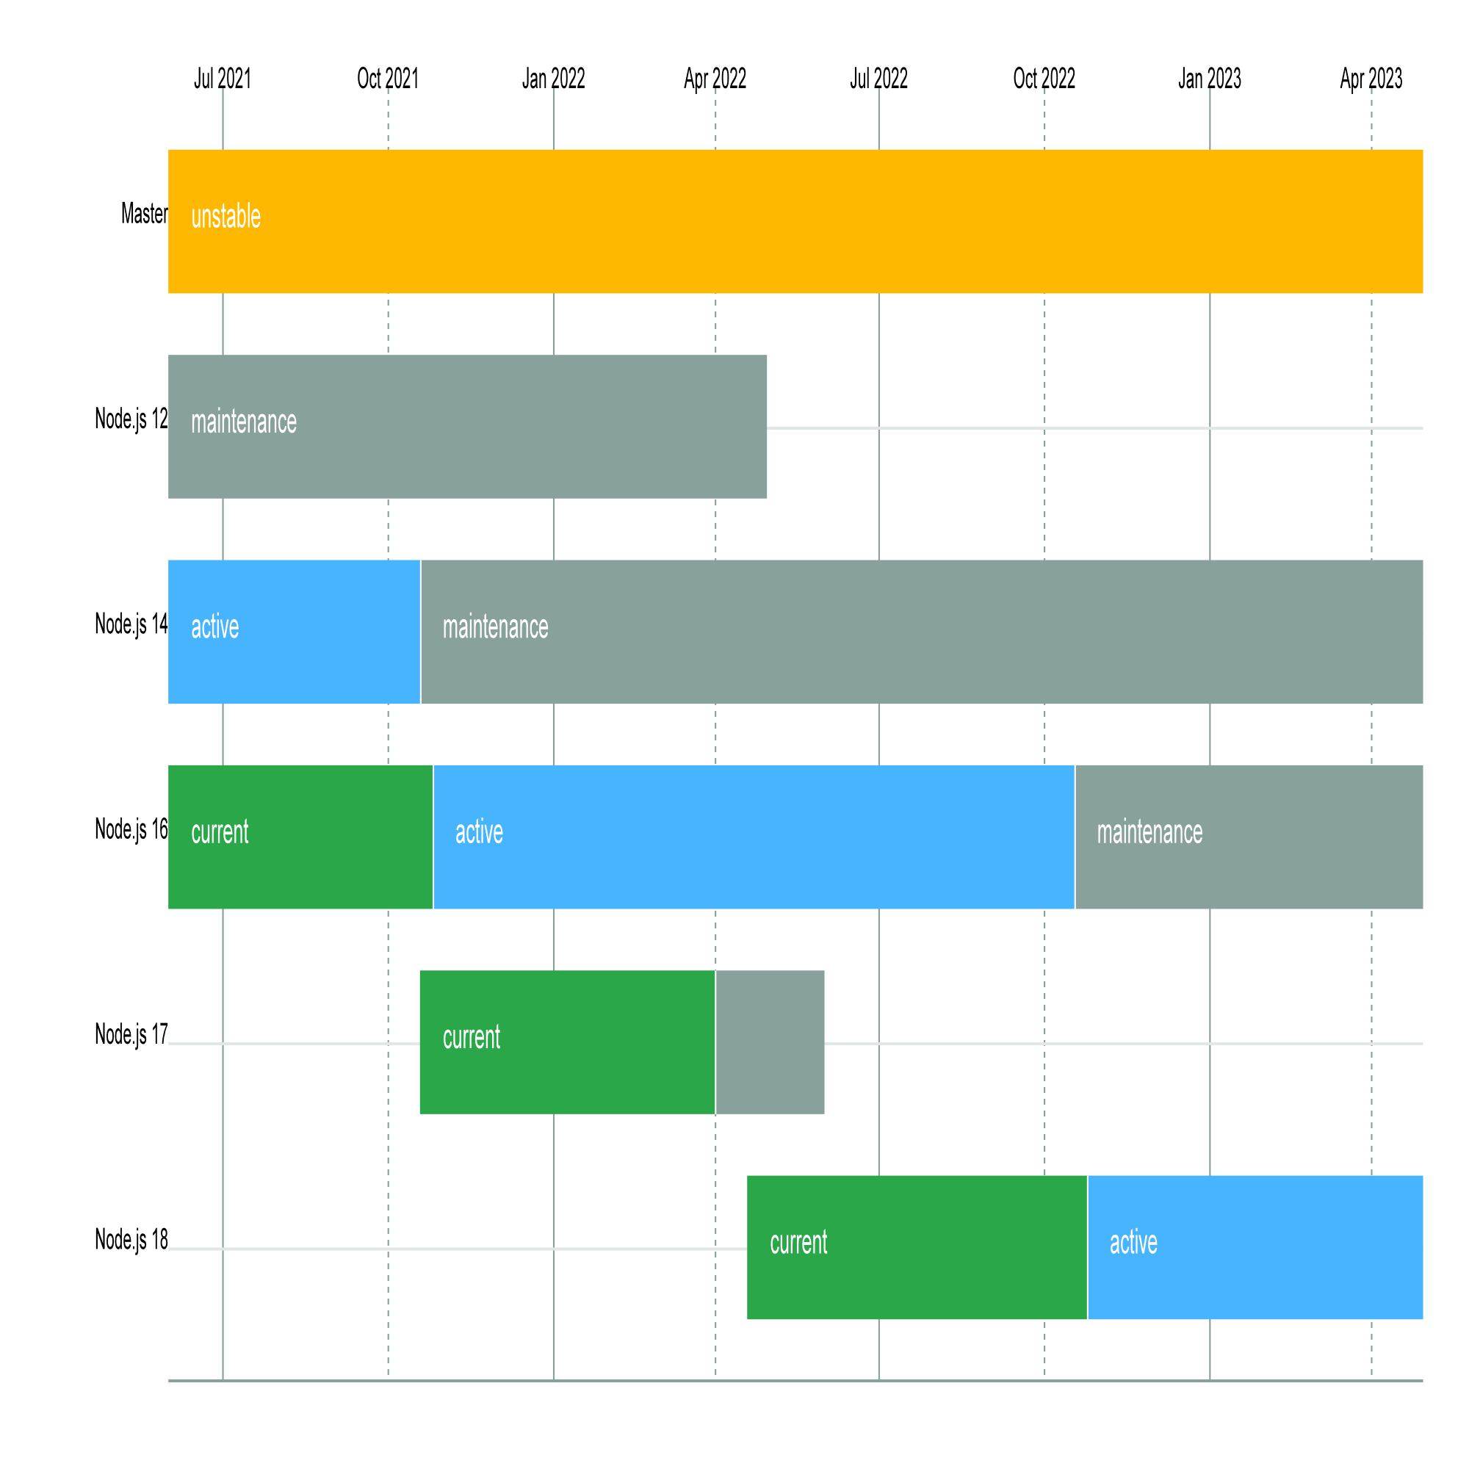
Install
Steps
curl -sL https://deb.nodesource.com/setup_16.x | sudo -E bash -
sudo apt-get install -y nodejs
npm install --global windows-build-tools
FAQ
After upgrade nodejs, npm run build may fail with message like “Node Sass does not yet support your current environment:”
run “npm rebuild node-sass”

Slide 4
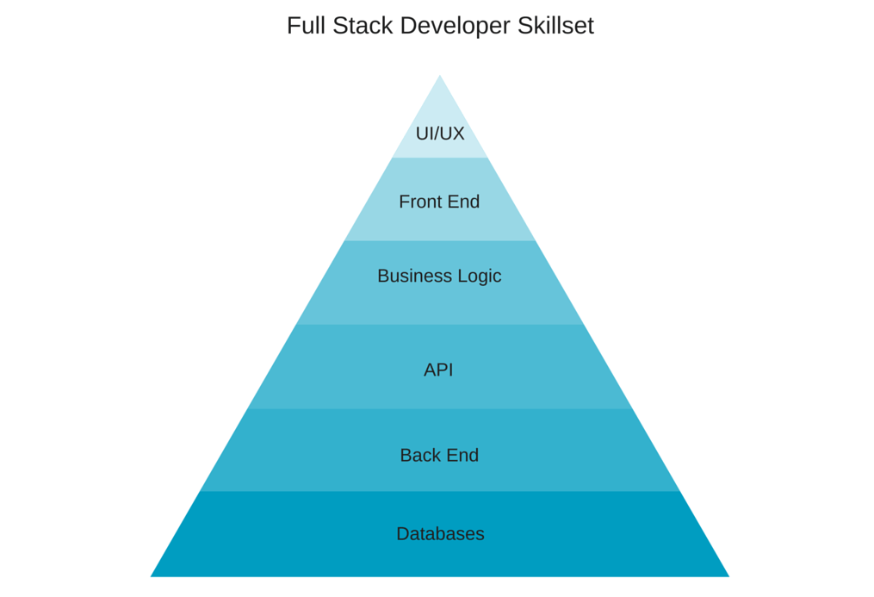
Full Stack Development
LAMP
MEAN
MEAN
PHP
MySQL
Express
MongoDB
Django
MySQL
Apache
AngularJS
Linux
Node.js
Python

Slide 5
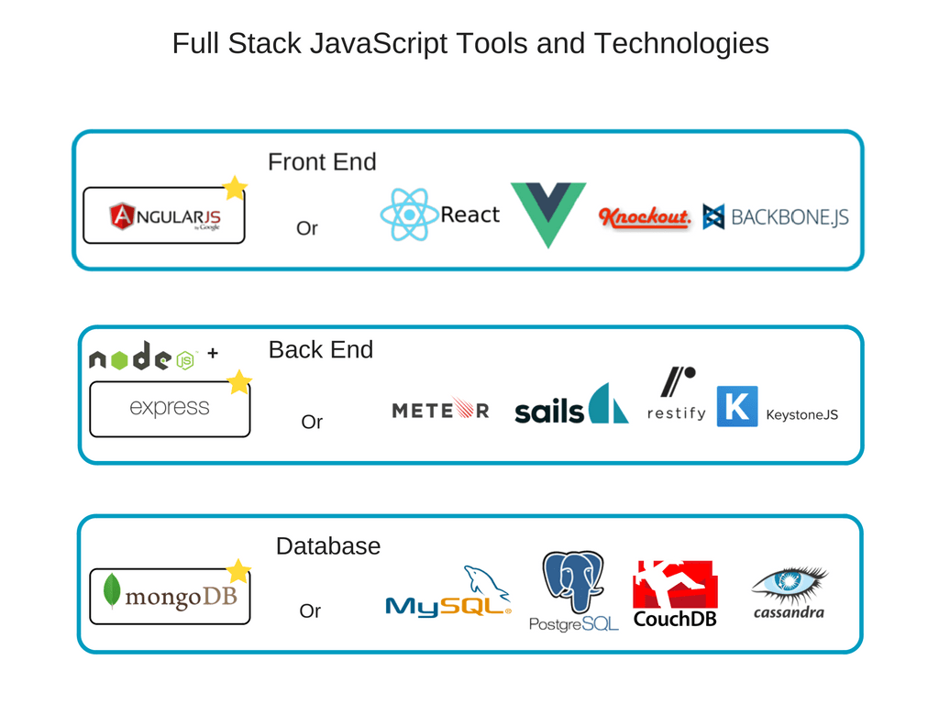
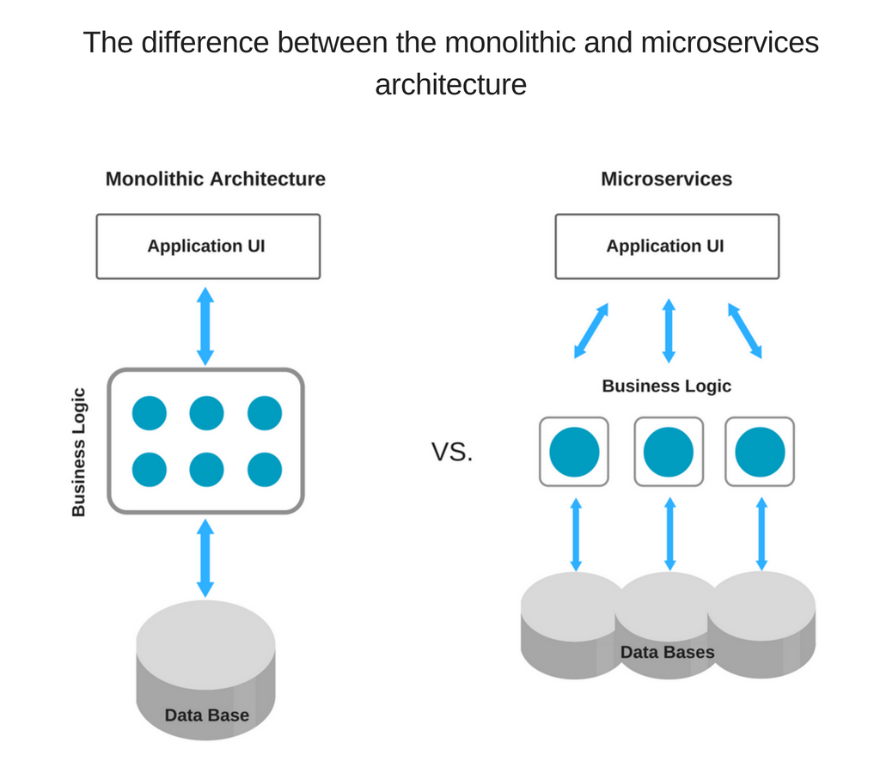
Web
Server
Express.js
Fontend
Angular.js
DB
MongoDB

Slide 6
Pros and Cons of Full-Stack JS Approach
Pros
Common language, better team efficiency with less resources
Extensive code reuse
High performance and speed
Huge talent pool
Extensive knowledge base
Free, open-source toolset
Cons
Insufficiency with computation-heavy backend
Relatively young technologies
Jack of all trade, master of none
Drawbacks of every separate tool in the stack combined

Slide 7
Package Management
npm
npm config list
npm install -g npm
npm install -g <package-name>@version-number
npm uninstall <package-name>@latest
npm list -g // list installed packages
npm outdated // list outdated packages
npm update // update all packages with newer minor version listed in package.json
npm update <package-name>
npm search <keyword>
npm cache clean
npm config set registry https://registry.npm.taobao.org/
npm config get
npm install -g cnpm --registry=https://registry.npm.taobao.org
cnpm install ...
https://docs.npmjs.com/common-errors
cnpm view <package-name> versions
cnpm view vue-panzoom versions
cnpm uninstall <package-name>
cnpm rebuild
npm install -g npm-check-updates
ncu -u // update all packages in package.json to latest
yarn
cnpm i -g yarn
yarn config set registry 'https://registry.npm.taobao.org
Clean up packages
cnpm install depcheck -g
depcheck

Slide 8
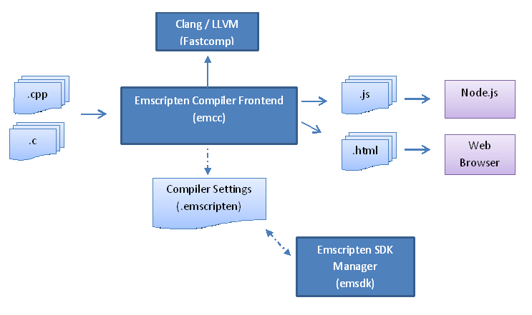
Interface with C++
FFI (Foreign Function Interface)
node-ffi
Node.js add-on for loading and calling dynamic libraries using pure JS
https://github.com/node-ffi/node-ffi/wiki/Node-FFI-Tutorial
SWIG
Interface compiler that connects programs written in C/C++ with scripting languages such as JS, Python, etc.
http://www.swig.org/tutorial.html
Emscripten
Compile LLVM into JS
http://kripken.github.io/emscripten-site/docs/getting_started/index.html
nbind
https://github.com/charto/nbind

Slide 9
node-opencv
Ref
https://github.com/peterbraden/node-opencv
https://community.risingstack.com/opencv-tutorial-computer-vision-with-node-js/

Slide 10
Set Up Web Server
server.js
const express = require("express");
const bodyParser = require("body-parser")
// New app using express module
const app = express();
app.use(bodyParser.urlencoded({
extended:true
}));
app.get("/", function(req, res) {
console.log('Received get request')
res.send('Received get request')
});
app.post("/qrcode", function(req, res) {
res.send("Received post request, body=", req.body);
});
app.listen(8080, function(){
console.log("server is running on port 8080");
})
References
https://nodejs.org/en/docs/guides/nodejs-docker-webapp/
Steps
mkdir proj & cd proj
cnpm init
create app.js
create package.json
run “node app.js”
package.json
{
"name": "docker_web_app",
"version": "1.0.0",
"description": "Node.js on Docker",
"author": "First Last <first.last@example.com>",
"main": "server.js",
"scripts": {
"start": "node server.js"
},
"dependencies": {
"express": "^4.16.1",
"body-parser": "^1.19.1"
}
}

Slide 11
Web Server using Docker
Docker
create Dockerfile
create server.js
run “docker build . -t node-web-app”
run “docker run -p 8080:8080 -d node-web-app”
Dockerfile
FROM node:16
# Create app directory
WORKDIR /usr/src/app
# Install app dependencies
# A wildcard is used to ensure both package.json AND package-lock.json are copied
# where available (npm@5+)
COPY package*.json ./
RUN npm install
# If you are building your code for production
# RUN npm ci --only=production
# Bundle app source
COPY . .
EXPOSE 8080
CMD [ "node", "server.js" ]
.dockerignore
node_modules
npm-debug.log

Slide 12
Express
Steps
/* express的服务器 */
//1. 导入express
var express = require('express')
//2. 创建express服务器
var server = express()
//3. 访问服务器(get或者post)
//参数一: 请求根路径
//3.1 get请求
server.get('/', function (request, response) {
// console.log(request)
response.send('get请求成功')
})
//3.2 post请求
server.post('/', function (request, response) {
response.send('post请求成功')
})
//4. 绑定端口
server.listen(4040)
console.log('启动4040')

Slide 13
Module Import and Export
References
https://www.freecodecamp.org/news/requiring-modules-in-node-js-everything-you-need-to-know-e7fbd119be8
require(‘module’)
steps: resolving, loading, wrapping, evaluating, caching
resolving
module.paths
index.js is used by default if require a folder
main property in package.json is used if require a folder
require.resolve
Only resolving, no other steps

Slide 14
THANKS
谢谢聆听

