Slide 1
Flutter Notes
Sparks-Lu
Last updated: 10/13/2022

Slide 2
Change History
11/10/2021
Added audio codec conversion

Slide 3
References
https://www.tutorialspoint.com/flutter/index.htm

Slide 4
Intro
Features
Modern and reactive framework
Uses Dart programming language and it is very easy to learn
Fast development
Beautiful and fluid user interfaces
Huge widget catalog
Runs same UI for multiple platforms
High performance application
Disadvantages
user interface and logic is intermixed

Slide 5
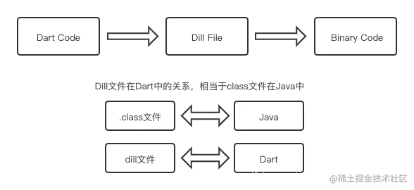
Dart
References

Slide 6
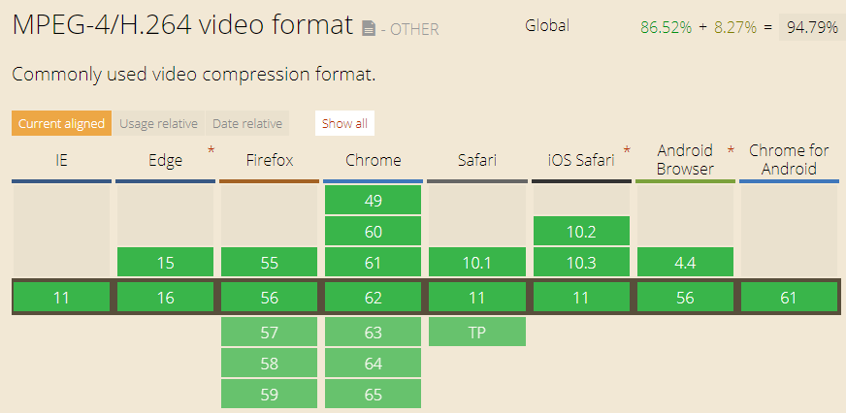
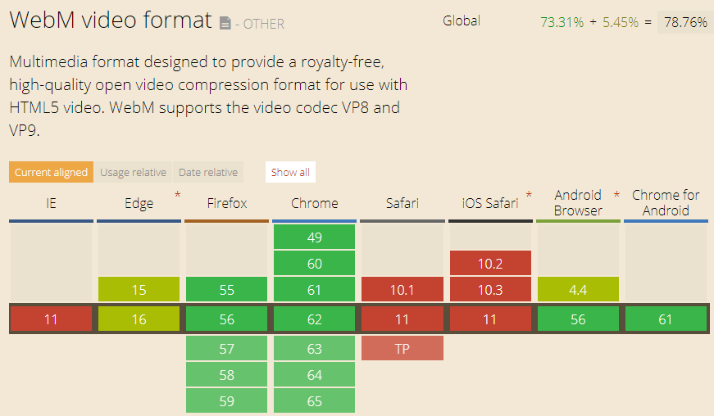
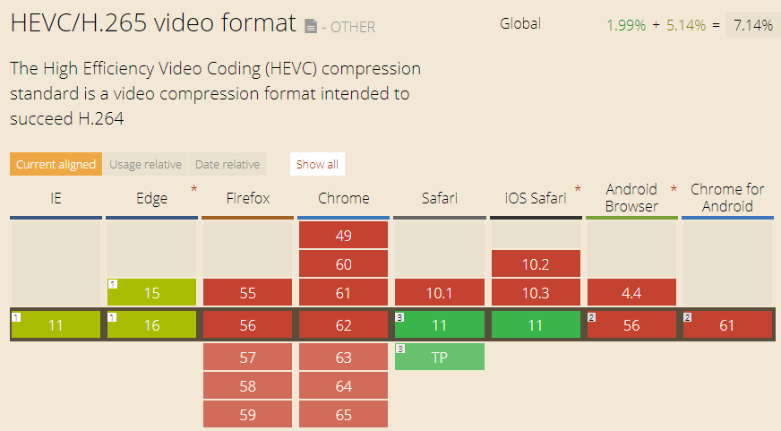
Video Container Format
MP4
audio encoding: AAC, MP3
video encoding: H.264 (AVC), H.265(HEVC)
not royalty-free
WebM
audio encoding: Ogg Vorbis
video encoding: VP8, VP9
royalty-free

Slide 7
Video Standards
Name |  | Info
MPEG-1 | Used for VCD
MP3 | Part of MPEG-1 standard
MPEG-2 / H.262 | Used for DVD
MPEG-4 / H.264 | Used in Blu-ray
MPEG-H / H.265 / HEVC (High Efficiency Video Coding) | Support 4K and 8K resoluation | Doubles the data compression ratio compared to H.264

Slide 8
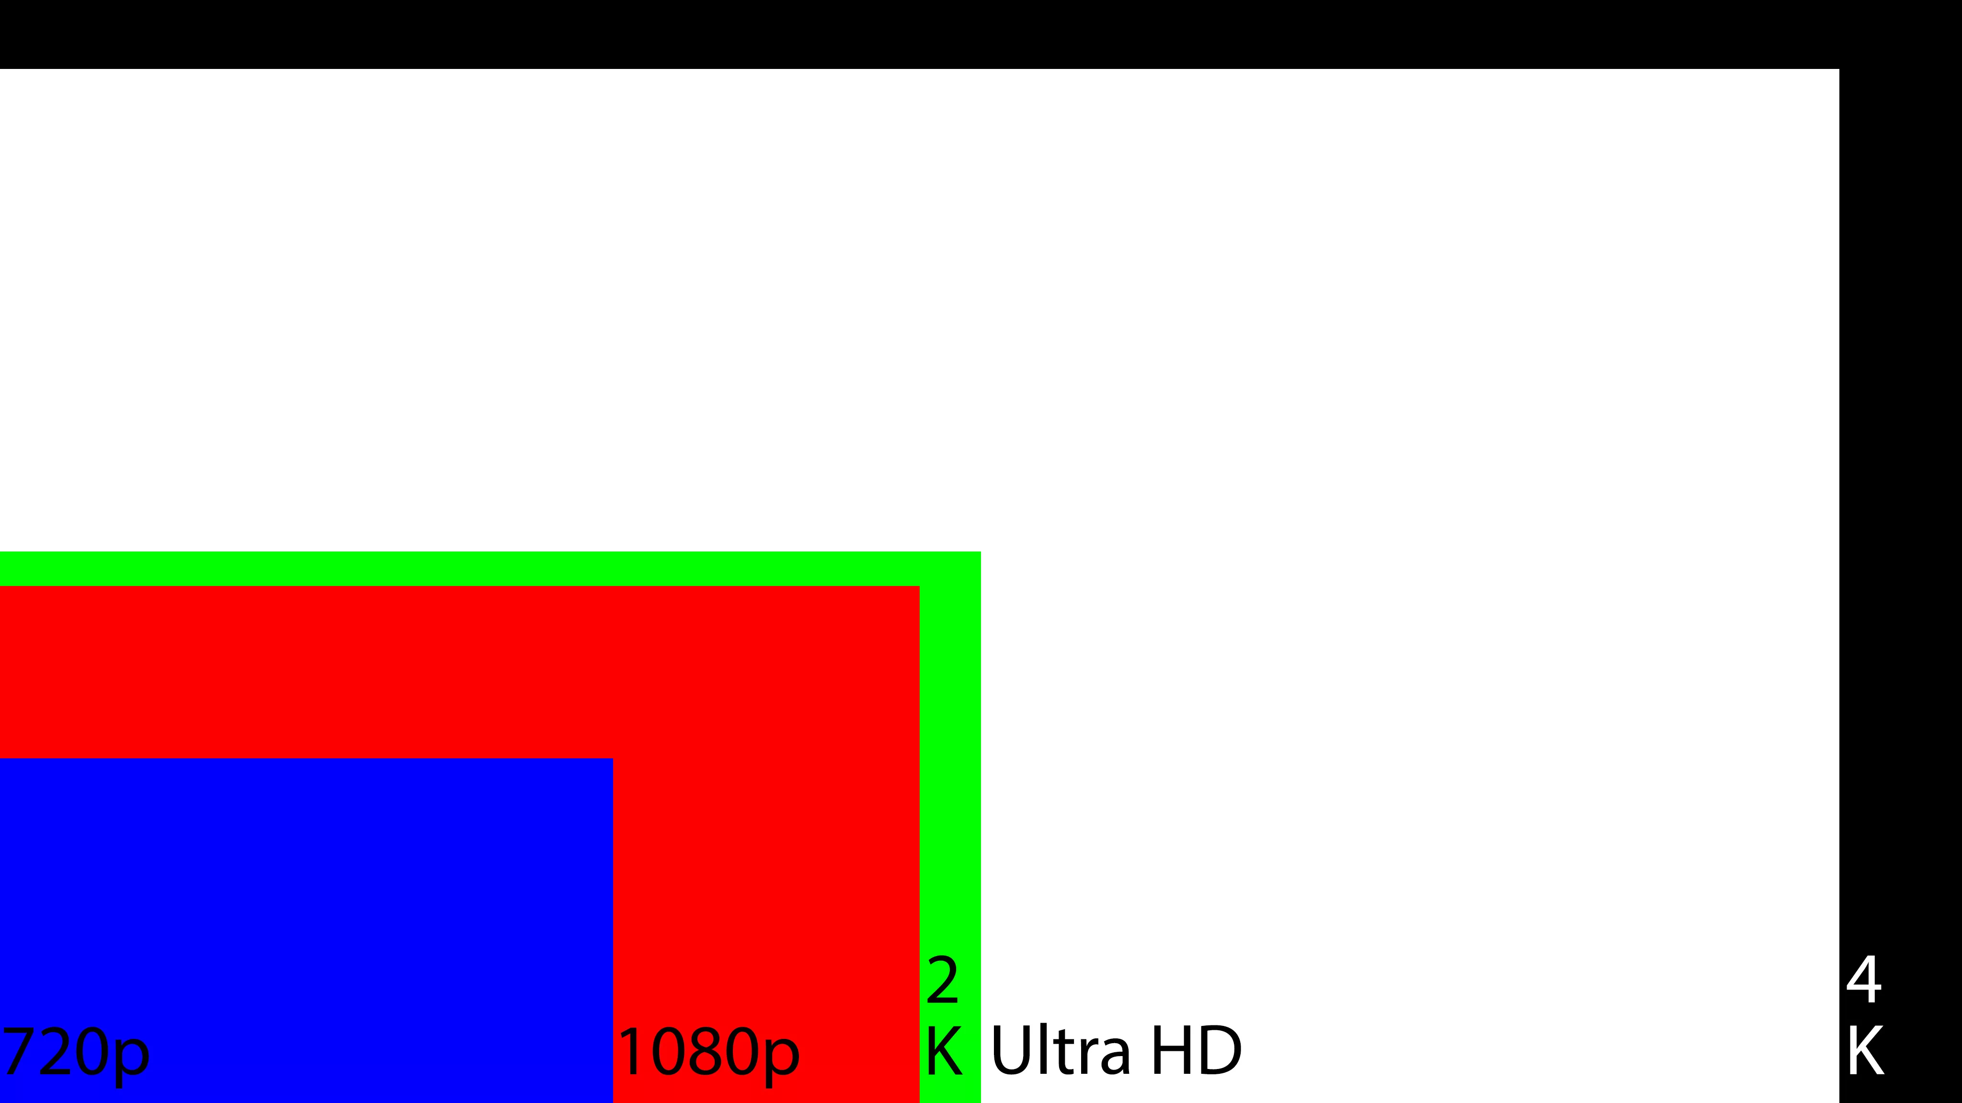
Resolution Standard
Name | Resolution | Note
8K | 7680x4320
4K | 4096x
UHD | 3840x2160 | Ultra High Definition
2K | 2048x
WUXGA | 1920x1200
1080p | 1920x1080 | FHD (Full HD)
720p | 1280x720 | HD (High Definition)

Slide 9
FourCC
Intro
Short for “Four Character Code”
An identifier for a video codec, compression format, color, or pixel format used in a media file.
Video Codecs by FourCC
H264
X264
XVID

Slide 10
FFMPEG Info
Install
sudo add-apt-repository ppa:videolan/master-daily
ffmpeg 3.3.3-2
Task | Commands | Note
Hide banner | ffmpeg -hide_banner
Log level | ffmpeg -loglevel quiet/panic/fatal/error/warning/info/verbose/debug
pix format | ffmpeg -pix_fmts
List info | ffmpeg -codecs/-fomats/--decoders/--encoders/--filters
Print format | ffprobe -show_format -print_format json -v quiet input.mp4
Get duration | ffprobe -i input.mp4 -v quiet -show_entries format=duration -hide_banner -of default=noprint_wrappers=1:nokey=1
Show stream info | ffprobe -v quiet -print_format json -show_format -show_streams input.mp4
Get fps | ffmpeg -i filename 2>&1 | sed -n "s/.*, \(.*\) fp.*/\1/p"

Slide 11
FFMPEG frames
Task | Commands | Note
Convert image sequences into video | ffmpeg -i %4d.png -r 20 output.mp4
Get frames from image | ffmpeg -i input.mp4 output/frame%04d.jpg
Extract frames with a ratio | ffmpeg -i input.mp4 -r 0.1 ./images/frames_%02d.jpg

Slide 12
FFMPEG Video
Task | Commands | Note
Change video size | ffmpeg -i input.avi -s 720x480 -c:a copy output.avi ffmpeg -i input.avi -filter:v scale=720:-1 -c:a copy output.avi
Crop video | ffmpeg -i input.mp4 -filter:v "crop=w:h:x:y" output.mp4
Change fps | ffmpeg -i input.mp4 -r 30 output.mp4 | video lengh not changed, frames added or removed
Add logo to video (bottom-right) | ffmpeg -i vt.mp4 -i vhuantech-org.png -filter_complex "overlay=W-w-5:H-h-5" -codec:a copy TempleOfHeaven.mp4
Speed up or slow down | ffmpeg -i input.mp4 -filter:v “setpts=0.6*PTS” output.mp4 | fps not changed, video length changed, frames added or removed PTS: presentation timestamp
Generate video from image | ffmpeg -loop 1 -i image.png -t 3 out.mp4
Output to gif | ffmpeg -i input.mp4 -f gif output.gif
Reverse video | ffmpeg -i input.mov -filter:v 'reverse' -filter:a 'areverse' output.mov
Rotate video | ffmpeg -i input.mp4 -filter:v 'transpose=1' rotated-video.mp4 // 1: 90 counter-clockwise, 2: 90 clockwise
Truncate video | ffmpeg -ss 10 -i input.mp3 -t 6 output.mp3
Concat video files | ffmpeg -f concat -safe 0 -i mylist.txt -c copy output.mp4 | mylist.txt: file 'filename1'
Change video codec | ffmpeg -i in.mpg -c:v libx264 out.mp4

Slide 13
FFMPEG Video 2
Task | Commands | Note
Set h264 encoding params | ffmpeg -c:v libx264 -profile:v high/main/baseline -level:v 4.0 -crf 0~51 (constant rate factor, default 23, 0 lossless, 17/18 nearly lossless) -preset // encoding speed, ultrafast, superfast, veryfast, faster, fast, medium (the default), slow, slower, veryslow. A slower preset provides better compression (quality per file size) but is slower. -b:a 128k // set audio bitrate to 128K // profile: video compression features the player must support // level: defines the peak bitrate the player can handle, along with the maximum resolution, and the maximum number of reference frames held in memory during playback
Padding | ffmpeg -i in.mp4 -vf “pad=width=800:height=600:x=10:y=75:color=black” out.mp4 | x/y: start placing point of the original
Web video | -movflags +faststart // Allows video to playback before it is completely downloaded in the case of progressive download viewing. Useful if you are hosting the video, otherwise superfluous if uploading to a video service like YouTube.
Convert to gif | ffmpeg -i video.mp4 -vf scale=500:-1 -t 10 -r 10 image.gif // scale to width=500
Add a poster image to audio to generate video | ffmpeg -loop 1 -i image.jpg -i audio.mp3 -c:v libx264 -c:a aac -strict experimental -b:a 192k -shortest output.mp4
Convert a single image to video | ffmpeg -loop 1 -i image.png -c:v libx264 -t 30 -pix_fmt yuv420p video.mp4

Slide 14
FFMPEG Audio
Task | Commands | Note
从MP4中提取声音 | ffmpeg -i input.mp4 -vn output.mp3
Add subtitle | ffmpeg -i input.avi -vf subtitles=subtitle.srt output.avi ffmpeg -i input.avi -vf “ass=subtitle.ass” output.avi ffmpeg -i movie.mp4 -i subtitles.srt -map 0 -map 1 -c copy -c:v libx264 -crf 23 -preset veryfast output.mkv
Extract audio from video | ffmpeg -i input.mp4 -vn -ac 2 -ab 187 audio.wav -ac number of audio channels -ab audio bitrate in Kbps
Merge audio and video | ffmpeg -i audio.mp3 -i input.mp4 output.mp4
Remove audio from video | ffmpeg -i input.avi -vcodec copy -an output.avi
Convert wav to mp3 | ffmpeg -i input.wav output.mp3
Change audio volume | ffmpeg -i input.wav -af "volume=0.25" output.mp3
Fade in volume | ffmpeg -y -i demo.wav -af "afade=t=in:ss=0:d=15" output.mp3
Reduce background noise | ffmpeg -i input.wav -af "highpass=f=200, lowpass=f=3000" output.mp3 | [200Hz, 300Hz] is kept
Slow down audio by 2 | ffmpeg -i input.mp4 -filter:a "atempo=0.5" -vn output.aac | atempo: 0.5~2.0
Change audio codec | ffmpeg -i in.mp4 -c:a aac out.mp4 | mp3-encoded video cannot play audio correctly in Mac/iOS

Slide 15
FFMPEG Subtitle
Task | Commands | Note
Remove soft subtitle | ffmpeg -i video.mkv -vcodec copy -acodec copy -sn video-no-subs.mkv
Integrate subtitle | ffmpeg -i demo.mkv -i sub.ass -codec copy -map 0 -map 1 output.mkv
Extract subtitle from video | ffmpeg -i demo.mkv -map 0:s:0 sub.srt

Slide 16
FFmpeg - Build From Source
References
https://trac.ffmpeg.org/wiki/CompilationGuide/Ubuntu
ffmpeg-git-amd64-static.tar.xz

Slide 17
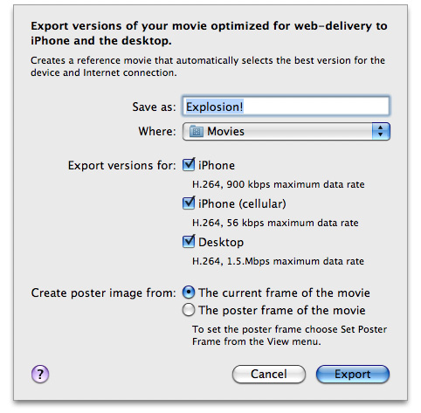
Video Support in Safari
References
https://developer.apple.com/library/archive/documentation/AppleApplications/Reference/SafariWebContent/CreatingVideoforSafarioniPhone/CreatingVideoforSafarioniPhone.html#//apple_ref/doc/uid/TP40006514-SW6
Supported
H.264 Baseline Profile Level 3.0 video, up to 640 x 480 at 30 fps. Note that B frames are not supported in the Baseline profile
MPEG-4 Part 2 video (Simple Profile)
AAC-LC audio, up to 48 kHz
.mov, .mp4, .m4v, and .3gp are supported
Server
Must support byte-range requests
curl --range 0-99 http://example.com/test.mov -o /dev/null

Slide 18
Video Edit Software
References
https://www.lifewire.com/best-free-video-editing-software-programs-4128924
OpenShot
Windows, Mac, Linux
Chinese version supported

Slide 19
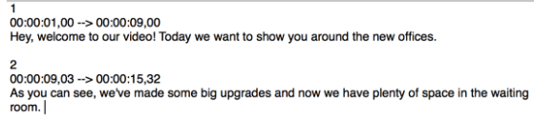
Subtitle
SRT format (.srt)
Subrip Subtitle
plain text
time format: [hours]: [minutes]: [seconds], [milliseconds]
ASS format (.ass)
Advanced SubStation Alpha subtitle
ffmpeg -i input.srt output.ass
ffmpeg -codecs | grep "^...S" // List supported subtitle codecs
[Section of subtitles number]
[Time the subtitle is displayed begins] –> [Time the subtitle is displayed ends]
[Subtitle]

