Slide 1
MoviePy Notes
Sparks Lu
Last updated: 2/25/2020

Slide 2
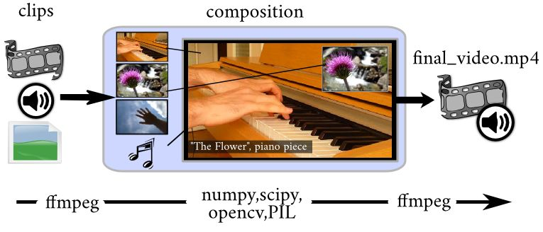
Introduction
References
https://github.com/Zulko/moviepy
https://zulko.github.io/moviepy/
Intro
video editing: cutting, concatenations, title insertions, video compositing, video processing, and creation of custom effects

Slide 3
Classes
moviepy.editor
AudioClips
VideoClips
- resize()
- subclip()
- fx()
ImageClip
TextClip
AudioFileClip
VideoFileClip
- resize()
- subclip()
- fx() // change attributes
- fl() // custom effects
- fl_time() // change timeline
- fl_image() // change frames
- write_videofile(fn)
Editor
- concatenate_videoclips([clips])

