Slide 1
Node.js Notes
Sparks Lu
Last updated: 6/3/2021

Slide 2
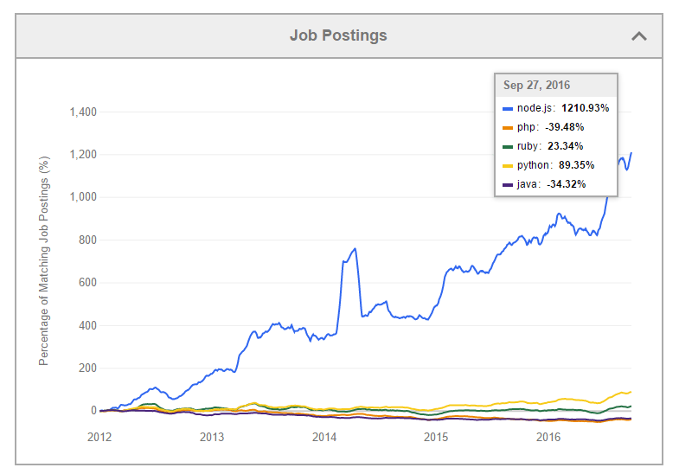
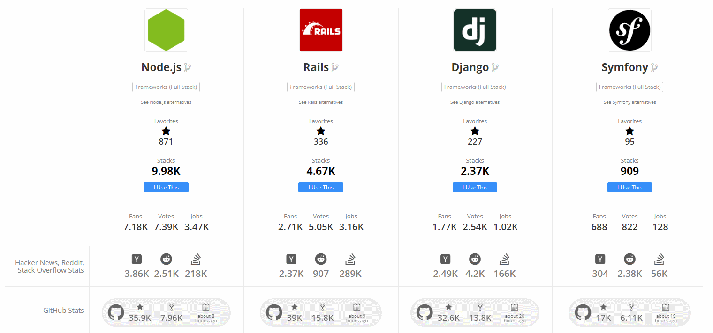
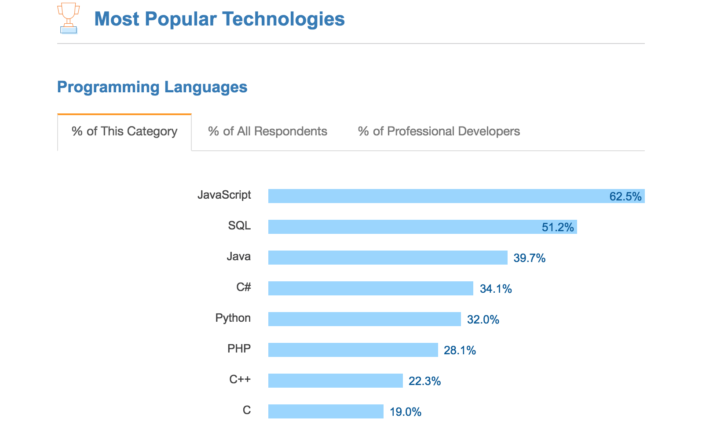
Overview
Overview
Runtime environment for executing JS code
Features
Asynchronous
node --version
node -p "process.arch" // 32bit or 64bit
Global object
global, window, module, __filename, __dirname
require: load module

Slide 3
Install
Steps
curl -sL https://deb.nodesource.com/setup_14.x | sudo -E bash -
sudo apt-get install -y nodejs
npm install --global windows-build-tools
FAQ
After upgrade nodejs, npm run build may fail with message like “Node Sass does not yet support your current environment:”
run “npm rebuild node-sass”

Slide 4
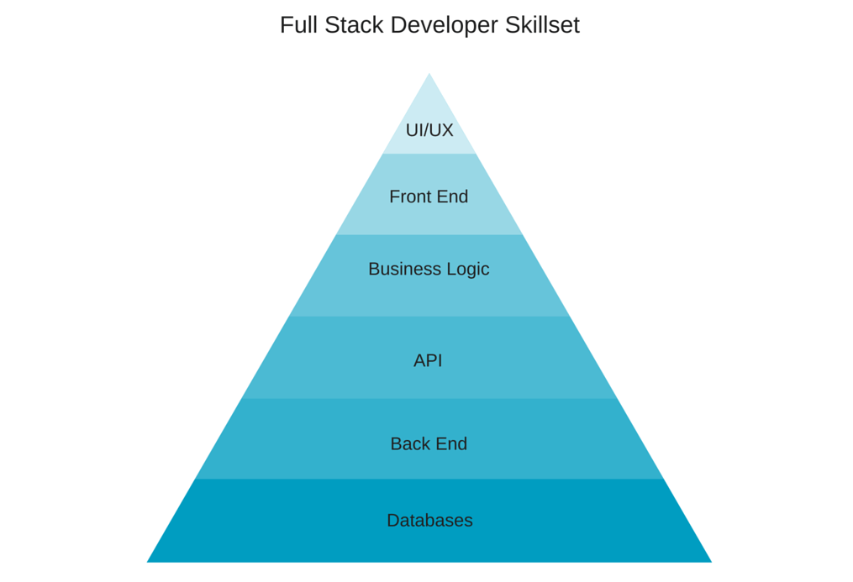
Full Stack Development
LAMP
MEAN
MEAN
PHP
MySQL
Express
MongoDB
Django
MySQL
Apache
AngularJS
Linux
Node.js
Python

Slide 5
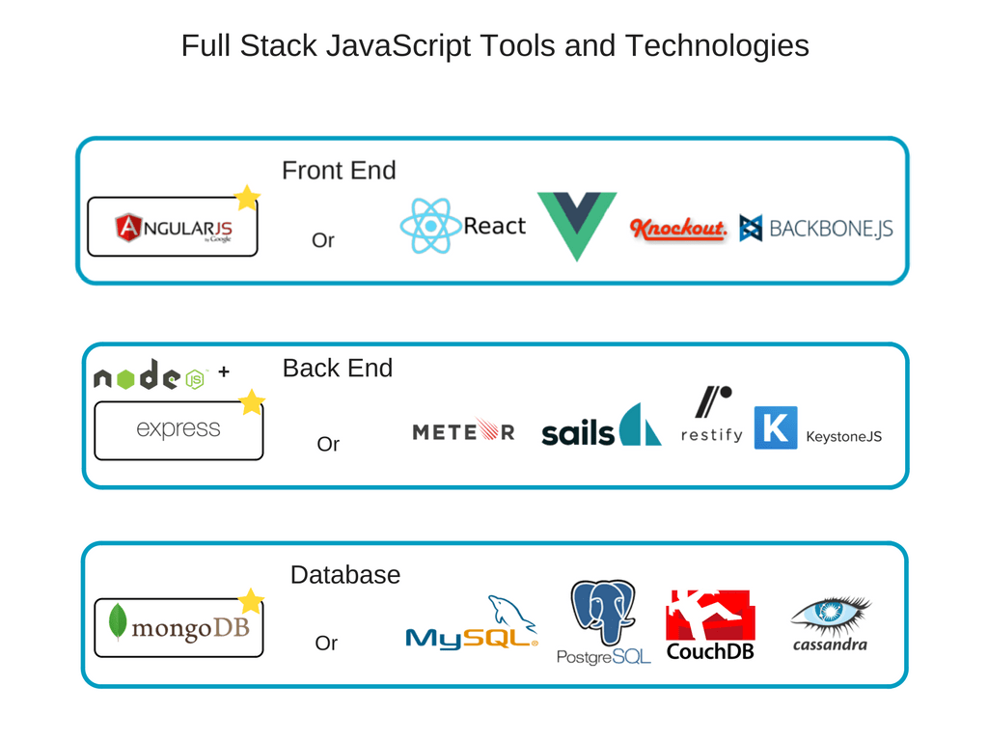
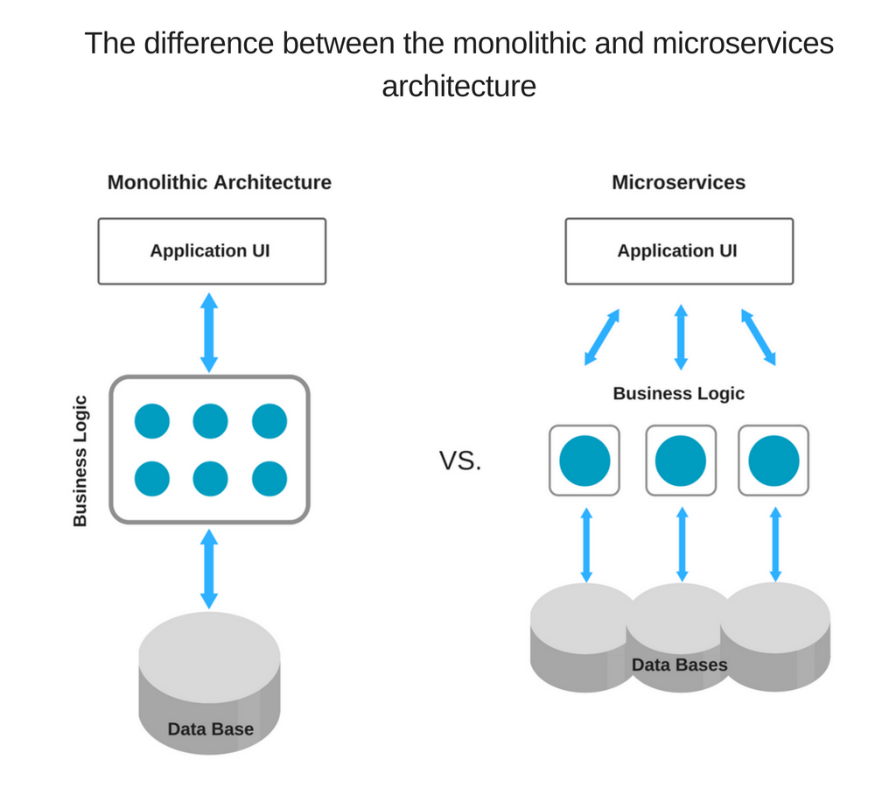
Web
Server
Express.js
Fontend
Angular.js
DB
MongoDB

Slide 6
Pros and Cons of Full-Stack JS Approach
Pros
Common language, better team efficiency with less resources
Extensive code reuse
High performance and speed
Huge talent pool
Extensive knowledge base
Free, open-source toolset
Cons
Insufficiency with computation-heavy backend
Relatively young technologies
Jack of all trade, master of none
Drawbacks of every separate tool in the stack combined

Slide 7
Package Management
npm
npm config list
npm install -g npm
npm install -g <package-name>@version-number
npm uninstall <package-name>
npm list -g // list installed packages
npm outdated
npm update <package-name>
npm search <keyword>
npm cache clean
npm install -g cnpm --registry=https://registry.npm.taobao.org
cnpm install ...
https://docs.npmjs.com/common-errors
cnpm view <package-name> versions
cnpm view vue-panzoom versions
cnpm uninstall <package-name>
cnpm rebuild
yarn
cnpm i -g yarn
yarn config set registry 'https://registry.npm.taobao.org

Slide 8
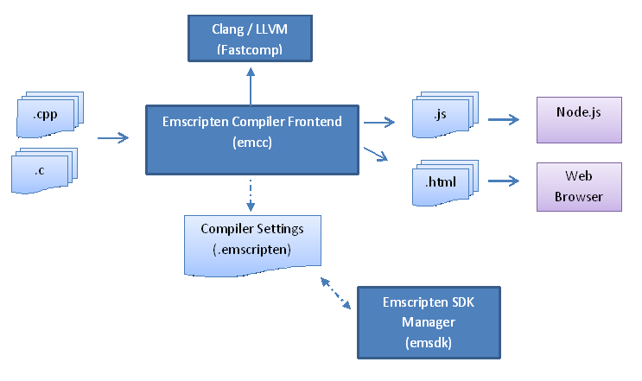
Interface with C++
FFI (Foreign Function Interface)
node-ffi
Node.js add-on for loading and calling dynamic libraries using pure JS
https://github.com/node-ffi/node-ffi/wiki/Node-FFI-Tutorial
SWIG
Interface compiler that connects programs written in C/C++ with scripting languages such as JS, Python, etc.
http://www.swig.org/tutorial.html
Emscripten
Compile LLVM into JS
http://kripken.github.io/emscripten-site/docs/getting_started/index.html
nbind
https://github.com/charto/nbind

Slide 9
node-opencv
Ref
https://github.com/peterbraden/node-opencv
https://community.risingstack.com/opencv-tutorial-computer-vision-with-node-js/

Slide 10
THANKS
谢谢聆听

