Slide 1
VTK Notes
Sparks Lu
Last updated: 7/13/2018

Slide 2
References
https://www.vtk.org/doc/nightly/html/
https://lorensen.github.io/VTKExamples/site/Python/

Slide 3
Pipeline 1/2
vtkSphereSource
vtkCubeSource
vtkConeSource
Source/Reader
vtkSTLReader
Filter
Mapper
vtkPolyDataMapper
Maps data to graphics primitives which can be displayed by the renderer
- Represents an object in a rendering scene
- Has position, scale, orientation, textures, ...
Actor
vtkActor
Renderer
vtkRenderer
Render Window
vtkRenderWindow
Create a window for renderers to draw into
Interactor
vtkRenderWindowInteractor
Window interaction

Slide 4
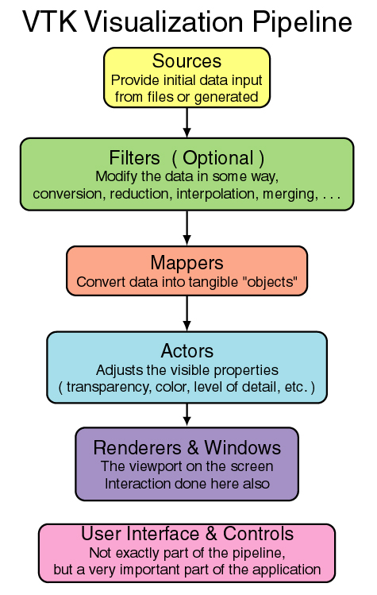
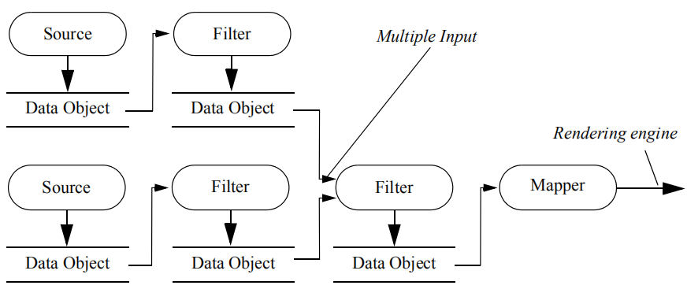
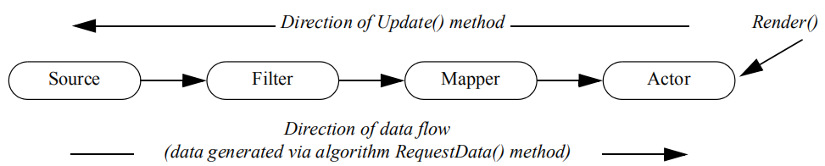
Pipeline 2/2

Slide 5
Basic Classes
vtkRenderWindowInteractor
- SetRenderWindow(ren_win)
- Initialize()
- Start()
vtkAlgorithm
- SetInputConnection(conn)
- GetOutputPort()
vtkActor
- SetMapper(mapper)
- SetTexture(tex)
- SetPosition(x, y, z)
- RotateX(degree)
- RotateY(degree)
- RotateZ(degree)
- GetProperty()
vtkRenderer
- AddActor(actor)
- SetBackground(r, g, b)
- ResetCamera()
- GetActiveCamera()
- AddLight(light)
vtkRenderWindow
- AddRenderer(renderer)
- Render()
- SetSize()
- SetWindowName()
- SetOffScreenRendering()
vtkPolyDataMapper
- SetInputConnection(conn)
vtkCamera
- SetClippingRange (dnear, dfar)
- SetFocalPoint (x, y, z)
- SetPosition (x, y, z)
- SetViewUp (x, y, z)
vtkLight
- SetColor(r, g, b)
- SetFocalPoint(x, y, z)
- SetPosition(x, y, z)
vtkCylinderSource

Slide 6
Reader
vtkJPEGReader
vtkImageReader2
vtkPNGReader
vtkSTLReader
vtkReaderAlgorithm
vtkDataReader
- SetFileName(fn)
- Update()
vtkPolyDataReader
- GetOutput()
vtkOBJReader
vtkPLYReader

Slide 7
Data
vtkDataObject
vtkDataSet
vtkImageData
vtkPolyData

Slide 8
Source
vtkConeSource
vtkCubeSource
vtkPlaneSource
vtkPolyDataAlgorithm
- GetOutput()

Slide 9
Filters

Slide 10
Mappers

Slide 11
Actors

Slide 12
Texture
vtkAlgorithm
- SetInputConnection(conn)
vtkTexture
- SetInputConnection(conn)
- InterpolateOn()

Slide 13
Text
vtkTextActor

Slide 14
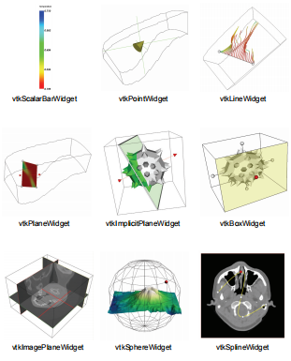
3D Widgets
vtkScalarBarWidget
vtkBoxWidget
vtkPointWidget
vtkLineWidget
vtkPlaneWidget

Slide 15
Animation
vtkAnimationScene
- SetStartTime()
- SetEndTime()
- SetPlayMode()
- SetFrameRate()
- AddCue()
- RemoveCue()
- RemoveAllCue()
- SetAnimationTime()
- GetAnimationTime()
- Play()
- SetLoop()

Slide 16
Exporter

Slide 17
Conversion
To Numpy
from vtk.util.numpy_support import vtk_to_numpy
vtk_rw = vtk.vtkRenderWindow()
vtk_win_im = vtk.vtkWindowToImageFilter()
vtk_win_im.SetInput(vtk_rw)
vtk_win_im.Update()
vtk_image = vtk_win_im.GetOutput()
width, height, _ = vtk_image.GetDimensions()
vtk_array = vtk_image.GetPointData().GetScalars()
components = vtk_array.GetNumberOfComponents()
arr = vtk_to_numpy(vtk_array).reshape(height, width, components)

