Slide 1
Media Notes
Sparks-Lu
Last updated: 2/2/2020

Slide 2
References
https://helgeklein.com/blog/2017/12/browser-video-codecs-formats-hardware-acceleration/
https://www.fourcc.org/codecs.php

Slide 3
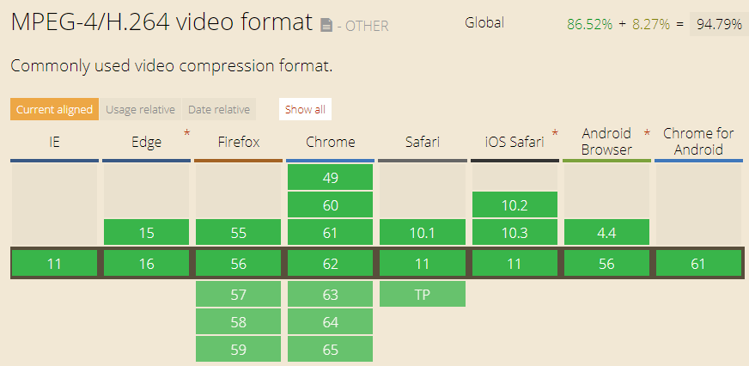
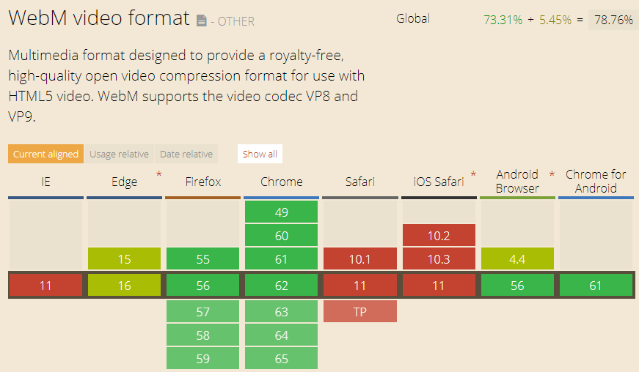
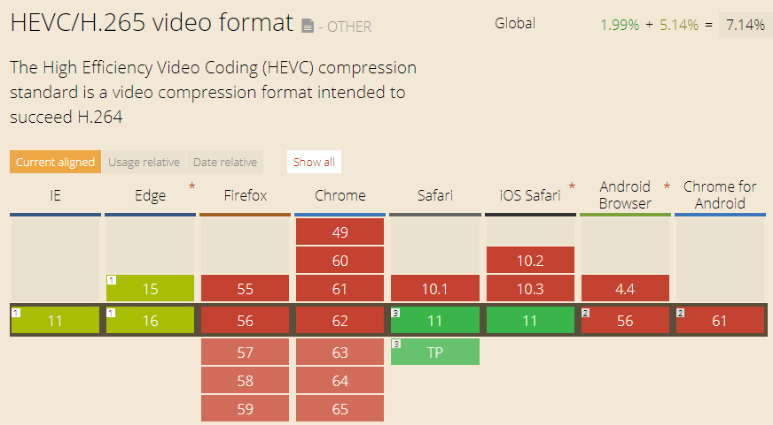
Video Container Format
MP4
audio encoding: AAC, MP3
video encoding: H.264 (AVC), H.265(HEVC)
not royalty-free
WebM
audio encoding: Ogg Vorbis
video encoding: VP8, VP9
royalty-free

Slide 4
Video Standards
Name |  | Info
MPEG-1 | Used for VCD
MP3 | Part of MPEG-1 standard
MPEG-2 / H.262 | Used for DVD
MPEG-4 / H.264 | Used in Blu-ray
MPEG-H / H.265 / HEVC (High Efficiency Video Coding) | Support 4K and 8K resoluation | Doubles the data compression ratio compared to H.264

Slide 5
FourCC
Intro
Short for “Four Character Code”
An identifier for a video codec, compression format, color, or pixel format used in a media file.
Video Codecs by FourCC
H264
X264
XVID

Slide 6
FFMPEG
Options
ffmpeg -codecs // List install codecs
ffmpeg -fomats
ffmpeg -decoders
ffmpeg -encoders
ffmpeg -filters
ffmpeg -y // overwrite without confirmation
ffmpeg -profile:v high/main/baseline
ffmpeg -level:v 3.0/3.1/4.0
Change video codec to h264
ffmpeg -i in.mpg -c:v libx264 out.mp4
Padding
ffmpeg -i in.mp4 -vf “pad=width=800:height=600:x=10:y=75:color=black” out.mp4
x/y: start placing point of the original frame
Truncate
ffmpeg -ss 10 -i input.mp3 -t 6 output.mp3
Change fps
ffmpeg -r 30 -i input.mp4 output.mp4 // change to 30fps
Get frames from image
ffmpeg -i input.mp4 output/frame%04d.jpg
Add audio to video
ffmpeg -i input.mp4 -i input.mp3 -c copy -map 0:v:0 -map 1:a:0 output.mp4
Concat video files
ffmpeg -f concat -safe 0 -i mylist.txt -c copy output.mp4
list.txt:
file 'filename1'
ffprobe a.mp4

Slide 7
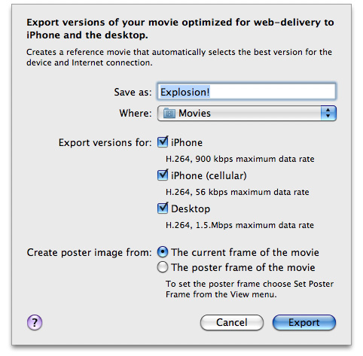
Video Support in Safari
References
https://developer.apple.com/library/archive/documentation/AppleApplications/Reference/SafariWebContent/CreatingVideoforSafarioniPhone/CreatingVideoforSafarioniPhone.html#//apple_ref/doc/uid/TP40006514-SW6
Supported
H.264 Baseline Profile Level 3.0 video, up to 640 x 480 at 30 fps. Note that B frames are not supported in the Baseline profile
MPEG-4 Part 2 video (Simple Profile)
AAC-LC audio, up to 48 kHz
.mov, .mp4, .m4v, and .3gp are supported
Server
Must support byte-range requests
curl --range 0-99 http://example.com/test.mov -o /dev/null

