Slide 1
Android General
Sparks Lu
Last updated: 11/9/2021

Slide 2
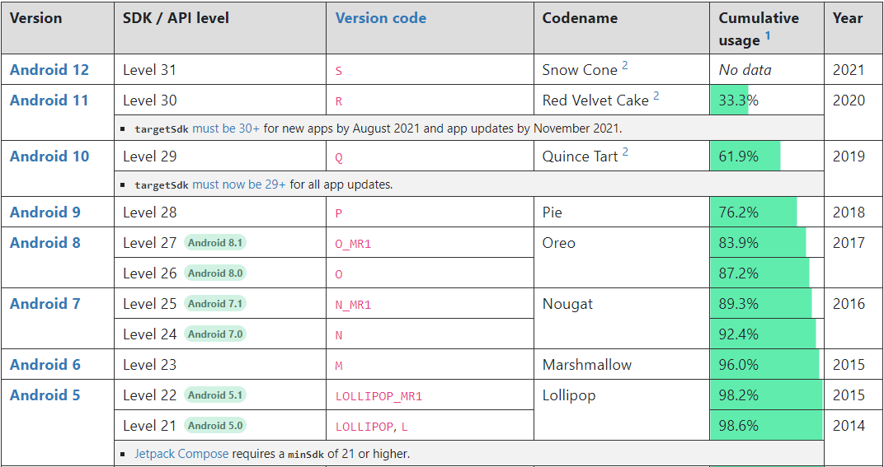
Android Versions

Slide 3
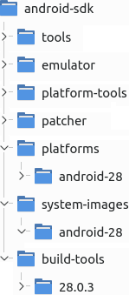
SDK Cmdline Tools
cmdline-tools
cmdline-tools\latest\bin\
sdkmanager
https://developer.android.com/studio/command-line/sdkmanager
sdkmanager --list List installed and avaiable packages
sdkmanager --list_installed List install packages
sdkmanager {package_name} Install package
sdkmanager.bat "system-images;android-30;default;arm64-v8a"
sdkmanager --uninstall {package-name}
avdmanager
avdmanager list List available targets, virtual devices, and device definitions
avdmanager list avd, list target, list device
avdmanager create avd --help
avdmanager create avd --force --name Pixel5 --package 'system-images;android-31;default;x86_64' --device ‘pixel_5’
Needs to install system-images first using sdkmanager
avd folder: {Android_sdk}/system-images/android-{apiLevel}/{variant}/{arch}/
avdmanager delete avd --name Pixel5
apkanalyzer
apkanalyzer apk summary myapk.apk
output package_name, version code, version name
apkanalyzer files list myapk.apk
apkanalyzer manifest print

Slide 4
Emulator
emulator
https://developer.android.google.cn/studio/run/emulator-commandline?hl=zh-cn
emulator --help
emulator -list-avds
avd needs to be created using “avdmanager create avd ...”
emulator -avd Pixel_5
snapshot
-no-snapshot-load code boot, save state when exit
-no-snapshot-save quick boot, do not save state when exit
-no-snapshot
-snapshot-list list snapshots
camera
-webcam-list list available camera name
-camera-back {cam_name}
storage
-sdcard {path} SD file path
misc
-shell launch shell

Slide 5
Platform Tools
adb (Android Debug Bridge)
references
https://developer.android.com/studio/command-line/adb
Included in platform-tools
adb devices -l
adb -s emulator-5554 install helloWorld.apk
must start emulator first
Phone
“Setting”->”About phone”->”Build number”, tap 7 times to make “Developer options” visible
turn on “Settings”->”Developer option”->”USB debugging”
adb install -t path_to_apk
adb pull remote local # pull from phone
adb push local remote # push to phone
adb shell
adb shell ls /system/bin
adb shell screencap /sdcard/1.jpg
adb shell screenrecord /sdcard/demo.mp4
adb logcat
-b {main/system/crash}
-d >C:\tmp\1.log # dump log to screen and exit
-v color
*:W # warning and above
*:E # error and above
-f /sdcard/logs
-c # clear logs

Slide 6
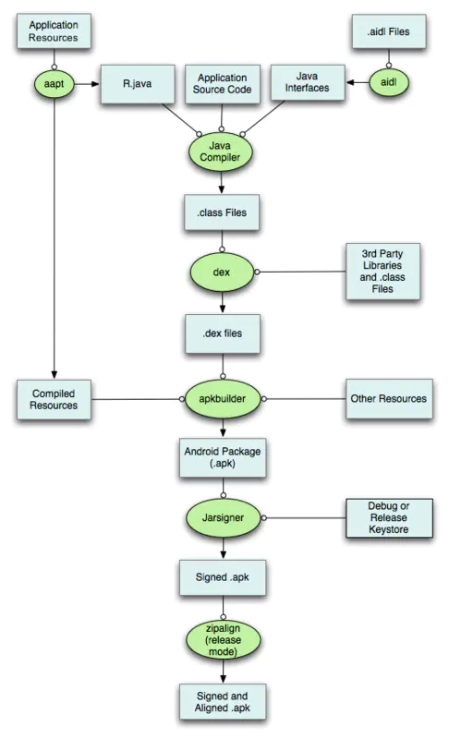
SDK Build Tools
aapt (Android Asset Packing Tool)
apksigner

Slide 7
SDK Build Tools
Check apk signature
keytool -printcert -jarfile {a.apk}
Check apk package name
aapt dump badging {a.apk} | grep package:\ name

Slide 8
Keystore
Generate
keytool -genkey -alias mydomain -keyalg RSA -keystore keystore.jks -keysize 2048
Verify
onkstore -file my_keystore -verify
keytool -list -v -keystore keystore.jks

Slide 9
Apps
Termux
https://f-droid.org/packages/com.termux/
terminal app

Slide 10
Python Support
Steps
install termux
pkg install root-repo
pkg update
pkg install python

Slide 11
Printing
Mopia
https://mopria.org/
Mi Print

