Slide 1
Docker Notes
Sparks Lu
Last updated: 12/21/2021

Slide 2
References
Dockerfile
https://docs.docker.com/develop/develop-images/dockerfile_best-practices/
https://www.tutorialspoint.com/docker/
https://runnable.com/blog/9-common-dockerfile-mistakes
https://www.digitalocean.com/community/tutorials/how-to-debug-and-fix-common-docker-issues

Slide 3
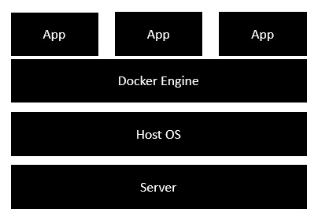
Intro
Concept
Docker: a platform to build, share, and run applications with containers
container: a running process
Docker image: everything needed to run an application
Dokerfile: describe how to assemble a private filesystem for a container
Install
Docker for Windows
https://github.com/docker/toolbox/releases
Start “Docker Quickstart Terminal”
Ubuntu Linux
sudo apt install apt-transport-https ca-certificates curl gnupg-agent software-properties-common
curl -fsSL https://download.docker.com/linux/ubuntu/gpg | sudo apt-key add -
CentOS
Test install: docker run hello-world

Slide 4
Install on Ubuntu
Install Docker Engine - Community (deb)
Download and install .deb for docker-ce docker-ce-cli, and containerd.io from https://download.docker.com/linux/ubuntu/dists/
sudo docker run hello-world # test installation
Install Docker
sudo apt install docker.io
Install Docker Compose
sudo curl -L "https://github.com/docker/compose/releases/download/1.25.3/docker-compose-$(uname -s)-$(uname -m)" -o /usr/local/bin/docker-compose # slow
sudo curl -L https://get.daocloud.io/docker/compose/releases/download/1.29.2/docker-compose-`uname -s`-`uname -m` -o /usr/local/bin/docker-compose
sudo chmod +x /usr/local/bin/docker-compose
docker-compose --version # test installation

Slide 5
Install On Ubuntu 16.04 (2)
Install Docker Machine
Download docker-machine from https://github.com/docker/machine/releases/download/
docker-machine --version # test installation
wget -q https://www.virtualbox.org/download/oracle_vbox_2016.asc -O- | sudo apt-key add -
wget -q https://www.virtualbox.org/download/oracle_vbox.asc -O- | sudo apt-key add -
sudo sh -c 'echo "deb http://download.virtualbox.org/virtualbox/debian $(lsb_release -sc) contrib" >> /etc/apt/sources.list.d/virtualbox.list'
sudo apt update
sudo apt install virtualbox

Slide 6
Install On Aliyun Ubuntu 16.04 (3)
Docker Engine
sudo curl -fsSL https://get.docker.com | bash -s docker --mirror Aliyun
sudo -E sh -c 'apt-get install -y -qq --no-install-recommends docker-ce >/dev/null'
sudo -E sh -c 'docker version'
sudo docker run hello-world # test install

Slide 7
Install on CentOS
References
https://www.digitalocean.com/community/tutorials/how-to-install-and-use-docker-compose-on-centos-7
Install docker
sudo yum check-update
sudo yum install -y yum-utils device-mapper-persistent-data lvm2
sudo vim /usr/bin/yum-config-manager
modify first line from #/usr/bin/python to /usr/bin/python?
sudo yum-config-manager --add-repo https://download.docker.com/linux/centos/docker-ce.repo
sudo yum install docker
Install docker-compose
sudo curl -L "https://github.com/docker/compose/releases/download/1.23.2/docker-compose-$(uname -s)-$(uname -m)" -o /usr/local/bin/docker-compose
Or download directly from https://github.com/docker/compose/releases
sudo curl -L https://get.daocloud.io/docker/compose/releases/download/1.25.3/docker-compose-`uname -s`-`uname -m` -o /usr/local/bin/docker-compose
sudo chmod +x /usr/local/bin/docker-compose
docker-compose --version
Start
systemctl start docker.service

Slide 8
Components
Docker Compose
Bundle a multi-container application into a single app
docker-compose --version
Docker Machine
Create Docker hosts both locally and in the cloud
docker-machine --version
Kitematic
Docker CLI Client
Docker Compose
Docker Machine
Docker Engine

Slide 9
Working Logic
Docker Client
Docker Daemon
contact
pull from Docker Hub
create a new container
stream output

Slide 10
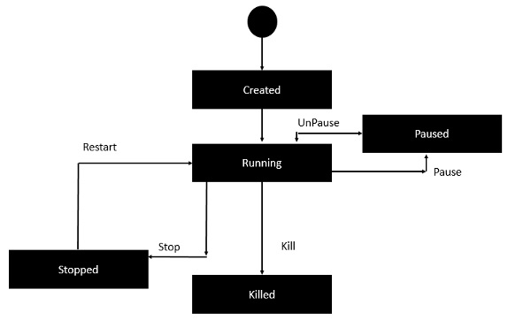
Container Lifecycle

Slide 11
Docker Commands - Basic
Command | Description | Note
docker version
docker info
docker pull {image-name} | Pull docker image from registry | docker pull busybox
docker build . -t {image-name} | Build docker
docker run -p 8081:8080 -d {image-name} | Run docker image
docker stop {container-id}
docker ps | List docker images and container ids
docker logs -f {container-id} | Show logs in docker image, -f follow
docker network ls | List network names for containers
docker network inspect {network_name}
docker exec -it <container_name> /bin/bash | Run bash in container in interactive mode
docker cp {local_file} {image_name}:{dir_in_image} docker cp {image_name}:{dir_in_image} {local_dir}
docker volume ls
docker volume inspect {volume-name} | Get mount point of the volume
docker volume rm {volume-name}
docker volume prune

Slide 12
Docker Commands - System
Command | Description | Note
docker system df | Show docker disk usage
docker system info | Display system-wide info
docker system prune | Remove unused data | Files in /var/lib/docker are huge.
docker system events | Get real-time events from the server

Slide 13
Docker Commands - Container
Command | Description | Note
docker container ls -a | list containers
docker container ps | list containers
docker container stop {container-name} | stop container
docker container stop $(docker container ls -aq) | stop all containers
docker container rm --force {container-name} | remove a container
docker container run --name {container-name} {image-name}
docker top/stats/attach/pause/unpause/kill/stop/rm {container-id}

Slide 14
Docker Commnads - Image
Command | Description | Note
docker images | list installed images
docker image prune | clean up dangling images, free huge space
docker rmi {image-id} | remove docker image
docker image build -t {image-name}
docker inspect {image-name}
docker history {image-id}

Slide 15
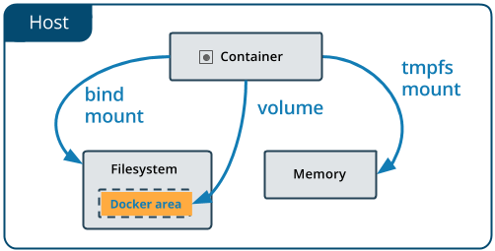
Docker Volume
References
https://docs.docker.com/storage/volumes/
Concept
Volumes in image are added when run container.
Volume data is preserved across runs.
Commands
docker volume ls
docker volume inspect {volume_name}

Slide 16
Dockerfile
#This is a sample Image
FROM ubuntu
MAINTAINER demousr@gmail.com
RUN apt-get update
RUN apt-get install –y nginx
CMD [“echo”,”Image created”]
Intro
Tells docker how to build an image
Build
docker build -t {image-name}:{tag-name} dir
-t: with tag

Slide 17
Instructions in Dockerfile
References
https://www.fosstechnix.com/dockerfile-instructions/
Instruction | Meaning | Note
FROM | docker image name to pull from | FROM ubuntu:latest
CMD | execute when image is deployed | CMD ["/usr/sbin/apache2", "-D", "FOREGROUND"]
RUN | execute when image is deployed | RUN apt-get update
ENV | set environment variables with key and value | ENV workdirectory /usr/node
ADD | copies a file and directory from your host to Docker image, can from URL | ADD java/jdk-8u231-linux-x64.tar /opt/jdk/
COPY | copies a file and directory from your host to Docker image, can from URL | COPY package*.json ./
ENTRYPOINT | specifies a commands that will executes when the Docker container starts | ENTRYPOINT ["ls"]
VOLUME | create or mount volume to docker container | VOLUME /node
USER | set the user name and UID when running container | USER admin
WORKDIR | set the working directory | WORKDIR /nodejsapp
ARG | set Environment variables with key and value during the image build | ARG JAVA_PATH=/opt/jdk/jdk1.8.0_251

Slide 18
Docker Compose 1/2
Intro
Used to run multiple containers as a single service
https://docs.docker.com/compose/compose-file/
docker-compose commands
docker-compose build
docker-compose up -d // create and start containers
-d: in daemon mode
docker-compose up --no-start // create a container, but not start
docker-compose start {service_name} // start a service defined
docker-compose down // Stop and remove containers, networks, images and volumes, -v to remove named volumes
docker-compose run web env // show env variables
docker-compose logs --tail=10 // show logs
docker-compose ps // list containers
docker-compose images // list images
docker-compose -h // show help
docker-compose exec {service-name} {cmd} //Execute a command in a running container.
docker-compose.yml
ports
{host}:{container}, ports {container}
shared among different services
if only a container port is provided, a random host port will be chosen
expose
ports are not exposed to host machine, only exposed to linked services
volumes:
path-based volume
- /host/path:/container/path
named volume
named_volume_name: /container/path
the volume will get saved to /var/lib/docker/volumes/named_volume_name/_data
create a volume only
- /container/path
command
override default command in Dockerfile

Slide 19
Docker Compose 2/2
Logic for docker compose up
A network called myapp_default is created, myapp is the name of the folder where this docker-compose.yml file is located
this name can be overriden with -p {projectname} when run docker-compose up
A container is created using web’s configuration. It joins the network myapp_default under the name web
A container is created using db’s configuration. It joins the network myapp_default under the name db
Set project name
Define in .env
COMPOSE_PROJECT_NAME=SOMEPROJECTNAME
docker-compose.yml
docker-compose.override.yml
override config in docker-compose.yml
set time zone
volumes:
- "/etc/timezone:/etc/timezone:ro"
- "/etc/localtime:/etc/localtime:ro”

Slide 20
Docker Machine
docker-machine commands
docker-machine create -d virtualbox {machine-name}
-d/--driver: which provider the machine should be created on (VirtualBox, DigitalOcean, AWS, etc.)
eval $(docker-machine env dev)
docker-machine ls
docker-machine ip default
docker-machine start {docker-machine-name}
eval "$(docker-machine env dev)" # make a machine active

Slide 21
Alpine
Intro
a minimal docker image based on Alpine Linux with a complete package index and only 5MB in size

Slide 22
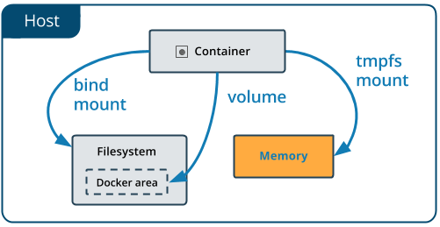
tmpfs
Features
Do not persist in either the host or the container writable layer
Limitations
Cannot share between containers
Only available when host is Linux
Configure
In docker-compose.yml
version 3.6或以上
tmpfs: /tmp

Slide 23
Clean
sudo docker system prune -a -f
/var/lib/docker
Huge size

Slide 24
Docker Images
Python docker images
https://hub.docker.com/_/python/
Nginx docker images
https://hub.docker.com/_/nginx/

Slide 25
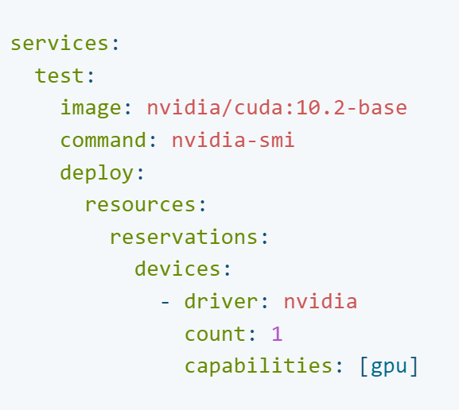
GPU Support
References
https://docs.docker.com/engine/reference/commandline/run/
docker-compose
https://docs.docker.com/compose/gpu-support/
docker
install driver in host OS
https://docs.nvidia.com/datacenter/tesla/tesla-installation-notes/index.html#ubuntu-lts
sudo apt-get install linux-headers-$(uname -r)
distribution=$(. /etc/os-release;echo $ID$VERSION_ID | sed -e 's/\.//g')
wget https://developer.download.nvidia.com/compute/cuda/repos/$distribution/x86_64/cuda-keyring_1.0-1_all.deb
sudo dpkg -i cuda-keyring_1.0-1_all.deb
sudo apt-get update
sudo apt-get -y install cuda-drivers
export PATH=/usr/local/cuda-11.7/bin${PATH:+:${PATH}}
export LD_LIBRARY_PATH=/usr/local/cuda-11.7/lib64\ ${LD_LIBRARY_PATH:+:${LD_LIBRARY_PATH}}
cat /proc/driver/nvidia/version

Slide 26

tmpfs
References
https://docs.docker.com/storage/tmpfs/
Info
only persisted in the host memory
Limitations
can’t share tmpfs mounts between containers
only available if you’re running Docker on Linux

Slide 27
Timezone
Set timezone
# Set up time zone.
ENV TZ=Asia/Shanghai
RUN sudo apt-get update && \
sudo DEBIAN_FRONTEND=noninteractive apt-get install -yq tzdata

Slide 28
FAQ
docker run hello-world
Issue:
docker: Cannot connect to the Docker daemon at unix:///var/run/docker.sock. Is the docker daemon running?.
Solution
sudo dockerd
docker-compose up
Issue
Traceback (most recent call last):
File "urllib3/connectionpool.py", line 677, in urlopen
File "urllib3/connectionpool.py", line 392, in _make_request
File "http/client.py", line 1252, in request
File "http/client.py", line 1298, in _send_request
File "http/client.py", line 1247, in endheaders
File "http/client.py", line 1026, in _send_output
File "http/client.py", line 966, in send
File "docker/transport/unixconn.py", line 43, in connect
FileNotFoundError: [Errno 2] No such file or directory
Solution
sudo dockerd
Postgresql
psycopg2.OperationalError: FATAL: password authentication failed
It may be caused by old volume in docker. Remove the old volume with “sudo docker-compose down -v”

