Slide 1
Flutter Notes
Sparks-Lu
Last updated: 10/13/2022

Slide 2
Change History
11/10/2021
Added audio codec conversion

Slide 3
References
https://www.tutorialspoint.com/flutter/index.htm
https://docs.flutter.dev/

Slide 4
Intro
Features
Modern and reactive framework
Uses Dart programming language and it is very easy to learn
Fast development
Beautiful and fluid user interfaces
Huge widget catalog
Runs same UI for multiple platforms
High performance application
Disadvantages
user interface and logic is intermixed

Slide 5
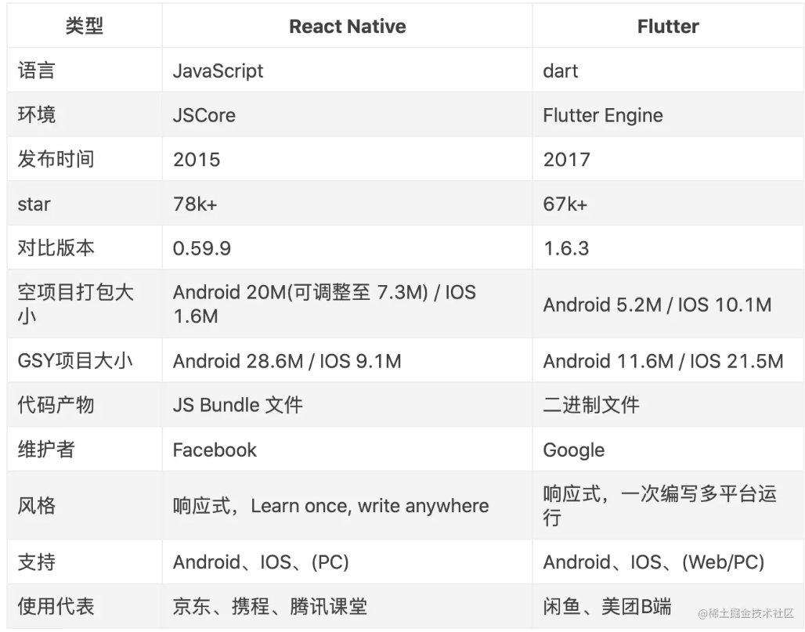
Flutter vs. React Native

Slide 6
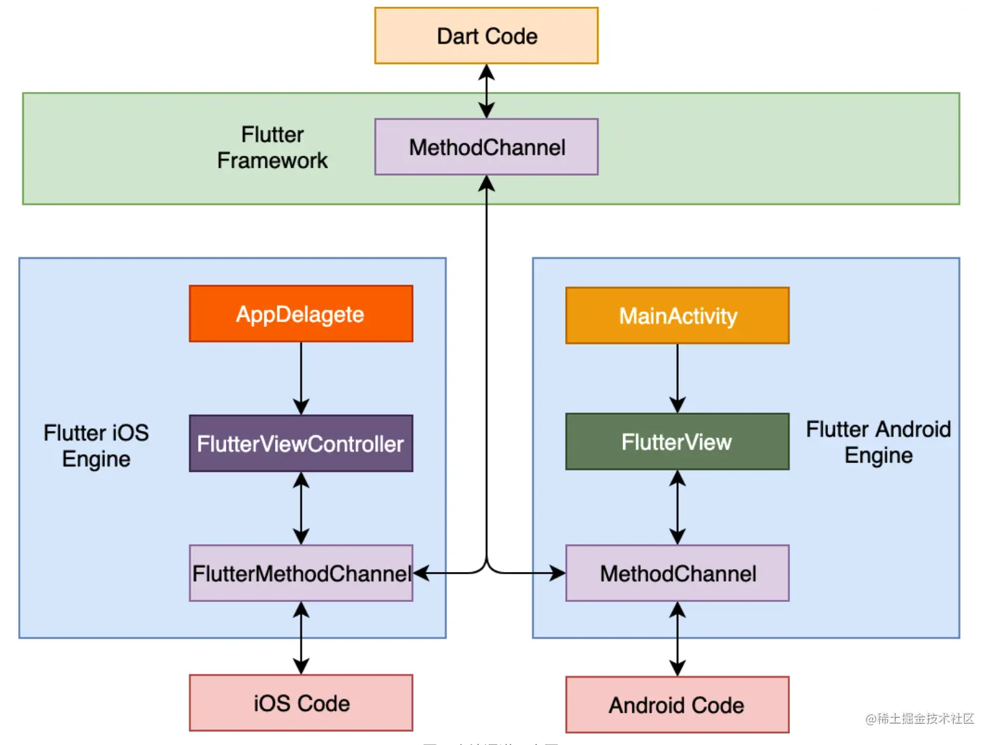
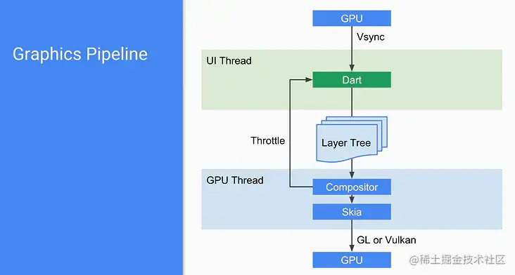
Theory

Slide 7
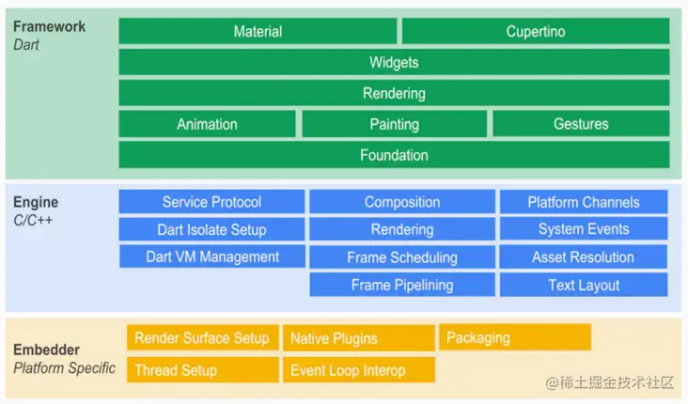
Framework

Slide 8
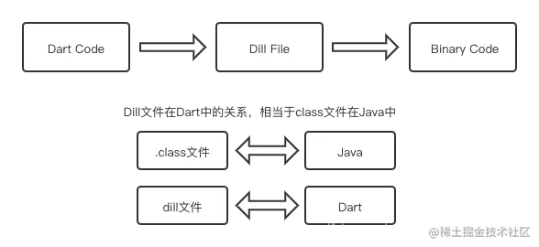
Dart
References

Slide 9
Channel
Type
BasicMessageChannel：用于传递字符串和半结构化的信息
MethodChannel：用于传递方法调用（method invocation）,非线程安全的
EventChannel: 用于数据流（event streams）的通信

Slide 10
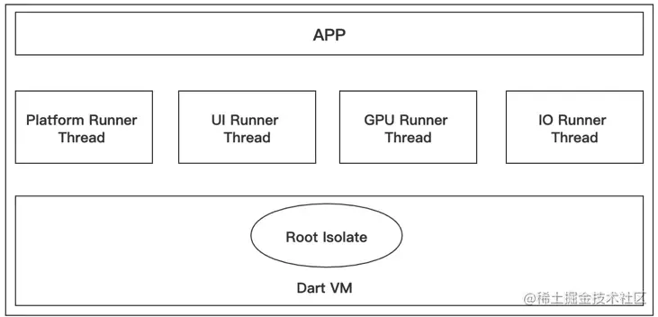
线程管理

