Slide 1
Media Notes
Sparks-Lu
Last updated: 11/10/2021

Slide 2
Change History
11/10/2021
Added audio codec conversion

Slide 3
References
https://helgeklein.com/blog/2017/12/browser-video-codecs-formats-hardware-acceleration/
https://www.fourcc.org/codecs.php
https://trac.ffmpeg.org/wiki/Encode/H.264
http://www.lighterra.com/papers/videoencodingh264/

Slide 4
Concepts
Streams
ffprobe ../videos/samples_subtitle/1.mp4 |& grep stream -i
video (-vn to turn off)
audio (-an to turn off)
subtitle (-sn to turn off)
data (-dn to turn off)

Slide 5
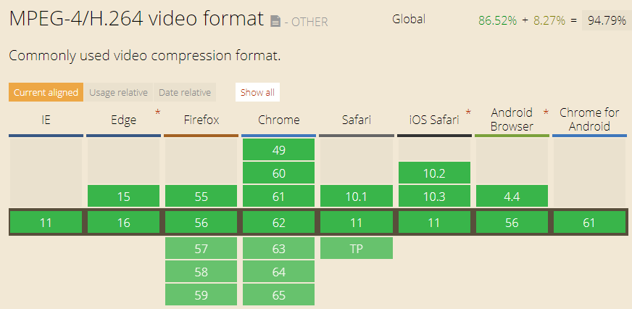
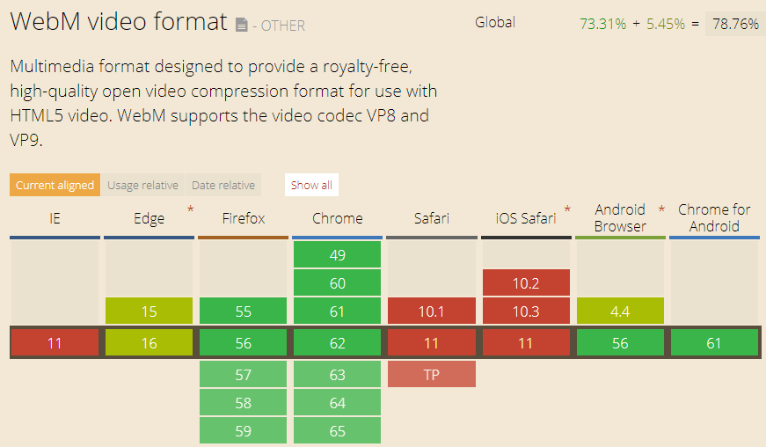
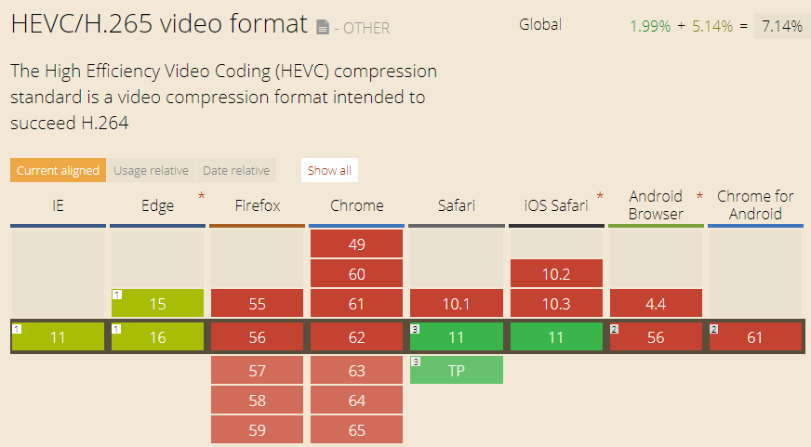
Video Container Format
MP4
audio encoding: AAC, MP3
video encoding: H.264 (AVC), H.265(HEVC)
not royalty-free
WebM
audio encoding: Ogg Vorbis
video encoding: VP8, VP9
royalty-free

Slide 6
Video Standards
Name |  | Info
MPEG-1 | Used for VCD
MP3 | Part of MPEG-1 standard
MPEG-2 / H.262 | Used for DVD
MPEG-4 / H.264 | Used in Blu-ray
MPEG-H / H.265 / HEVC (High Efficiency Video Coding) | Support 4K and 8K resoluation | Doubles the data compression ratio compared to H.264

Slide 7
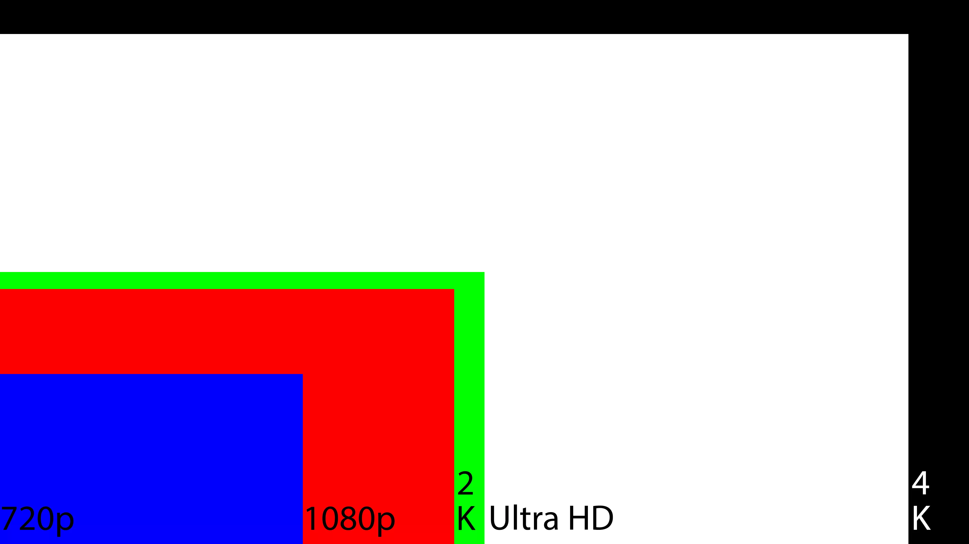
Resolution Standard
Name | Resolution | Note
8K | 7680x4320
4K | 4096x
UHD | 3840x2160 | Ultra High Definition
2K | 2048x
WUXGA | 1920x1200
1080p | 1920x1080 | FHD (Full HD)
720p | 1280x720 | HD (High Definition)

Slide 8
FourCC
Intro
Short for “Four Character Code”
An identifier for a video codec, compression format, color, or pixel format used in a media file.
Video Codecs by FourCC
H264
X264
XVID

Slide 9
FFMPEG Info
Install
sudo add-apt-repository ppa:videolan/master-daily
ffmpeg 3.3.3-2
Task | Commands | Note
Hide banner | ffmpeg -hide_banner
Log level | ffmpeg -loglevel quiet/panic/fatal/error/warning/info/verbose/debug
pix format | ffmpeg -pix_fmts
List info | ffmpeg -codecs/-fomats/--decoders/--encoders/--filters
Print format | ffprobe -show_format -print_format json -v quiet input.mp4
Get duration | ffprobe -i input.mp4 -v quiet -show_entries format=duration -hide_banner -of default=noprint_wrappers=1:nokey=1
Show stream info | ffprobe -v quiet -print_format json -show_format -show_streams input.mp4
Get fps | ffmpeg -i filename 2>&1 | sed -n "s/.*, \(.*\) fp.*/\1/p"

Slide 10
FFMPEG frames
Task | Commands | Note
Convert image sequences into video | ffmpeg -i %4d.png -r 20 output.mp4
Get frames from image | ffmpeg -i input.mp4 output/frame%04d.jpg
Extract frames with a ratio | ffmpeg -i input.mp4 -r 0.1 ./images/frames_%02d.jpg
Extract a specific frame | ffmpeg -ss 00:00:05.01 -i myvideo.avi -frames:v 1 myimage.jpg

Slide 11
FFMPEG Video
Task | Commands | Note
Change video size | ffmpeg -i input.avi -s 720x480 -c:a copy output.avi ffmpeg -i input.avi -filter:v scale=720:-1 -c:a copy output.avi
Crop video | ffmpeg -i input.mp4 -filter:v "crop=w:h:x:y" output.mp4
Change fps | ffmpeg -i input.mp4 -r 30 output.mp4 | video lengh not changed, frames added or removed
Add logo to video (bottom-right) | ffmpeg -i vt.mp4 -i vhuantech-org.png -filter_complex "overlay=W-w-5:H-h-5" -codec:a copy TempleOfHeaven.mp4
Speed up or slow down | ffmpeg -i input.mp4 -filter:v “setpts=0.6*PTS” output.mp4 | fps not changed, video length changed, frames added or removed PTS: presentation timestamp
Generate video from image | ffmpeg -loop 1 -i image.png -t 3 out.mp4
Output to gif | ffmpeg -i input.mp4 -f gif output.gif
Reverse video | ffmpeg -i input.mov -filter:v 'reverse' -filter:a 'areverse' output.mov
Rotate video | ffmpeg -i input.mp4 -filter:v 'transpose=1' rotated-video.mp4 // 1: 90 counter-clockwise, 2: 90 clockwise
Truncate video | ffmpeg -ss 10 -i input.mp3 -t 6 output.mp3
Concat video files | ffmpeg -f concat -safe 0 -i mylist.txt -c copy output.mp4 | mylist.txt: file 'filename1'
Change video codec | ffmpeg -i in.mpg -c:v libx264 out.mp4

Slide 12
FFMPEG Video 2
Task | Commands | Note
Set h264 encoding params | ffmpeg -c:v libx264 -profile:v high/main/baseline -level:v 4.0 -crf 0~51 (constant rate factor, default 23, 0 lossless, 17/18 nearly lossless) -preset // encoding speed, ultrafast, superfast, veryfast, faster, fast, medium (the default), slow, slower, veryslow. A slower preset provides better compression (quality per file size) but is slower. -b:a 128k // set audio bitrate to 128K // profile: video compression features the player must support // level: defines the peak bitrate the player can handle, along with the maximum resolution, and the maximum number of reference frames held in memory during playback
Padding | ffmpeg -i in.mp4 -vf “pad=width=800:height=600:x=10:y=75:color=black” out.mp4 | x/y: start placing point of the original
Web video | -movflags +faststart // Allows video to playback before it is completely downloaded in the case of progressive download viewing. Useful if you are hosting the video, otherwise superfluous if uploading to a video service like YouTube.
Convert to gif | ffmpeg -i video.mp4 -vf scale=500:-1 -t 10 -r 10 image.gif // scale to width=500
Add a poster image to audio to generate video | ffmpeg -loop 1 -i image.jpg -i audio.mp3 -c:v libx264 -c:a aac -strict experimental -b:a 192k -shortest output.mp4
Convert a single image to video | ffmpeg -loop 1 -i image.png -c:v libx264 -t 30 -pix_fmt yuv420p video.mp4

Slide 13
FFMPEG Audio
Task | Commands | Note
从MP4中提取声音 | ffmpeg -i input.mp4 -vn output.mp3
Add subtitle | ffmpeg -i input.avi -vf subtitles=subtitle.srt output.avi ffmpeg -i input.avi -vf “ass=subtitle.ass” output.avi ffmpeg -i movie.mp4 -i subtitles.srt -map 0 -map 1 -c copy -c:v libx264 -crf 23 -preset veryfast output.mkv
Extract audio from video | ffmpeg -i input.mp4 -vn -ac 2 -ab 187 audio.wav -ac number of audio channels -ab audio bitrate in Kbps
Merge audio and video | ffmpeg -i audio.mp3 -i input.mp4 output.mp4
Remove audio from video | ffmpeg -i input.avi -vcodec copy -an output.avi
Convert wav to mp3 | ffmpeg -i input.wav output.mp3
Change audio volume | ffmpeg -i input.wav -af "volume=0.25" output.mp3
Fade in volume | ffmpeg -y -i demo.wav -af "afade=t=in:ss=0:d=15" output.mp3
Reduce background noise | ffmpeg -i input.wav -af "highpass=f=200, lowpass=f=3000" output.mp3 | [200Hz, 300Hz] is kept
Slow down audio by 2 | ffmpeg -i input.mp4 -filter:a "atempo=0.5" -vn output.aac | atempo: 0.5~2.0
Change audio codec | ffmpeg -i in.mp4 -c:a aac out.mp4 | mp3-encoded video cannot play audio correctly in Mac/iOS
Change sample rate | ffmpeg -i input.mp3 -ar 44100 output.mp3 | Change audio sample rate to 44K Hz

Slide 14
FFMPEG Subtitle
Task | Commands | Note
Remove soft subtitle | ffmpeg -i video.mkv -vcodec copy -acodec copy -sn video-no-subs.mkv
Integrate subtitle | ffmpeg -i demo.mkv -i sub.ass -codec copy -map 0 -map 1 output.mkv
Extract subtitle from video | ffmpeg -i demo.mkv -map 0:s:0 sub.srt

Slide 15
FFmpeg - Build From Source
References
https://trac.ffmpeg.org/wiki/CompilationGuide/Ubuntu
ffmpeg-git-amd64-static.tar.xz

Slide 16
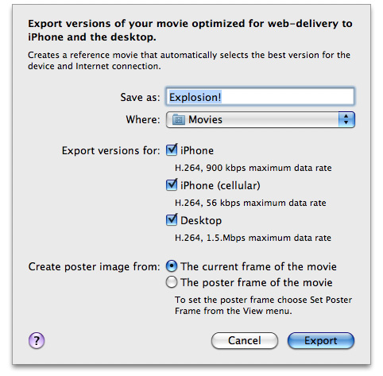
Video Support in Safari
References
https://developer.apple.com/library/archive/documentation/AppleApplications/Reference/SafariWebContent/CreatingVideoforSafarioniPhone/CreatingVideoforSafarioniPhone.html#//apple_ref/doc/uid/TP40006514-SW6
Supported
H.264 Baseline Profile Level 3.0 video, up to 640 x 480 at 30 fps. Note that B frames are not supported in the Baseline profile
MPEG-4 Part 2 video (Simple Profile)
AAC-LC audio, up to 48 kHz
.mov, .mp4, .m4v, and .3gp are supported
Server
Must support byte-range requests
curl --range 0-99 http://example.com/test.mov -o /dev/null

Slide 17
Video Edit Software
References
https://www.lifewire.com/best-free-video-editing-software-programs-4128924
OpenShot
Windows, Mac, Linux
Chinese version supported

Slide 18
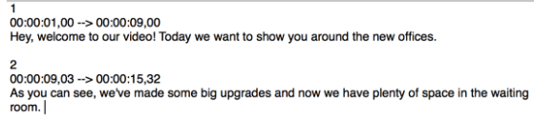
Subtitle
SRT format (.srt)
Subrip Subtitle
plain text
time format: [hours]: [minutes]: [seconds], [milliseconds]
ASS format (.ass)
Advanced SubStation Alpha subtitle
ffmpeg -i input.srt output.ass
ffmpeg -codecs | grep "^...S" // List supported subtitle codecs
[Section of subtitles number]
[Time the subtitle is displayed begins] –> [Time the subtitle is displayed ends]
[Subtitle]

