Slide 1
Java Backend Notes
Sparks-Lu
Last updated: 5/29/2021

Slide 2
Install
Ref
https://blog.csdn.net/cpjiiiiiii/article/details/95317115
Steps
Install JDK
Configure environment variables
Install Eclipse

Slide 3
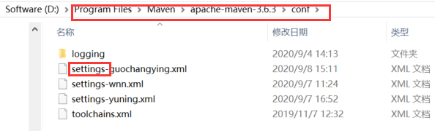
Maven
Install
Download zip from https://maven.apache.org/download.cgi
Add bin folder to system path
mvn -v
POM （Project Object Model）
pom.xml
更换国内镜像
全局配置: ${M2_HOME}/conf/settings.xml
用户配置: user.home/.m2/settings.xml
Build
mvn compile
mvn package
mvn clean
mvn clean package
<mirror>
<id>alimaven</id>
<name>aliyun maven</name>
<url>http://maven.aliyun.com/nexus/content/repositories/central/</url>
<mirrorOf>central</mirrorOf>
</mirror>

Slide 4
Gradle
Intro
build tool
Install
https://gradle.org/install/

Slide 5
Vim
Reference
https://dev.to/mafflerbach/vim-as-java-ide-3b1a

Slide 6
Spring Cloud
参考
http://c.biancheng.net/spring_cloud/
介绍
开发分布式系统的“全家桶”，是一系列框架的有序集合。
环境搭建
JDK
java -version
Maven
mvn -version
Gradle
https://gradle.org/install/

Slide 7
Install Tomcat as Windows Service
Reference
https://tomcat.apache.org/tomcat-8.5-doc/windows-service-howto.html
Steps
bin/service.bat install {ServiceName}

Slide 8
Keytool
Verify keystore
keytool -list -v -keystore <yr keystore file>

Slide 9
Spring Boot

Slide 10
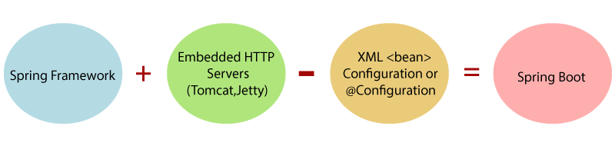
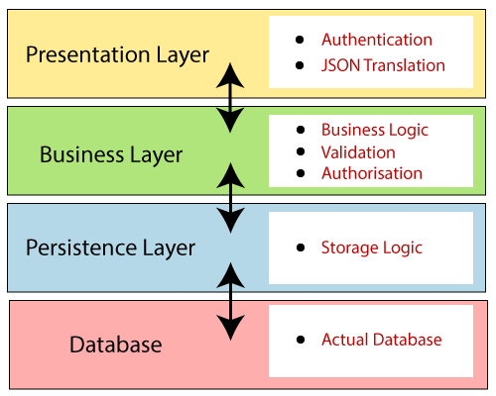
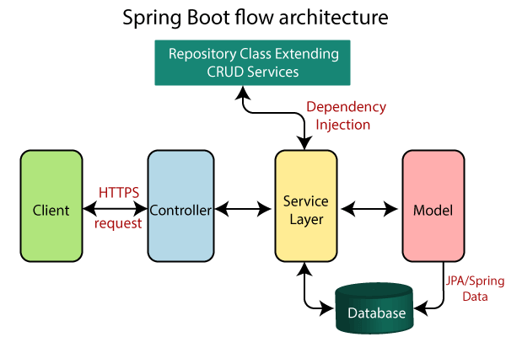
Introduction
简化新 Spring 应用的初始搭建以及开发过程

Slide 11
Install
Reference
https://docs.spring.io/spring-boot/docs/current-SNAPSHOT/reference/html/getting-started.html
Install
maven
gradle
Spring Boot CLI
spring --version

Slide 12
First App
Create pom.xml
Run “mvn package”
Add dependencies to pom.xml
mvn dependency:tree
Coding
@RestController
@RequestMapping
Run “mvn spring-boot:run”

Slide 13
DB

Slide 14
Structure
dao
define mapper functions
mapping
define mapping between pojo and SQL statements
pojo
define java object

Slide 15
Pojo (Plain Old Java Object)
A Pojo class
contains variables and their getters and setters
References
https://www.javatpoint.com/pojo-in-java

Slide 16
MyBatis
Intro
an open source, lightweight, persistence framework
automates the mapping among SQL databases and objects in Java, .NET, and Ruby on Rails.
an alternative to JDBC and Hibernate
Mapper XML
contains a set of statements to configure various SQL statements such as select, insert, update, and delete
in accordance with pojo
Result maps
Add a new DB column
update mapper xml
update pojo

Slide 17
Misc

Slide 18
Base64
java.util.Base64
encoding
String originalInput = "test input";
String encodedString = Base64.getEncoder().encodeToString(originalInput.getBytes());
decoding
byte[] decodedBytes = Base64.getDecoder().decode(encodedString);
String decodedString = new String(decodedBytes);

Slide 19
Configure Tomcat as Windows Service
Run “bin/service.bat install”

