Slide 1
Digital Twin Notes
Last Updated：2/20/2024

Slide 2
References
https://www2.deloitte.com/us/en/insights/focus/industry-4-0/digital-twin-technology-smart-factory.html
https://www.digitaltwinconsortium.org/2023/11/understanding-dtcs-digital-twin-platform-stack-architectural-framework/

Slide 3
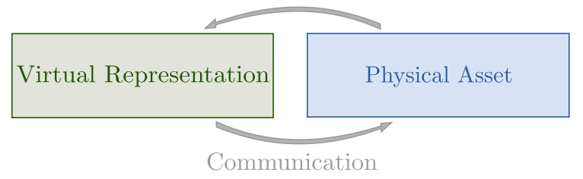
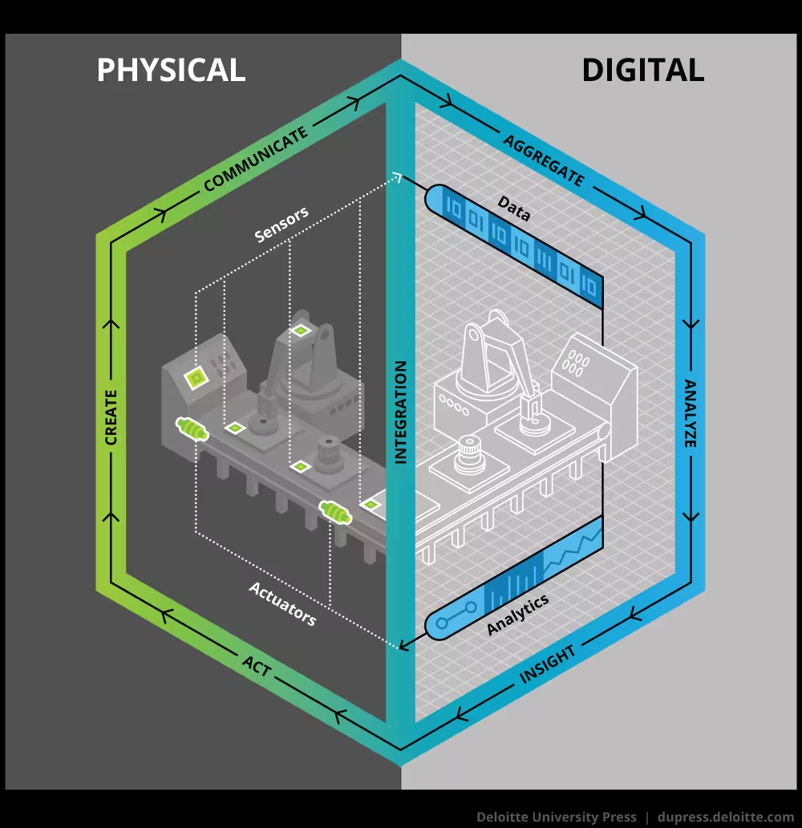
Overview 1
Definition
A digital twin can be defined, fundamentally, as an evolving digital profile of the historical and current behavior of a physical object or process that helps optimize business performance.
Benefit
it can provide a near-real-time comprehensive linkage between the physical and digital worlds

Slide 4


Overview 2
Considerations
Availability and integration of live data from physical systems;
Flexibility in distributed definition and operation of applications and services;
Generic capabilities for communication and coordination;
Modularity and extensibility.
Enabling Technologies
Data acquisition: SCADA/PMU
Modeling: system identification, model reduction
Communication
Computing: cloud computing, edge computing
Data analysis: machine learning

Slide 5
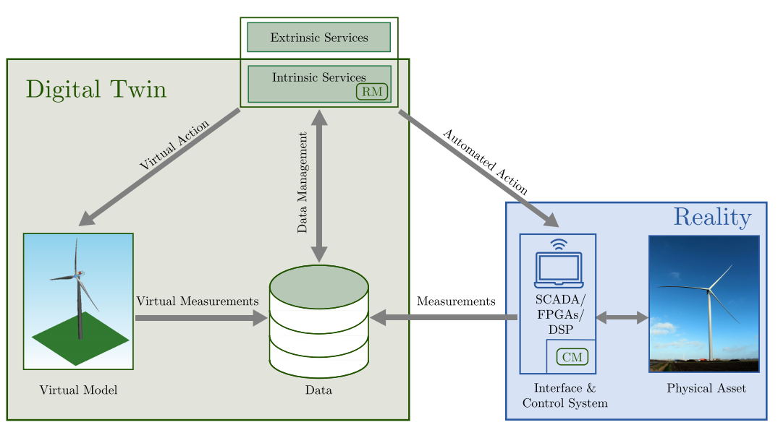
Architecture 1

Slide 6
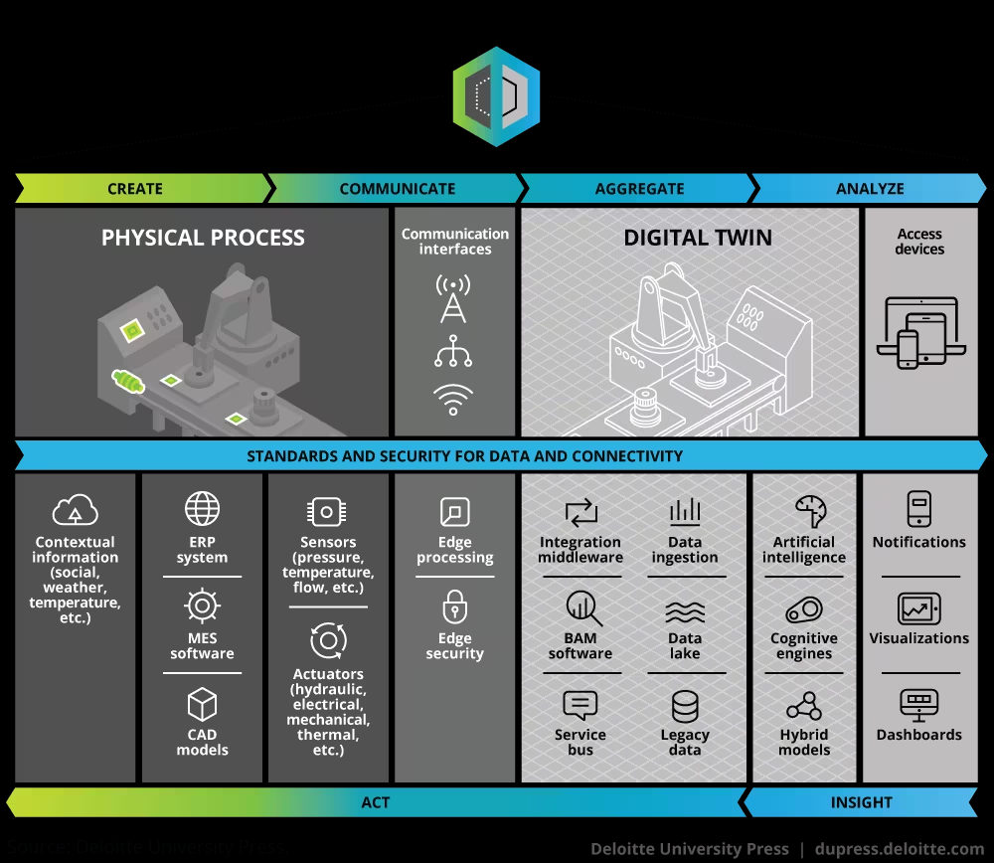
Architecture 2

Slide 7
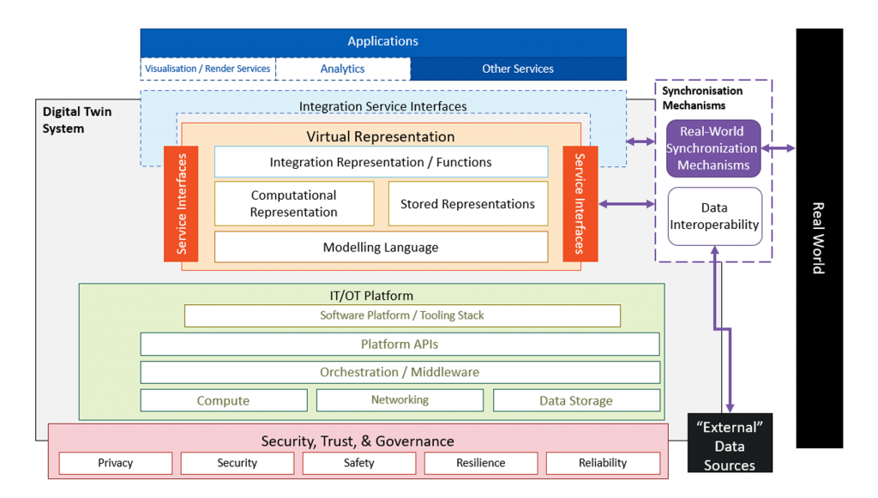
Architecture 3
Source: https://www.digitaltwinconsortium.org/2023/11/understanding-dtcs-digital-twin-platform-stack-architectural-framework/

Slide 8
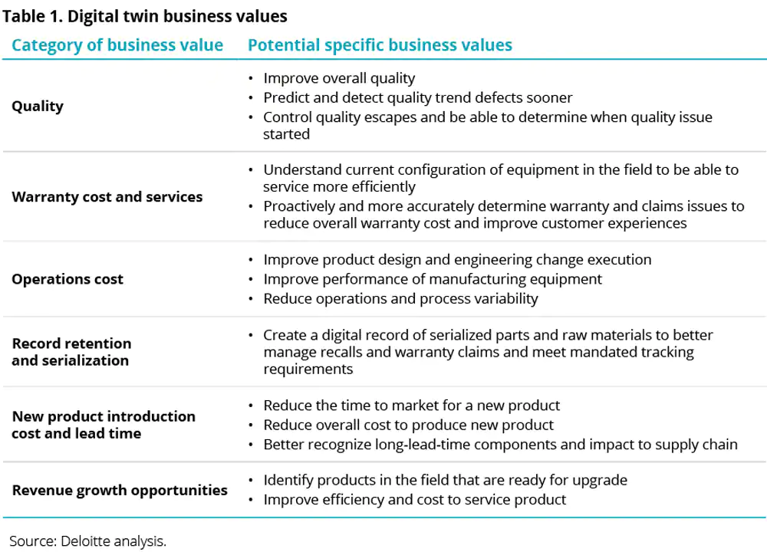
Business Values

Slide 9
Frameworks
Name | Author/Organization | Link
Eclipse Ditto | Eclipse Foundation & Bosch | https://www.eclipse.org/ditto/
Equinox Murat Artim |  | https://github.com/muratartim/Equinox
AASX Package Explorer | Industrial Digital Twin Association (IDTA) | https://github.com/admin-shell-io/aasx_x0002_package-explorer
PYI40AAS | RWTH Aachen | https://git.rwth-aachen.de/acplt/pyi40aas
SAP I4.0 AAS | SAP | https://github.com/SAP/i40-aas
Eclipse Basyx | Eclipse / Bosch / Fraunhofer Institute | https://projects.eclipse.org/projects/technology.basyx
NOVA AAS | NOVA School of Science and Technology (NOVA University Lisbon) | https://gitlab.com/gidouninova/novaas
CPS-Twinning | SBA Research | https://github.com/sbaresearch/cps-twinning
Twined | Octue Ltd | https://github.com/octue/twined
Azure Digital Twins Definition Language (DTDL) | Microsoft Azure | https://github.com/Azure/opendigitaltwins_x0002_dtdl
iTwin.js | Bentley Systems, Incorporated | https://www.itwinjs.org/
Digital Twin Cities Centre Platform (DTCC) | Chalmers University of Technology | https://gitlab.com/dtcc-platform
TerriaJS (NSW Digital Twin implementation) | New South Wales State, Australia | https://nsw.digitaltwin.terria.io/about.html https://github.com/TerriaJS/terriajs
INTO-CPS Co-simulation Framework | INTO-CPS Association | https://into-cps-association.readthedocs.io/ en/latest/

Slide 10
成熟度模型
等级
L0：以虚仿实
L1：以虚映实
单向映射（实-》虚）、动态可视
L2：以虚控实
双向交互、闭环迭代
L3：以虚预实
时效分析、孪生预演
L4：以虚优实
决策优化、智能管控
L5：虚实共生
动态重构、自主孪生

Slide 11
Demos
https://stevenfeng.cn/threejs-demo/
three.js
https://www.sovitjs.com/demo_3d.html
低代码平台

