Slide 1
Canon Camera Notes
Last updated： 2024/8/27

Slide 2
CCAPI

Slide 3
Intro
Refrences
https://developercommunity.usa.canon.com/s/article/CCAPI-Function-List
Intro
RESTful API that will allow users to control compatible Canon cameras via HTTP commands. This allows user to control compatible cameras from almost any OS out there via WiFi.

Slide 4
Function List - State and Settings
Function | URI | Note
Acquire support API table | http://[IPAddress]:[PortNumber]/ccapi/[Version]
Acquire camera's peculiar information | http://[IPAddress]:[PortNumber]/ccapi/[Version]/deviceinformation
Acquire accessible storage information in Camera | http://[IPAddress]:[PortNumber]/ccapi/[Version]/devicestatus/storage
Acquire battery information | http://[IPAddress]:[PortNumber]/ccapi/[Version]/devicestatus/battery
Acquire Temp Warning information | http://[IPAddress]:[Port]/ccapi/[Version]/devicestatus/temperature
Acquire lens information | http://[IPAddress]:[PortNumber]/ccapi/[Version]/devicestatus/lens
Copyright Information (Acquire,Update,Delete) | http://[IPAddress]:[PortNumber]/ccapi/[Version]/functions/copyright
Artist name (Acquire,Update,Delete) | http://[IPAddress]:[PortNumber]/ccapi/[Version]/functions/author
Owner's name (Acquire,Update,Delete) | http://[IPAddress]:[PortNumber]/ccapi/[Version]/functions/ownername
Nickname (Acquire,Update,Delete) | http://[IPAddress]:[PortNumber]/ccapi/[Version]/functions/nickname
Date and Time (Acquire,Update) | http://[IPAddress]:[PortNumber]/ccapi/[Version]/functions/datetime
Format a storage | http://[IPAddress]:[PortNumber]/ccapi/[Version]/functions/cardformat
Silence settings (Acquire,Update) | http://[IPAddress]:[PortNumber]/ccapi/[Version]/functions/beep
Auto Display Off Settings (Acquire,Update) | http://[IPAddress]:[PortNumber]/ccapi/[Version]/functions/displayoff
Auto Power Off Settings (Acquire,Update) | http://[IPAddress]:[PortNumber]/ccapi/[Version]/functions/autopoweroff
Wi-Fi off | http://[IPAddress]:[PortNumber]/ccapi/[Version]/functions/wificonnection
Setting Wi-Fi Connection | http://[IPAddress]:[PortNumber]/ccapi/[Version]/functions/wifisetting/[Set]

Slide 5
Function List - Photography Control
Function | URI | Note
Acquire Storage URL | http://[IPAddress]:[PortNumber]/ccapi/[Version]/contents
Acquire URL of the directory under storage (DCIM) | http://[IPAddress]:[Port]/ccapi/[Version]/contents/sd
Remote Live View control | http://[IPAddress]:[Port]/ccapi/[Version]/shooting/liveview
Live View Flip | http://[IPAddress]:[Port]/ccapi/[Version]/shooting/liveview/flip
Capture still image | http://[IPAddress]:[PortNumber]/ccapi/[Version]/shooting/control/shutterbutton
Capture still image (Shutter Button control) | http://[IPAddress]:[PortNumber]/ccapi/[Version]/shooting/control/shutterbutton/manual
Capture movie | http://[IPAddress]:[PortNumber]/ccapi/[Version]/shooting/control/recbutton
Zoom control | http://[IPAddress]:[PortNumber]/ccapi/[Version]/shooting/control/zoom
Focus drive | http://[IPAddress]:[PortNumber]/ccapi/[Version]/shooting/control/drivefocus
Perform AF (only) | http://[IPAddress]:[PortNumber]/ccapi/[Version]/shooting/control/af

Slide 6
Function List - Photography Setting
Function | URI | Note
Acquire current and range of all parameter | http://[IPAddress]:[PortNumber]/ccapi/[Version]/shooting/settings
Shooting mode (Auto/P/Tv/Av/M/Custom etc) | http://[IPAddress]:[PortNumber]/ccapi/[Version]/shooting/settings/shootingmodedial
AV | http://[IPAddress]:[PortNumber]/ccapi/[Version]/shooting/settings/av
TV | http://[IPAddress]:[PortNumber]/ccapi/[Version]/shooting/settings/tv
ISO | http://[IPAddress]:[PortNumber]/ccapi/[Version]/shooting/settings/iso
Exposure (Exposure revision) | http://[IPAddress]:[PortNumber]/ccapi/[Version]/shooting/settings/exposure
White balance | http://[IPAddress]:[PortNumber]/ccapi/[Version]/shooting/settings/wb
Color temperature | http://[IPAddress]:[PortNumber]/ccapi/[Version]/shooting/settings/colortemperature
AF Operation in finder photography (Acquire) | http://[IPAddress]:[PortNumber]/ccapi/[Version]/shooting/settings/afoperation
AF Method of Live View (Acquire,Update) | http://[IPAddress]:[PortNumber]/ccapi/[Version]/shooting/settings/afmethod
Quality of Still Image. | http://[IPAddress]:[PortNumber]/ccapi/[Version]/shooting/settings/stillimagequality
Aspect ratio of still image | http://[IPAddress]:[PortNumber]/ccapi/[Version]/shooting/settings/stillimageaspectratio

Slide 7
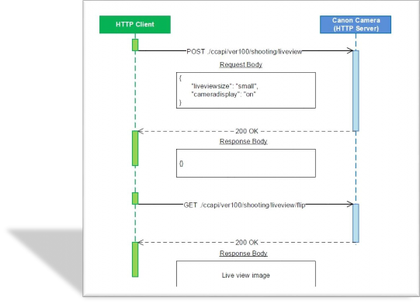
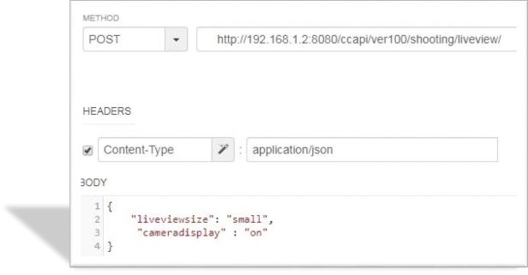

Live View
API
POST /ccapi/ver100/shooting/liveview
start live view
GET /ccapi/ver100/shooting/liveview/flip
get live view image

