Slide 1
OSS Tools
Last updated: 3/15/2024
汇报人姓名
汇报日期

Slide 2
General Tools
Purpose | Name | Home page | Download URL
UML Diagram | Draw.io | https://github.com/jgraph/drawio-desktop/ | https://github.com/jgraph/drawio-desktop/releases
Mind Map | Simple Mind Map | https://github.com/wanglin2/mind-map | https://github.com/wanglin2/mind-map/releases
磁盘分析 | SpaceSniffer | https://github.com/redtrillix/SpaceSniffer | https://github.com/redtrillix/SpaceSniffer/releases
安装包制作 | Inno Setup

Slide 3
Inno Setup
References
https://zhuanlan.zhihu.com/p/538265067
https://zhuanlan.zhihu.com/p/168690637
签名
创建X.509证书
"c:\Program Files (x86)\Windows Kits\10\bin\10.0.22000.0\x64\MakeCert.exe" -sv VhuanTech_signature.pvk -r -n "CN=微幻科技（北京）有限公司" VhuanTech_signature.cer
创建发行者证书
"c:\Program Files (x86)\Windows Kits\10\bin\10.0.22000.0\x64\cert2spc.exe" VhuanTech_signature.cer VhuanTech_signature.spc
导出pfx证书文件
"c:\Program Files (x86)\Windows Kits\10\bin\10.0.22000.0\x64\pvk2pfx.exe" -pvk VhuanTech_signature.pvk -pi vhu@ntech -spc VhuanTech_signature.spc -pfx VhuanTech_signature.pfx -f
软件签名
"c:\Program Files (x86)\Windows Kits\10\bin\10.0.22000.0\x64\signtool.exe" sign /fd sha1 /f VhuanTech_signature.pfx /p vhu@ntech d:\Projects\Obj360Studio\installer\Output\FishObj360Setup_0.7.3.exe
加盖时间戳
"c:\Program Files (x86)\Windows Kits\10\bin\10.0.22000.0\x64\signtool.exe" timestamp /t http://timestamp.digicert.com d:\Projects\Obj360Studio\installer\Output\FishObj360Setup_0.7.3.exe

Slide 4
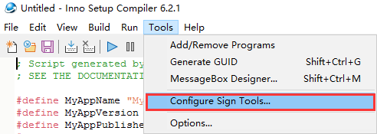
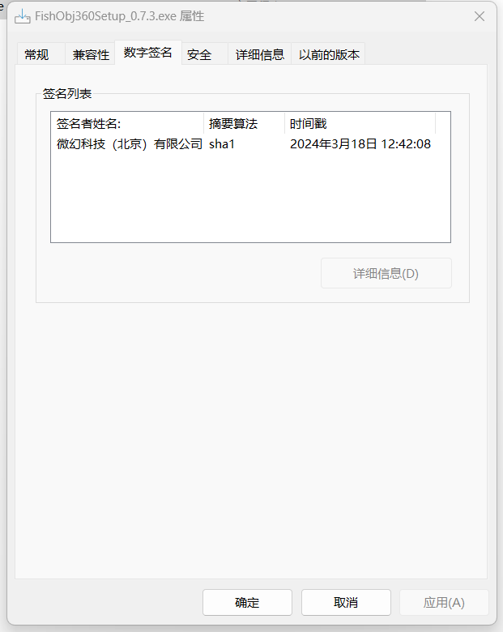
Inno Setup 2
签名
Configure
"c:\Program Files (x86)\Windows Kits\10\bin\10.0.22000.0\x64\signtool.exe" sign /v /fd sha1 /f D:\Weifantasy\Dev\VhuanTech_signature.pfx /p vhu@ntech /t http://timestamp.digicert.com $f
Add lines to [Setup]
SignTool=mysigntool
SignedUninstaller=yes

