Slide 1
Reactive Native Notes
Last updated: 10/8/2024

Slide 2
References
https://reactnative.cn/docs/getting-started
https://cloud.tencent.com/developer/article/2138848
https://cloud.tencent.com/developer/article/1035975
iOS 常见错误和解决方案
https://winney07.github.io/2021/10/02/React-Native环境配置相关笔记/
Mac环境搭建

Slide 3
搭建开发环境
Windows+Android
安装Node>=18
nvm install 22.9
nvm use 22.9.0
npx nrm use taobao (npx nrm use npm)
安装yarn
npm i -g yarn （yarn -v)
安装JDK17
download from https://adoptium.net/zh-CN/temurin/releases/?variant=openjdk17&jvmVariant=hotspot
javac -version
安装Android Studio、Android SDK
添加ANDROID_HOME环境变量，指向Android SDK路径
将%ANDROID_HOME%\platform-tools添加到系统Path环境变量
添加GRADLE_USER_HOME环境变量，指向正确的路径（C:\Users\losti\.gradle）

Slide 4
创建、调试项目
创建项目
npx @react-native-community/cli@latest init AwesomeProject --version 0.74.6 --verbose
cd AwesomeProject
yarn android --verbose (yarn react-native run-android)
调试项目
设备上开启USB调试
通过USB连接设备
adb devices
npx react-native run-android

Slide 5
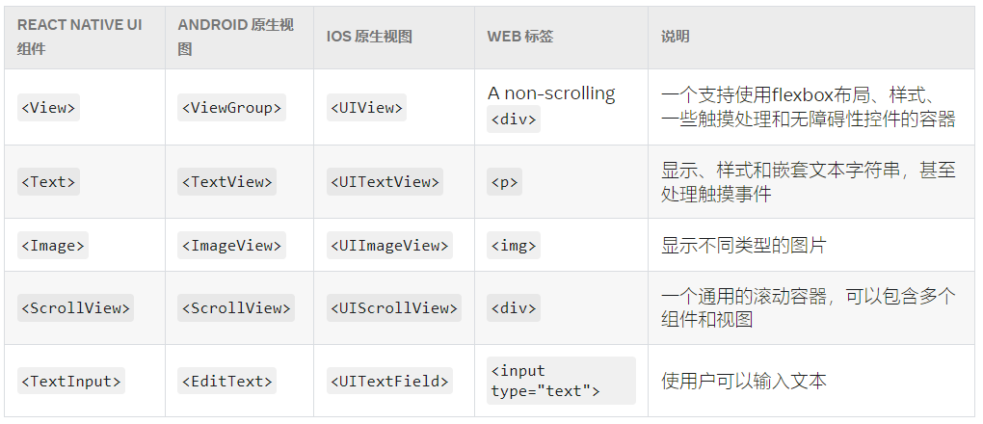
组件
Intro
RN组件是对原生视图的封装

Slide 6
JSX

Slide 7
FAQ
Downloading https://services.gradle.org/distributions/gradle-8.6-all.zip

