Slide 1
Douyin Notes
2021
2022
2023

Slide 2


Overview
Info
https://developer.open-douyin.com/

Slide 3
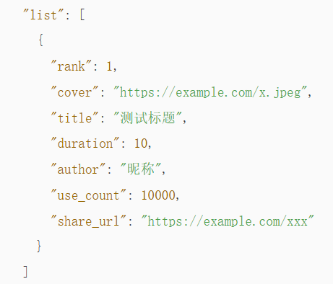
抖音音乐榜单
References
https://developer.open-douyin.com/capacity-center-page/capacity-detail/7180545630253629498
Hot
热歌榜 https://developer.open-douyin.com/docs/resource/zh-CN/dop/develop/openapi/data-open-service/tops-data/music-list-data/hot-songs-list
GET /data/extern/billboard/music/hot/

Slide 4
Crawl
https://github.com/Evil0ctal/Douyin_TikTok_Download_API

