Slide 1
Flutter Notes
Sparks-Lu
Last updated: 10/13/2022

Slide 2
Change History
11/10/2021
Added audio codec conversion

Slide 3
References
https://www.tutorialspoint.com/flutter/index.htm
https://docs.flutter.dev/
https://flutter.cn/
https://docs.flutter.dev/community/china

Slide 4
Intro
Features
Modern and reactive framework
Uses Dart programming language and it is very easy to learn
Fast development
Beautiful and fluid user interfaces
Huge widget catalog
Runs same UI for multiple platforms
High performance application
Disadvantages
user interface and logic is intermixed

Slide 5
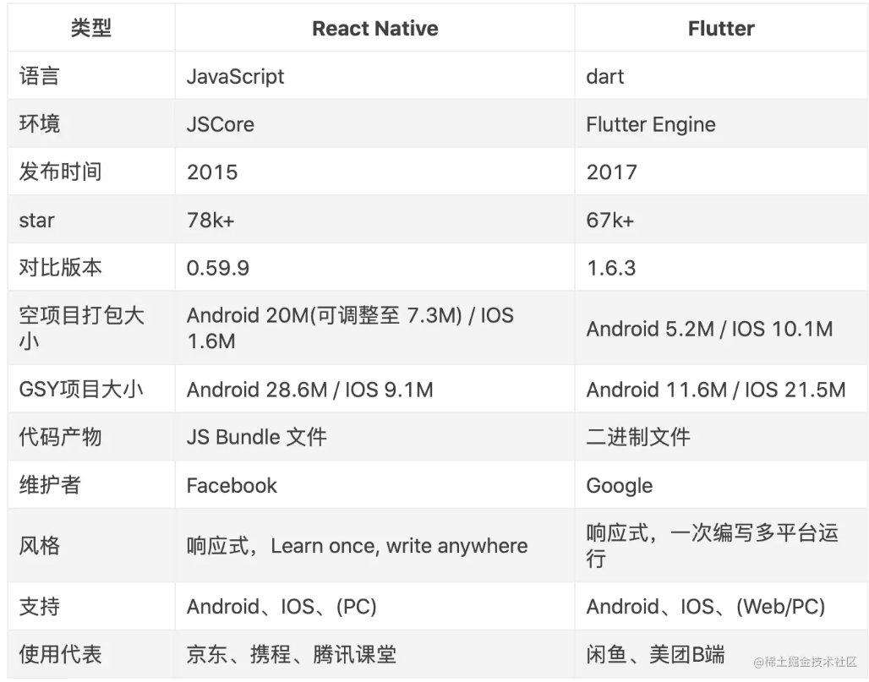
Flutter vs. React Native

Slide 6
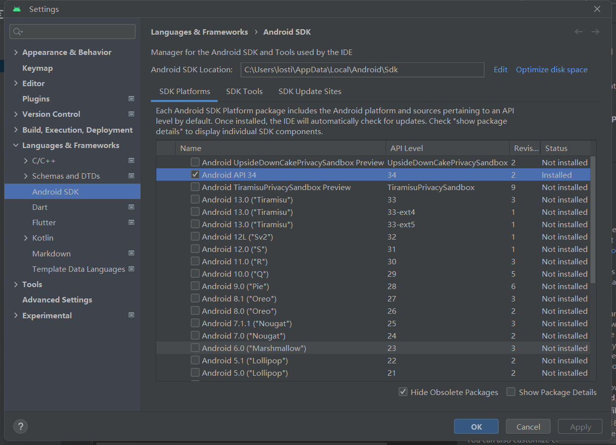
Install
References
https://flutter.cn/docs/get-started/install/windows
Windows Install
Download installer
Unzip to “D:\Programs\flutter”
Added “D:\Programs\flutter\bin” to Path env variable
run “flutter doctor”
Install Android Studio
Run Android Studio, set up
flutter doctor --android-licenses
/path-to-flutter-sdk/packages/flutter_tools/lib/src/http_host_validator.dart
修改https://maven.google.com/为 google maven 的国内镜像，如https://maven.aliyun.com/repository/google/
Set env variables
PUB_HOSTED_URL=https://mirrors.tuna.tsinghua.edu.cn/dart-pub
FLUTTER_STORAGE_BASE_URL=https://mirrors.tuna.tsinghua.edu.cn/flutter
Java
The Android Studio app includes a version of Java, which Flutter uses by default.
If you don’t have Android Studio installed, Flutter relies on the version defined by your shell script’s JAVA_HOME environment variable.

Slide 7
Linux Install
Steps
sudo snap install flutter --classic
export PUB_HOSTED_URL=https://pub.flutter-io.cn
export FLUTTER_STORAGE_BASE_URL=https://storage.flutter-io.cn
git clone -b dev https://github.com/flutter/flutter.git
export PATH="$PWD/flutter/bin:$PATH"
cd ./flutter
flutter doctor

Slide 8
App Basic
Create app
flutter create my_app
flutter devices
flutter run
--info --debug --scan --stacktrace
Project structure
lib/main.dart
pubspec.yaml
android/
build.gradle
compileSdkVersion
gradle
wrapper/gradle-wrapper.properties
flutter:
platforms:
android:
sdk: '>=29.0.0 <32.0.0'
ios: '9.0'

Slide 9
Flutter Commands
Flutter
flutter --version
Dart
dart --version
Command | Note
flutter --help --verbose | Show help
flutter version | Show version
flutter upgrade | Upgrade flutter system
flutter doctor --verbose | Check project health
flutter create app_name | Create flutter app
flutter run dart_file --verbose --ignore-deprecation | Run a dart file
flutter pub get | Download dependencies
flutter pub update | Update dependencies
flutter build dir | Build a dir
flutter devices | Show connected devices
flutter logs | Show logs

Slide 10
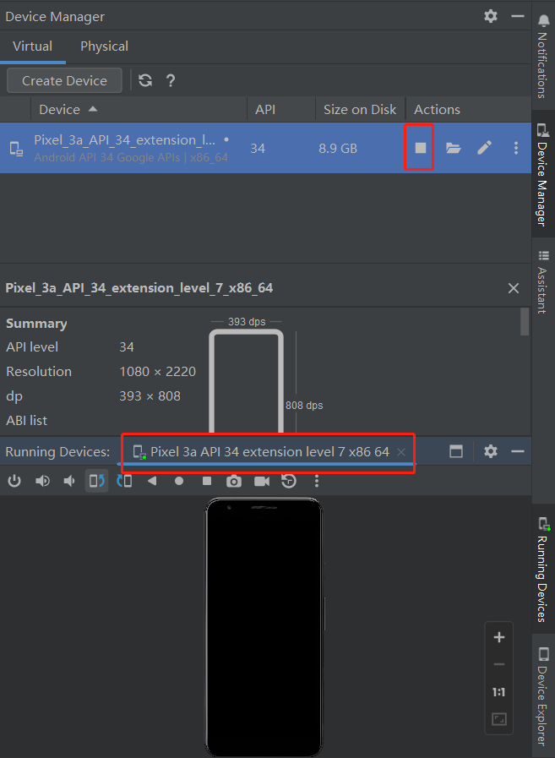
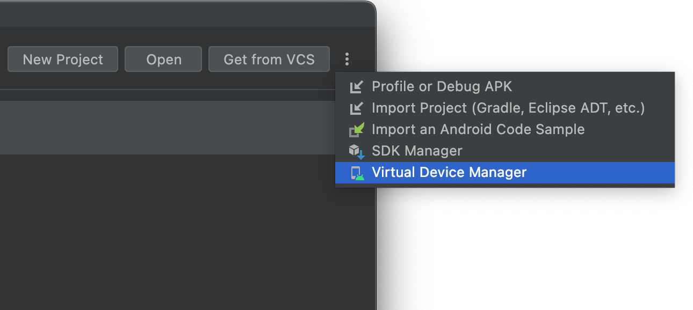
Android
Emulator

Slide 11
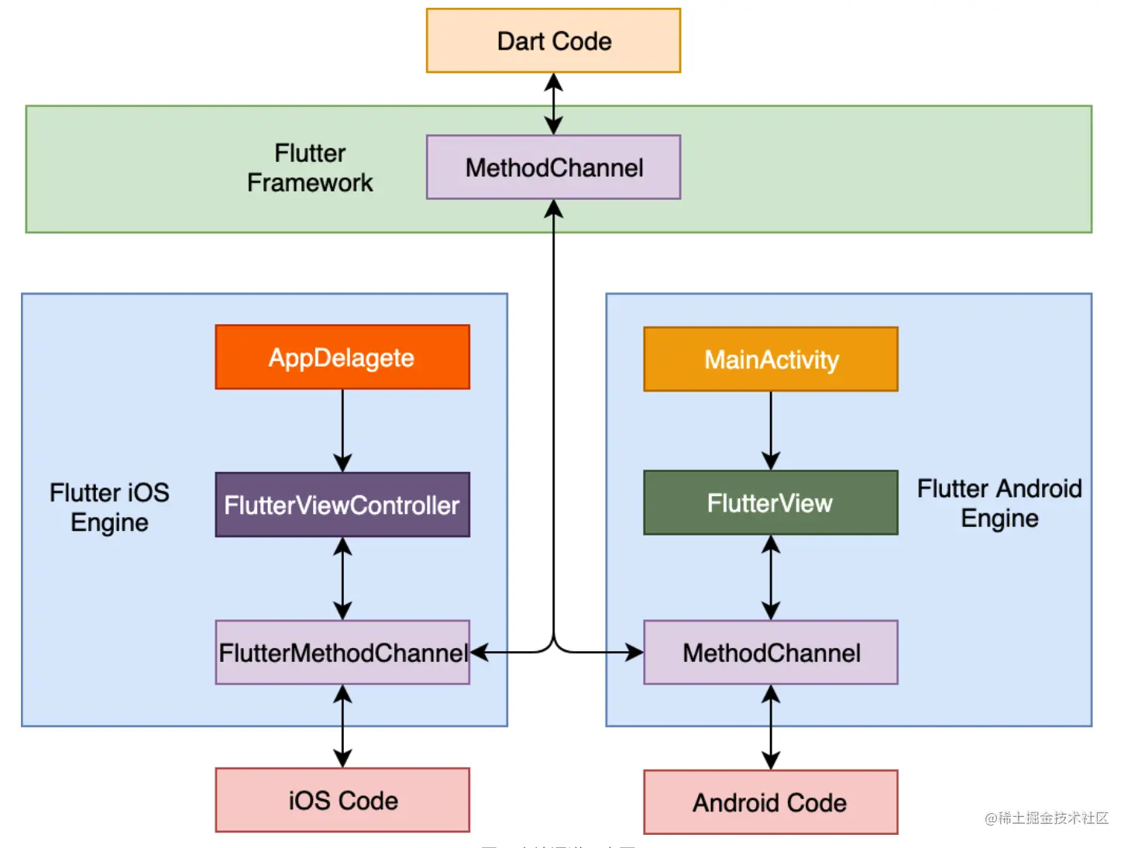
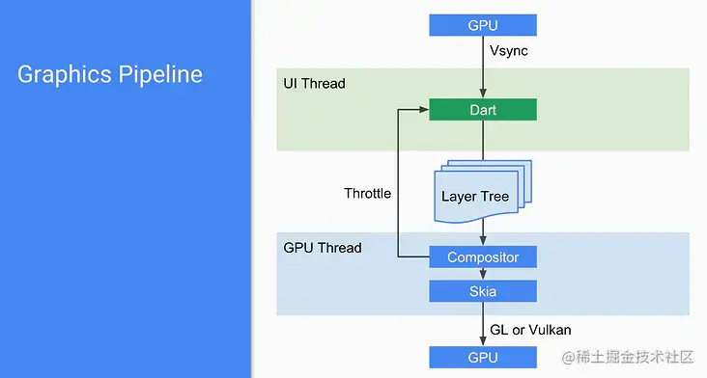
Theory

Slide 12
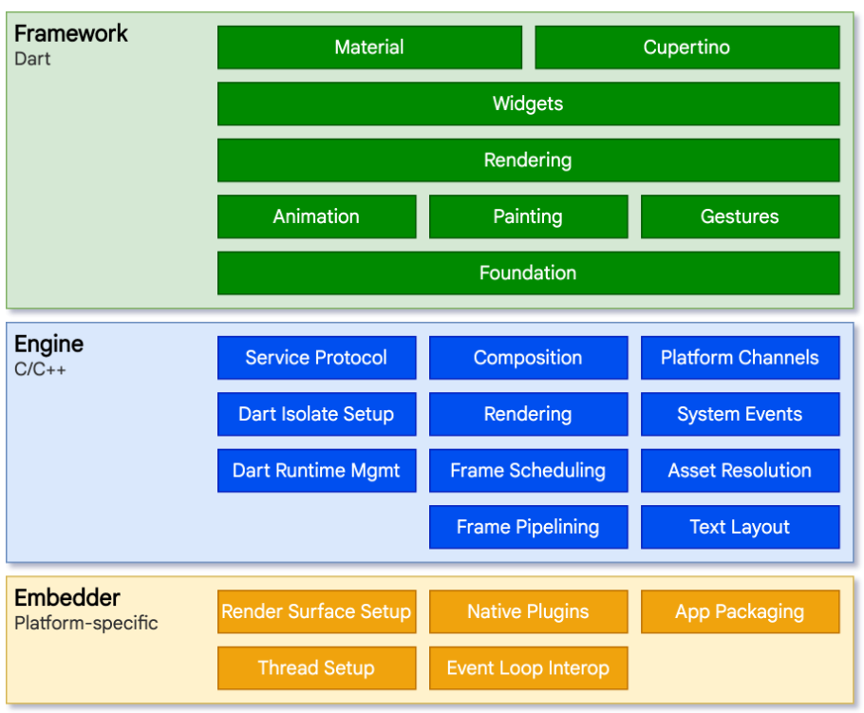
Framework

Slide 13
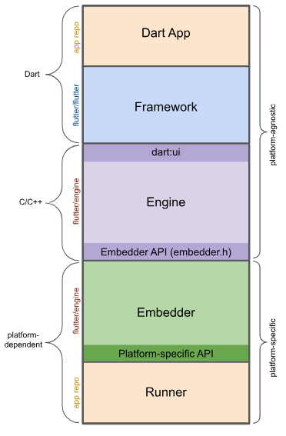
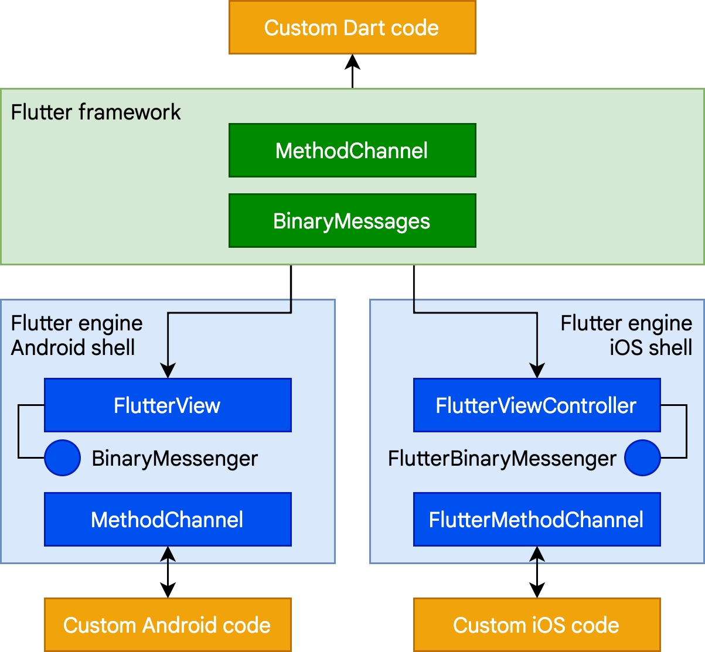
App Internal

Slide 14
Channel
Type
BasicMessageChannel：用于传递字符串和半结构化的信息
MethodChannel：用于传递方法调用（method invocation）,非线程安全的
EventChannel: 用于数据流（event streams）的通信

Slide 15
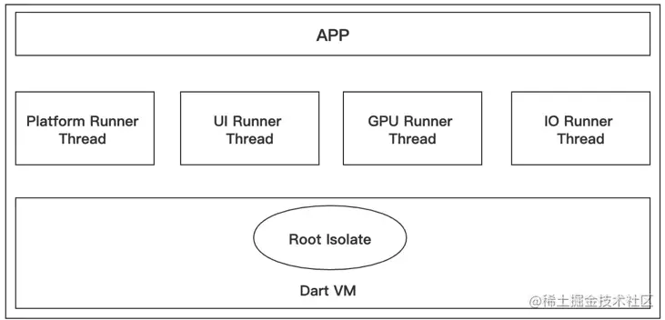
线程管理

Slide 16
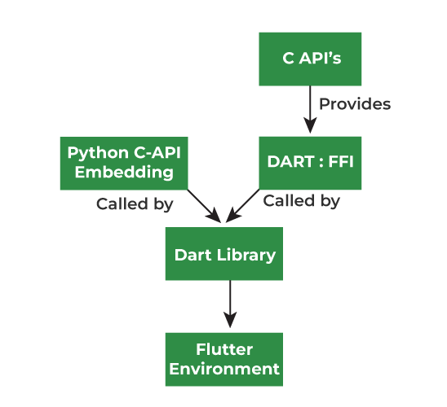
Integrate Python Module
gRPC server
https://dev.to/maximsaplin/integrating-flutter-all-6-platforms-and-python-a-comprehensive-guide-4ipo
python_ffi
https://pub.dev/documentation/python_ffi/latest/
DartPy

Slide 17
Packages
VideoCompress
https://github.com/jonataslaw/VideoCompress
Could not find com.otaliastudios:transcoder:0.9.1
modify android/build.gradle, add “jcenter()” to “repositories”
VideoCompressPlus
https://github.com/kamaravichow/VideoCompressPlus
Reason: A property of type 'File' annotated with @Input cannot determine how to interpret the file.

Slide 18
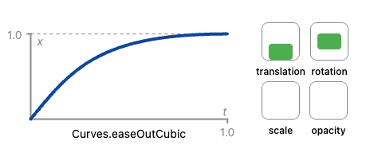
Animation
References
https://docs.flutter.dev/ui/animations
Intro
types: tween animation, physics-based animation, pre-canned animation
import package:flutter/animation.dart

Slide 19
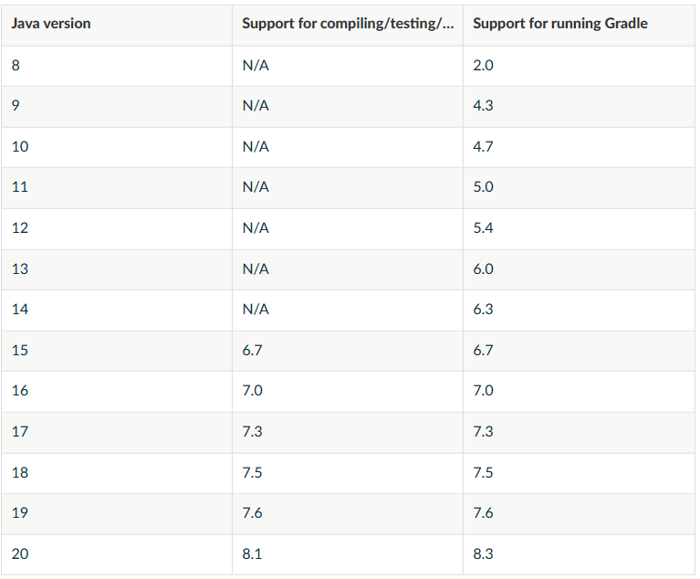
FAQ
Got TLS error trying to find package...
Add env variables
PUB_HOSTED_URL=https://mirrors.tuna.tsinghua.edu.cn/dart-pub
FLUTTER_STORAGE_BASE_URL=https://mirrors.tuna.tsinghua.edu.cn/flutter
Unable to find valid certification path to requested target
Solution
Can't load Kernel binary: Invalid kernel binary format version.
Could not initialize class org.codehaus.groovy.runtime.InvokerHelper
Java/gradle compatibility
https://docs.gradle.org/current/userguide/compatibility.html#java
flutter docter --verbose // check Java version in Flutter
Edit android\gradle\wrapper\gradle-wrapper.properties
distributionUrl=https\://services.gradle.org/distributions/gradle-{7.3}-all.zip

Slide 20
FAQ 2
java.lang.NoClassDefFoundError: Could not initialize class org.codehaus.groovy.vmplugin.v7.Java7

Slide 21
Dart

Slide 22
References
References
https://www.geeksforgeeks.org/dart-tutorial/
https://dart.dev/

Slide 23
Install
Linux Install Dart
https://dart.dev/get-dart
sudo dpkg -i dart_3.1.2-1_amd64.deb
Windows Install Dart
wget https://storage.googleapis.com/dart-archive/channels/stable/release/{2.19.0}/sdk/dartsdk-windows-x64-release.zip
extract to $flutter/bin/cache/ with “dart-sdk” folder
Command | Note
dart info | Show info
dart analyze | Analyze
dart pub cache clean

Slide 24
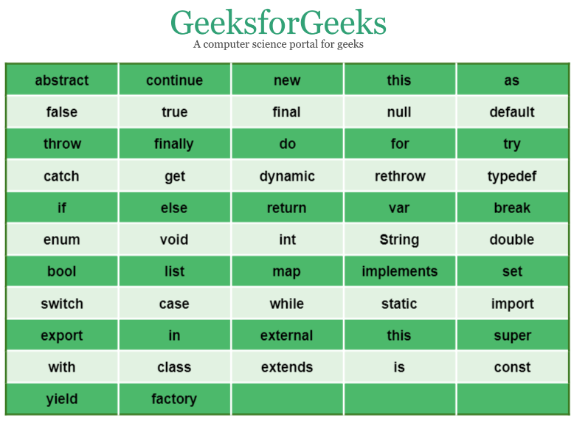
Basic
Data types
int, double, num, bool, BigInt
String, List, Map
Set
Set<String> gfg2 = {'GeeksForGeeks'};
set1.add(val), set1.addAll(val1, val2)
length(), elementAt(), contains(), remove(), forEach(),clear(), toList()
Control flow
Key functions
Optional named params with default values
void gfg3(int g1, { int g2 : 12 })
lambda function
void gfg() => print("Welcome to GeeksforGeeks");
anonymous function
(parameter_list) {..}
main(), exit(0)
getter/setter
return_type get identifier {}
set identifier {}
Collection functions
isEmpty, isNotEmpty
forEach()
where(), any(), every()

Slide 25
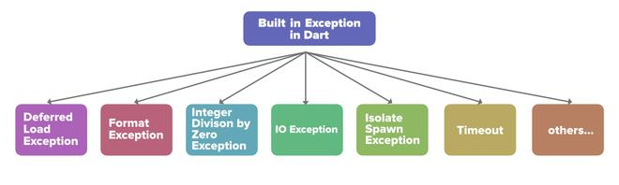
Basic 2
Class
class child_class extends parent_class
Utilities
DateTime
now(), utc()
DateTime.fromMillisecondsSinceEpoch(946684800000, isUtc: true)
DateTime.parse('2000-01-01T00:00:00Z')
add(Duration(days: 366)), subtract(Duration(days: 30)), difference(y2k)
async/await
Iterable: synchronous generator
Stream: asynchronous generator
Exceptions
try/on/catch/finally
Isolate
null safety
non-nullable by default
int? aNullableInt = null;

Slide 26
Core Libraries
Core
VM
Web
dart:async
dart:ffi
dart:html
dart:indexed_db
dart:collection
dart:io
dart:js
dart:convert
dart:isolate
dart:js_interop
dart:core
dart:mirrors
dart:js_interop_unsafe
dart:js_util
dart:developer
dart:svg
dart:math
dart:web_audio
dart:typed_data
dart:web_gl

Slide 27
Core
data:core
numbers, strings, collections, uris, dates and times, exceptions
data:async
import 'dart:async';
async/await
dart:convert
jscon, utf-8
dart:io
import 'dart:io';
Platform
environment, operatingSystem, isMacOS,
dart:ui
dart:io
File
Directory
FileStat
Platform
dart:ui
Scene
TextBox
TextDecoration
TextStyle
Display
FlutterView
Paint
Image
FontFeature
FontVariation
FontWeight
Paragraph
Canvas
Codec
Color
Gradient

Slide 28
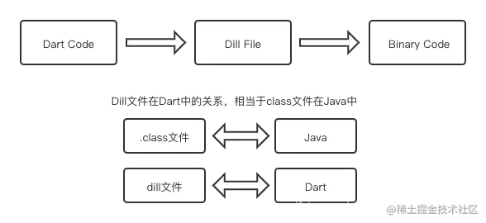
Internal

Slide 29
Dart Package
Refrences
https://docs.flutter.dev/packages-and-plugins/developing-packages
Concept
dart package
plugin package
a specialized Dart package that contains an API written in Dart code combined with one or more platform-specific implementations.
Steps
flutter create --template=package hello
pubspec.yaml
lib/hello.dart

Slide 30
Dart Library
Create a library
Add a library declarition at the top of .dart file
library library_name;
Use a library
import

Slide 31
Packages
Command | Note
dart pub get | get all packages the application is dependent upon
dart pub upgrade
dart pub build
dart pub add | add a dependency
dart pub deps | print dependencies
pub
https://pub.dev/
pubspec
pubspec.yaml
general-purpose packages
archive, characters, http, intl, json_serializable, logging, mockito, path, quiver, shelf, stack_trace, test, yaml
async, collection, convert, io

Slide 32
Drawing
Drawing plugins
https://api.dart.dev/stable/3.1.2/dart-html/OffscreenCanvasRenderingContext2D-class.html
https://pub.dev/packages/flutter_painter

Slide 33
Audio/Video
media_kit
https://github.com/media-kit/media-kit
dart pub add media_kit
ffmpeg-kit
https://github.com/arthenica/ffmpeg-kit/tree/main/flutter/flutter

