Slide 1
Three.js Notes
Sparks Lu
Last updated: 4/25/2021

Slide 2
References
https://riptutorial.com/three-js
https://threejsfundamentals.org/threejs/lessons/threejs-textures.html
https://discoverthreejs.com/tips-and-tricks/
https://sbcode.net/threejs/

Slide 3
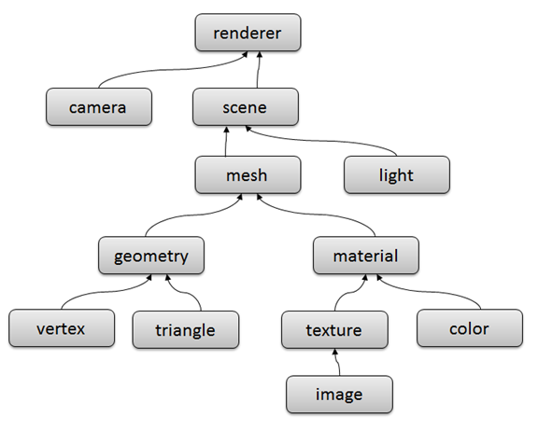
Architecture

Slide 4
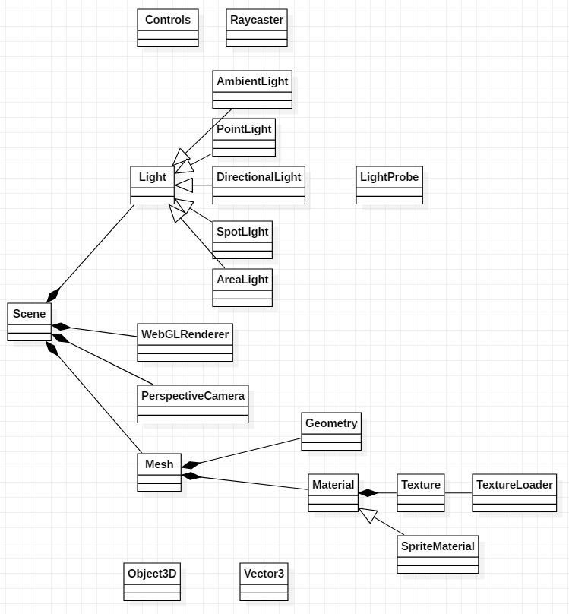
Classes

Slide 5
Basic Demo
<!DOCTYPE html>
<html lang="en">
<head>
<meta charset="UTF-8">
<meta http-equiv="X-UA-Compatible" content="IE=edge">
<meta name="viewport" content="width=device-width, initial-scale=1.0">
<title>room</title>
</head>
<body>
<div id="webgl-output"></div>
<script src="https://unpkg.com/three@0.119.0/build/three.js"></script>
<script>
function init () {
const scene = new THREE.Scene()
const camera = new THREE.PerspectiveCamera(45,
window.innerWidth / window.innerHeight,
0.1,
1000
)
camera.position.set(-30, 40, 30)
camera.lookAt(0,0,0)
scene.add(camera)
const planeGeometry = new THREE.PlaneGeometry(60,20)
const planeMaterial = new THREE.MeshLambertMaterial({
color: 0xAAAAAA
})
const plane = new THREE.Mesh(planeGeometry, planeMaterial)
plane.rotation.x = -Math.PI / 2
plane.position.set(15, 0, 0)
scene.add(plane)
const spotLight = new THREE.SpotLight(0xffffff)
spotLight.position.set(-20, 30, -15)
scene.add(spotLight)
const renderer = new THREE.WebGLRenderer()
renderer.setClearColor(new THREE.Color(0x000000))
renderer.setSize(window.innerWidth, window.innerHeight)
document.getElementById('webgl-output').appendChild(renderer.domElement)
renderer.render(scene, camera)
}
init()
</script>
</body>
</html>

Slide 6
Scene
Scene
- autoUpdate // default true
- background
- environment
- fog
- clear()
- getCurrentViewport()
- getSize()
- getViewport()
- render()
- setPixelRatio()
- setScissor()
- setScissorTest()
- setSize()

Slide 7
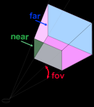
Camera
Perspective camera

Slide 8
WebGLRenderer
- alpha (default: false)
- antialias (default: false)
- autoClear
- domElement
- clear()
- getCurrentViewport()
- getSize()
- getViewport()
- render()
- setClearAlpha(alpha)
- setPixelRatio()
- setScissor()
- setScissorTest()
- setSize()
renderer = new THREE.WebGLRenderer();
renderer.setPixelRatio( window.devicePixelRatio );
renderer.setSize( window.innerWidth, window.innerHeight );
container.appendChild( renderer.domElement );

Slide 9
Light
light = new THREE.SpotLight(color)
Properties
position
rotation
Types
AmbientLight
PointLight
DirectionalLight
SpotLight
AreaLight

Slide 10
Mesh
mesh = new THREE.Mesh(geometry, material)
Properties
rotation
position.set(x, y, z)

Slide 11
Geometry
BufferGeometry
BoxGeometry(width, height, depth)
PlaneGeometry(width, height)
CircleGeometry(radius, numSegments)
SphereGeometry(radius, widthSegments, heightSegments)
ExtrudeGeometry(shape, extrudeSettings)
BufferGeometry
- position.set(x, y, z)
- clone()
- dispose()
- lookAt(vector3)
- rotateX(radian)
- rotateY(radian)
- rotateZ(radian)
- scale(x, y, z)
- translate(x, y, z)
BoxGeometry
CircleGeometry

Slide 12
Material
Material
- opacity
Material
Properties
transparent: true/false, default false
opacity: 0.0~1.0, default 1.0
MeshBasicMaterial
simple shaded way, not affected by lights
MeshDepthMaterial
drawing material based on depth, white is nearest, black is farest
MeshStandardMaterial
MeshLambertMaterial
const mat = new MeshLambertMaterial({
map: texture
})
MeshBasicMaterial
- alphaMap
- aoMap
- color
- envMap
- lightMap
- specularMap

Slide 13
Coordinates
From screen space (normalized device coordinate) to world space
Vector3.unproject(camera)

Slide 14
Texture, Texture Loader
let texture = TextureLoader.load()
Properties
- id
- uuid
- image // image or video loaded using
- wrapS // how to wrap horizontally
- wrapT // how to wrap vertically
- format // default: THREE.RGBAFormat
- offset // 0.0~1.0
- repeat // Vector2, how many times to repeat
Methods
dispose()

Slide 15
Texture Loader
TextureLoader
var loader = new THREE.TextureLoader()
loader.load(url, onLoadCallback, onProgressCallback, onErrorCallback)
Load cubemap
const loader = new THREE.CubeTextureLoader()
const texture = loader.load([
pos-x.jpg, neg-x.jpg, pos-y.jpg, neg-y.jpg, pos-z.jpg neg-z.jpg])
scene.background = texture
Load equirectangular
const loader = new THREE.TextureLoader()
const texture = loader.load('equi.jpg', () => {
const rt = new THREE.WebGLCubeRenderTarget(texture.image.height)
rt.fromEquirectangularTexture(render, texture)
scene.background = rt
})
TextureLoader
CubeTextureLoader

Slide 16
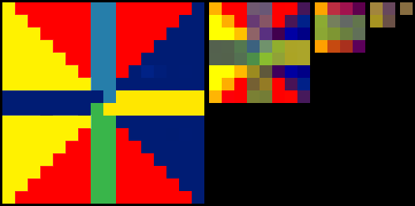
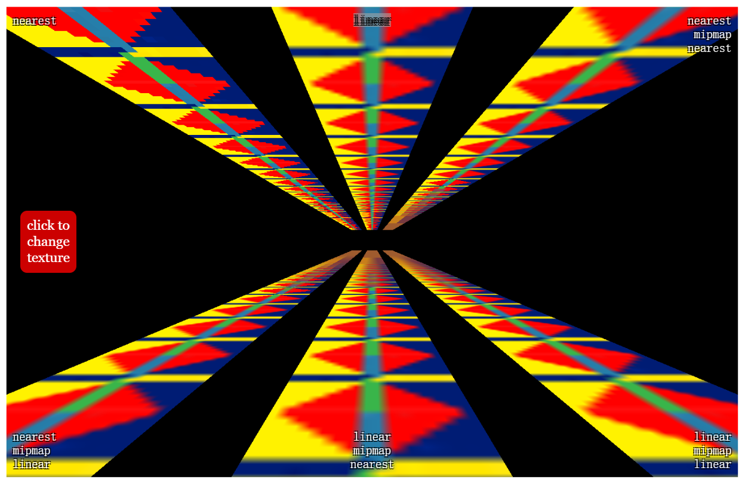
Texture - Mipmap
Mipmap
mip: copies of the texture, each one half as wide and half as tall as the previous mip
Options
Nearest: choose the closest pixel in the texture
Linear: choose 4 pixels from the texture and blend them
NearestMipmapNearestFilter: choose the nearest mip then choose one pixel
NearestMipmapLinearFilter: choose 2 mips, choose one pixel from each, blend the 2 pixels
LinearMipmapNearestFilter: chose the nearest mip then choose 4 pixels and blend them
LinearMipmapLinearFilter: choose 2 mips, choose 4 pixels from each and blend all 8 into 1 pixel
texture.magFilter = Three.LinearFilter / Three.NearestFilter
texture.minFilter = Three.NearestFilter / Three.LinearFilter / Three.NearestMipmapNearestFilter / Three.NearestMipmapLinearFilter / Three.LinearMipmapNearestFilter / Three.LinearMipmapLinearFilter

Slide 17
Controls
Types
FirstPersonControls
keyboard to move, mouse to rotate
FlyControls
RollControls
TrackBallControls
OrbitControls

Slide 18
Sprite
SpriteMaterial
Properties
color: .map is multiplied by the color
map: texture
rotation
sizeAttenuation: whether or not size of sprite is attenuated by the camera depth, default true
SpriteMaterial
({map: texture,
color: color})
Sprite
(spriteMaterial)
- material

Slide 19
Texts
Refer
https://www.cnblogs.com/tengge/p/11979854.html
troika-three-text
https://protectwise.github.io/troika/troika-three-text/
npm i troika-three-text
SpriteText
https://github.com/vasturiano/three-spritetext
npm i three-spritetext
import SpriteText from 'three-spritetext'
var myText = new SpriteText('My text')
text is clear, not blurry
TextSprite
https://github.com/SeregPie/THREE.TextSprite
npm i @seregpie/three.text-sprite
import TextSprite from '@seregpie/three.text-sprite'
SpriteText2D
https://github.com/gamestdio/three-text2d
three-text2d
SpriteText2D
(msg, {props})

Slide 20
Animation
References
https://threejs.org/docs/#manual/en/introduction/Animation-system
Animated target
material properties, like colors, opacity, booleans
Components
animation clips
keyframe tracks
AnimationMixer: player for animations
AnimationAction

Slide 21
Raycaster
Code Snippets
var rc = new Three.Raycaster()
rc.setFromCamera(mousePos, camera)
intersects = rc.intersectObjects( scene.children )
rc.ray
direction
intersection
object : intersected object (THREE.Mesh)
distance : distance from camera to intersection (number)
face : intersected face (THREE.Face3)
faceIndex : intersected face index (number)
point : intersection point (THREE.Vector3)
uv : intersection point in the object's UV coordinates (THREE.Vector2)

Slide 22
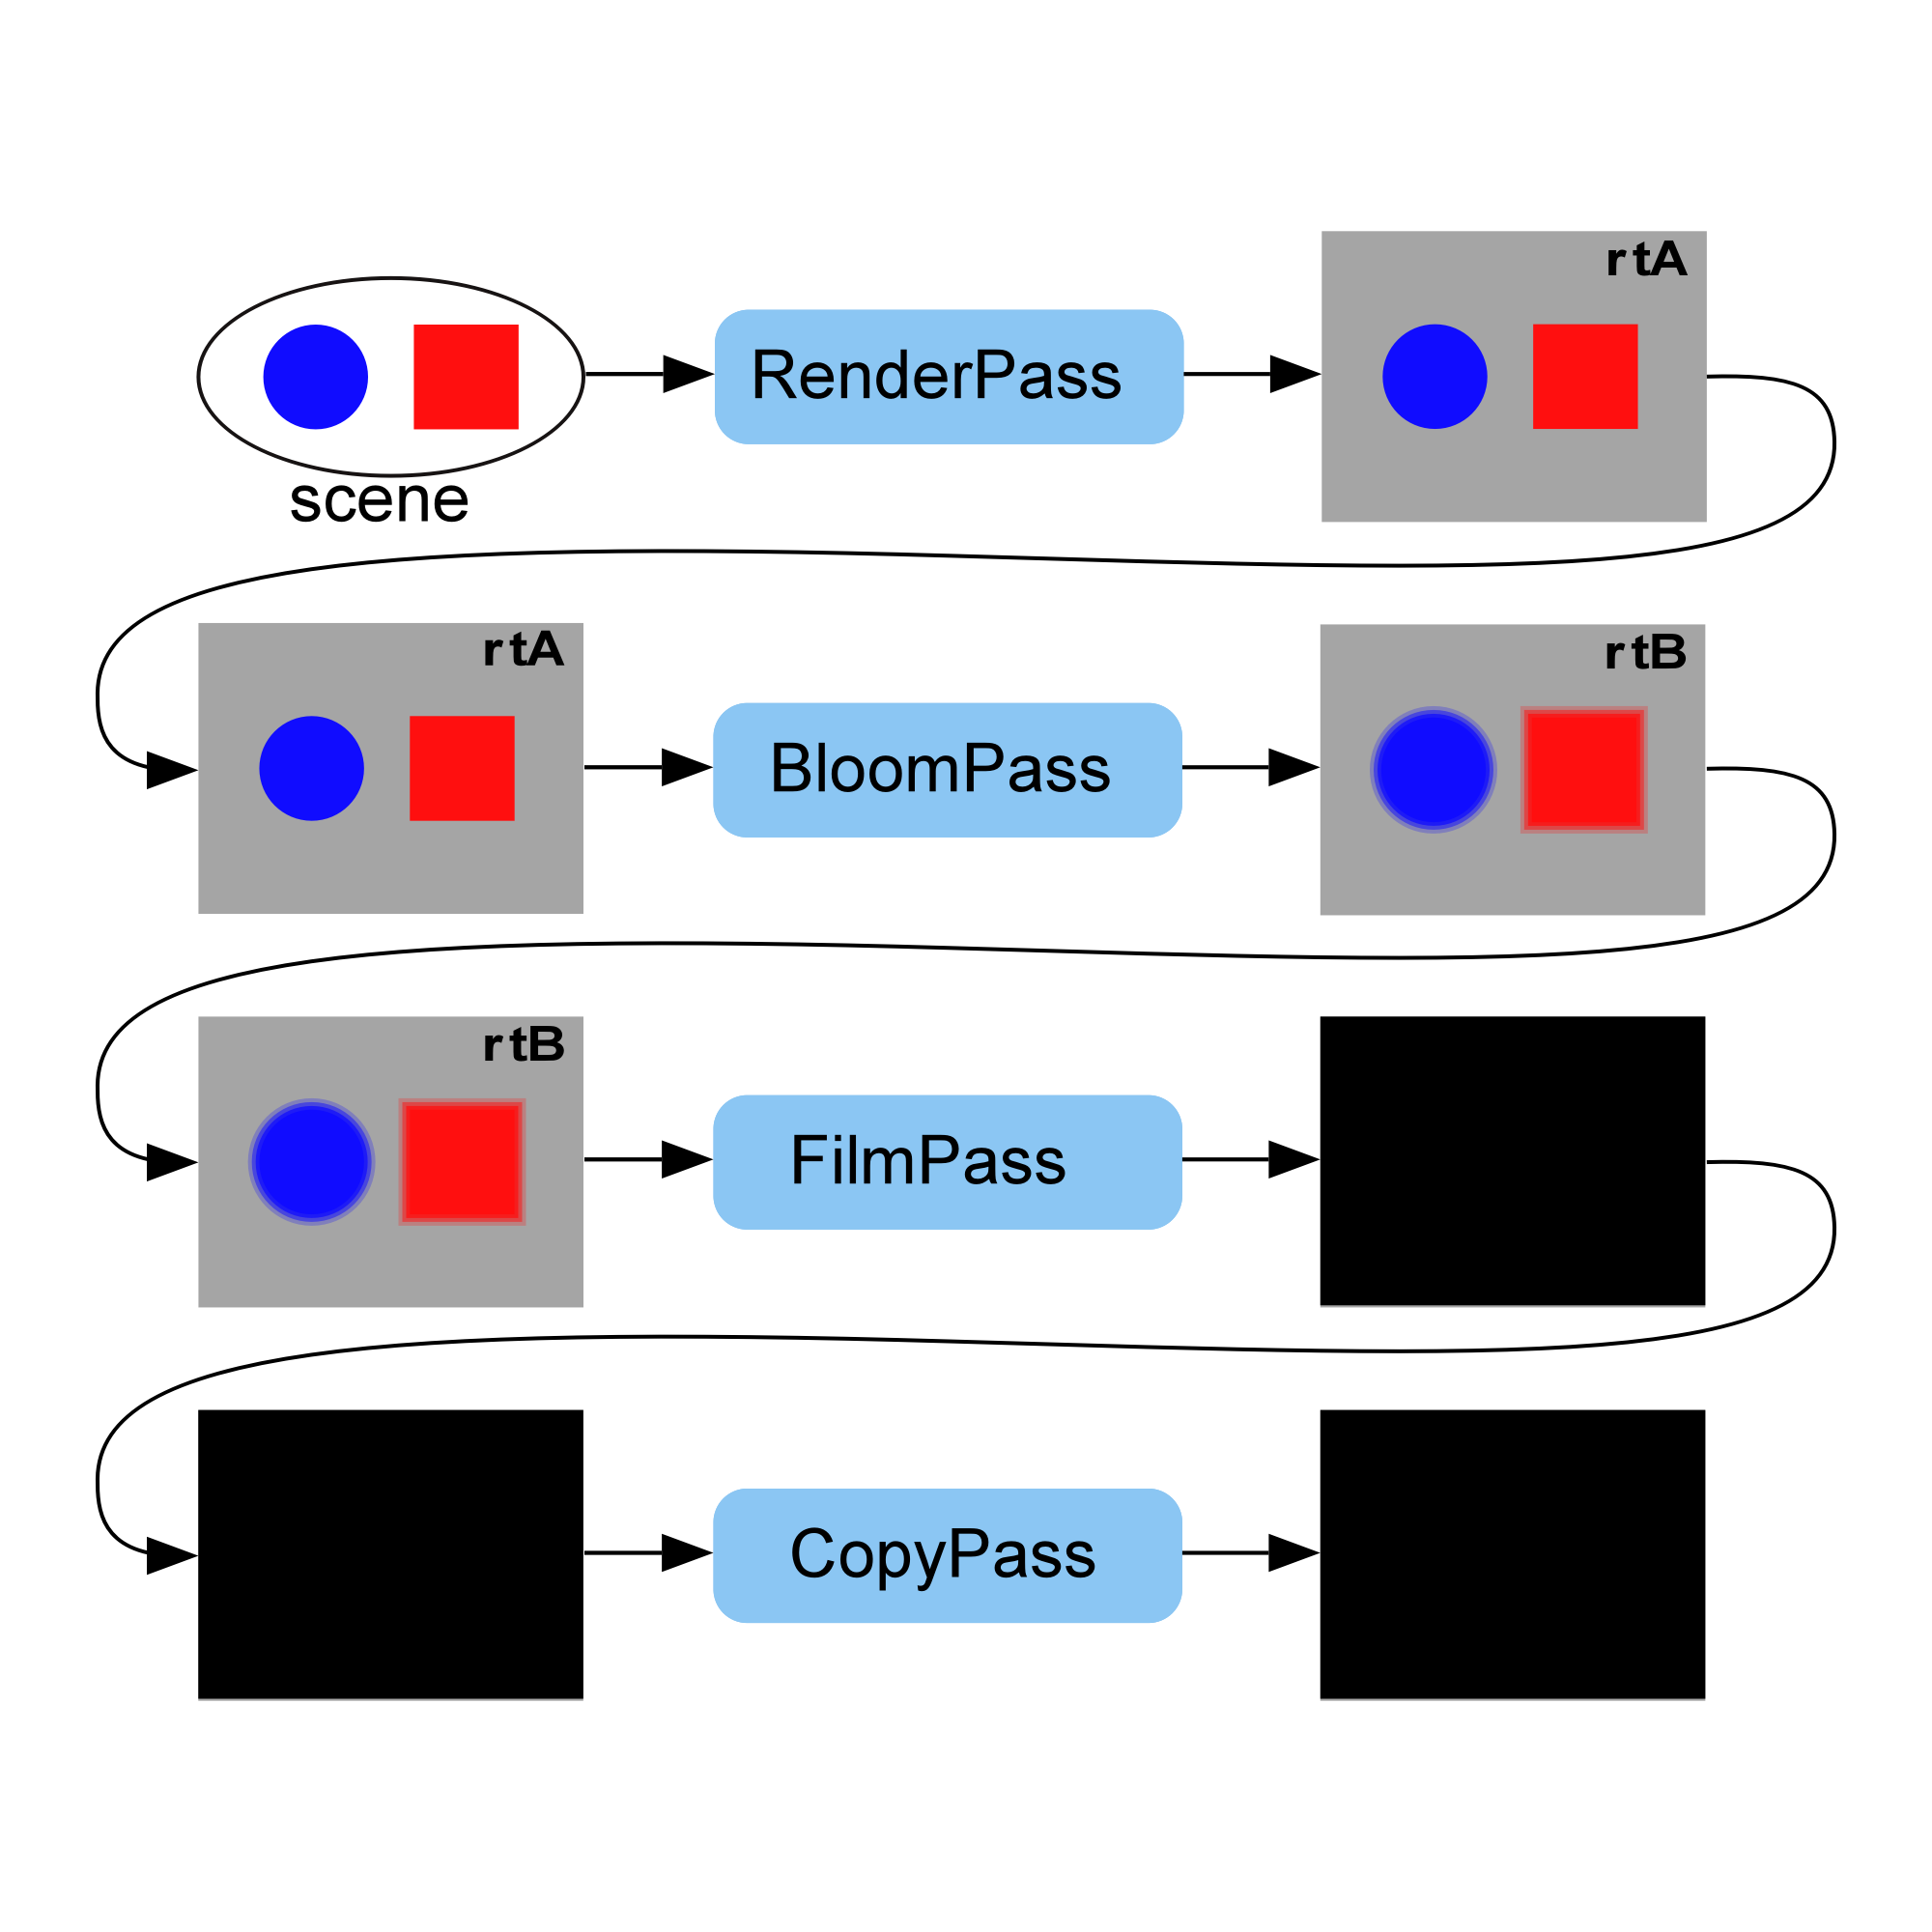
Post Processing
Refer
https://threejsfundamentals.org/threejs/lessons/threejs-post-processing.html

Slide 23
Particle System
https://redstapler.co/space-warp-background-effect-three-js/
Fog
https://dustinpfister.github.io/2018/04/16/threejs-fog/
scene.fog = THREE.fog(fogColor, nearDistance, farDistance)
Rain
https://redstapler.co/three-js-realistic-rain-tutorial/

Slide 24
WebGL
References
https://developer.mozilla.org/en-US/docs/Web/API/WebGL_API/WebGL_best_practices

Slide 25
VR
References
https://r105.threejsfundamentals.org/threejs/lessons/threejs-webvr.html
https://ada.is/blog/2020/05/18/using-vr-controllers-and-locomotion-in-threejs/
https://codingxr.com/articles/getting-started-with-webxr-and-threejs/
http://charliegerard.github.io/blog/Virtual-Reality-ThreeJs/
https://tutorialsforvr.com/360-vr-player-web-threejs/

Slide 26
微信小程序
References
https://juejin.cn/post/6918755518593007623

