Slide 1
Vue Notes
Sparks Lu
Last updated: 2/22/2022

Slide 2
General

Slide 3
References
https://juejin.cn/post/6901466994478940168

Slide 4
Introdution
Progressive JS framework that focuses on building UI
React
AngularJS

Slide 5
Install
Methods
Include the <script> tag in the html file (cdnjs)
Install using NPM
curl -sL https://deb.nodesource.com/setup_14.x | sudo -E bash -
sudo apt install nodejs npm
nodejs -v
sudo npm install -g cnpm --registry=https://registry.npm.taobao.org
Use the vue-cli tool along with Webpack
https://cli.vuejs.org/
sudo cnpm install -g @vue/cli // Install vue-cli globally
vue --version
vue init webpack myapp
npm run dev
npm run build // Build application to production
Install using the client-side package manager
Vim Support
https://github.com/posva/vim-vue
Vundle: Plugin 'posva/vim-vue'

Slide 6
Config
vue ui
Drop console when release:
build/webpack.prod.conf.js
new UglifyJsPlugin({
uglifyOptions: {
compress: {
warnings: false,
drop_debugger: true,
drop_console: true // 打包之后关闭console.log
}
},

Slide 7

Debug
npm run dev
webpack.prod.conf.js
drop_debugger
drop_console
Vue-devtools
Install
git clone https://github.com/vuejs/vue-devtools
cd vue-devtools
cnpm install
npm run build
open chrome://extensions/ in Chrome
打开“开发者模式”
Select vue-devtools/shells/chrome folder
Use
Open vue debug page (localhost:8080)
F12, Vue tab

Slide 8
Binding
Description | Data | Computed | Watcher
Store variables | Store local variables | Can be static, derived from other variables, or can be static functions | Does not store variables - only watches them.
React to variable value changes | Y | Y | Y
Cached? | Y | Y | N/A
Scope | Local to component | Local to component, but can derive/make calculations with variables from props, store, etc. | Can watch local or store variables and react to changes
Can be referred by <template> | Y e.g. {{ myName }} | Y {{ myCalcName }} | N/A
Can be referred by <script> methods | Y this.myName | Y this.myCalcName | N/A
Perform action when value changes | N | N | Y
Consequence of a value change | Change UI to react to change | Change UI | Perform action - local/vuex
Can change other variable values | N | Y | Y
Vue
el
Bind to HTML element
data
Bind data
computed
Bind computed data
cached
methods
Bind method

Slide 9
Directives
Bind with HTML
v-text
v-html
explain data as HTML
v-model
HTMl element value <-> Vue model
<input v-model=”message” placeholder=”edit me”>
Conditional or loop rendering
v-show
v-if/v-else/v-else-if
v-for
Event binding
v-on
<button v-on:click=”...”></button>, <input v-on:keyup.enter=”...”></input>
v-resize
v-resize:throttle, v-resize:debounce
class or style binding
v-bind:class=”...”, v-bind:style=”...”, v-bind:src=”...”,v-bind:href=”...”
v-pre
v-clock
v-once

Slide 10
Component
Global registration
Vue.component('component-name', {data: ..., props: ..., template: ...})
HTML component
Encapsulate and reuse
data: must be function

Slide 11
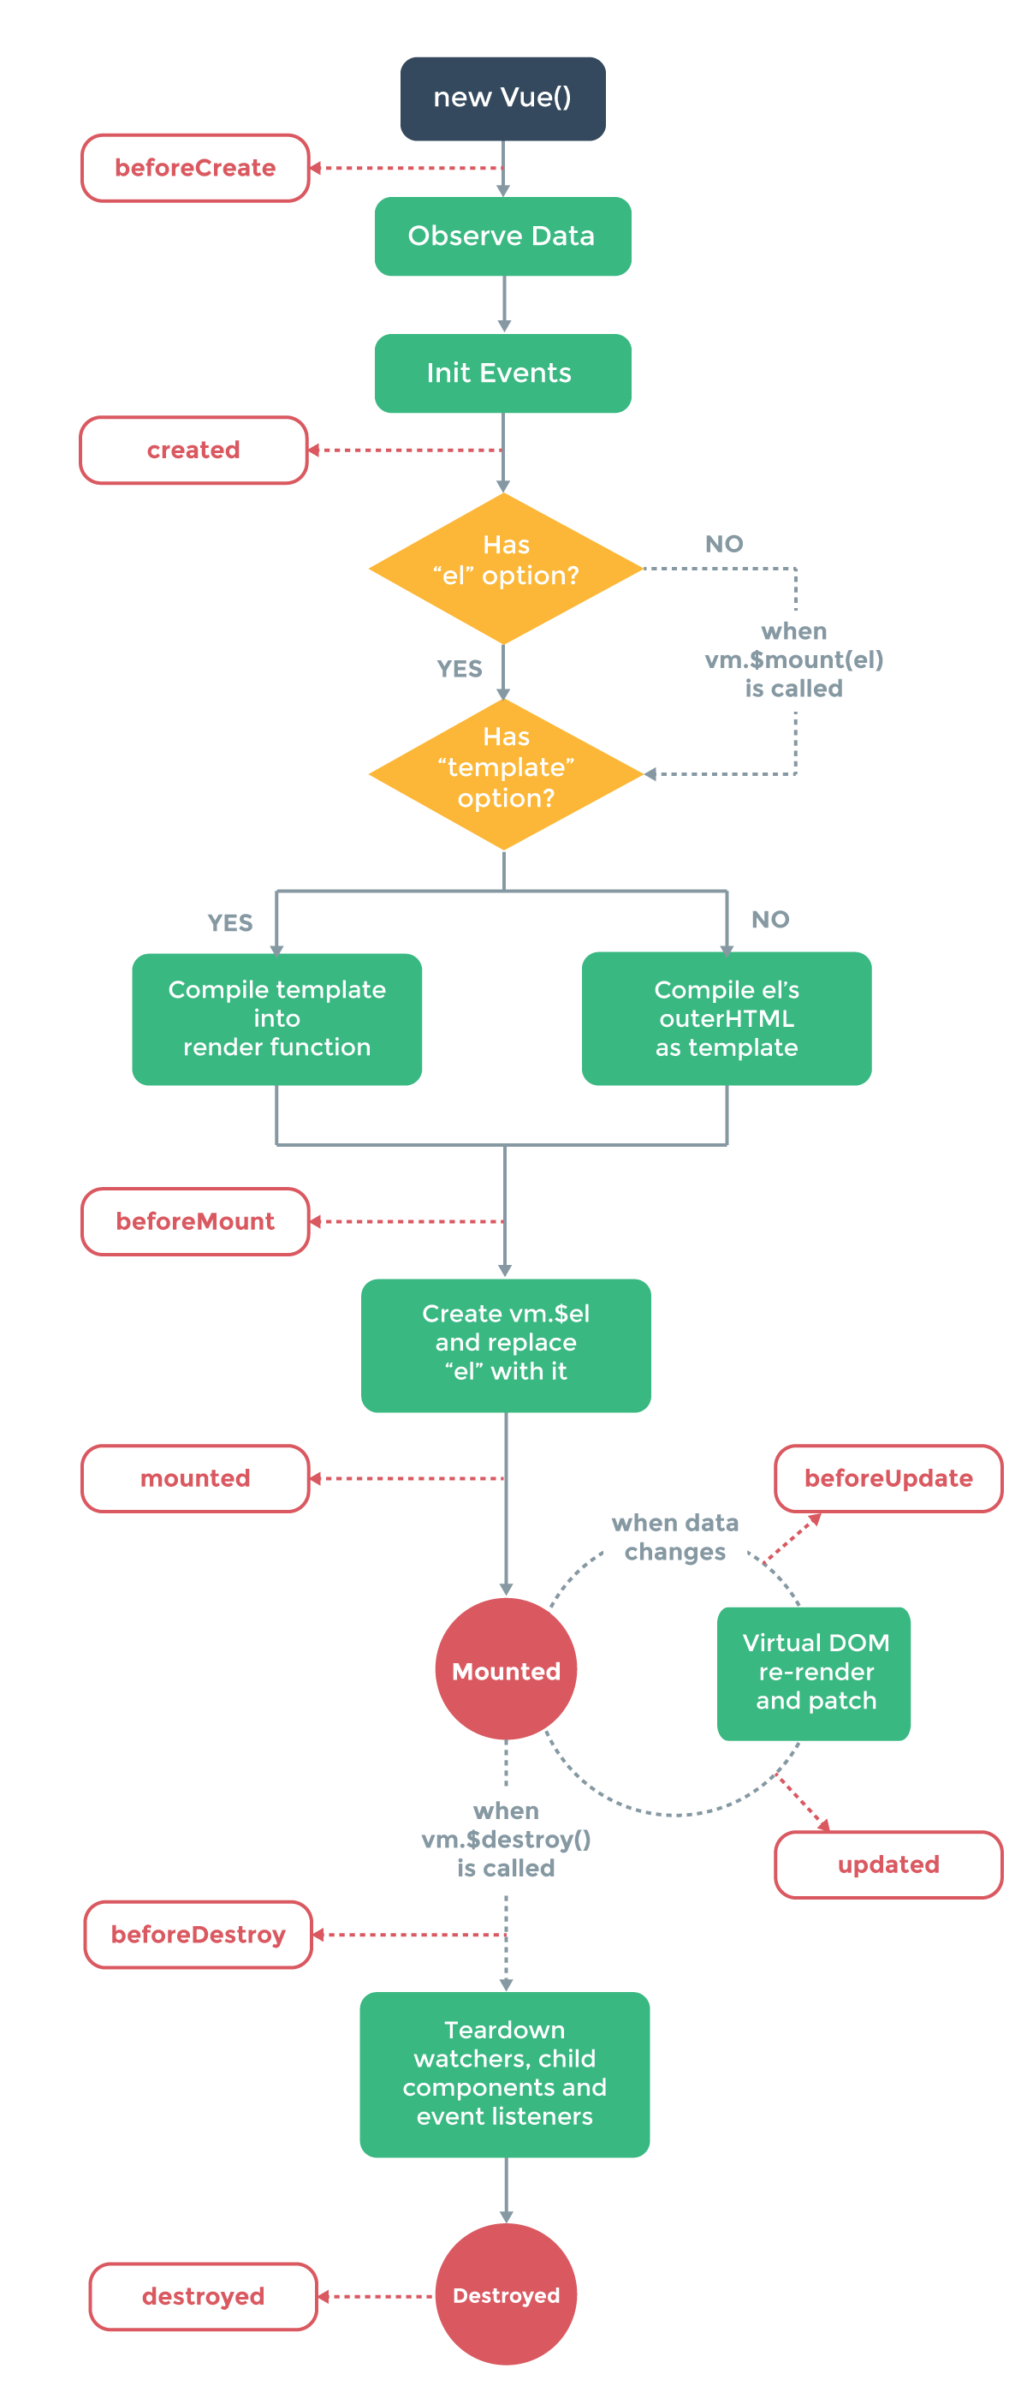
Lifecycle Hooks
Hooks
created
mounted
destroyed
activated/deactivated
for keep-alive components

Slide 12
Props
Concept
one-way-down binding
When the parent property update, it will flow down to the child.
But not the other way around

Slide 13
Additional Tools & Plugins
vue-router
vue-resource
vuex
Store
vue-async-data
vue-validator
vue-devtools
Chrome extension, Firefox addon
vue-touch

Slide 14
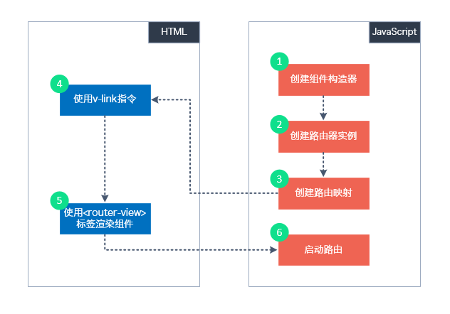
Single Page Application
Command
vue init webpack {appname}
Structure
index.html
src
App.vue
main.js
components/

Slide 15
Vue Router
import Vue from 'vue'
import VueRouter from 'vue-router'
Vue.use(VueRouter)
Install
npm install vue-router --save
Vue.use(VueRouter)
this.$router
router object
navigate to a new route
this.$router.push('route-name')
this.$router.replace({ path: 'name'})
this.$router.go(-1/1)
this.$route
<router-link>
<router-link to=”home”>Home</router-link>
<router-view>
Vue router puts the content which match current url
router.js
routes: [{path: 'url1', name: 'name1', component: 'component1'}]

Slide 16
Vue-i18n
const messages = {
en: {
message: {
hello: '{msg} world'
}
}
}
https://github.com/kazupon/vue-i18n
vue add i18n
Formatting
Named formatting
List formatting
HTML formatting
Custom formatting
Pluralization
$tc()
Datetime localization
$d()
Number formatting
<i18n-n :value=”...”></i18n>
v-t
better performance than $t
npm i --save-dev @kazupon/vue-i18n-loader
vue-cli-plugin-i18n
BabelEdit: translation editor
<p>{{ $t('message.hello', { msg: 'hello' }) }}</p>
<p>{{ $t('message.hello', ['hello']) }}</p>
<p v-html="$t('message.hello')"></p>
const i18n = new VueI18n({
locale: 'ja',
fallbackLocale: 'en',
messages
})

Slide 17
Axios
axios.post('/user', {
firstName: 'Fred', // 参数 firstName
lastName: 'Flintstone' // 参数 lastName
})
.then(function (response) {
console.log(response);
})
.catch(function (error) {
console.log(error);
});
Install
npm install axios vue-axios
Usage
request
get, post
response
axios.interceptors.request.use(...)
axios.interceptors.response.use(...)
Serialize
default: json
axios.defaults.baseUrl
axios.defaults.timeout
axios.get('/user?ID=12345')
.then(function (response) {
console.log(response);
})
.catch(function (error) {
console.log(error);
});
response:
- data: {}
- status
- statusText
- headers: {}
- config: {}

Slide 18
Share Data Between Components
// 父组件
<template>
<div>
<button @click="handleClick">按钮</button>
<Child ref="child"></Child>
</div>
</template>
​
​
<script>
import Child from './components/child.vue'
export default {
components: {
Child,
},
methods: {
handleClick() {
this.$refs.child.sing()
},
},
}
</script>
​
// 子组件
<script>
export default {
methods: {
sing() {
console.log('使用refs直接调用函数方法')
},
},
}
</script>
// 父组件
<template>
<div>
<magic-eight-ball @give-advice="showAdvice">
</magic-eight-ball>
</div>
</template>
// 子组件
<script>
export default {
methods:{
giveAdvice(){
let randomAdviceIndex = Math.floor(Math.random()
*this.possibleAdvice.length);
this.$emit('give-advice',
this.possibleAdvice[randomAdviceIndex])
}
}
}
</script>
Parent -> child
props
refs
Events
父组件监听子组件触发的事件，需要在子组件用使用 $emit 触发，在父组件中使用 v-on: / @ 自定义事件监听
this.$emit(“msg”)
@msg='method'

Slide 19
Window
window.addEventListener('resize', funcName)
window.removeEventListener('resize', funcName)
window.innerWidth, window.innerHeight

Slide 20
Storage
Session storage
sessionStorage.setItem(key, value)
sessionStorage.getItem(key)
Local storage
localStorage.setItem(key, value)
localStorage.getItem(key)

Slide 21
Load External JS
https://www.npmjs.com/package/vue-plugin-load-script
Usage
In main.js
import LoadScript from 'vue-plugin-load-script'
Vue.use(LoadScript);
this.$loadScript("/js/jquery-2.2.4.min.js").then( () => {
})
.catch( () => {
})
this.$loadScript("https://maps.googleapis.com/maps/api/js")

Slide 22
Plugin
Vuetify
Install
vue add vuetify
npm install vuetify --save
Ref
https://vuetifyjs.com
Vue-element-admin
vue-resize-directive
npm install vue-resize-directive --save
import resize from 'vue-resize-directive'

Slide 23
Module System
Speed up npm run build
https://www.hangge.com/blog/cache/detail_2105.html
266041ms
Install node latest version
from 8.x to 14.x:

Slide 24
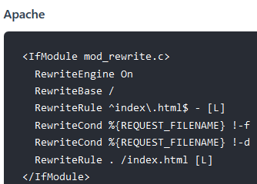
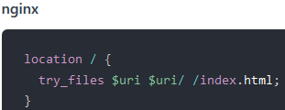

Issues and Solutions
Array value change
this.$set(array, index, newValue)
array[index] = newValue, change will not be detected
<select> in IE
If use customized bg image, default image is also shown
.select::-ms-expand {
display: none;
}
History mode

Slide 25
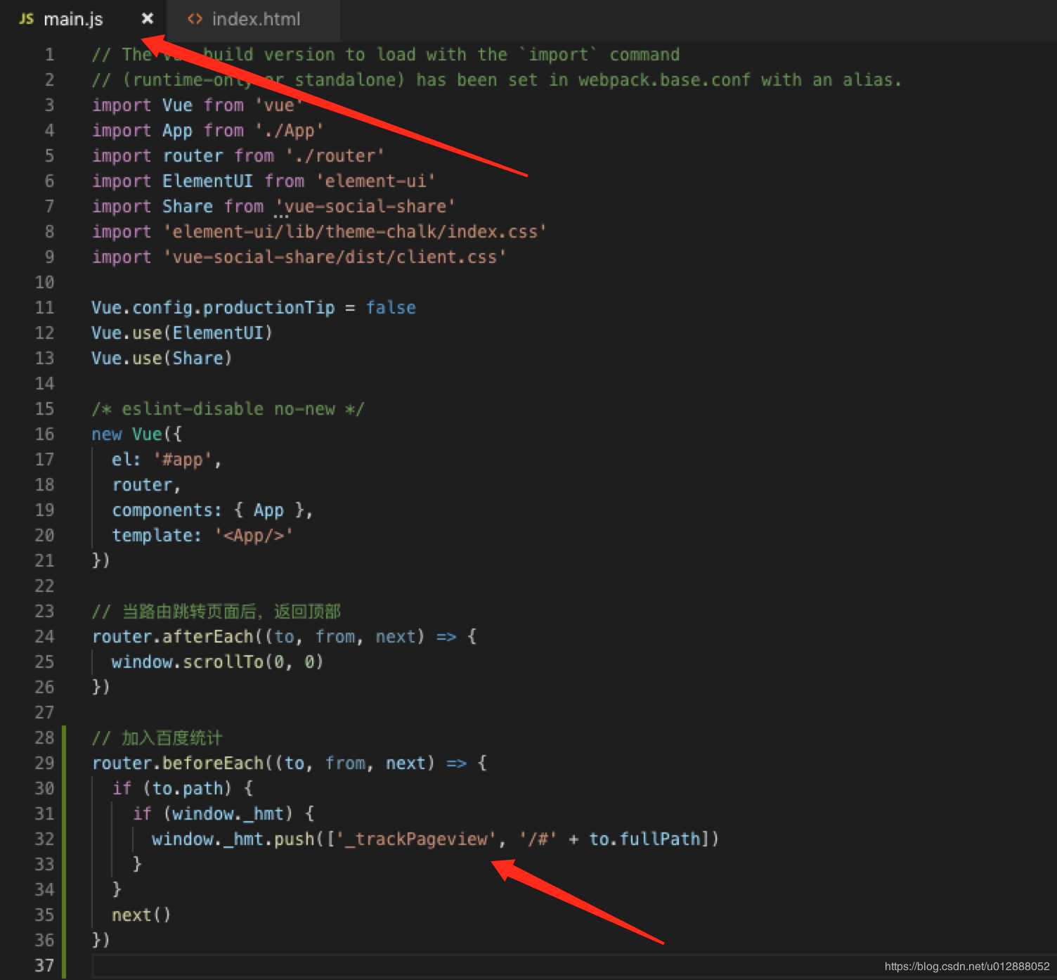
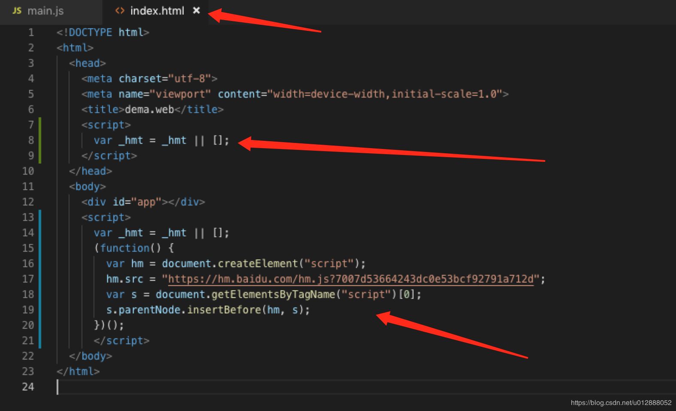
Add Baidu Tongji
References
https://blog.csdn.net/u012888052/article/details/93195909
Steps:
modify index.html
modify src/main.js

Slide 26
Webpack

Slide 27
Intro
References
https://webpack.js.org/
https://www.valentinog.com/blog/webpack/
https://webpack.js.org/migrate/5/
https://www.cnblogs.com/webhmy/p/14791194.html
Intro
module bundler
webpack --version
node --trace-deprecation node_modules/webpack/bin/webpack.js
npm run build --report
Webpack 5
Improve build performance with Persistent Caching.
Improve Long Term Caching with better algorithms and defaults.
Improve bundle size with better Tree Shaking and Code Generation.
Improve compatibility with the web platform.
Clean up internal structures that were left in a weird state while implementing features in v4 without introducing any breaking changes.
Prepare for future features by introducing breaking changes now, allowing us to stay on v5 for as long as possible

Slide 28
Upgrade from 3 to 4
Migrate 3 to 4
references
https://webpack.js.org/migrate/4/
https://wxsm.space/2020/upgrade-webpack-of-vue-cli-projects-from-3-to-4/
https://blog.csdn.net/harsima/article/details/80819747
https://dev.to/flexdinesh/upgrade-to-webpack-4---5bc5
improvements
Performance improvements and faster build times (up to 98% faster)
Steps
cnpm i -D webpack@4
add VueLoaderPlugin to webpack.base.conf.js
upgrade packages
upgrade html-webpack-plugin to 4, upgrade eslint-loader to 2, upgrade vue-loader to 15
modify build/webpack.base.conf.js, add below line to module.exports
const devMode = process.env.NODE_ENV !== "production";
mode: process.env.NODE_ENV === 'production' ? 'production' : 'development',
modify from build/webpack.prod.conf.js
remove modules: NoEmitOnErrorsPlugin、ModuleConcatenationPlugin、NamedModulesPlugin、CommonsChunkPlugin、HashedModuleIdsPlugin、UglifyJsPlugin
replace extract-text-webpack-plugin with mini-css-extract-plugin@1
support npm run dev
cnpm i -D webpack-cli webpack-dev-server@3
in package.json, change webpack-dev-server to webpack serve

Slide 29
Modules
Code Splitting
Entry Points: Manually split code using entry configuration.
Prevent Duplication: Use the SplitChunksPlugin to dedupe and split chunks.
Dynamic Imports: Split code via inline function calls within modules.
Optimization
https://v4.webpack.js.org/configuration/optimization/
moduleIds: natural (numeric), named, hashed (better long-term caching), size, total-size
chunkIds: natural (numeric), named, size, total-size
Bundle Analysis
analyse
https://github.com/webpack/analyse
webpack --json > stats.json
webpack-chart
https://alexkuz.github.io/webpack-chart/

Slide 30
Modules 2
html-webkit-plugin
https://github.com/jantimon/html-webpack-plugin#writing-your-own-templates
simplifies creation of HTML files to serve your webpack bundles
mini-css-extract-plugin
https://github.com/webpack-contrib/mini-css-extract-plugin
This plugin extracts CSS into separate files. It creates a CSS file per JS file which contains CSS. It supports On-Demand-Loading of CSS and SourceMaps.
clean-webpack-plugin
clean webpack output
SplitChunksPlugin
https://v4.webpack.js.org/plugins/split-chunks-plugin/

Slide 31
SEO

Slide 32
General
References
https://www.digitalocean.com/community/tutorials/vuejs-vue-seo-tips
Tools
Lighthouse Chrome extension
TKD
title
document.title = ‘title’
description
vue-meta (https://vue-meta.nuxtjs.org/)
keyword
// Component.vue
{
metaInfo: {
meta: [
{ charset: 'utf-8' },
{ name: 'viewport', content: 'width=device-width, initial-scale=1' }
]
}
}
var meta=document.getElementsByTagName("meta");
for (var i=0; i<meta.length; i++) {
if (meta[i].name.toLowerCase()=="description") {
meta[i].content=document.getElementsByClassName("Category-H1")[0].innerHTML;
}
}

Slide 33
Sitemap
vue-cli-plugin-sitemap
https://github.com/cheap-glitch/vue-cli-plugin-sitemap
vue add sitemap
cnpm i
cnpm i -S @vue/cli-service
cnpm i -S esm
create vue.config.js
rm -f ./sitemap.xml
npm run sitemap -- --pretty
sitemap-webpack-plugin
https://github.com/schneidmaster/sitemap-webpack-plugin
https://www.suprithreddy.com/sitemap-generation-for-vue-spas-using-webpack/
npm install sitemap-webpack-plugin --save-dev
vue-router-sitemap
https://github.com/40818419/vue-router-sitemap
cnpm i --save-dev vue-router-sitemap
Validate
https://www.xml-sitemaps.com/validate-xml-sitemap.html

Slide 34
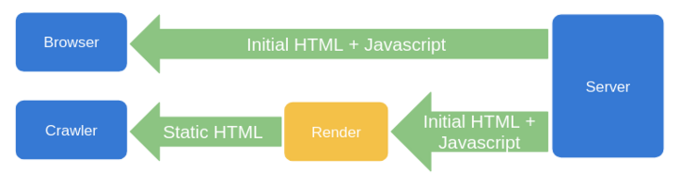
SPA
References
https://segmentfault.com/a/1190000023481810?utm_source=sf-similar-article
CSR (Client-Side Rendering)
缺点: SEO不友好（爬虫如果没有执行js的能力，如百度，获取到的页面是空的，不利于网站推广）, 首屏加载慢（到达浏览器端后再加载数据，增加用户等待时间）
SSR (Server-Side Rendering)
Vue: Nuxt.js
React: Nextjs
缺点: 代码改动大,Node容易成为性能瓶颈
Prerender
prerender-spa-plugin
服务端动态渲染（利用user-agent）
puppeteer, rendertron, prerender.io (https://prerender.io/)

Slide 35
Prerender.io
References
https://prerender.io/
https://docs.prerender.io/article/15-getting-started
https://dashboard.prerender.io/
Steps
Nginx config
proxy_set_header X-Prerender-Token cv7MlHMCkxu392Ftd1Iq;
curl -H "X-Prerender-Token: cv7MlHMCkxu392Ftd1Iq" https://service.prerender.io/https://fishpano.com/
install middleware
nginx reverse proxy
https://github.com/prerender/prerender-nginx/blob/master/nginx-reverse-proxy/nginx.conf
test middleware
curl -A Googlebot https://fishpano.com/
curl -A Baiduspider https://fishpano.com/

Slide 36
Phantomjs 1/2
References
https://blog.csdn.net/dengzy926/article/details/105397730
https://www.jianshu.com/p/3b72c08cafb2
使用Phantomjs针对爬虫做处理
对已用SPA开发完成的项目，这是不二之选
无界面的webkit内核浏览器
通过Nginx配置，判断访问的来源UA是否是爬虫访问，如果是则将搜索引擎的爬虫请求转发到一个node server，再通过PhantomJS来解析完整的HTML，返回给爬虫。
Steps
install method 1
npm i phantomjs
install method 2
wget https://bitbucket.org/ariya/phantomjs/downloads/phantomjs-2.1.1-linux-x86_64.tar.bz2
tar xvjf phantomjs-2.1.1-linux-x86_64.tar.bz2 -C /usr/local/share/
git clone https://github.com/lengziyu/vue-seo-phantomjs.git
cd vue-seo-phantomjs && phantomjs --debug=true spider.js 'https://www.baidu.com'
upstream spider_server {
server localhost:3000;
}
server {
listen 80;
server_name example.com;
location / {
proxy_set_header Host $host:$proxy_port;
proxy_set_header X-Real-IP $remote_addr;
proxy_set_header X-Forwarded-For $proxy_add_x_forwarded_for;
if ($http_user_agent ~* "Baiduspider|twitterbot|facebookexternalhit|rogerbot|linkedinbot|embedly|quora link preview|showyoubot|outbrain|pinterest|slackbot|vkShare|W3C_Validator|bingbot|Sosospider|Sogou Pic Spider|Googlebot|360Spider") {
proxy_pass http://spider_server;
}
}
}

Slide 37
Phantomjs 2/2
Issues & Solutions
phantonjs ReferenceError: Can't find variable: Promise
cnpm i -S es6-promise
main.js:
import Promise from ‘es6-promise’
Promise.polyfill()
Resource error code= 6 , string= SSL handshake failed
phantomjs --ssl-protocol=any --ignore-ssl-errors=yes spider.js 'https://fishpano.com'
Error code: 5, Description: Operation canceled
page.settings.resourceTimeout = 10000;

Slide 38
Puppeteer
References
https://developers.google.com/web/tools/puppeteer/articles/ssr
https://zhuanlan.zhihu.com/p/70006823
http://thetiso.github.io/2021/05/06/vue-seo/#more
https://github.com/skalfyfan/dockerized-puppeteer
Intro
headless browser to generate screenshots of web pages
test
curl -H 'User-agent:Baiduspider' https://fishpano.com
curl -A “Baiduspider” https://fishpano.com
No available complete solution including docker image
主体 user-agent 用途
Google googlebot 搜索引擎
Google google-structured-data-testing-tool 测试工具
Google Mediapartners-Google Adsense广告网页被访问后，爬虫就来访
Microsoft bingbot 搜索引擎
Linked linkedinbot 应用内搜索
百度 baiduspider 搜索引擎
奇虎 360 360Spider 搜索引擎
搜狗 Sogou Spider 搜索引擎
Yahoo Yahoo! Slurp China 搜索引擎
Yahoo Yahoo! Slurp 搜索引擎
Twitter twitterbot 应用内搜索
Facebook facebookexternalhit 应用内搜索

Slide 39
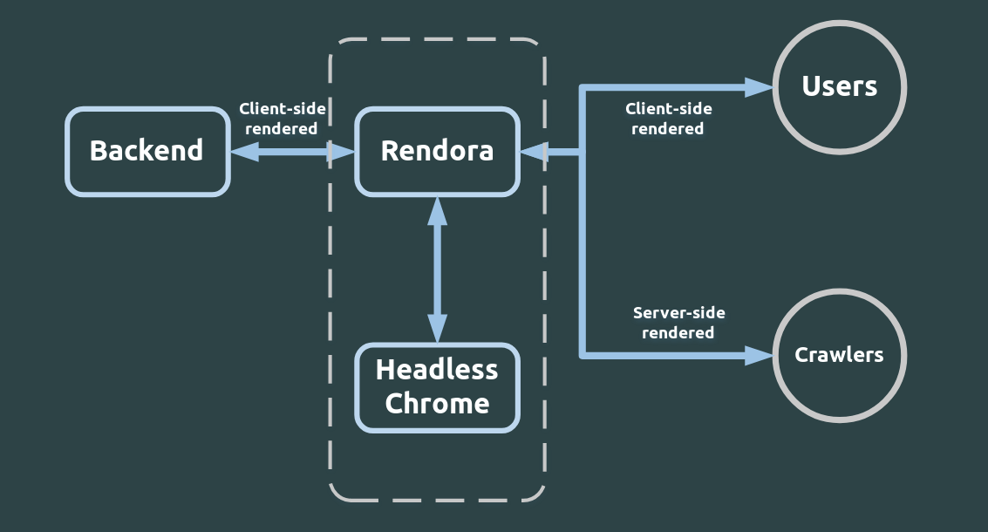
Rendora 1/2
References
https://github.com/rendora/rendora
https://segmentfault.com/a/1190000019704882
https://github.com/rendora/dockerfiles
https://github.com/rendora/rendora/tree/master/docs/configuration
Intro
by default, listen on 3001 port
by default, headless chrome service listen on 9222 port
run on host network
Steps
git clone https://github.com/rendora/rendora
install go v1.17+
configure go
go env -w GO111MODULE=on
go env -w GOPROXY=https://goproxy.io,direct
make build
sudo make install
Usage
need to start chrome-headless separately as a dependency
check whether or not rendora service work correctly
curl -A “Baiduspider” http://localhost:3001
Flask
User
Rendora
Nginx
Crawler
Headless
Chrome

Slide 40
Rendora 2/2
Debug
In rendora-config.yaml, add “server: enabled”
curl --header "Content-Type: application/json" -X GET 127.0.0.1:9242/metrics
curl --header "Content-Type: application/json" --data '{"uri": "/"}' -X POST 127.0.0.1:9242/render
returns status, content, headers, latency

Slide 41
SpaRender
References
https://github.com/zuoyanart/sparender
Info
based on puppeteer

Slide 42
Components

Slide 43
Vue UI Framework
Element UI
Vuetify
https://vuetifyjs.com/en/
BootstrapVue
https://bootstrap-vue.org/
https://github.com/bootstrap-vue/bootstrap-vue
Buefy
Quasar

Slide 44
Element UI
https://element.eleme.cn/#/zh-CN
Install
npm i element-ui -S
Usage
Import all
Import on demand
npm i babel-plugin-component -D
npm install babel-cli babel-preset-es2015
$msgbox(options)
$alert(message, title, options)
$confirm(message, title, options)
$prompt(message, title, options) // prompt input

Slide 45
Font Awesome
References
https://fontawesome.com/icons?d=gallery&m=free
https://github.com/FortAwesome/vue-fontawesome
https://blog.logrocket.com/full-guide-to-using-font-awesome-icons-in-vue-js-apps-5574c74d9b2d/
Icon library
solid (fas), regular (far), light (fal), brands (fab)
Usage
<link href="https://cdnjs.cloudflare.com/ajax/libs/font-awesome/5.11.2/css/all.min.css" rel="stylesheet" type="text/css">
Vue-fontawesome
npm install --save @fortawesome/fontawesome-svg-core @fortawesome/free-solid-svg-icons @fortawesome/free-regular-svg-icons @fortawesome/vue-fontawesome
In main.js
import { library } from '@fortawesome/fontawesome-svg-core'
import { faCoffee } from '@fortawesome/free-solid-svg-icons'
import { FontAwesomeIcon } from '@fortawesome/vue-fontawesome'
library.add(faCoffee)
Vue.component('font-awesome-icon', FontAwesomeIcon)

Slide 46
Progress UI
vue-ellipse-progress
https://github.com/setaman/vue-ellipse-progress
npm i -S vue-ellipse-progress
vue-progressbar
https://github.com/hilongjw/vue-progressbar
npm i vue-progressbar

Slide 47
Vue-Konva
References
https://github.com/konvajs/vue-konva
Install
npm i -S konva vue-konva
vue.js v2.4+
Shapes
v-rect, v-circle, v-ellipse, v-line, v-image, v-svg, v-text, v-text-path, v-star, v-label, v-path, v-regular-polygon

Slide 48
Webp Image Format Support
imagemin-webp-webpack-plugin
https://github.com/iampava/imagemin-webp-webpack-plugin

Slide 49
FAQ
Fixed CORS issue during debug
Modify config/index.js
proxyTable: {
'/': {
target: 'http://47.105.68.219:8090/',
changeOrigin: true,
pathRewrite: {
'^/': '/'
}
}
},

Slide 50
Advanced

Slide 51
Handle Large JS Files
Reference
https://github.com/vuejs-templates/webpack/issues/1297
https://www.jianshu.com/p/1c60ed2064b5
https://blog.csdn.net/qq_19694913/article/details/82628637
npm run build --report
Reduce size
element ui
remove whole library import
import only used component
remove language pack in moment.js
const webpack = require('webpack')
module.exports = {
plugins: [
new webpack.IgnorePlugin(/^\.\/locale$/, /moment$/)
]
}
import 'moment/locale/zh-cn';

Slide 52
Speed Up Loading 1/2
Code Splitting
References
https://webpack.js.org/guides/code-splitting/
Methods
entry points
prevent duplication
import immediately before usage
prefetch, preload hints
Loadable component
https://loadable-components.com/docs/getting-started/
npm install @loadable/component
Bundle analysis
webpack --config ./build/webpack.prod.conf.js --profile --json > stats.json
webpack-visualizer-plugin
webpack-bundle-analyzer
https://github.com/webpack-contrib/webpack-bundle-analyzer
sudo npm i -g webpack-bundle-analyzer
import loadable from '@loadable/component'
const OtherComponent = loadable(() => import('./OtherComponent'))
function MyComponent() {
return (
<div>
<OtherComponent />
</div>
)
}
import('./math').then(math => {
console.log(math.add(16, 26))
})
optimization: {
splitChunks: {
chunks: 'all',
},
},
var Visualizer = require('webpack-visualizer-plugin');
//...
plugins: [new Visualizer({
filename: './statistics.html'
})],
//...

Slide 53
Speed Up Loading 2/2
References
https://dzone.com/articles/speed-up-your-vuejs-single-page-app
Lazy-load routes
split each route’s components into a separate chunk and only load them when the route is visited.
in routes file
change “import ProjectList from '@/components/ProjectList.vue'; “ into “const ProjectList = () => import('@/components/ProjectList.vue');”
Laz-load components
Any lazily loaded resource is downloaded when it’s import() function is invoked.
Metrics
TTFB: time to first byte

Slide 54
Patch Package
References
https://github.com/ds300/patch-package
Steps
In package.json
"scripts": {
+ "postinstall": "patch-package"
}
npm i patch-package
modify source in node_modules/
npx patch-package some-package
npm i
npm run build

Slide 55
THANKS
谢谢聆听

