Slide 1
Web Geneal Notes
Sparks Lu
Last updated: 10/16/2019

Slide 2
HTTP Status Code
1×× Informational
100 Continue
101 Switching Protocols
102 Processing
2×× Success
200 OK
201 Created
202 Accepted
203 Non-authoritative Information
204 No Content
205 Reset Content
206 Partial Content
207 Multi-Status
208 Already Reported
226 IM Used
3×× Redirection
300 Multiple Choices
301 Moved Permanently
302 Found
303 See Other
304 Not Modified
305 Use Proxy
307 Temporary Redirect
308 Permanent Redirect
4×× Client Error
400 Bad Request
401 Unauthorized
402 Payment Required
403 Forbidden
404 Not Found
405 Method Not Allowed
406 Not Acceptable
407 Proxy Authentication Required
408 Request Timeout
409 Conflict
410 Gone
411 Length Required
412 Precondition Failed
413 Payload Too Large
414 Request-URI Too Long
415 Unsupported Media Type
416 Requested Range Not Satisfiable
417 Expectation Failed
418 I'm a teapot
421 Misdirected Request
422 Unprocessable Entity
423 Locked
424 Failed Dependency
426 Upgrade Required
428 Precondition Required
429 Too Many Requests
431 Request Header Fields Too Large
444 Connection Closed Without Response
451 Unavailable For Legal Reasons
499 Client Closed Request
5×× Server Error
500 Internal Server Error
501 Not Implemented
502 Bad Gateway
503 Service Unavailable
504 Gateway Timeout
505 HTTP Version Not Supported
506 Variant Also Negotiates
507 Insufficient Storage
508 Loop Detected
510 Not Extended
511 Network Authentication Required
599 Network Connect Timeout Error

Slide 3
Common Errors
net::ERR_CONNECTION_RESET
Maybe setting of max upload file size
e.g. nginx/sites-enabled/flask-project

Slide 4
Website Check List
Ref
https://www.namecheap.com/resource-center/getting-started/website-check-up/
Check list
Response and load time
large image files, unclean codes, poor hosting
https://www.17ce.com/
Mobile friendly
mobiletest.me
Brand
Icongraphy, Colors, Logos, Font
Above the fold, below the fold
Compelling, readable content
Clear navigation
Search function
Analytics
Broken links
www.deadlinkchecker.com
Security
siteguarding
Acunetix
Contact info

Slide 5
Backend API Testing Using Curl
Option | Meaning | Notes
-v | verbose output
-i | Output response headers
-I | Fetch the HTTP header only
-H '...' | GET with provided header | -H “Content-Type: application/json”
-X POST | POST
-d '{'a': 'val', ...} | POST additional data
-F name=content | Post form data content: @filename to post file content
-r (--range) {start}-{end} | Download byte range | --range 0-99

Slide 6
Web Server for Development
http-server
npm install http-server -g
http-server {path} {options}
-p: port to use
-a: address to use
-d: show directory listings
-i: display autoIndex

Slide 7
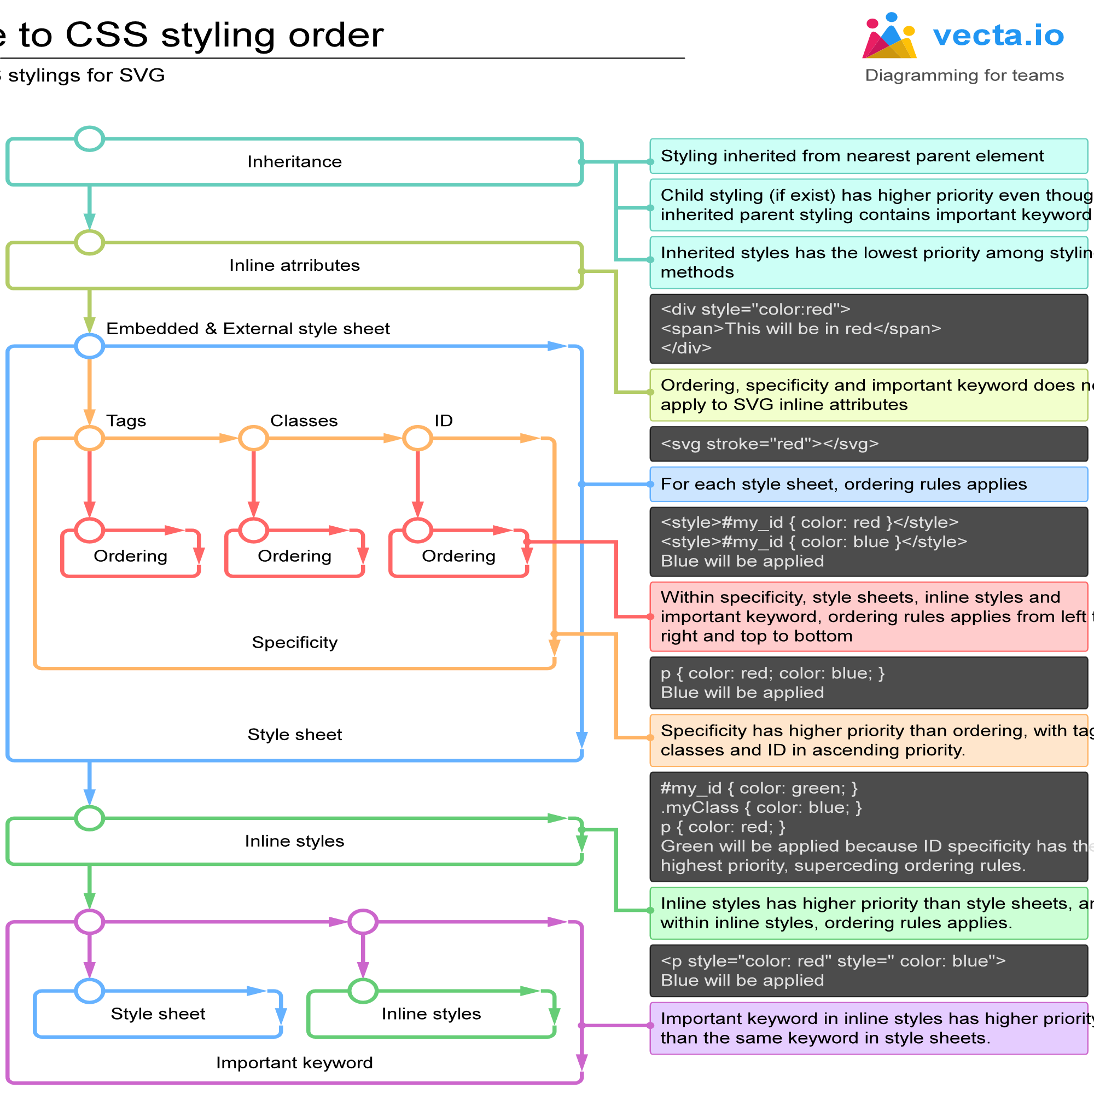
CSS - 1
限制宽高且等比缩放
img {
max-width:64px;
max-height:64px;
width:auto;
height:auto;
}

Slide 8
CSS - 2
Units
rem font size of root element (<html>)
vh 1/100 of the height of the viewport
vw 1/100 of the width of the viewport
vmin min(vh, vw)
vmax max(vh, vw)
em width of ‘M’ of the font size of current element

Slide 9
Resolution Adaptation Test
Website
http://whatismyscreenresolution.net/
http://www.responsinator.com/
http://testsize.com/
Tools

Slide 10
Browser Compatibility Test
Website
http://browsershots.org/
https://www.browserstack.com/ (paid)

Slide 11
Favicon
Generation
https://favicon.io/
How to use
Add to html
<link rel="apple-touch-icon" sizes="180x180" href="/apple-touch-icon.png">
<link rel="icon" type="image/png" sizes="32x32" href="/favicon-32x32.png">
<link rel="icon" type="image/png" sizes="16x16" href="/favicon-16x16.png">
<link rel="manifest" href="/site.webmanifest">

Slide 12
SSH
Avoid freeze
Modify /etc/ssh/ssh_config on client
Host *
ServerAliveInterval 100
Modify /etc/ssh/sshd_config on server
ClientAliveInterval 60
TCPKeepAlive yes
ClientAliveCountMax 10000
Run 'service sshd restart' on server

Slide 13
SEO - General
References
https://zhuanlan.zhihu.com/p/335743455
Title
在标题增加搜索量较高的词
在标题减少搜索量较低的词
丰富页面内容
添加相关链接
Register to search engine
https://www.bing.com/webmasters

Slide 14
SEO - Sitemaps
References
https://www.sitemaps.org/index.html

Slide 15
SEO - Robots.txt
References
https://seosherpa.com/robots-txt/
User agents
Google: Googlebot
Google Images: Googlebot-Image
Google Video: Googlebot-Video
Google News: Googlebot-News
Bing: Bingbot
Bing Images & Videos: MSNBot-Media
Yahoo: Slurp
Yandex: YandexBot
Baidu: Baiduspider
DuckDuckGo: DuckDuckBot
Directives
Disallow
Allow
Sitemap
Sitemap: [URL location of sitemap]
User-agent: [bot identifier]
[directive 1]
[directive 2]
[directive ...]
User-agent: [another bot identifier]
[directive 1]
[directive 2]
[directive ...]

Slide 16
Crawl
Puppeteer
references
https://www.aymen-loukil.com/en/blog-en/google-puppeteer-tutorial-with-examples/#3Mobile_device_emulation_example
launch Chromium in headless mode
cnpm i -g puppeteer
website-screenshot
const puppeteer = require('puppeteer');
(async () => {
const browser = await puppeteer.launch();
const page = await browser.newPage();
await page.goto('https://example.com');
await page.screenshot({ path: 'example.png' });
await browser.close();
})();

Slide 17
ClearPath

Slide 18
References
https://www.arubanetworks.com/assets/so/SO_ClearPass.pdf
https://www.arubanetworks.com/products/security/network-access-control/secure-access/

Slide 19
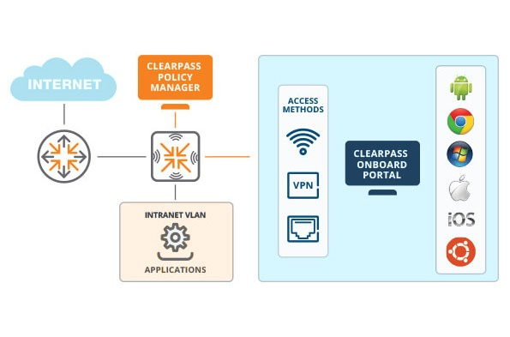
Intro
Intro
API
https://community.arubanetworks.com/browse/articles/blogviewer?blogkey=0744ffa6-e5aa-4957-9910-c3f52b9f3055
create a new guest account
user name, password, expire_time, role_id
update a guest account
delete a guest account
fetch a guest account details

Slide 20
Performance

Slide 21
In General
References
https://www.webpagetest.org/
https://web.dev/fast/#optimize-webfonts
https://developer.mozilla.org/en-US/docs/Learn/Performance/CSS
https://developer.mozilla.org/en-US/docs/Web/Performance/Lazy_loading
https://phoenixnap.com/kb/reduce-server-response-time
https://phoenixnap.com/kb/best-website-speed-performance-test-tools#ftoc-4-varvy-pagespeed-optimmization
Lazy loading
JS
type=”module”
CSS
Images
<img loading=”lazy”>

