Slide 1
Conservation

Slide 2
Springs

Slide 3
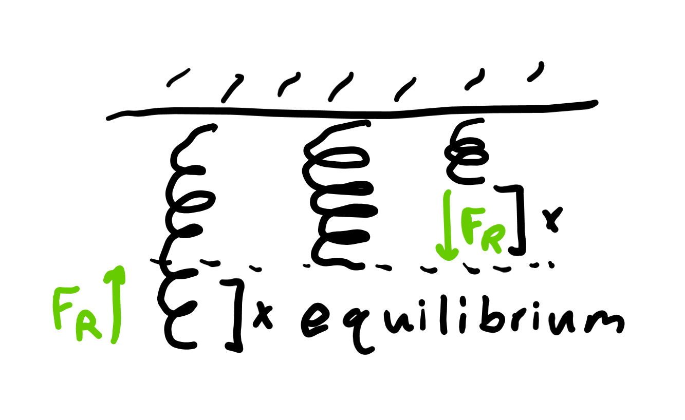
Equilibrium
Springs pull everything toward the center, called the equilibrium.
You can pull objects on a spring a distance x from the spring.
The spring will always apply a force to restore itself to equilibrium.

Slide 4
Hooke’s law
The magnitude of the restoring force, or the force bringing it back to equilibrium is proportional to x, the distance either compressed or stretched.
F_{r} = -kx, where k is a constant and x is the distance the spring is stretched. Negative as it’s opposite the applied force which is usually denoted as positive.
Note that F_{r} is negative no matter if you compress or stretch it as the negative sign tells you that it’s acting against your F_{a} used to deform it in either direction.

Slide 5
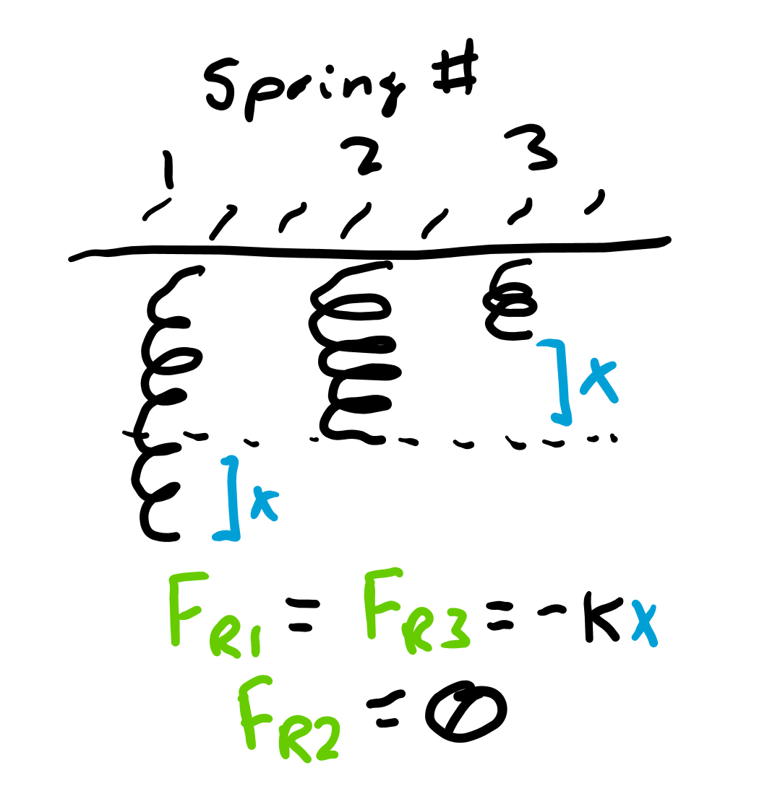
Spring constant
The units of the spring constant are N/m or kg/s² since F_{r} = -kx.
The larger the constant, the stiffer the spring, meaning it takes more force to stretch it out the same distance as one with a smaller spring constant.

Slide 6
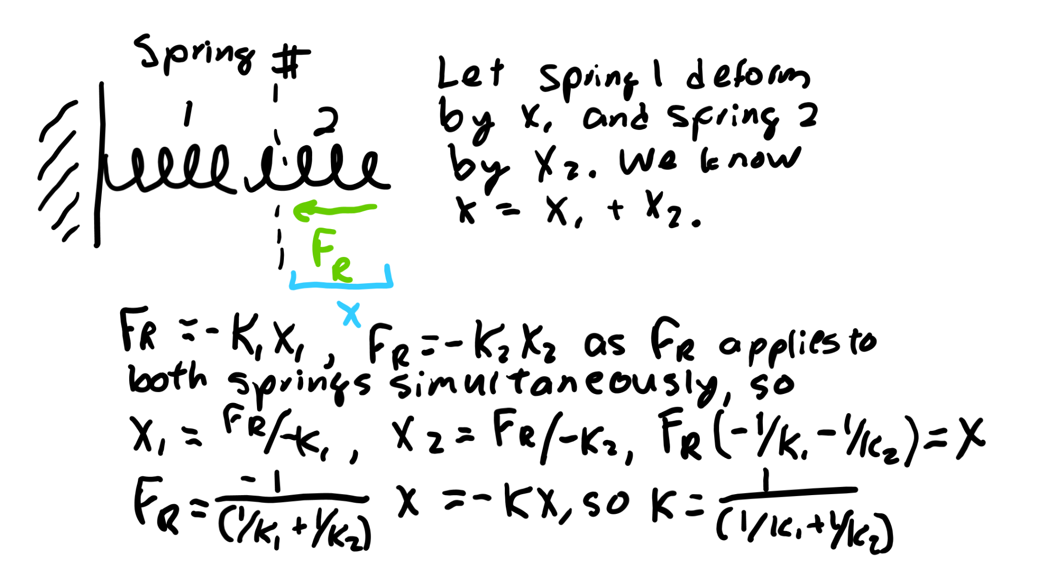
Springs in series
If you stack springs, they actually seem weaker than before because the “stretching” is distributed across more springs.
The formula for the new spring constant is k = 1/(1/k₁ + 1/k₂) which will always be smaller than k₁ or k₂.

Slide 7
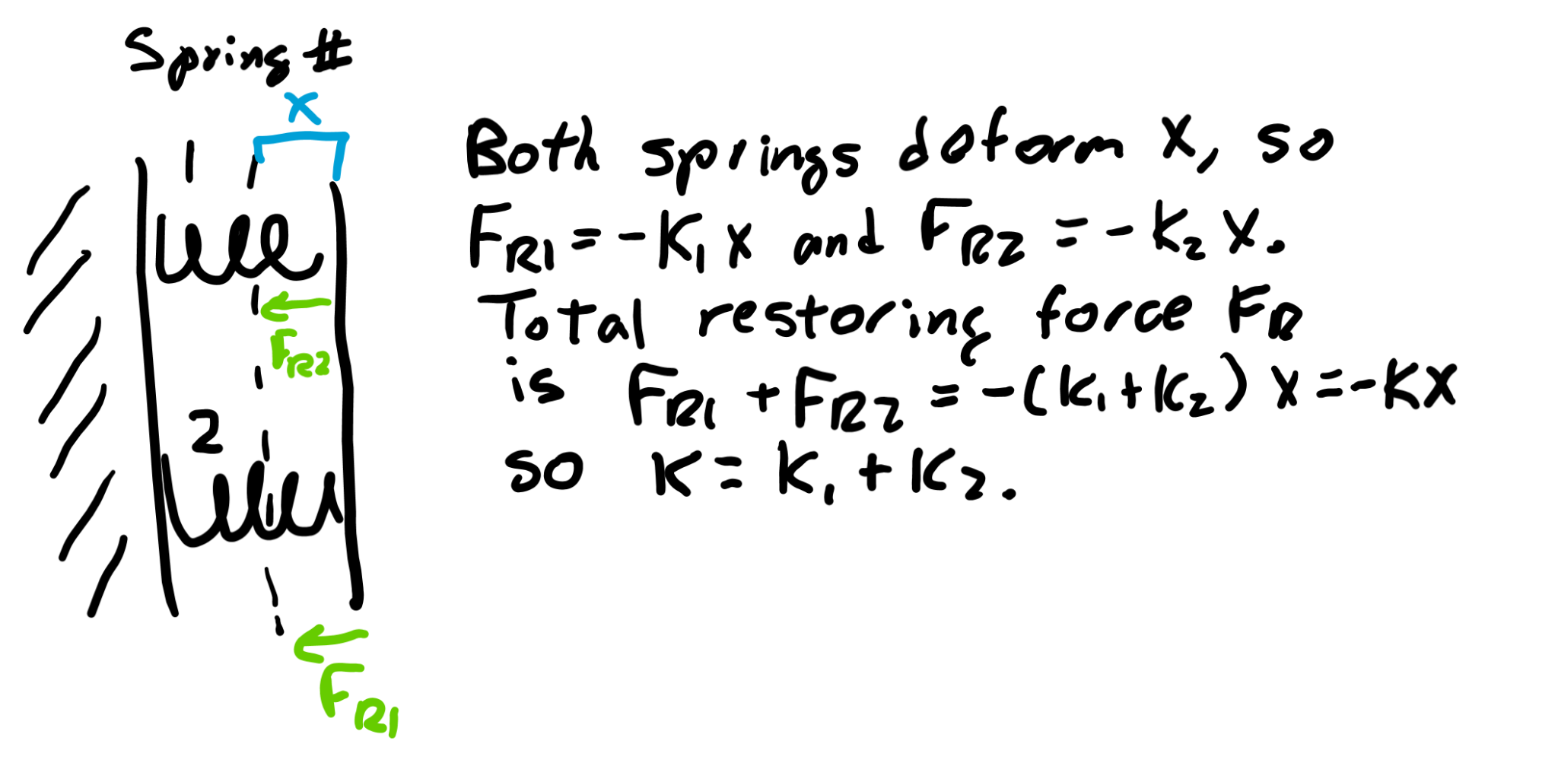
Springs in parallel
The more springs you attach to an object, the harder it is to displace that object as more springs pull.
Thus, the spring constant of the system is larger.
The formula is k = k₁ + k₂ for springs put in a row.

Slide 8
Spring potential

Slide 9
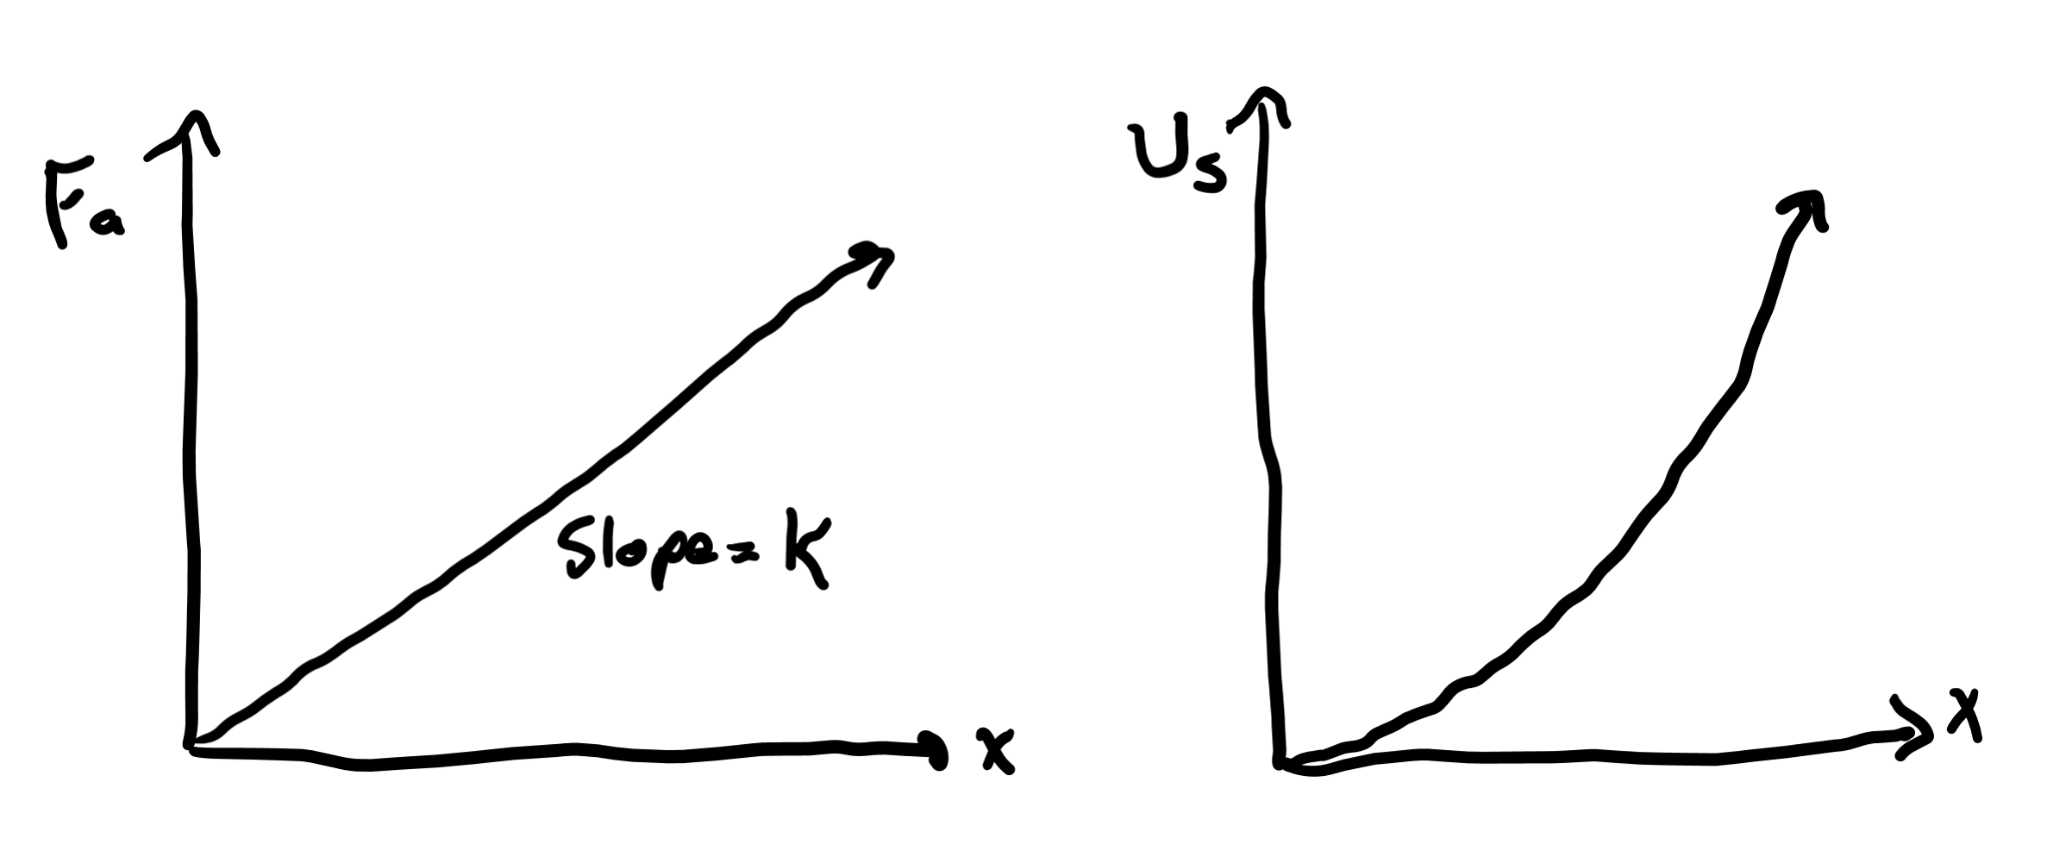
Force as you stretch the spring
As you stretch the spring over more and more distance, more and more force F_{a} =-F_{r} is involved to counteract F_{r}=-kx.
Thus, the work you apply increases as you keep stretching the spring.
The energy stored in the spring as a result of your stretching is called U_{s}, or spring potential energy.

Slide 10
Integrate Hooke’s law
Work is force applied over a certain distance, or in other words the integral of force with respect to distance.
The work to load a spring a distance x is thus the integral of Hooke’s law F = kx, or F = ½ kx².
Here it’s positive as F_{a}=kx is the force we need to counteract the negative restoring force to stretch/compress the spring.

Slide 11
Integral approach to work
For any force function with respect to distance, like F = 3x², the work applied is the integral with respect to distance, or W = x³+C.
If force is constant, then the integral W = ∫Fdx = Fx, or force times distance.

Slide 12
Conservation

Slide 13
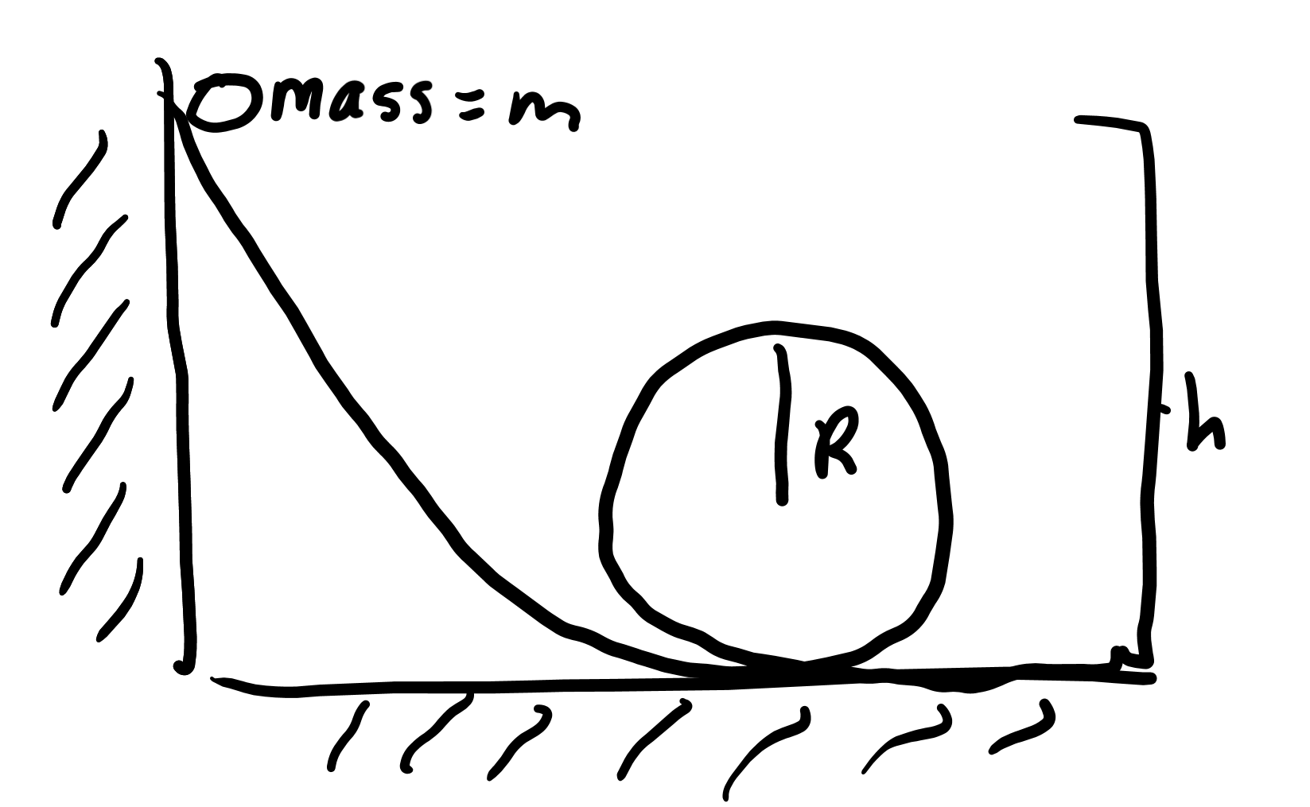
Classic energy conservation problem
If a ball of mass m is dropped off a height of h onto a ramp that goes in a loop de loop, what must be the radius of the loop in order for the ball to be able to complete the loop without falling?

Slide 14
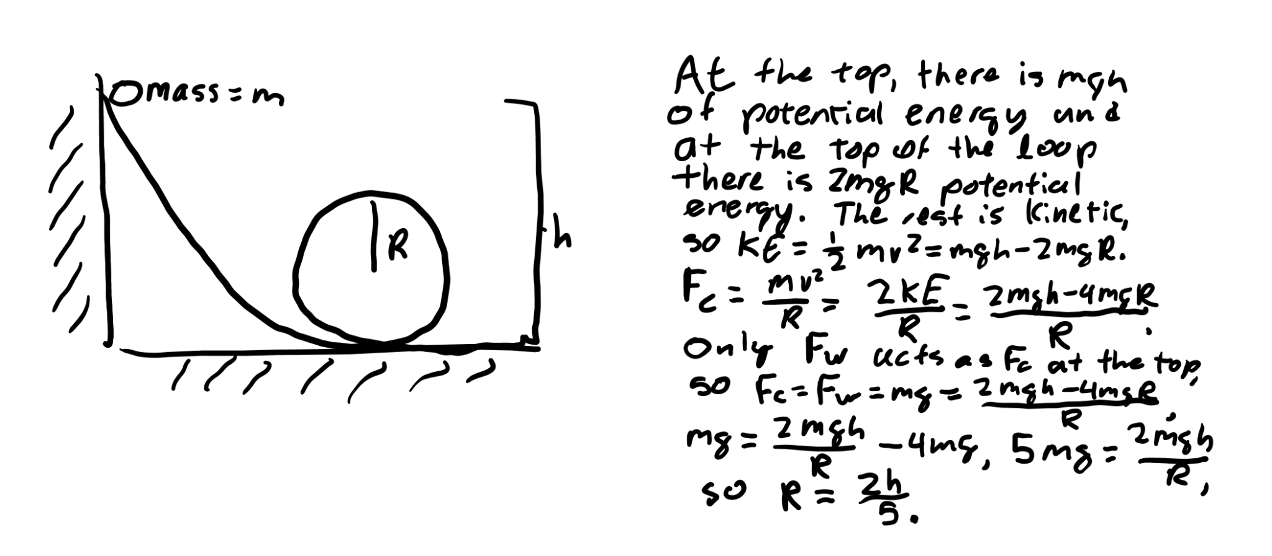
Solution

Slide 15
Momentum

Slide 16
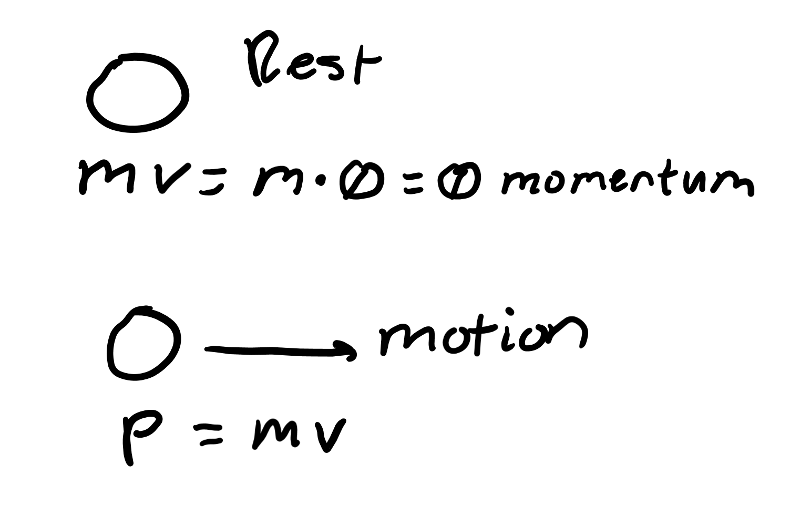
Moving inertia
Objects in motion wish to stay in motion.
The more motion they have, and the more mass they have, the more they wish to stay moving.
Momentum is this “moving” inertia, and is defined as m*v, or mass times velocity.

Slide 17
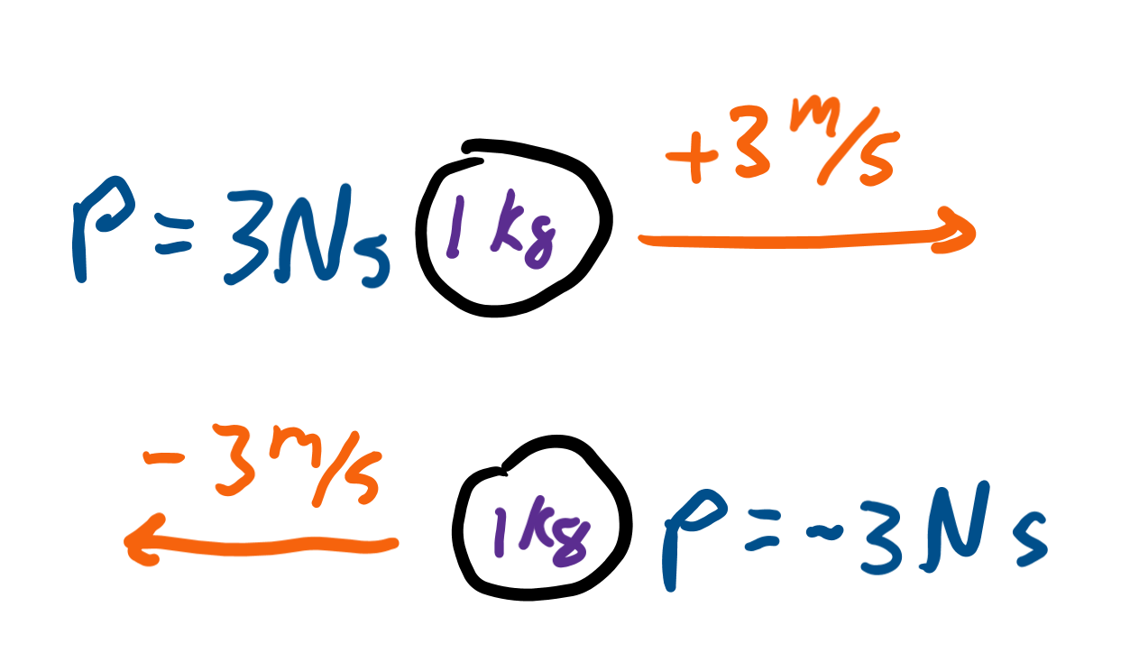
Vector
Momentum is a vector, meaning the direction of velocity is important as you have different momentum given a different direction of motion.

Slide 18
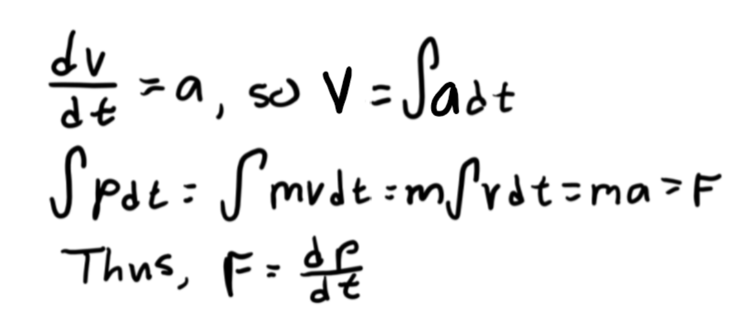
Momentum is force times time
We can rewrite mv as m∫a(dt) since a = dv/dt.
If a is constant, then this is mat = Ft, or force times time.
Thus momentum, represented as p, is also Ft when acceleration is constant.
If force is not constant, momentum is the integral of force with respect to time.

Slide 19
Integral definition
We can also integrate a force function with respect to time, like say F = 2t to get p = t²+C.
This is how we account for a non-constant force or acceleration.

Slide 20
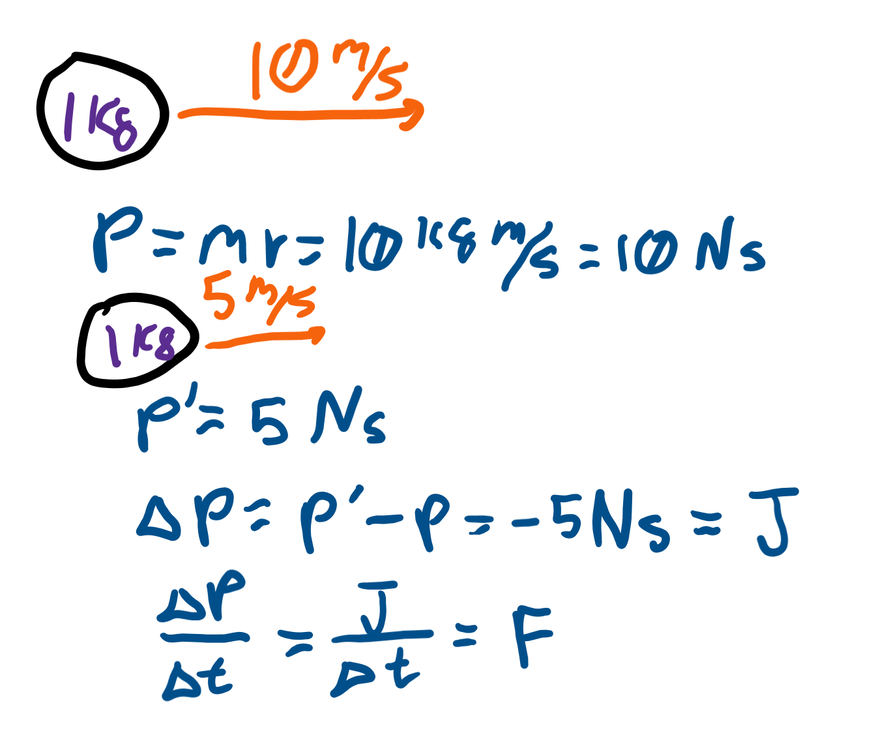
Impulse
Impulse is change in momentum and is represented by the letter J.
If we go from 10 Ns of momentum to 5 Ns of momentum in 5 seconds, impulse is -5 Ns.
Force is change in momentum over time, or impulse divided by time, so force is -1 N.

Slide 21
Newton’s second law
The most general form of Newton’s second law actually says F = dp/dt, or force is change in momentum over time.
Since momentum is mv, and mass is usually constant, this rearranges to F = mdv/dt = ma.
However, by writing F = dp/dt, this allows us to account for a non-constant mass, which makes it a more general form of the law.

Slide 22
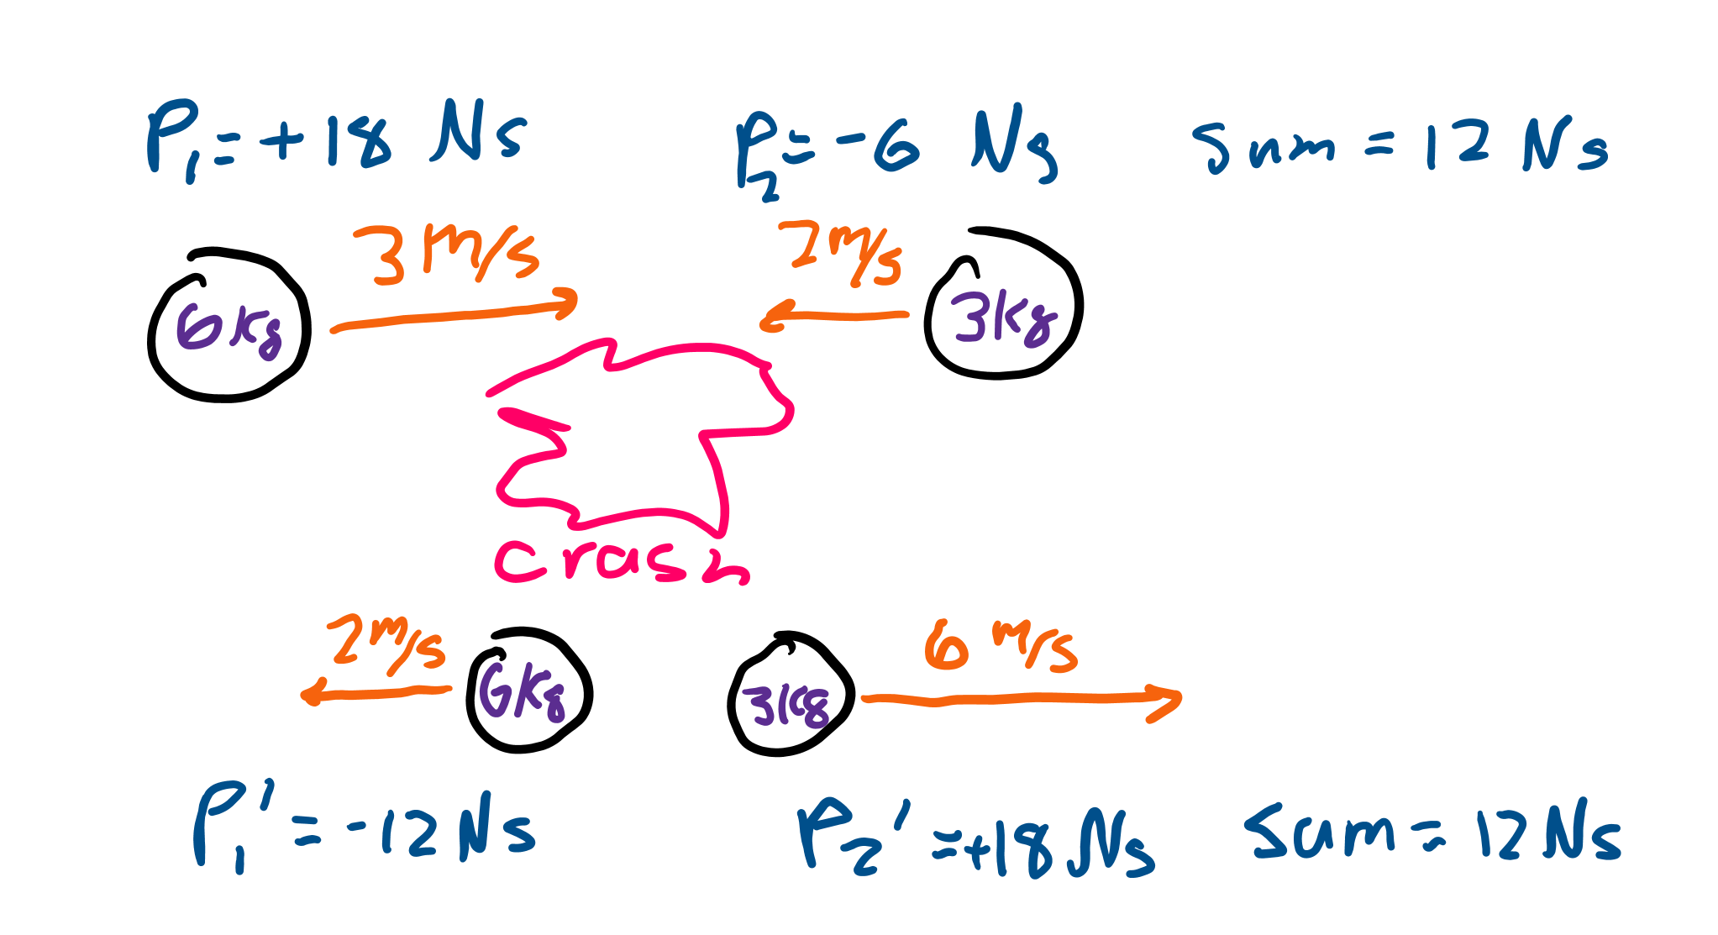
Conservation of momentum
Since change in momentum over time is force, if a system has no forces applied, the momentum should stay the same.
One instance of systems like this is a collision system.

Slide 23
Collisions

Slide 24
What are collisions
This is a way for multiple objects to interact while maintaining their momentums.
We will say initial momentums of each object are p_{i} for object i and the final momentum is p_{i}’.
In collisions, multiple objects will collide with each other, and their velocities may change while the total momentum of the system is constant.

Slide 25
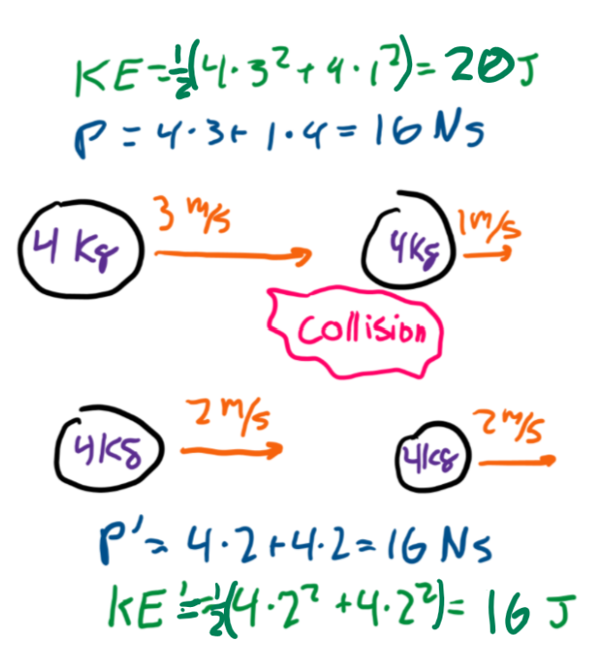
Inelastic
Most collisions are inelastic meaning objects will lose KE after colliding, but momentum will still remain the same.
The reason they lose KE is because friction acts on objects as they collide, turning KE to heat.
p₁+p₂=p₁’+p₂’.

Slide 26
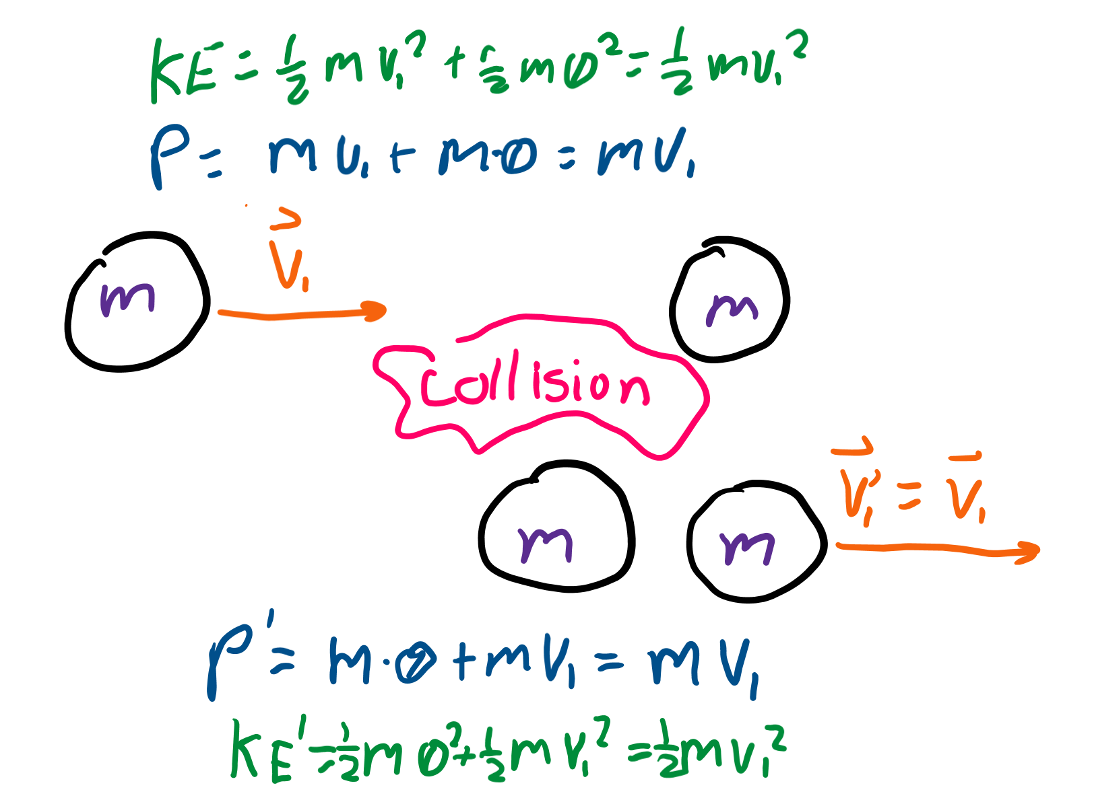
Elastic
An elastic collision means that not only is momentum conserved, but KE is as well.
These are elastic, as objects do not stick to each other, but bounce off each other after hitting.

Slide 27
Equations for elastic collisions
p₁+p₂=p₁’+p₂’ AND KE₁+KE₂=KE₁’+KE₂’.
Rearranging gives v₁+v₁’=v₂+v₂’.
There’s also a nice formula that gives each final velocity: v₁’=(m₁-m₂)v₁/(m₁+m₂) + (2m₂)v₂/(m₁+m₂)
v₂’=(2m₁)v₁/(m₁+m₂) + (m₂-m₁)v₂/(m₁+m₂)

Slide 28
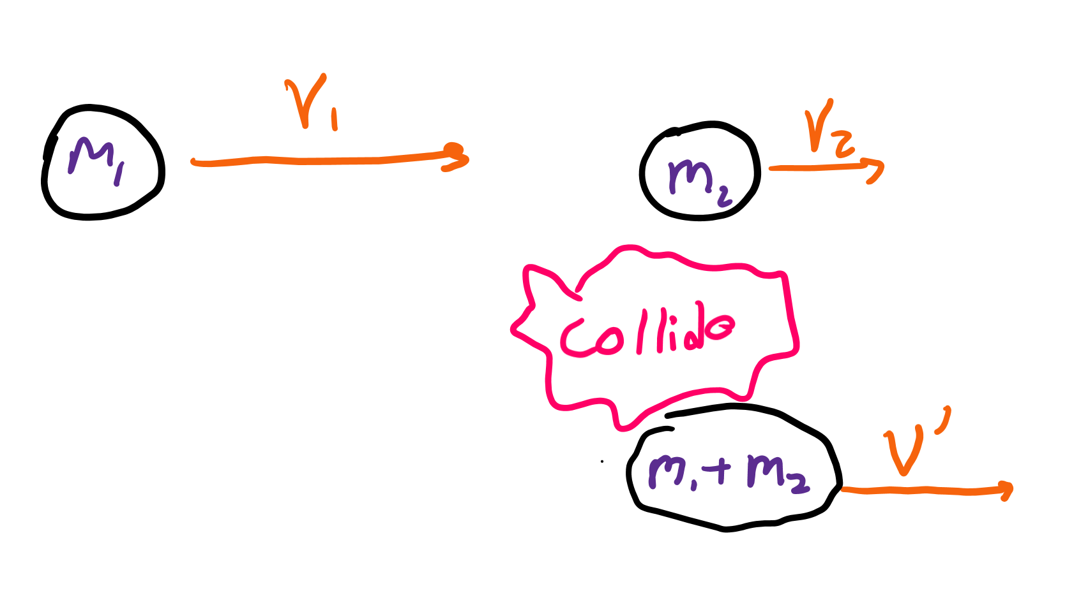
Perfectly inelastic
This is where colluding objects stick to each other, which means that the sum of momentums of the two objects p₁+p₂ turns into p_{1,2}, the momentum of the new object with combined mass of object 1 and 2.

Slide 29
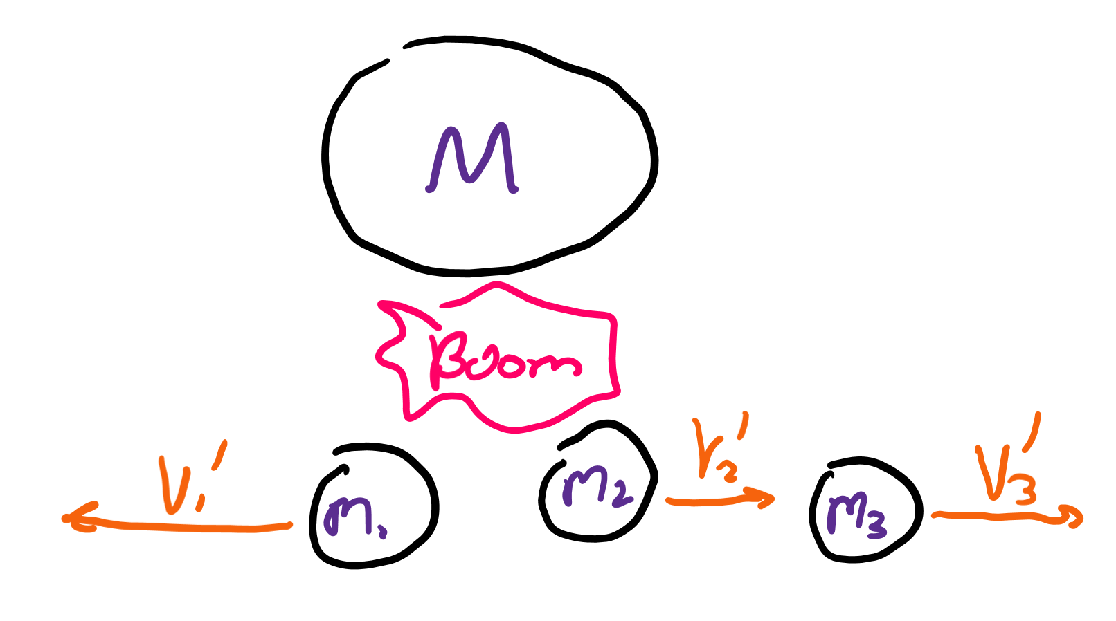
Explosions (not a collision)
This is the “opposite” of a perfectly elastic collision where one object of momentum p_{1,2} splits into two (or more) objects with momentum p₁ and p₂.

