Slide 1
Mechanics

Slide 2
Labs

Slide 3
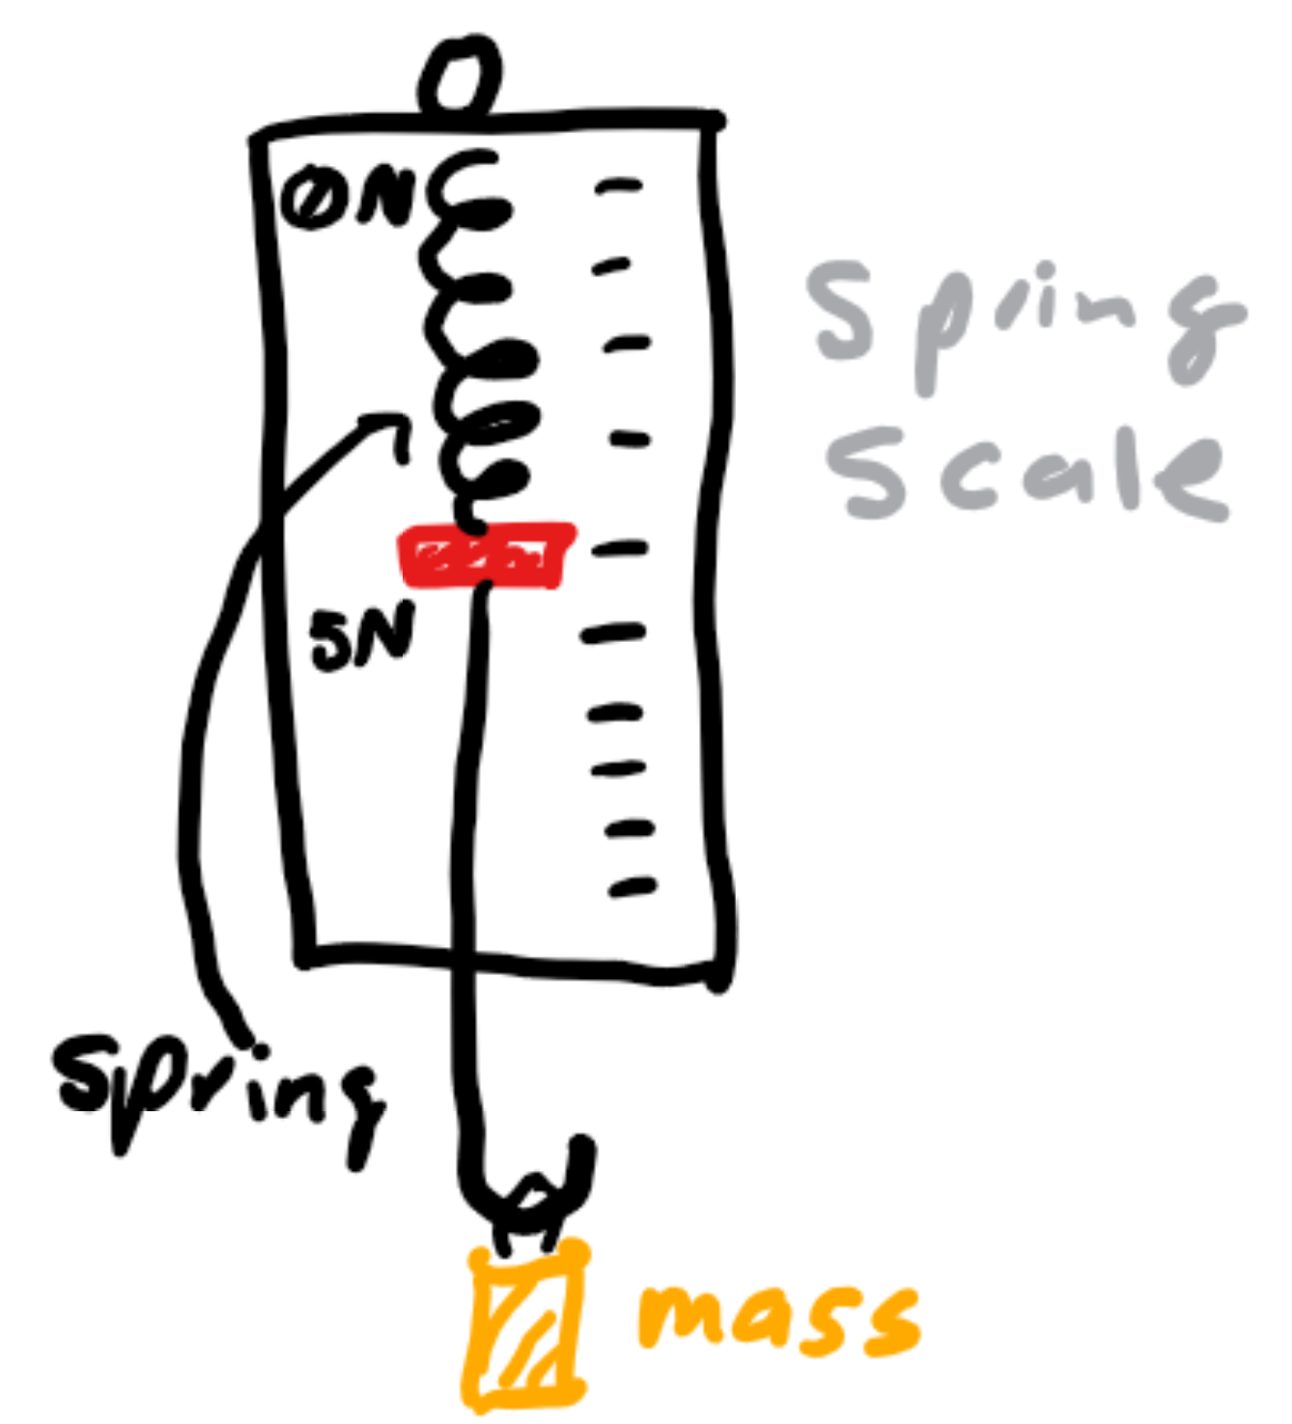
Tools commonly found in a lab
Distance: meter stick
Time: stopwatch
Mass: scale or objects of specified masses
Angle: protractor
Force: spring scale (a spring scale has little markers on the side so you can see how many Newtons of force you’re applying -- it uses F = -kx to find this force given how much you displace the spring)

Slide 4
What is a lab question
These kinds of questions force you to investigate certain topics and write equations yourself to determine something
Your measurements will usually be the base units: kg, m, s, and you will want to determine what tools you need to measure these items in particular
Then, you must assign each measurement a variable name and write equations to solve for a particular variable or constant

Slide 5
Error analysis

Slide 6
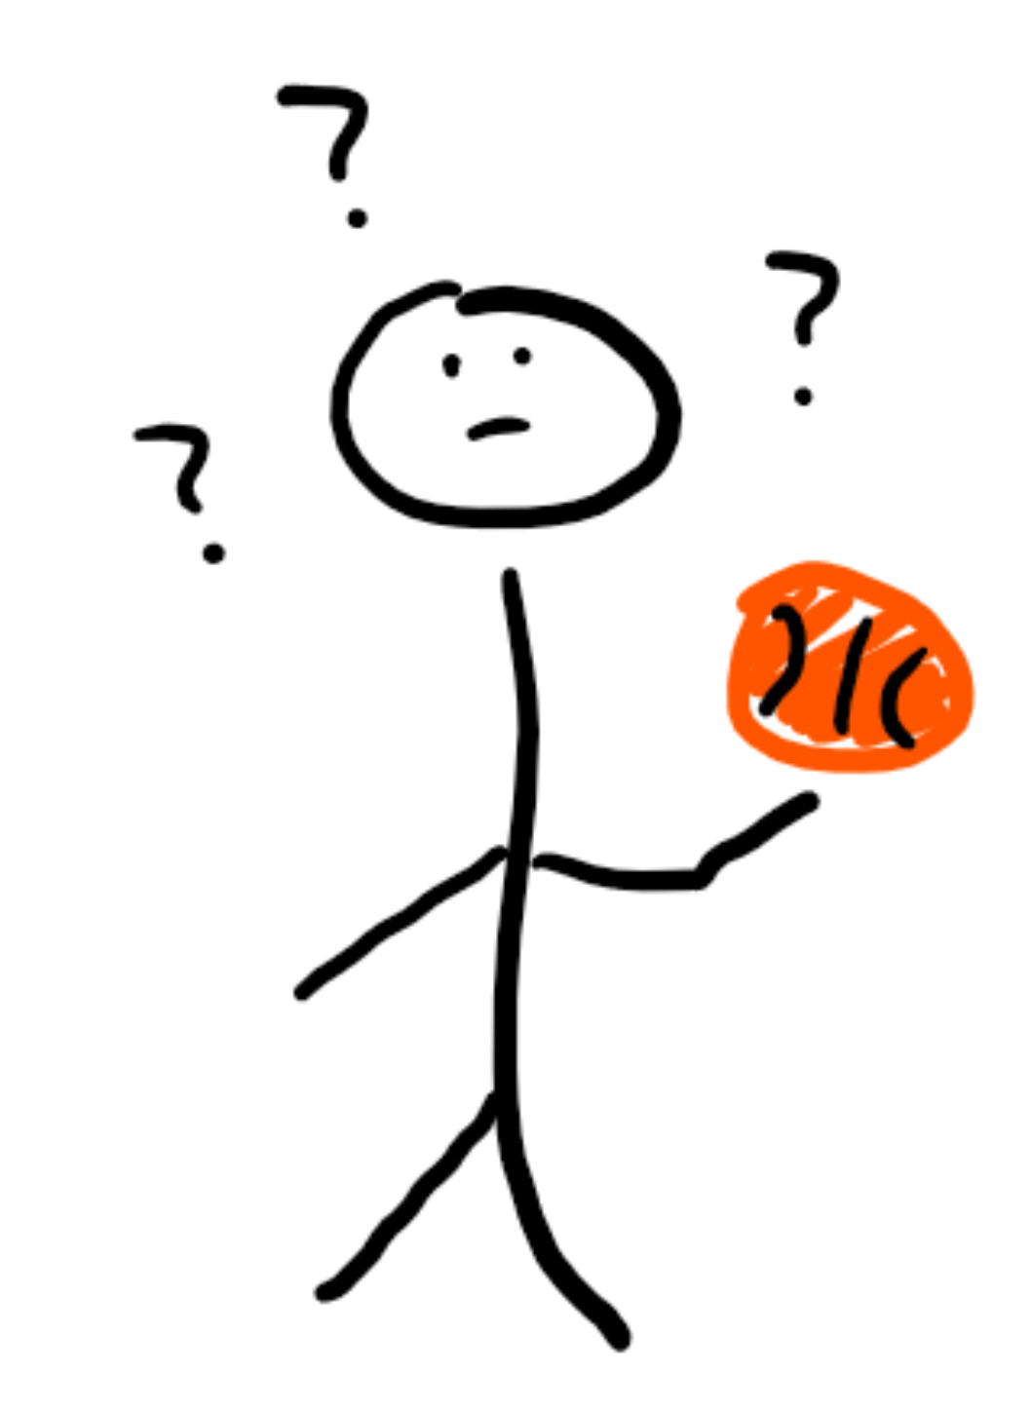
Kinematics
You believe, since you are much higher than sea level, the gravitational acceleration of where you live is different than the generally accepted 9.801 m/s².
Given that you have access to a basketball, what tools commonly found in a lab setting could you use in order to determine the gravitational acceleration of the location you are in?
Write equations that take into account the measurements you would make in order to find the gravitational acceleration.

Slide 7
Solution
This one is simple: you would need a stopwatch and a meter stick to measure the time, t, it takes for the ball to fall a distance, d.
The equation is just one of the kinematics: d = ½ at² for free fall, and since the only acceleration on the object is gravity, then we know d = ½ gt², so g = 2d/t².

Slide 8
Eror analysis
However, your lab assistant forgot to tell you that your stopwatch was actually off and would consistently add 0.1 seconds to the final reading.
Would this error cause you to overestimate, underestimate, or not affect the measurement of the true value of g in your location?
To answer this kind of question: since we know g = 2d/t², the stopwatch would cause you to overestimate t, so it would cause you to underestimate g.

Slide 9
How to analyze errors
Error analysis questions can be answered with two simple steps
Let’s say the thing we’re trying to solve for can be given by the equation abc/(def)
The first step is determining if the error affects the numerator (variables a, b, c) or the denominator (variables d, e, f)
The second is seeing if your error overestimates or underestimates: an overestimated numerator or underestimated denominator means the overall thing is overestimated while underestimating the numerator or overestimating the denominator will result in underestimating the thing you’re looking for

Slide 10
Procedure questions

Slide 11
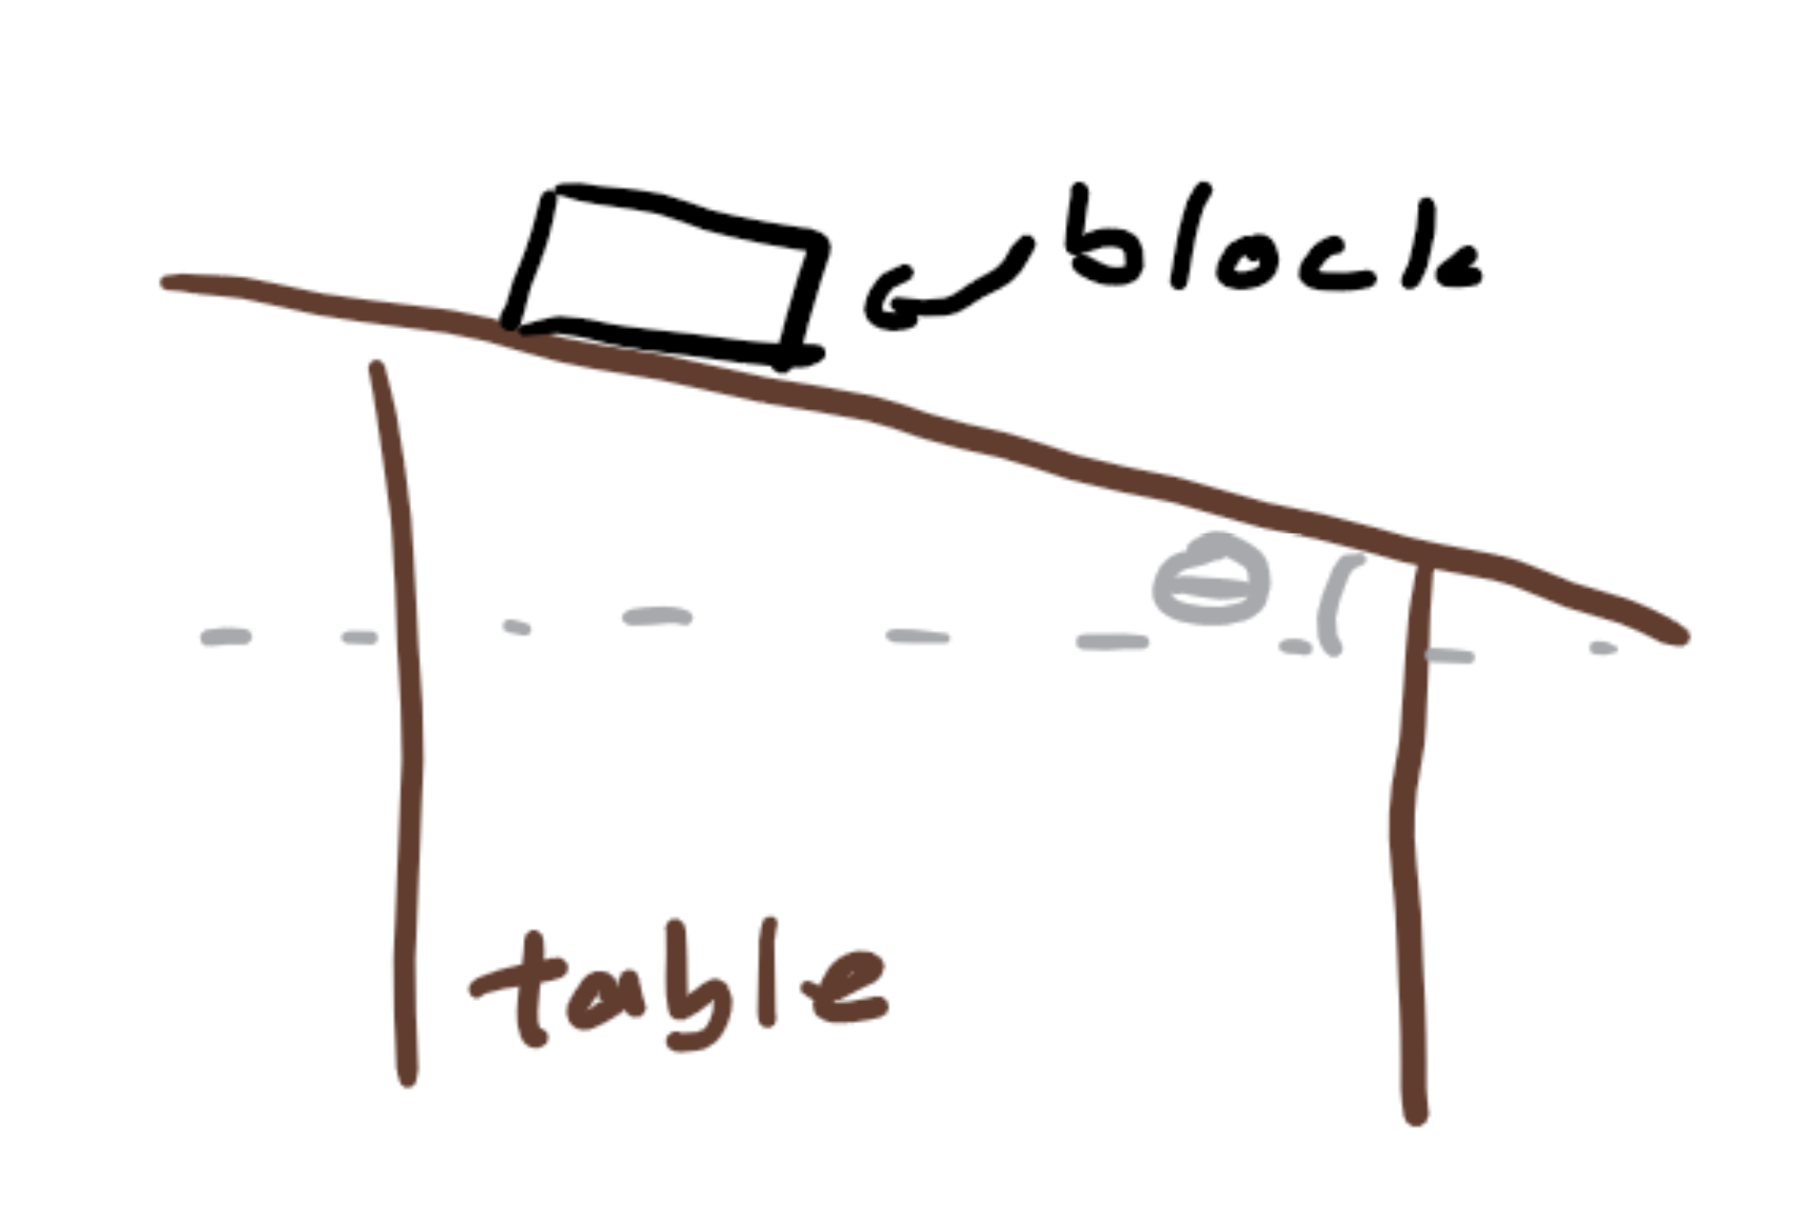
Newton’s laws
In the last lab it turns out we don’t live too far from sea level, so the gravitational acceleration was around g = 9.801 m/s².
However, through the entire lab the silicone block you used to hold the basketball kept slipping off the table.
You noticed that you can change the angle on the rubber table, so using the table, block, and any other tools found in a lab, write a procedure that will let you find the maximum coefficient of static friction between the silicone and rubber.

Slide 12
Solution
This question is a little different because it asks for a procedure.
We know that the coefficient of static friction changes based on how much force you apply to an object, so to find the maximum, we need to find a point where we’re applying a force just below the amount that would get the object moving: thus, we should angle the table up just before the block slips and measure the angle θ.
We know that the coefficient of static friction, , is counteracting the gravitational force pulling the block down, so f = mgsin(θ), and f = μ_{s}F_{N} = μ_{s}mgcos(θ), where μ_{s} is the maximum static friction. so set those two definitions of f equation and you get μ_{s} = mgsin(θ)/[mgcos(θ)] = sin(θ)/cos(θ) = tan(θ).
Instead of doing all that work though, it would be cool if you just said μ_{s} = tan(θ) because you remembered this equation.

Slide 13
Procedures
Note when we solved the procedure question before, what we did was first say the steps we needed to do -- often, a bullet point list is a good step to organize your thoughts.
However, you must also identify all measurements you must take, the tool you used, and the variables you assigned: in the previous question, we measured the angle the table was tilted, θ, using the protractor.

Slide 14
Using hints

Slide 15
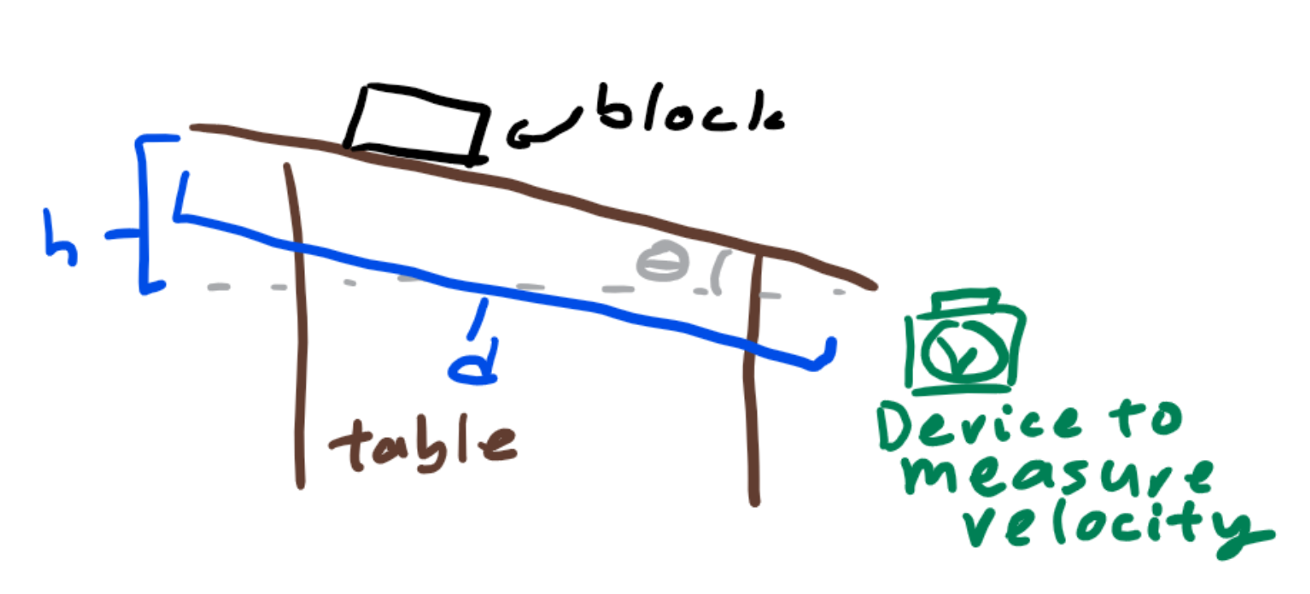
Work and energy
When you angle the table a little higher, you realized that you might be able to compare the potential energy at the start and the kinetic energy at the bottom of the ramp to find out how much kinetic friction acted on when the silicone block slides down the rubber table.
You asked your lab to loan you a device that allows you to measure velocity of objects (yes these exist and are super cool) to write your procedure and equations in order to find the coefficient of kinetic friction on the object as it slides down the table.

Slide 16
Solution
Again, we have to write a procedure: we will tilt the ramp such that the block slides down. Use a protractor to measure the angle, θ, Use a scale to measure the mass, m, of the block. Then, we will use a meter stick to measure the height from which our block will slide down, h. Then, use the meter stick to measure the distance the block travels down the ramp, d. Finally, as soon as the block reaches the bottom, use the velocity measuring device in order to find the velocity, v, of the object.
At the top of the ramp, there is only potential energy: mgh. However, as the object rolls down the slope, this potential energy is converted into kinetic energy, ½ mv², and internal energy. If friction is represented as f, then internal energy is fd. Thus, mgh = ½ mv² + fd, so we can rearrange to get f = (mgh - ½ mv²)/d. Since f = μ_{k}F_{N} = μ_{k}mgcos(θ), μ_{k} = (mgh - ½ mv²)/[dmgcos(θ)].

Slide 17
Hints
Some problems are really difficult, so the problem itself might actually give you some hints along the way: in this case, you got a device used to measure velocity, so you know that velocity must be involved.
However, the problem also said to note the potential energy before the block is dropped and the kinetic energy after the block ends up at the bottom of the ramp, so you know you need mgh, so mass and height, and you need ½ mv² -- aha, a use for the velocity measuring device.
Since you are asked to find friction, and you know μ_{k}mgcos(θ), we need θ.
Finally, as energies are involved, you know that this problem must be a conservation of energy problem, so some equation revolving around conservation of energy must be written.

Slide 18
Drawing diagrams

Slide 19
Linear momentum and systems of particles
After your trials, you decide to put the block away. However, you drop it straight down and the block of mass m breaks into three equal pieces. Two go to the right and one goes to the left.
The velocity device captures the velocity, v, of one of the pieces going to the right and you assume the other piece also travels to the right at the same velocity.
Write an equation for the velocity of the piece going to the left.
The piece going left maintains that velocity you calculated and hits a ramp made of rubber, which you know has the same coefficient of kinetic friction on the block, μ_{k}, as the table.
Given that the ramp is angled at π/6 radians, draw a diagram of forces on the block as soon as it hits the ramp. If the block travels a bit up the ramp and then comes to a stop, draw a free body diagram of the block at that point on the ramp.

Slide 20
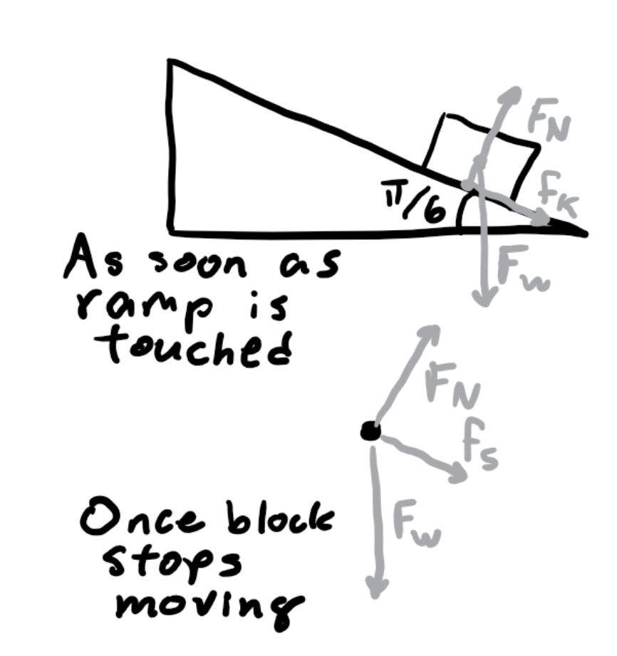
Solution
The first part is a conservation of momentum question. Since the block is dropped straight down, the momentum to the right must equal that to the left.
Thus, the velocity of the block to the left must be 2v since there are two blocks of mass m/3 travelling to the right at speed v and only one travelling left with mass m/3.
The diagrams are drawn on the right.

Slide 21
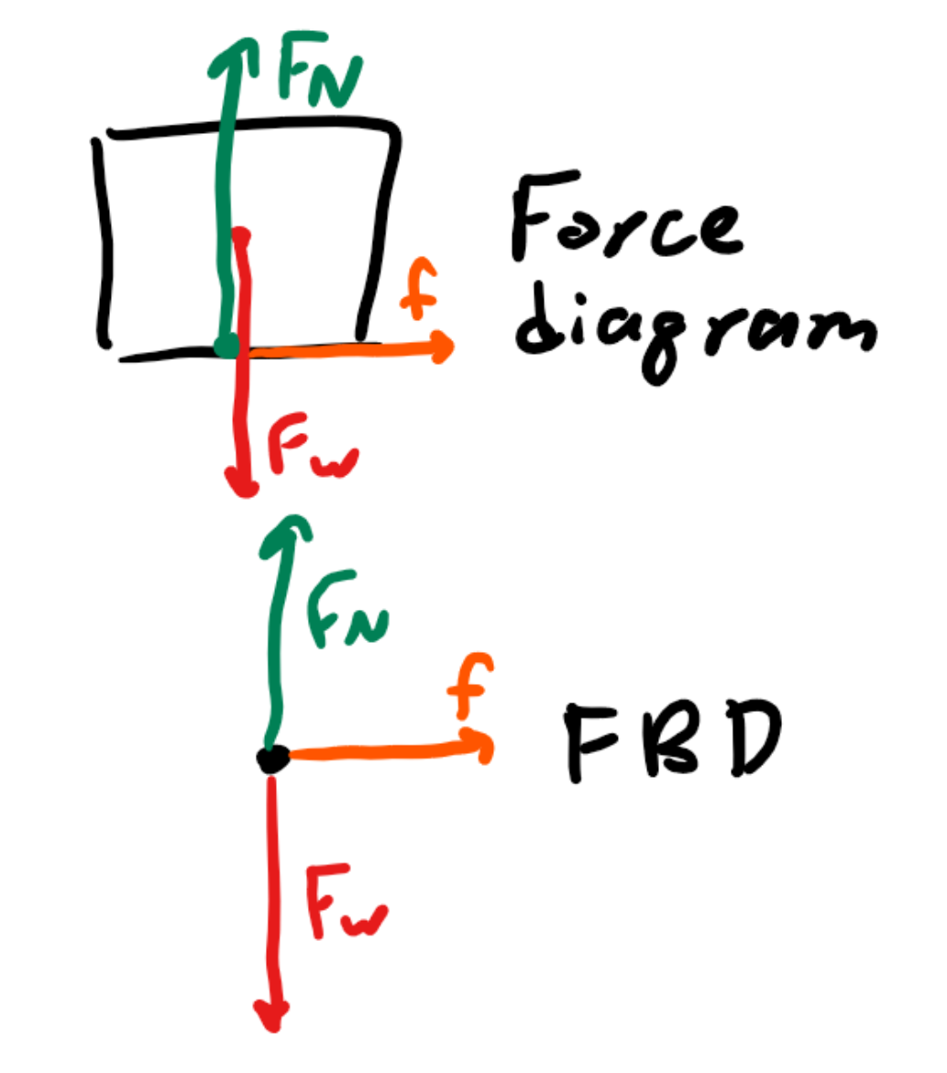
Diagrams
Note that for the forces diagram, gravitational force (weight) acts on the center of mass of the block, the normal force happens between the surfaces, perpendicular to both of them, and the friction force acts between the surfaces but parallel.
However, on the free body diagram (fbd) none of that matters as we assume the object to be a point so all forces are extending out of that point.

Slide 22
Differential equations

Slide 23
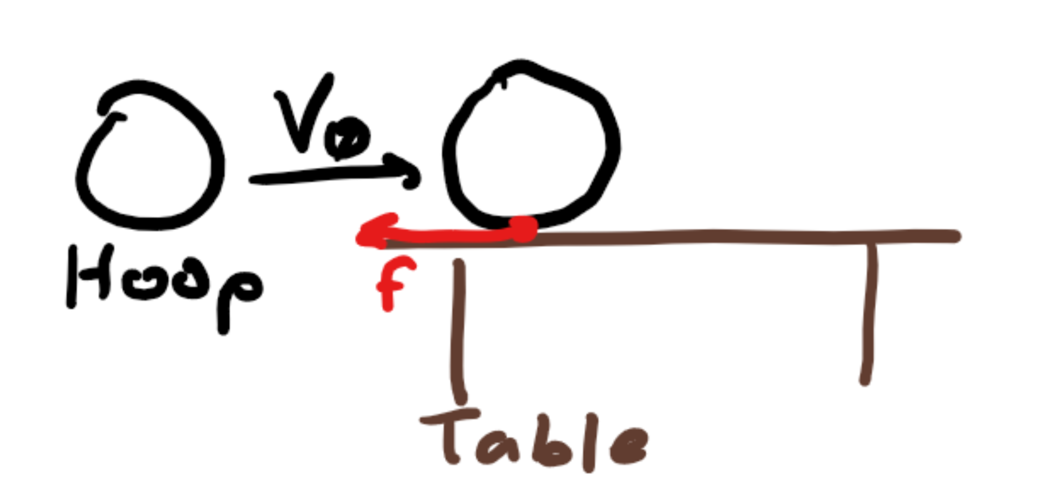
Rotational dynamics
After cleaning up and setting the table flat again, you decide to have a little fun.
Then use either Newton’s linear or rotational second law to write and solve a differential equation for the linear velocity with respect to time of the tube until it stops slipping.
You linearly throw the tube, at a velocity v₀ with moment of inertia mr² where m is the mass of the tube and r is the radius, made of silicone across the rubber table, so you know μ_{k} and μ_{s} from previous problems.
The tube slips on the table for a while before it starts rolling without slipping.
Identify the type of frictional force that allows the tube to roll.

Slide 24
Solution
This is a very challenging question, but let’s try to make sense of the situation: there’s a tube that first travels linearly on the table. However, some force, likely friction, acts on the object, causing it to roll.
If we want to find the linear (slipping) velocity, then we should use the linear second law, in other words F = ma, or a = F/m, or dv/dt = F/m.
We know the force acting on the object is some form of friction, causing the linear velocity to decrease but the object to roll. As there is linear velocity, the friction involved must be kinetic friction -- thus we have identified the force.

Slide 25
Differential equation
To set up the differential equation, we know that friction is slowing down the linear velocity, so F = f_{k} = -μ_{k}F_{N} = -μ_{k}mg, so dv/dt = -μ_{k}mg/m = -μ_{k}g. Note the negative as friction should decrease linear velocity.
Thus, our differential equation is dv/dt = μ_{k}g. To solve it, we rewrite it to dv = -μ_{k}gdt, and integrate both sides to get v(t) = -μ_{k}gt + C for some constant C. We can let C represent the initial velocity v₀, so v(t) = v₀ - μ_{k}gt, which should make sense intuitively as the linear velocity is going to keep decreasing as a function of friction on the object.
However, you should find the fact that mass and moment of inertia don’t matter as the frictional force is only dependent on the coefficient of friction which is calculated between materials.

Slide 26
Interpreting graphs

Slide 27
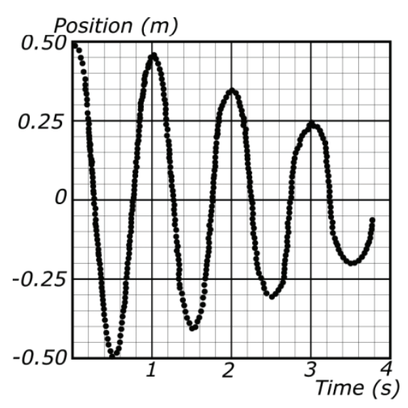
Oscillations
Slowly you realize everything around you is physics. There is no escape.
You grab one of those force spring scales and attach a mass to it. You let it drop to equilibrium, and read 19.6 N are applied to the spring scale.
You decide to compress it from equilibrium up 0.5 meters and graph its motion as it bobs up and down and up and down.
Given the graph, determine the magnitude of the maximum velocity of the mass. Then, use that to determine the spring constant k.

Slide 28
Solution
We can read the position vs time values on the graph, but we also know something else.
At t = 0.22 s, position is at equilibrium, so that must be where velocity is maximized. The slope of the line passing through (0.25 m, 0.2 s) and (-0.25 m, 0.4 s) is approximately the instantaneous slope at t = 0.22 s. Rise over run tells us that slope is 0.5/-0.2 = -2.5 m/s. As the slope of a position vs time graph gives velocity, our maximum velocity has magnitude 2.5 m/s.
To relate velocity with spring constant, we know that maximum spring potential energy equals maximum kinetic energy since one is maximized when the other is zero. We know maximum spring potential energy is ½ kx² where x = 0.5 m since that’s how far we deformed initially (we want to use earlier measurements since the graphs indicate energy loss due to resistive forces as time goes on) and maximum kinetic energy is ½ mv² where mg = 19.6 N, so m = 2 kg.
Thus, k = mv²/x² = [(2 * 2.5²)/0.5²] N/m = 50 N/m.

Slide 29
Interpreting graphs
There are only three things a graph can tell you: the reading you see directly on the graph, the slope at any point on a graph, and the area under a graph.
You always want to keep in mind these three things. In this case, we used the reading we saw directly on the graph and the slope of the graph, but consider why we didn’t use the area under the graph.
After all, why should we, the area under the graph represents the integral of position with respect to time time, which doesn’t mean anything. If it were a velocity vs time graph, the area under the graph would represent the integral of velocity with respect to time, or position.

Slide 30
Challenging preconceptions

Slide 31
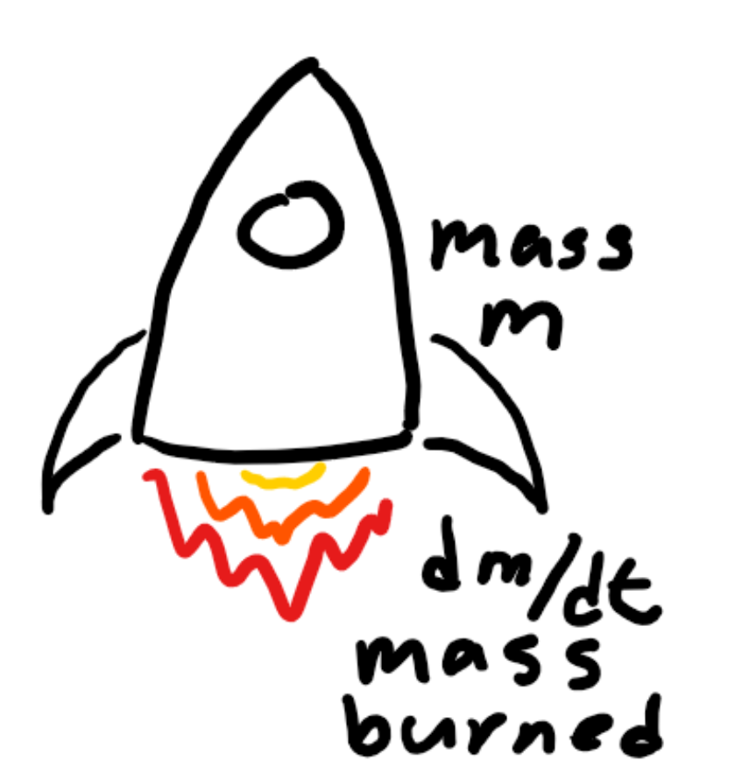
Gravitation
You’ve had enough of physics so you decide to go on a rocket and leave earth.
You want to maintain a constant velocity, v, as you leave earth with decreasing gravitational force F.
Your rocket is powered by burning some mass of fuel dm over a period of dt.
First, write an equation relating F and momentum. Then, write but do not solve a differential equation describing the mass of the rocket at launch.

Slide 32
Solution
Now this problem may be hard, but it’s because it forces you to think about the equations you know in a different way.
Use the hint given to write that F = dp/dt where dp is change in momentum and dt is change in time.
Since p = mv, and you want to maintain a constant velocity v, dp = vdm, so F = dp/dt = vdm/dt.
The force you are opposing is gravitational force, so F = GMm(t)/R² where G is the gravitational constant, M is the mass of earth, R is the radius of the earth -- since the rocket is at launch and thus on the surface of the earth -- and m(t) is a function for the mass of the rocket over time.
The final equation is GMm(t)/R² = vdm/dt.

Slide 33
Challenging what you know
You know that F = ma = mdv/dt.
However, if you only focus on that, then you miss the other way you could write the equation: F = dmv/dt. It’s just mass often doesn’t change.
This equation didn’t just pop out of the blue though. Since it would be very difficult to notice, the problem included a hint: first write F in terms of momentum.
If you pay close attention to the hints, you can use your intuition to find out how to fit the puzzle pieces together: constant v but changing m when the equations you might have memorized may not help point you in the right direction.

