Slide 1
Thermnodymanics
Spleing hrad soryr

Slide 2
Intro

Slide 3
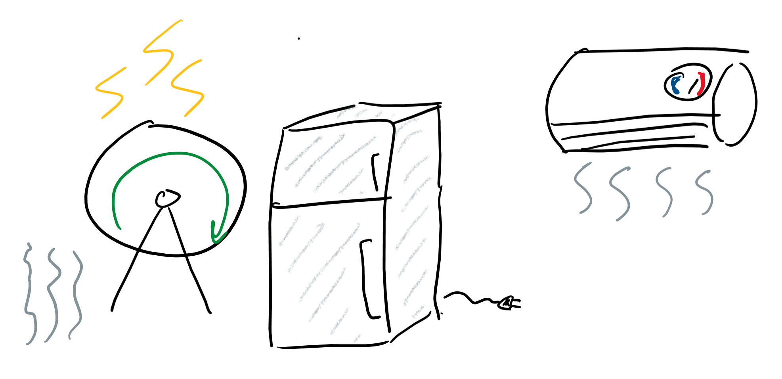
What is thermodynamics?
The study of:
Heat
Temperature
Energy

Slide 4
Kinetic Molecular Theory

Slide 5
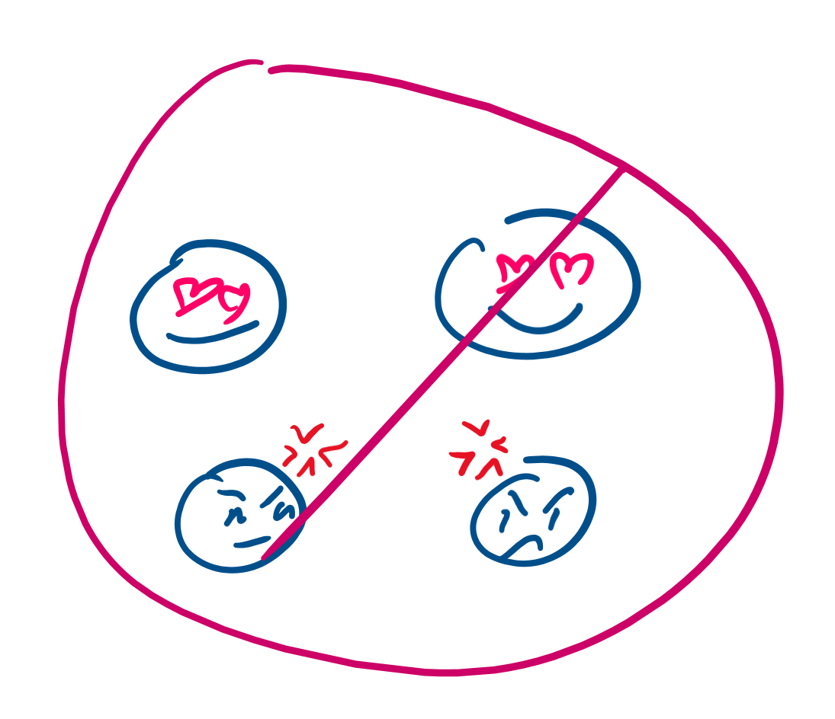
Gas particles do not attract or repel
Particles just vibe
No force pulls them together
No force pushes them apart

Slide 6
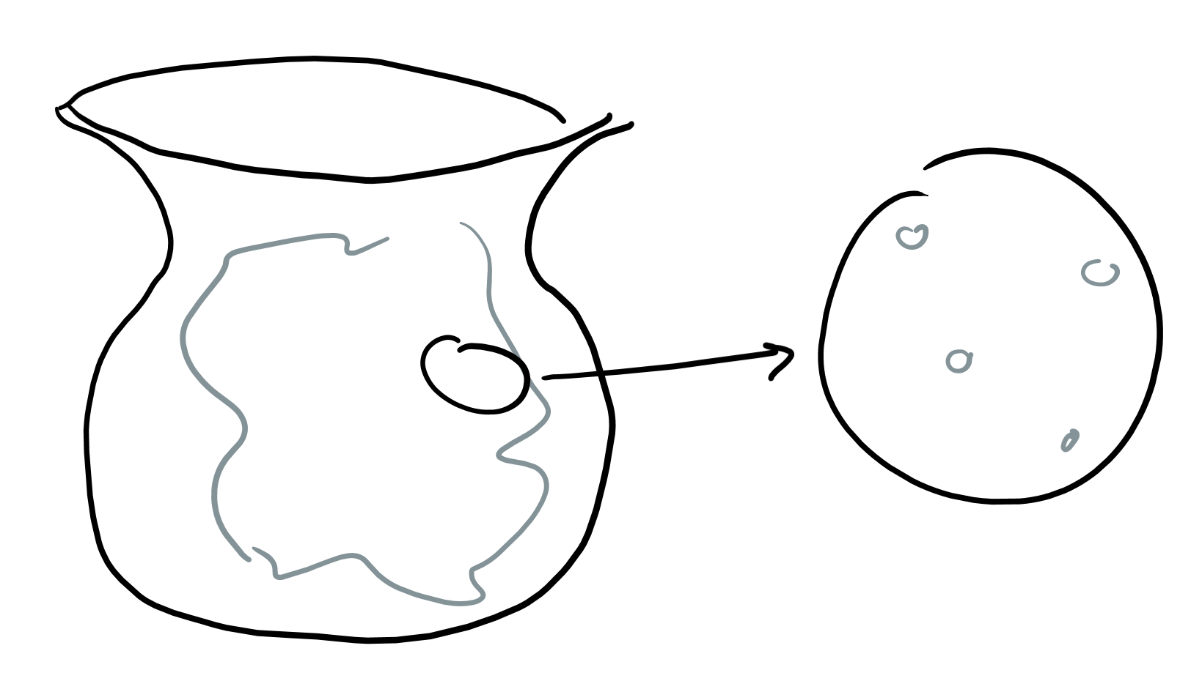
Most of the gas is empty space
Just like me, gasses are mostly empty
Empty space is liek nothing; nothing is there, no gasses, no particles, no more desire to study thermo, no nothing

Slide 7
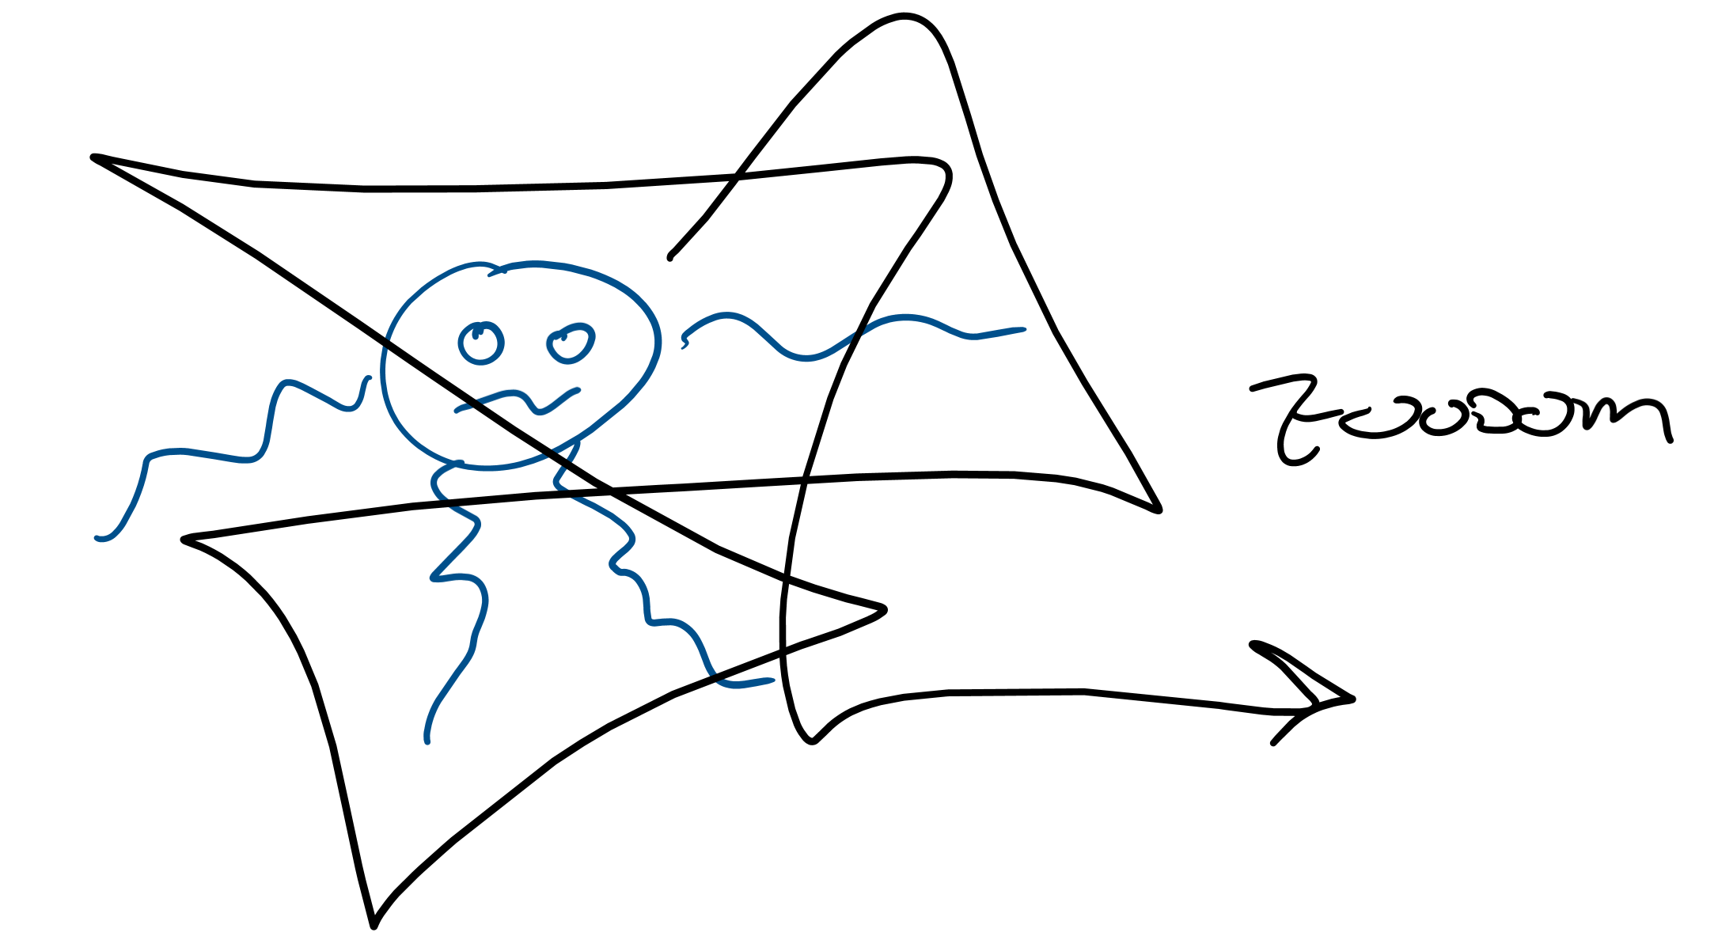
Particles in constant random motion
Never gonna give you up; never gonna let you down; but they’re gonna run around and desert you
Speedy
Zoom
They don’t stop movin’ movin’

Slide 8
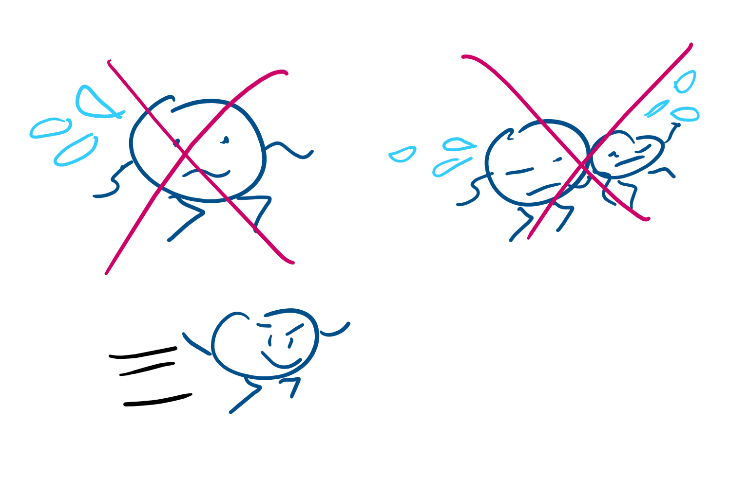
Collisions are perfectly elastic
Tl;dr, particles never get tired, even if they hit other particles
They keep moving, even if they bump into other particles, never slowing down
They just zoooom

Slide 9
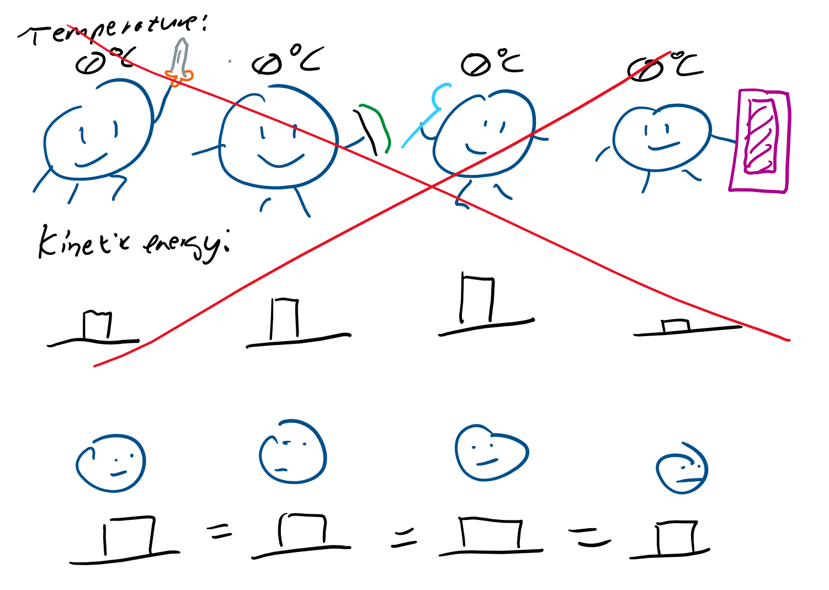
Same temperature means same avg. KE
At any given temperature, all particles have the same amount of kinetic energy (energy of motion)
You can’t have one particle more speedier than another, they’re all the same (communism moment)

Slide 10
Macro (large-scale) level

Slide 11
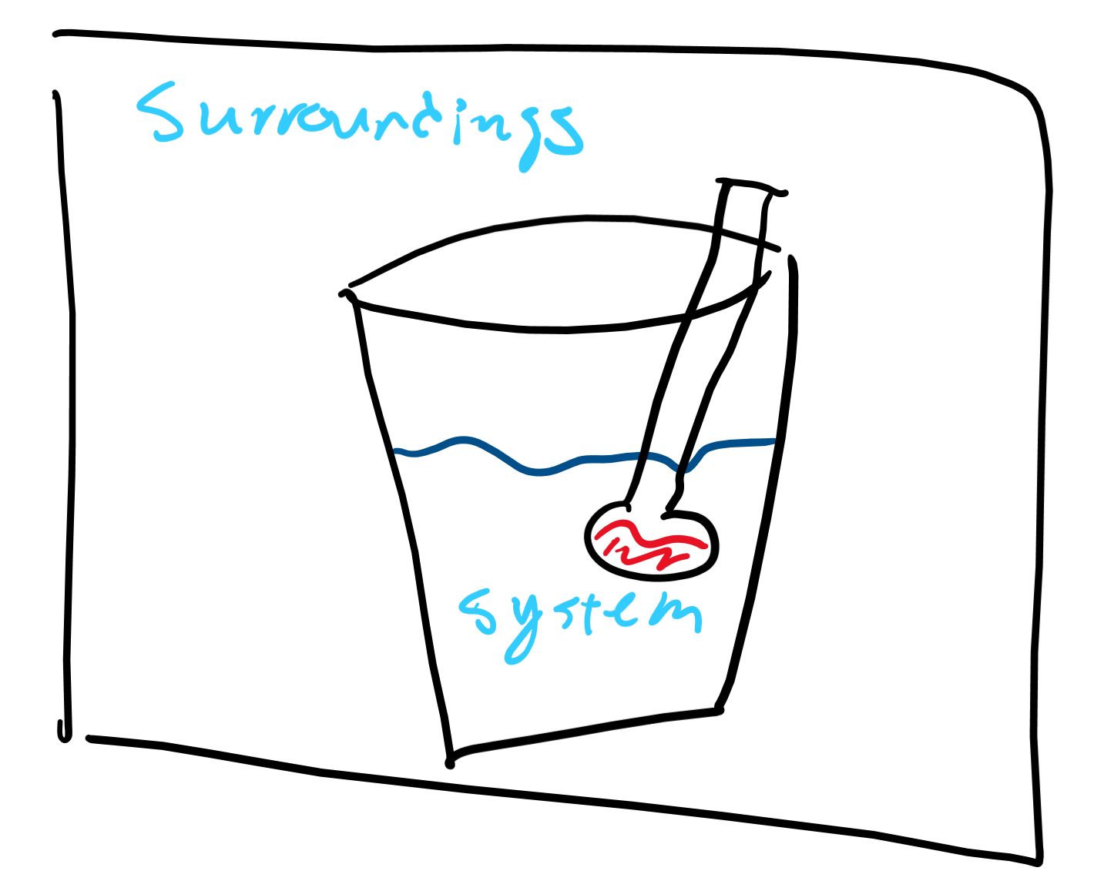
System vs Surroundings
System: the thing you’re measuring
Surrounding: literally everything else; whatever you’re not tryna measure

Slide 12
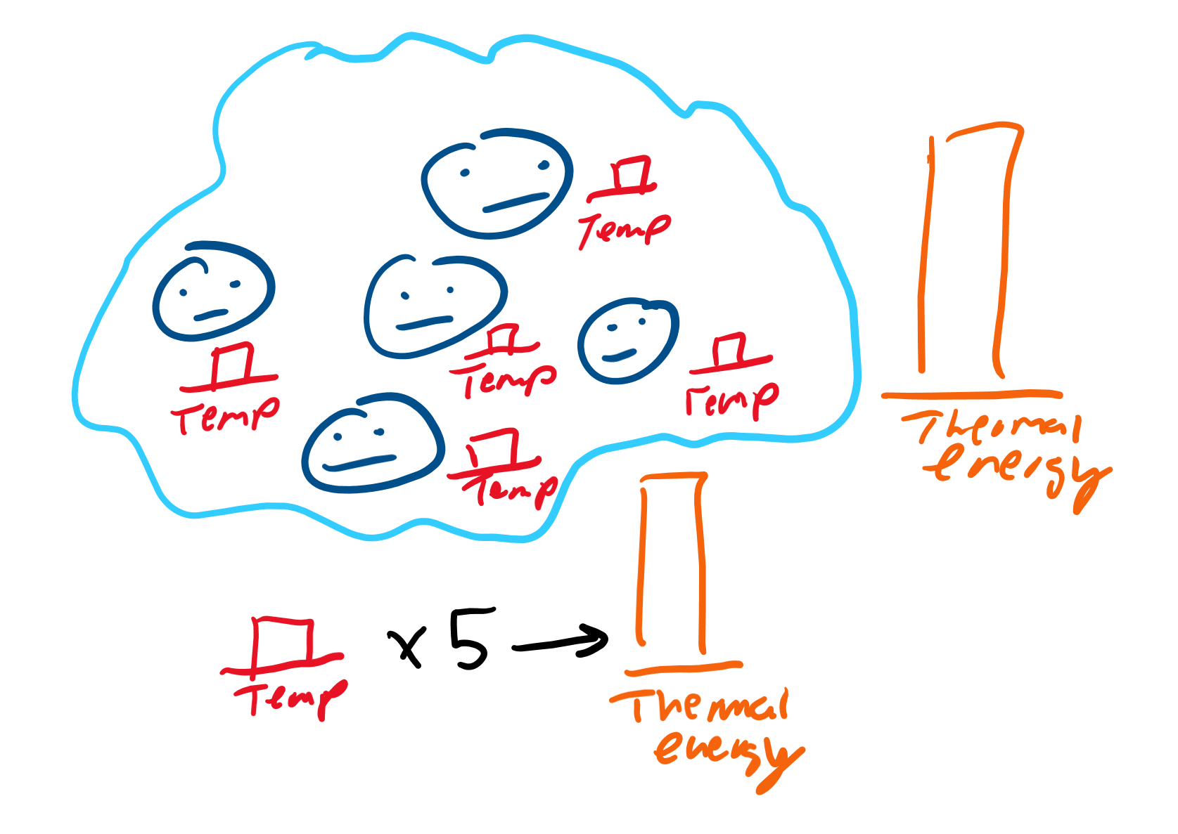
Temperature vs Thermal Energy
Thermal energy: The total amount of energy in a system The sum of the energy of all the particles in the system Depends on the mass of the system
Temperature: The average kinetic energy of a system

Slide 13
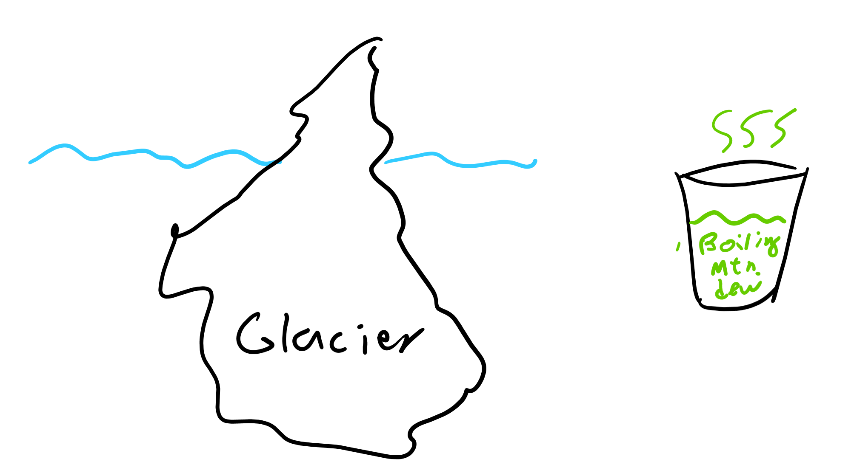
Which has more thermal energy?

Slide 14
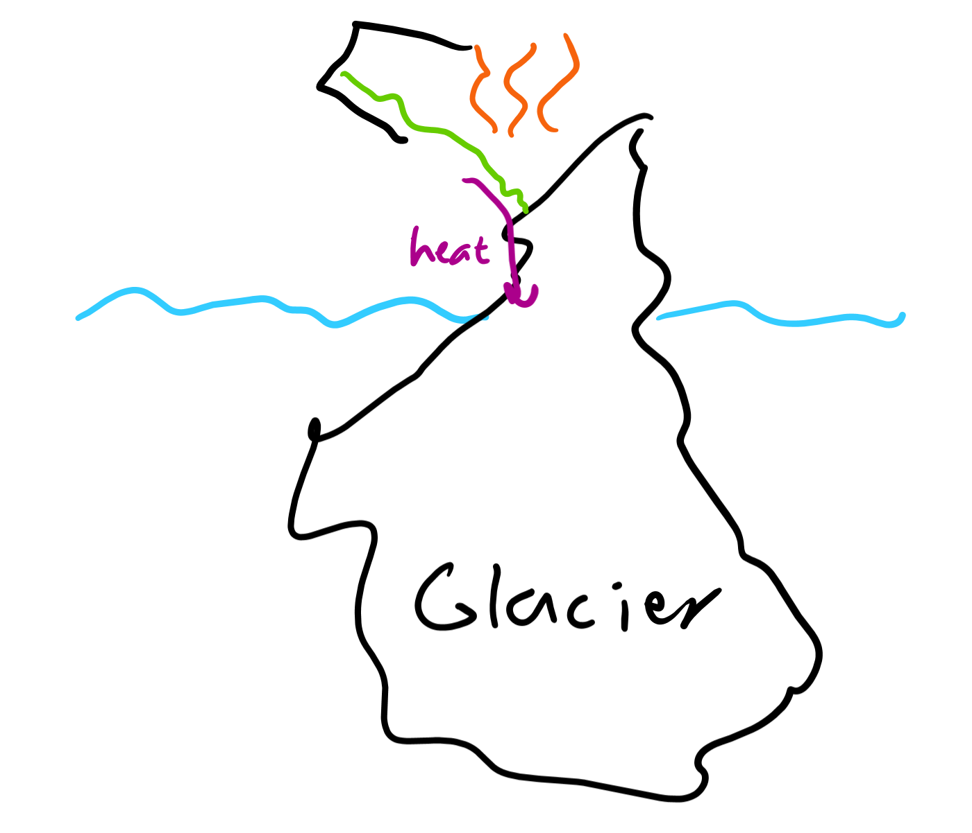
Heat
Transfer of energy
The measure of the amount of thermal energy transferred
Very important that energy is transferred
Did I mention that energy has to be transferred for heat to exist?

Slide 15
Molecular level

Slide 16
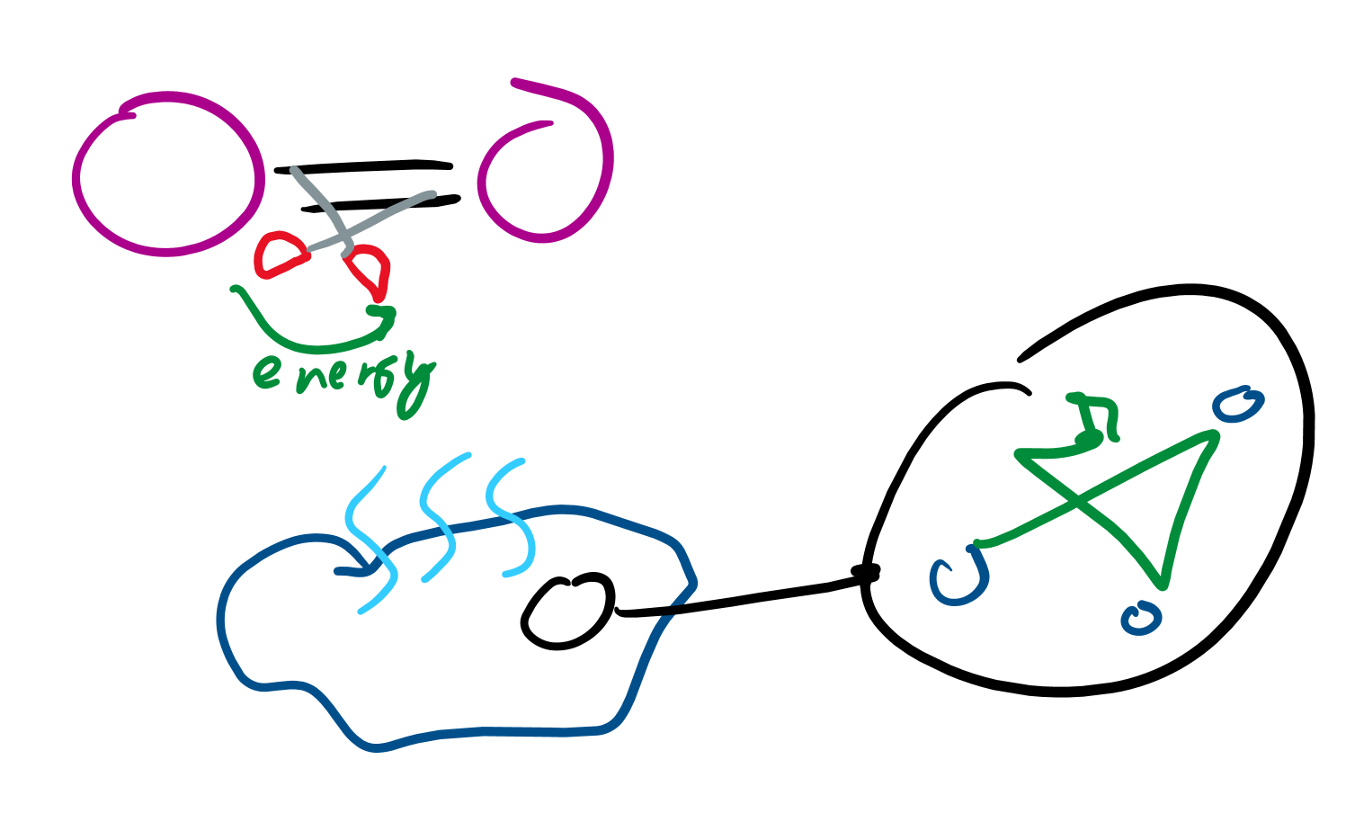
Heat in a system
If a system is heated up:
It gains energy
Bonds are broken (it takes energy to snip snip those bonds)
Particles move speedier
More of the gas is empty space
They bump into each other more
They have a higher temperature

Slide 17
Heat transfer

Slide 18

Conduction
If two things touch, there will be heat
“Hot” places transfer thermal energy to “cold” places
“Cold” cannot be transferred, that’s just a lack of the “hot”
Energy gonna leave hot places and go into cold places

Slide 19
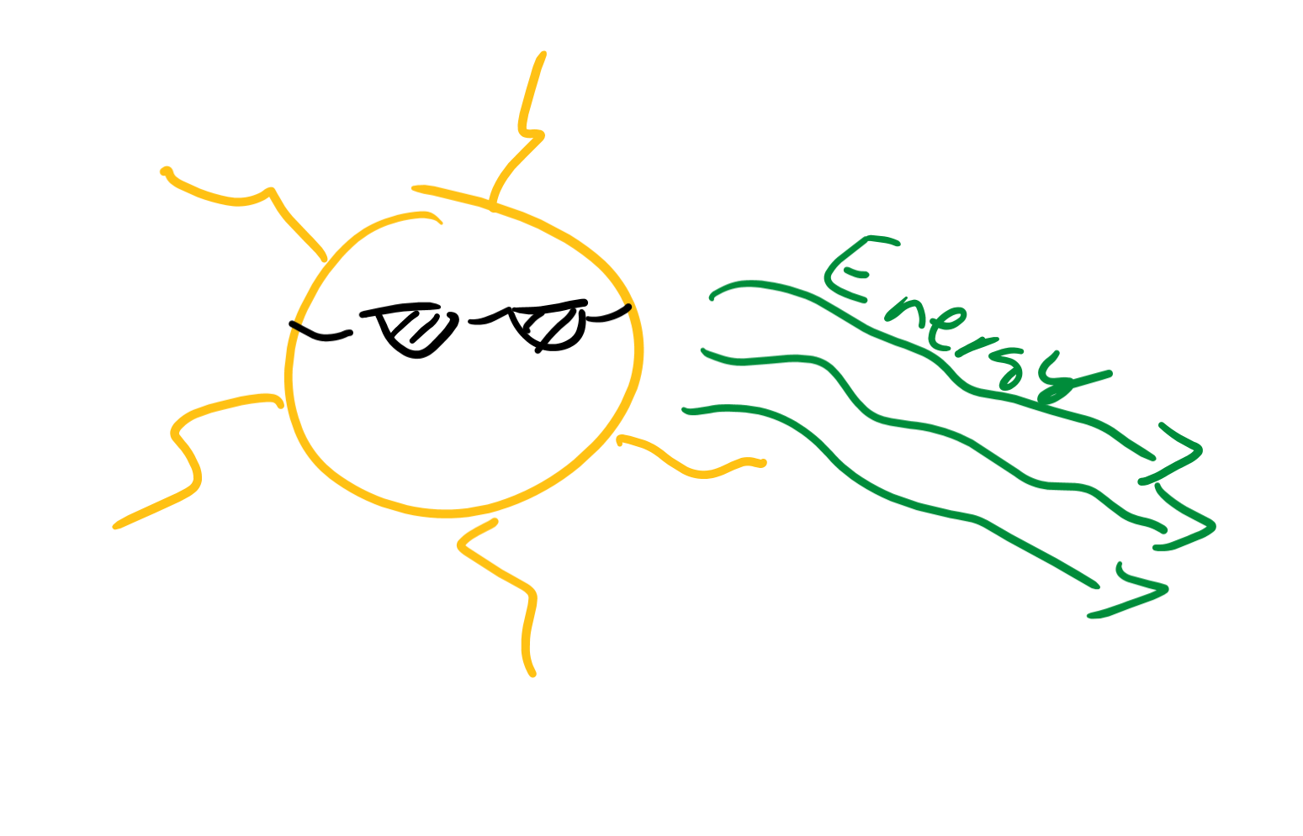
Radiation
Energy can be transferred through waves
Like the sun heats us with light rays
Basically, either heat is transferred through touch (conduction) or not touch (radiation)

Slide 20
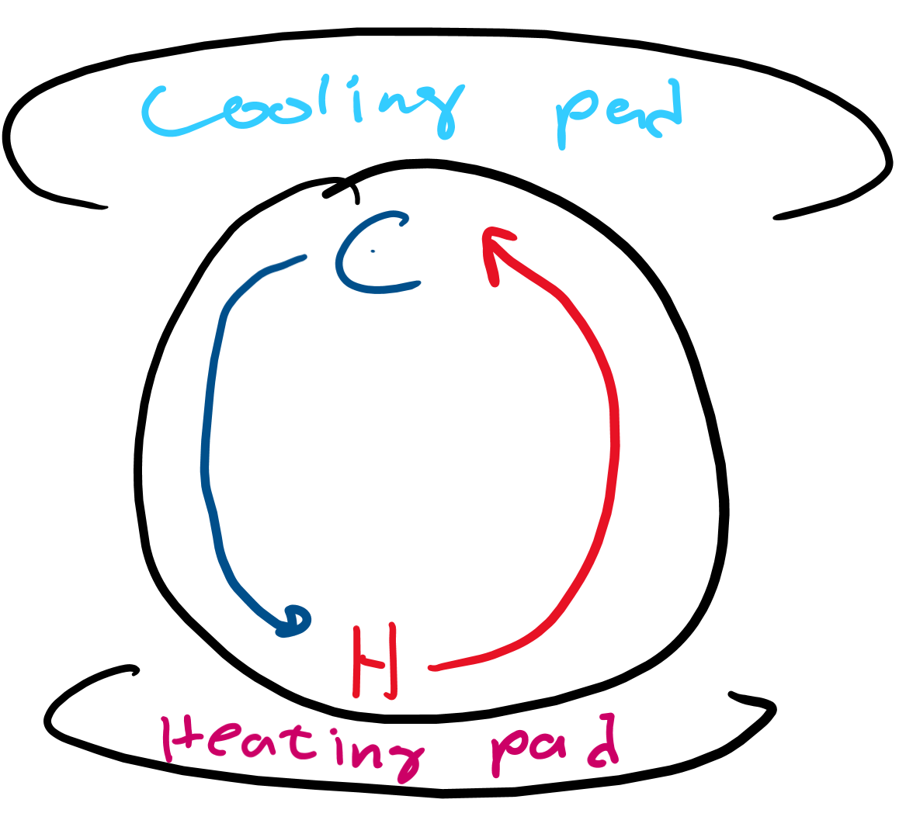
Convection
Hotter air rises
Colder air falls

